Slide 1
EXAM QUESTION – 10 MINUTES
Give examples of two political factors that could affect the popularity of a destination.
Explain how they do so.
Try without your notes if you can, but feel free to use them if you need to

Slide 2
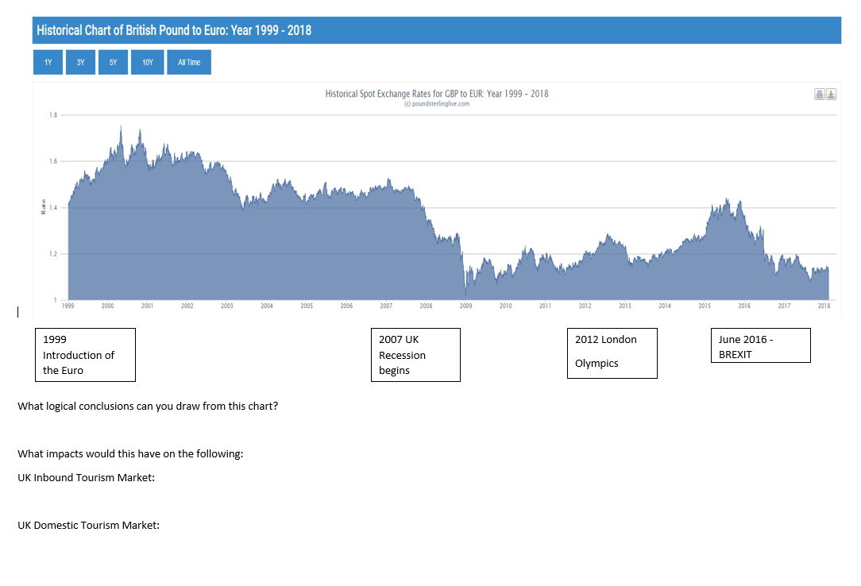

Slide 3
COST OF VISITING
Expensive countries vs cheap countries
Richard Ayoade & Fay Ripley in Oslo | 48hrs in...Oslo
Best of Stephen Mangan & Richard Ayoade | Travel Man
Come up with a list of cheap and expensive countries to visit
Cheap | Expensive

Slide 4
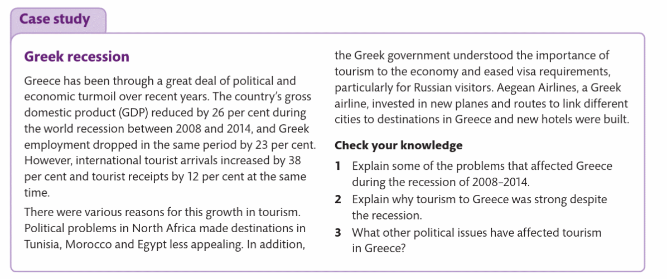

Slide 5
Key Words
Key Word | Definition
Stakeholder
Legislation
Staycation
Recession
Disposable income
Exchange rate
Visa
Outbound tourist
Inbound tourist
Schengen area

