Slide 1
Economic Climate
Learning Aim E

Slide 2
EXAM QUESTION – 10 MINUTES
Give examples of two political factors that could affect the popularity of a destination. Explain how they do so.
Try without your notes if you can, but feel free to use them if you need to

Slide 3
“ECONOMIC CLIMATE”
What is the “economic climate”?
It’s basically the general state of the economy in a country or globally
It considers things like jobs, the stock market, state of credit but also reflect how consumers and investors view the market
If a country has a strong economic climate, then there will be more money floating around (disposable income)
And therefore people are more likely to go on holiday/be a tourist as people have more disposable income
Strong economic growth in a country leads to a growth in travel from that country.

Slide 4
“ECONOMIC CLIMATE”
Strong global conditions may also lead to companies starting business in other countries…
What would this lead to?

Slide 5
RECESSIONS
We’ve looked at strong economic climates, but what about the opposite?
This is called a recession
Recessions mean people have less money to spend on extras (including travel!)
This has knock on effects and can therefore affect a number of different countries worldwide

Slide 6
EXCHANGE RATES

Slide 7
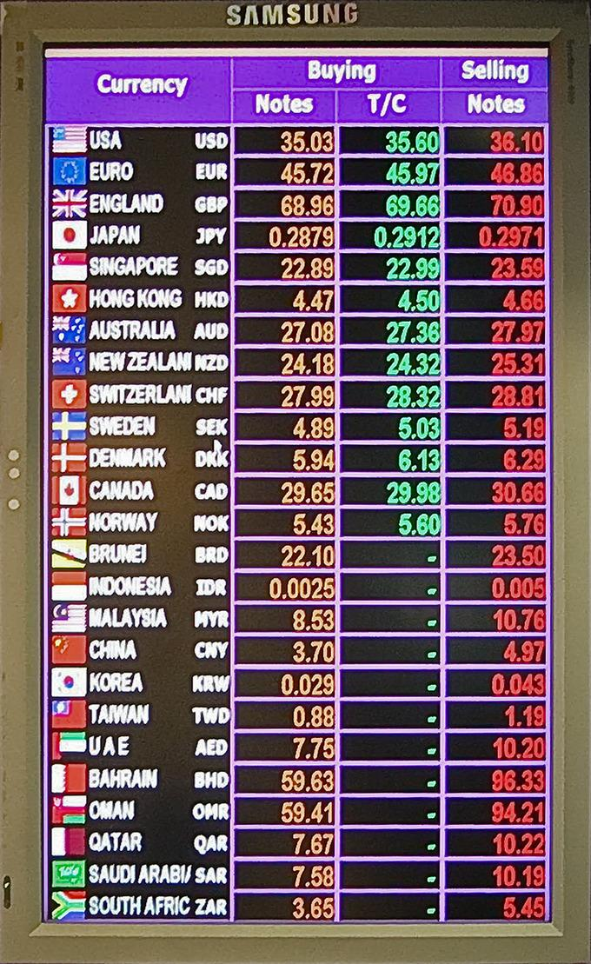
EXCHANGE RATES
What is an exchange rate?
The UK economy is (supposedly!) one of the strongest in Europe ( ignoring covid!)
Therefore, when the UK economy does well, the pound is stronger against the Euro
This means that outbound UK tourists could buy more Euros/Dollars/Dinar for their pounds (and get more spending money)
However, when the pound is weak, tourists can buy less foreign currency and it becomes more expensive to travel

Slide 8
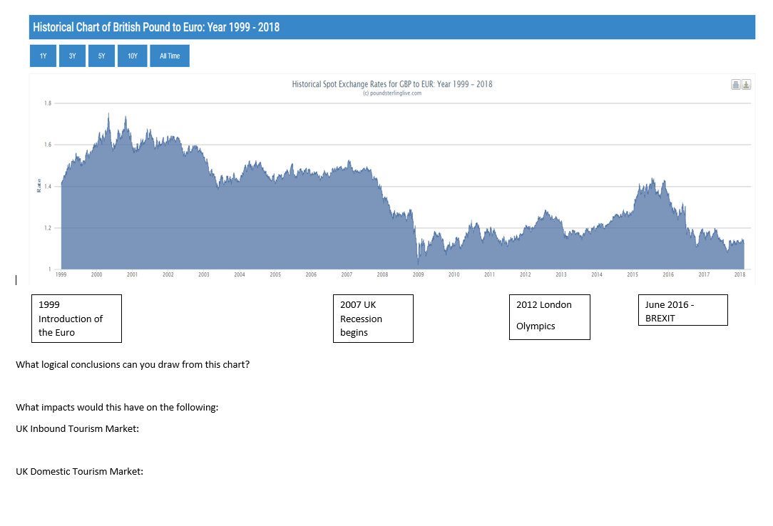

Slide 9
THE EURO
€
The Euro had a great impact on tourism within Europe
Eurozone vs. EU: What's the difference?
One shared currency and Schengen travel agreements meant that people could travel wherever they wanted within Europe
There are even advantages for outbound UK tourists – as if they want to visit a number of European countries they only have to change money once!

Slide 10
STAYCATIONS
What is a staycation?
'Staycations' experience a surge in popularity
(Top 5 UK Staycations)
When are staycations more likely to be popular?
Why else might people choose to holiday in the UK rather than go abroad?
Notes:
Staycation = domestic tourists taking a holiday in the UK rather than heading abroad
If economic situation is good then people will go abroad more
If less money then people stay in the UK
But also people might be worried about security, disease or are not able to go elsewhere

Slide 11
CURRENCY FLUCTUATIONS

Slide 12
CURRENCY FLUCTUATIONS
Most costs paid out by tour companies are in foreign currencies
This will be for things such as accommodation, airport charges, and transport
When exchange rates vary, tour operators may have to spend more than they had originally calculated
The price of oil can also vary which can have a significant impact on the price of air travel

Slide 13
THOUGHTS
Write down your definitions for the words ‘recession’, ‘disposable income’, and ‘exchange rate’
Try to do this without notes/internet but if you need to use them, please do
What happens to a tourism when a country’s economy is doing well?

Slide 14
COST OF VISITING
Expensive countries vs cheap countries
Richard Ayoade & Fay Ripley in Oslo | 48hrs in...Oslo
Best of Stephen Mangan & Richard Ayoade | Travel Man
Come up with a list of cheap and expensive countries to visit
Cheap | Expensive

Slide 16
Key Words
Key Word | Definition
Stakeholder
Legislation
Staycation
Recession
Disposable income
Exchange rate
Visa
Outbound tourist
Inbound tourist
Schengen area

