Slide 1
Research the following UK laws and summarise how they affect tourism?
Legislation Act | Summary
The Development of Tourism Act
Transport Act 1980/85
Package Travel and Linked Travel Arrangement Regulations 2018
The Countryside Act 1949
Holiday with Pay Act 1938

Slide 2
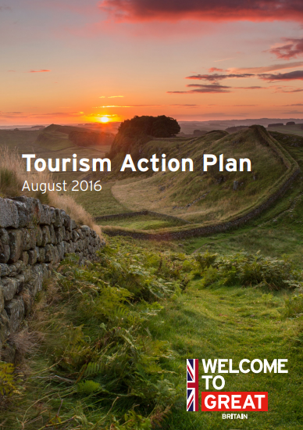

The UK Tourism Policy ??
What are the UK’s main tourism strategies?
Read the documents and make some key notes from this.

Slide 3
The UK’s Tourism Strategy Activity
Key Points

Slide 4
SCHENGEN AREA ACTIVITY
What is it?
What countries are part of it?
How much does a Schengen Visa cost if you live outside the EU?
What happened on the 1st January 2021?
What impact(s) did this have? (https://www.bbc.co.uk/news/uk-46627083)
Notes:
https://www.bbc.co.uk/news/uk-46627083

Slide 5
Safety and Security
If areas are known to be unstable the UK government will advise against travelling to an area
FCO travel advice gives this information
It is often difficult to access these countries anyway as airlines will limit or axe flights to these destinations
This is to protect staff and passengers
Research five destinations in the world that the UK advise against all travel to due to political issues with an explanation as to why. Use the FCO website to help you: https://www.gov.uk/foreign-travel-advice
Country | Explanation

