Slide 1
Factors affecting the popularity and appeal of destinations
Learning Aim E

Slide 2
CHANGING TRENDS OF DESTINATIONS
Destination managers try to react to changing trends
But, they can’t control them
Stakeholders can control some of these factors
But lots are outside of their control

Slide 3
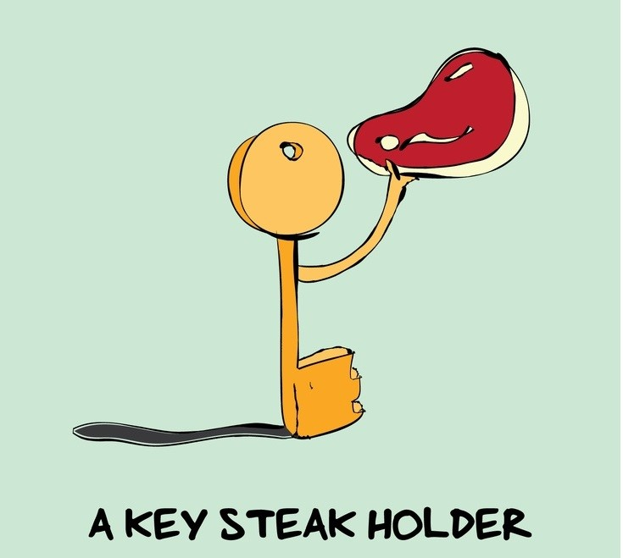
DRAG YOUR MIND BACK TO UNIT 1…
What is a stakeholder?

Slide 4
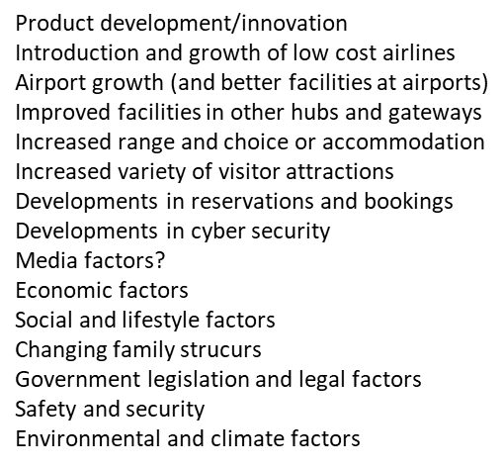
DRAG YOUR MIND BACK TO UNIT 1…
We looked at lots of factors that affect travel and tourism organisations
Can you remember any of them?
Notes:
Product development/innovation
Introduction and growth of low cost airlines
Airport growth (and better facilities at airports)
Improved facilities in other hubs and gateways
Increased range and choice or accommodation
Increased variety of visitor attractions
Developments in reservations and bookings
Developments in cyber security
Media factors?
Economic factors
Social and lifestyle factors
Changing family strucurs
Government legislation and legal factors
Safety and security
Environmental and climate factors

Slide 5
Learning Aim E
Political factors
Climate and its influence on travel
Economic climate
Factors affecting the changing popularity & appeal of destinations
Natural disasters
Accessibility and availability
Changing markets
Image and promotion

Slide 6
Political Factors

Slide 7
Political factors
Legislation
Tourism Policy
Target markets and promotion
Visa requirements or travel permits
Compatible travel arrangements
Safety and Security

Slide 8
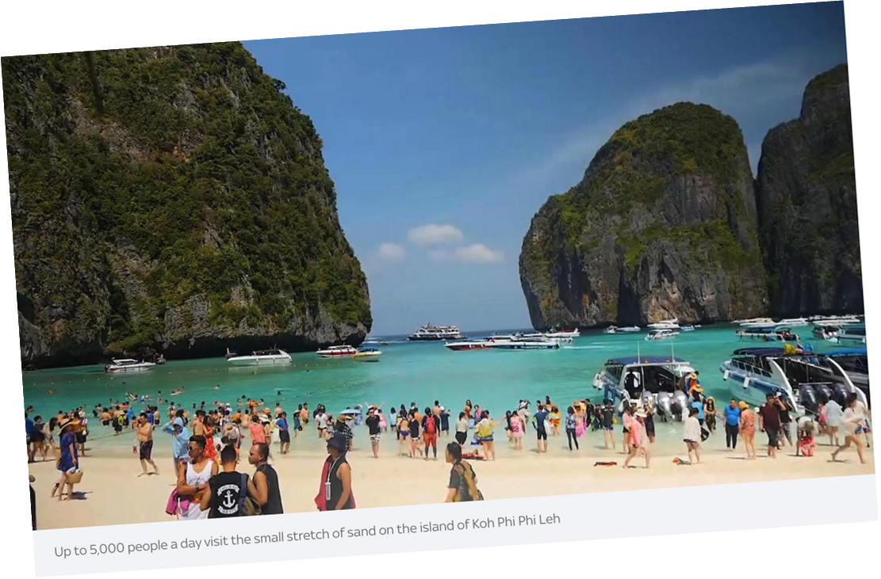
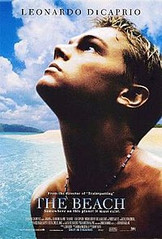
LEGISLATION (Government Laws & Paperwork!)
Legislation and laws are often needed to support tourism. But also to protect local communities. For example, a country may want to pass a law that limits the number of people able to access a beach to protect it
Similarly, a government may want to stop land assets from being purchased by foreign investors. So, they may introduce or amend legislation about land ownership. This would then protect interests of the local community

Slide 9
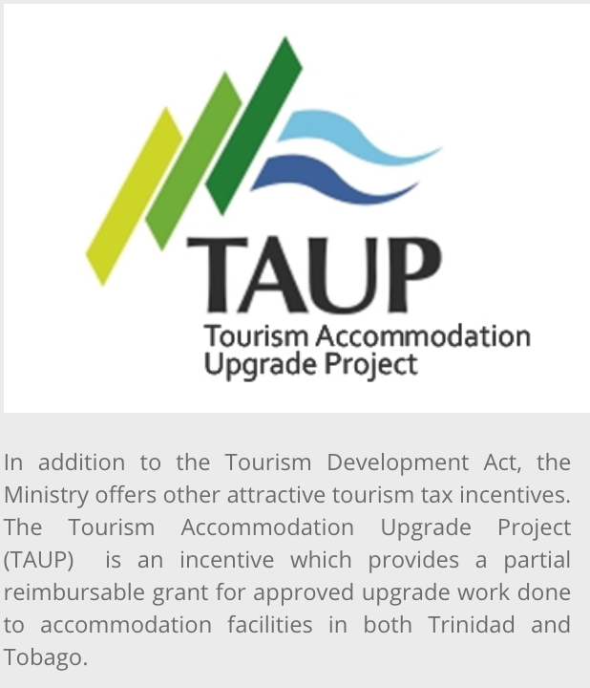
TRINIDAD AND TOBAGO
Trinidad and Tobago introduced the Tourism Development Act
This introduced tax benefits to encourage tourism
And measures to protect national ownership of development projects

Slide 10
Research the following UK laws and summarise how they affect tourism?
Legislation Act | Summary
The Development of Tourism Act
Transport Act 1980/85
Package Travel and Linked Travel Arrangement Regulations 2018
The Countryside Act 1949
Holiday with Pay Act 1938

Slide 11
TOURISM POLICIES
All countries that want to promote tourism will have a tourism policy. These will be interpreted and executed by tourist boards like VisitBritain
These tourist boards will also decide and determine which markets to target, and then organise promotions for these markets
They can also coordinate destination management
The NZ government has made a policy to grow tourism by 2025. This is through 5 main themes:
Air connectivity - improving air travel – 99% of international visitors arrive by air
Targeting for value - improving visitors experiences so they stay longer, travel more widely and spend more!
Visitor experience - improving visitors experiences so they stay longer, travel more widely and spend more!
Productivity - improving tourism productivity for existing investments and attracting new investments
Insights - Driving strategic and operational decision making for tourism businesses
Notes:
Air connectivity –Targeting for value – Identifying opportunities that deliver the biggest economic benefit
Visitor experience – improving visitors experiences so they stay longer, travel more widely and spend more!
Productivity – improving tourism productivity for existing investments and attracting new investments
Insights – Driving strategic and operational decision making for tourism businesses

Slide 12
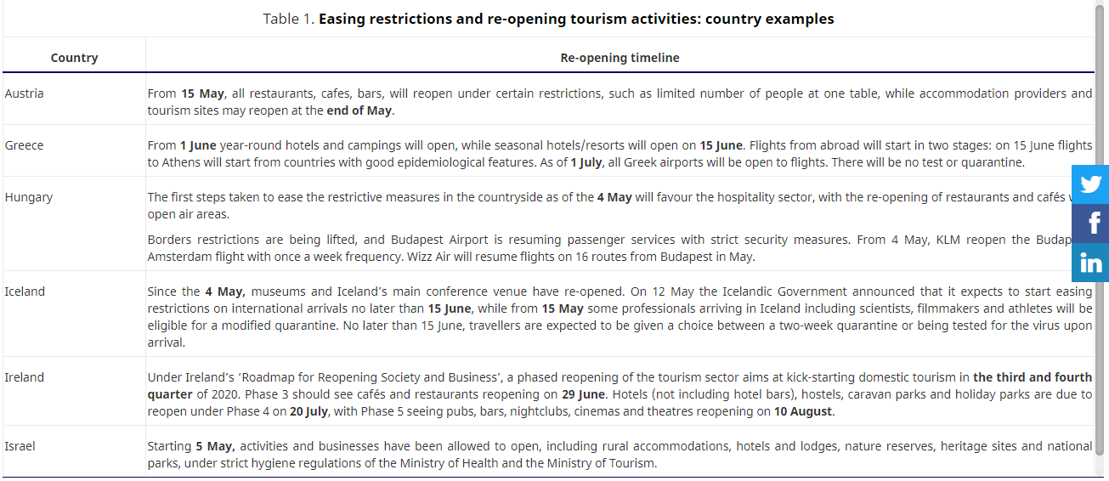

Slide 13
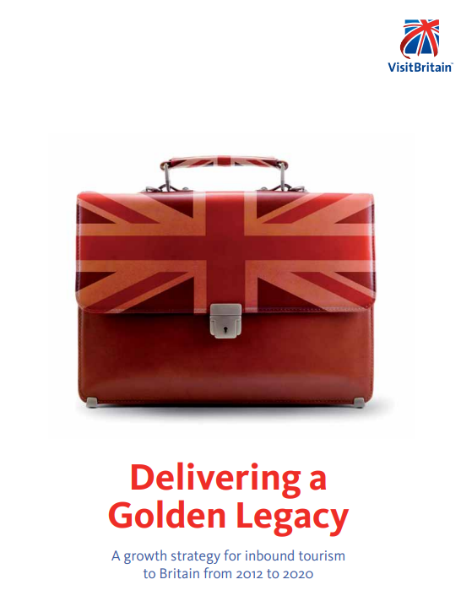
The UK Tourism Policy ??
What are the UK’s main tourism strategies?
Read the documents and make some key notes from this.

Slide 14
The UK’s Tourism Strategy Activity
Key Points

Slide 15
TARGET MARKETS AND PROMOTION
Governments will sometimes want to target a specific market
As such they will offer special promotions, or relax entry requirements
Why target these countries?
Fast growing economies (good source of tourist income!)
Large number of potential inbound tourists
Or – that country may have relaxed restrictions itself….

Slide 16
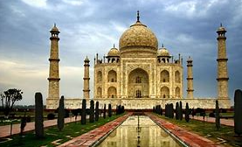
INDIA
India launched a promotion aimed towards English people, trying to persuade them to go to India
But… this all started because the UK government made it easier to apply for a Visa
https://www.gov.uk/check-uk-visa /
https://www.gov.uk/standard-visitor
This then meant that in return the Indian government relaxed rules itself and tried to encourage people to go to India

Slide 17
Destination Management
Destination management (i.e. managing all the bits that make up a destination) affects the way that country promotes tourism but also, on who it decides to target in its marketing activities
Governments generally control destination management (through its tourism policy) but it will work with partner organisations
For example, in Mexico the Mexican Tourism Board is in charge of promoting destinations and activities on offer in Mexico
VisitBritain does the same in Britain!

Slide 18
VISAS & TRAVEL PERMITS
Lots of countries require visas to visit
This is mainly for two/three reasons:
Control borders
Control health (human or animal/plant)
Raise money
However this can cause barriers to travel due to the expense and difficulty of obtaining them
Destinations can make it easier for particular groups or nationalities to travel by lowering the cost of visas or allowing them to buy electronic ones online.

Slide 19
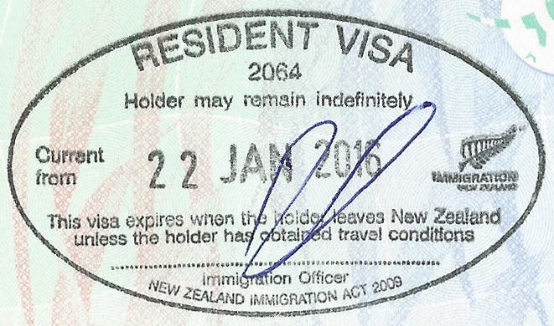
COMPATIBLE TRAVEL ARRANGEMENTS
Governments must ensure that travel arrangements meet legislation
For example, New Zealand and Australia have the Trans-Tasman agreement, within the EU there is a free travel agreement meaning that anyone within the European passport has the right to enter any other European country.
This means that each country has the right to enter the other but also that they can work and live in those countries however these agreements can change (Brexit???)

Slide 20
SCHENGEN AREA ACTIVITY
What is it?
What countries are part of it?
How much does a Schengen Visa cost if you live outside the EU?
What happened on the 1st January 2021?
What impact(s) did this have? (https://www.bbc.co.uk/news/uk-46627083)
Notes:
https://www.bbc.co.uk/news/uk-46627083

Slide 21
Safety and Security
What could be the result of political problems?
War?
Poverty?
Famine?
Disease?
Civil unrest/demonstrations
Will these be long or short term issues?

Slide 22
Safety and Security
If areas are known to be unstable the UK government will advise against travelling to an area
FCO travel advice gives this information
It is often difficult to access these countries anyway as airlines will limit or axe flights to these destinations
This is to protect staff and passengers
Research five destinations in the world that the UK advise against all travel to due to political issues with an explanation as to why. Use the FCO website to help you: https://www.gov.uk/foreign-travel-advice
Country | Explanation

