Slide 1
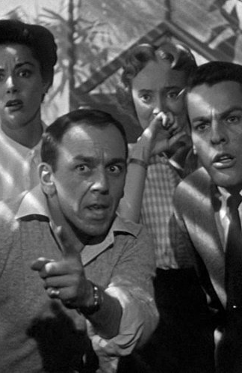
The Greenhouse Sequence
Watch the greenhouse sequence from IOTBS, from 39.30 “Driving home …” to 47.12 “Dr Bennell”. When Bennell discovers the hatching pods in Belicec’s greenhouse the narrative moves into it’s final phase. The 2 couples finally realise what is going on and form a plan to try and frustrate the invaders. Little do the know that time is much shorter than they know…. And answer the questions.

Slide 2
At the start of the sequence what genre does the low key lighting and voice-over suggest? (1b)Explain why.
How is sound important in creating the mood of this sequence?
How does the use of mise-en-scene provide a contrast that reminds us of the film’s central theme/idea?
Comment on the camera angle and framing used when we first see inside the greenhouse.
How are special effects used in this sequence? (5b) How does editing help with the impact of these special effects?
What other editing techniques are key to constructing this sequence so it achieves what the director is aiming for?
How are close-ups used in this sequence?
Comment on the use of low angle shots in this sequence.
Camera movement is fairly limited in this sequence, when is it used and why?
Where does the editor use a jump cut? (10b) What 2 reasons are there for using a jump cut here?
What meaning is created by the use of a zoom in at the end of the sequence?

Slide 3
Remember – use the pictures as clues
At the start of the sequence what genre does the low-key lighting and voice over suggest?
Explain why.
How is sound important in creating the mood of this sequence?
How does the use of mise-en-scene provide a contrast that reminds us of the film's central theme/idea?
Comment on the camera angle and framing used when we first see inside the greenhouse.
How are special effects used in this sequence?
How does editing help with the impact of these special effects?

Slide 4
What other editing techniques are key to constructing this sequence so it achieves what the director is aiming for?
How are close ups used in this sequence?
Comment on the use of low angle shots in this sequence.
Camera movement is fairly limited in this sequence, when is it used and why?
Where does the editor use a jump cut?
What 2 reasons are there for using a jump cut here?
What meaning is created by the use of a zoom in at the end of the sequence?

Slide 5
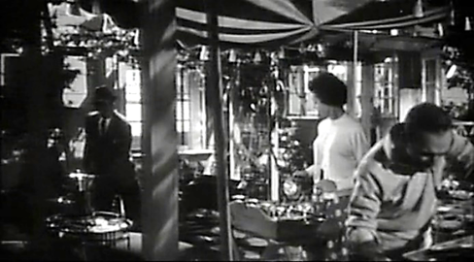
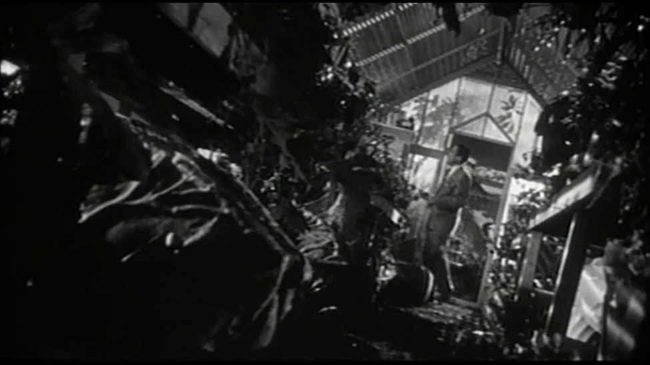
At the start of the sequence what genre does the low key lighting and voice-over suggest? Explain why.
Film Noir:
Low-key lighting
Stark light/dark contrasts and dramatic shadow patterning
Low-angle, wide-angle, and skewed, or Dutch angle shots
Flashbacks
Night-for-night shooting, as opposed to the Hollywood norm of day-for-night, was often employed.
Voiceover narration, sometimes used as a structuring device, usually first-person narration

Slide 6
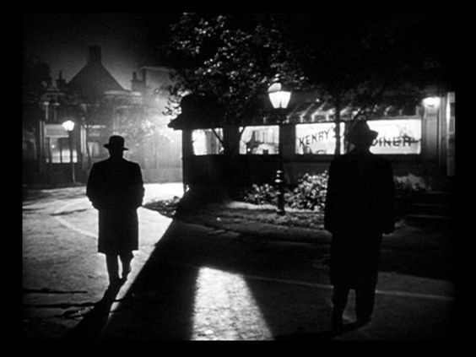
In detail
The low-key lighting schemes of many classic film noirs are associated with stark light/dark contrasts and dramatic shadow patterning—a style known as chiaroscuro. The shadows of Venetian blinds or banister rods, cast upon an actor, a wall, or an entire set, are an iconic visual in noir and had already become a cliché well before the neo-noir era. Characters' faces may be partially or wholly obscured by darkness—a relative rarity in conventional Hollywood filmmaking. While black-and-white cinematography is considered by many to be one of the essential attributes of classic noir.
Film noir is also known for its use of low-angle, wide-angle, and skewed, or Dutch angle shots. Other devices of disorientation relatively common in film noir include shots of people reflected in one or more mirrors, shots through curved or frosted glass or other distorting, and special effects sequences of a sometimes bizarre nature. low-angle, wide-angle, and skewed, or Dutch angle shots. Night-for-night shooting, as opposed to the Hollywood norm of day-for-night, was often employed.
Film noirs tend to have unusually convoluted story lines, frequently involving flashbacks and other editing techniques that disrupt and sometimes obscure the narrative sequence. Framing the entire primary narrative as a flashback is also a standard device. Voiceover narration, sometimes used as a structuring device, came to be seen as a noir hallmark; while classic noir is generally associated with first-person narration (i.e., by the protagonist).
In detail:

Slide 7
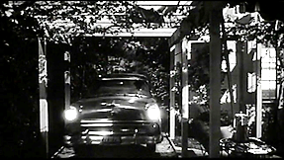
How is sound important in creating the mood of this sequence?
Diegetic & parallel:
We start with natural ambient sound.
e.g., the comfortingly familiar night time calling of the Crickets. With the friendly pre-barbeque dialogue.
Popping sound effect of pods to add an alien feel.
The phone – ring as a dramatic interruption to Miles killing the pods. The operator’s voice feels like the pod people reaching out & searching “Dr Bennell? Dr Bennell? Dr Bennell?”

Slide 8
Non-diegetic parallel:
Starts with voice over narration – returns to film noir ‘feel’.
Musical score - we move into the greenhouse & the pods with a harp ripple & low-level violins of mystery.
Dramatic brass notes for pod reveal with a sustained note to build tension towards Bennell’s discovery – drum roll – of the pods.
Very loud dramatic score overall. All action scored (varying in the sound mix) once pods discovered reflecting emotions of the people on screen for the audience. e.g., the ‘trauma’ of destroying the pods is the loudest and most high-pitched dominant section of music.

Slide 9
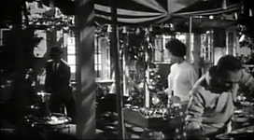
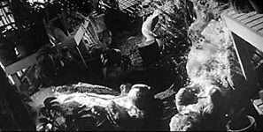
How does the use of mise-en-scene provide a contrast that reminds us of the film’s central theme/idea?
There is a direct contrast between the normal world of the barbeque and the alien world (other) of the pods in the green house.
This is further exaggerated by the use of canted / dutch angle shots in shooting the inside of the greenhouse.

Slide 10
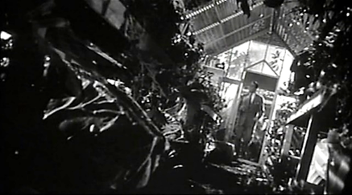
Comment on the camera angle and framing
used when we first see inside the greenhouse.
Framing:
Close-ups & mid-shots of Bennell who increasingly the centre of attention and the narrative – humanities last hope?
Angles:
Lots of low angle shots to emphasise the dominant presence of the ‘normal’ humans juxtaposed by the pods ‘otherness’.
Canted angles to unsettle the audience and underline the alien nature (otherness) of the pods.

Slide 11
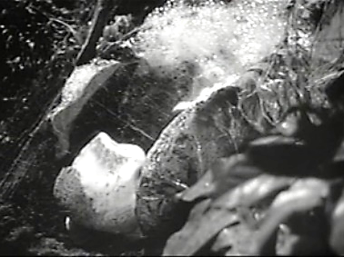
How are special effects used in this sequence?
The pods are on set props that are physically animated to open, the effect of which is ‘enhanced’ with the soap like substance that oozes out to announce the ‘birth’ of a new pod person just waiting for you to fall asleep…

Slide 12
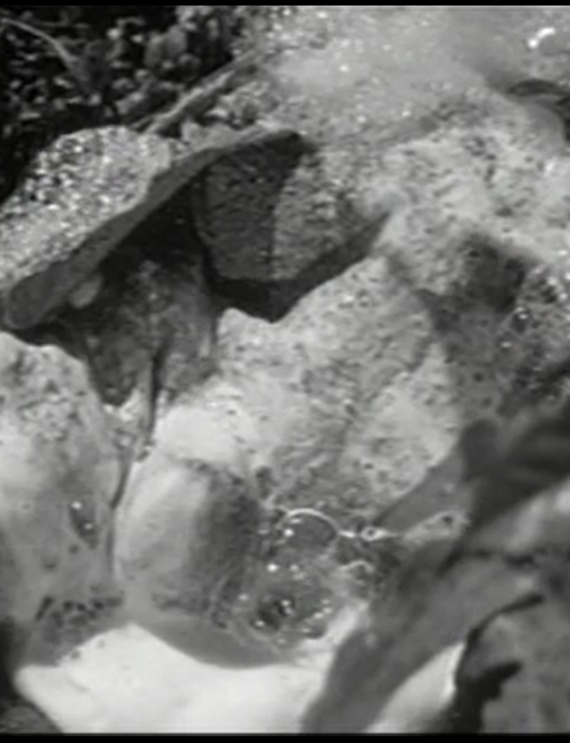
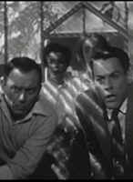
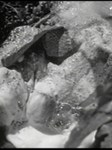
How does editing help with the impact of these special effects?
The audiences view of the pods is limited to what are almost glimpses. No single shot of the pods is on screen for more than 1-1½ seconds. This increases their impact and lessens their appearance as what are by today’s standards very basic special effects.

Slide 13






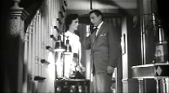
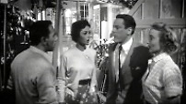
What other editing techniques are key to constructing this sequence so it achieves what the director is aiming for?
Continuity & cross cutting editing.
Siegel uses classical continuity editing by cross cutting between the erupting pods and the attempts to phone for help. The danger rises as the pods open and the phone call is not connected – meaning a new plan is needed.

Slide 14
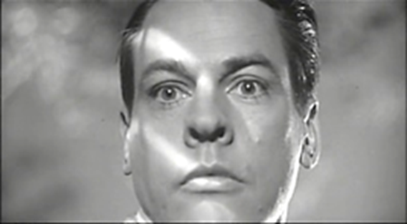
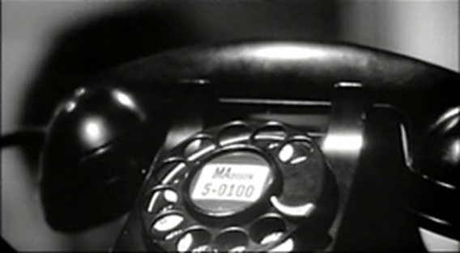
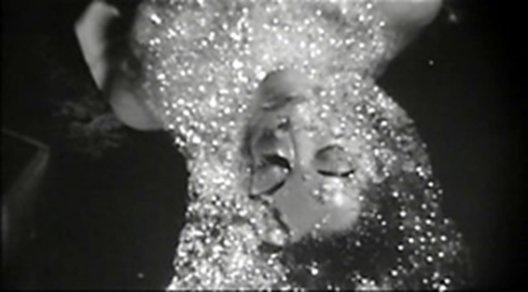
How are close-ups used in this sequence?
To see and share in Bennell’s horror when he discovers a fresh batch of pods.
To emphasise the importance of the phone as perhaps their last link to the outside world and help.
We see and share in Bennell’s horror when Becky’s duplicate emerges from the pod. (With perhaps a touch of foreshadowing?)

Slide 15
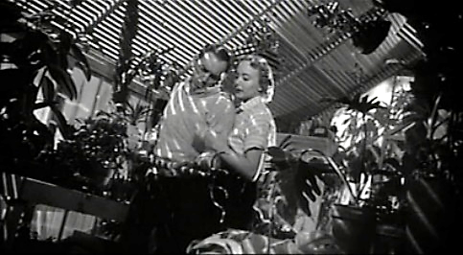
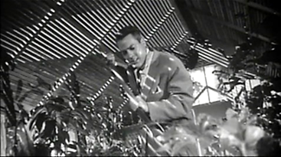
Comment on the use of low angle shots in this sequence:
Many of the low-angle shots could also be described as pod POV’s as at this moment the humans have the power to destroy them.
The threat the un-controlled humans represent to the alien’s plans is shown through a typical use of the low-angle placing them in a (temporary?) position of dominance.

Slide 16
Comment on the use of low angle shots in this sequence:
Many of the low-angle shots could also be described as pod POV’s as at this moment the humans have the power to destroy them. The threat the uncontrolled humans represent to the alien’s plans is shown through a typical use of the low-angle placing them in a (temporary?) position of dominance.

Slide 17
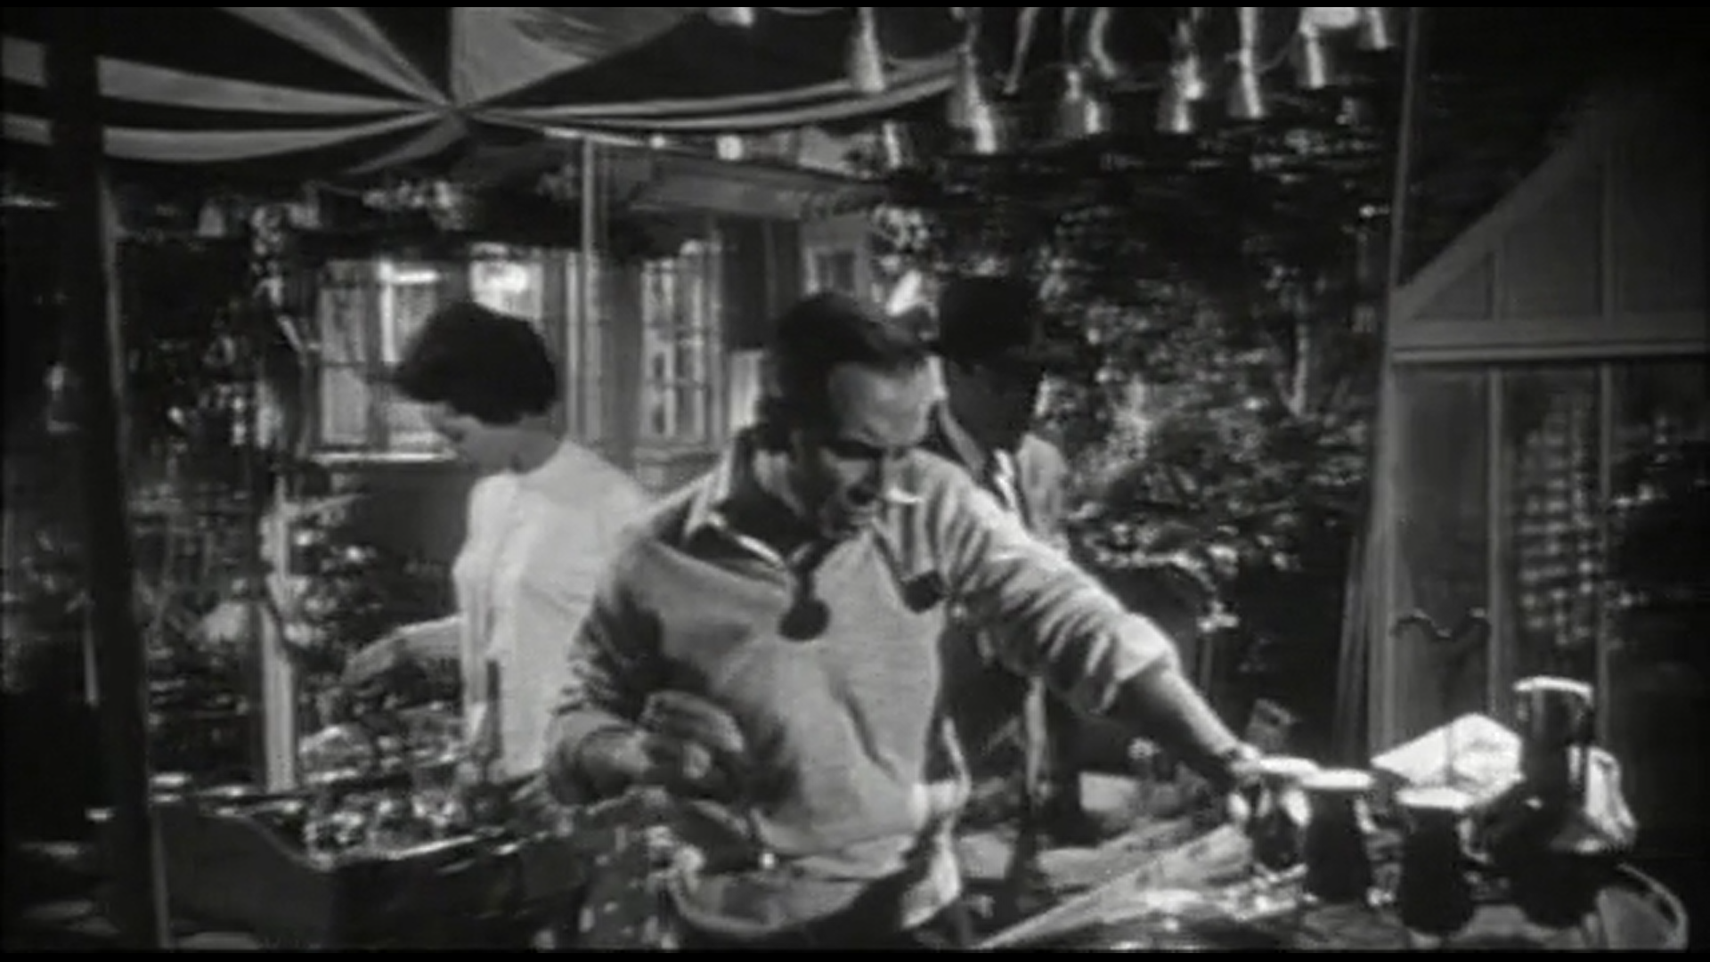
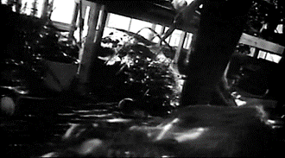
Camera movement is fairly limited in this sequence, when is it used and why?
It pans across and moves around the barbeque, relaxing us, ‘inviting the audience in’.
It tracks Belicec as he moves amongst the pods, the tension rises, as we go with him to ‘face the enemy’.

Slide 18
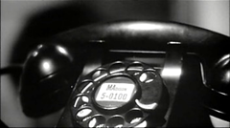
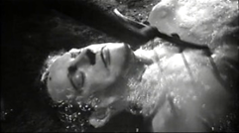
Where does the editor use a jump cut?
Just as Bennell stabs his own replica the phone rings in the house with what might be help.

Slide 19

What 2 reasons are there for using a jump cut here?
1.To emphasise both the stabbing blow and the sudden and
2. The unexpected ringing of the phone- giving the audience a quick jolt in the tension of the scene.

Slide 20
Where does the editor use a jump cut?
Just as Bennell stabs his own replica the phone rings in the house with what might be help.

Slide 21
What 2 reasons are there for using a jump cut here?
1.To emphasise both the stabbing blow and
2. The sudden unexpected ringing of the phone- giving the audience a quick jolt in the tension of the scene.

Slide 22
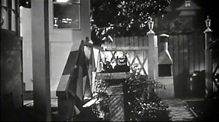
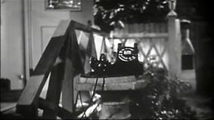
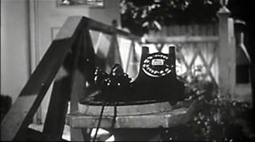
What meaning is created by the use of a zoom in at the end of the sequence?
It acts to further focus the audiences attention on the phone as the flat tone of the operator repeatedly asks “Mr Bennel? Mr Bennell? Mr Bennell?” and they realise that the protagonists can not trust anybody anymore, and the danger or jeapordy increases.

Slide 23
Notes from exam board
Mise-en-Scène: A feeling of claustrophobia and entrapment is created by the cage like structure of the greenhouse.
The pods replicate birth, they explode open, covered in a bubbling milky substance, very few special effects were used in the film, and this is one of the few instances.
Sound
Dramatic music to anchor the feeling of imminent threat.
Ideology
The perfect replica humans imply the sense of paranoia that was prevalent in the USA at this time, suggesting mistrust of those around you, that you cannot tell who are either alien/other/communist and that you should be prepared for an invasion.

