Slide 2
Objectives
Describe the features and implications of IT systems used by organisations for:
Stock control
Data logging
Data analysis
General office tasks
Creative tasks
Advertising
Manufacturing
Security

Slide 3
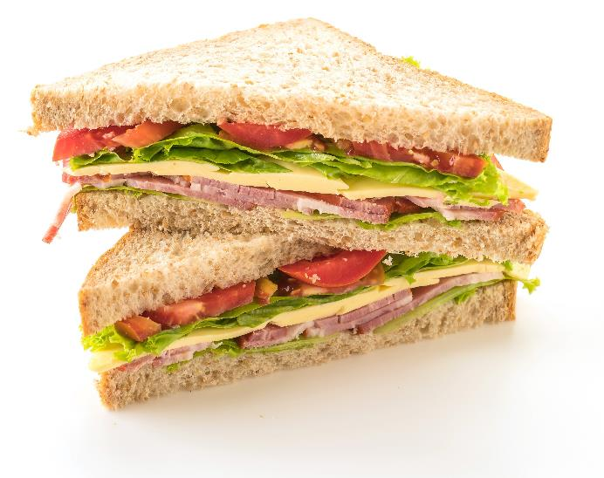
Starter
A sandwich company produces 500,000 sandwiches per day in their factory
These sandwiches are shipped overnight to stores around the country
What stock will they require to make these sandwiches?

Slide 4
Stock required
Ingredients per day:
Bread slices – 1,000,000
Butter – 7,000 kg
Cheese – 5,000 kg
Ham – 3,000 kg
Tomatoes – 100,000
Other stock:
Cardboard/plastic sandwich case – 500,000
Cardboard boxes for shipping – 10,000

Slide 5
Problems with stock
Products held by a company are known as their stock
There are problems with holding stock:
Large amounts of storage space are needed to hold it
Security costs are needed to prevent theft
Some stock, especially food, is perishable and needs to be sold quickly
How are problems with stock levels solved?

Slide 6
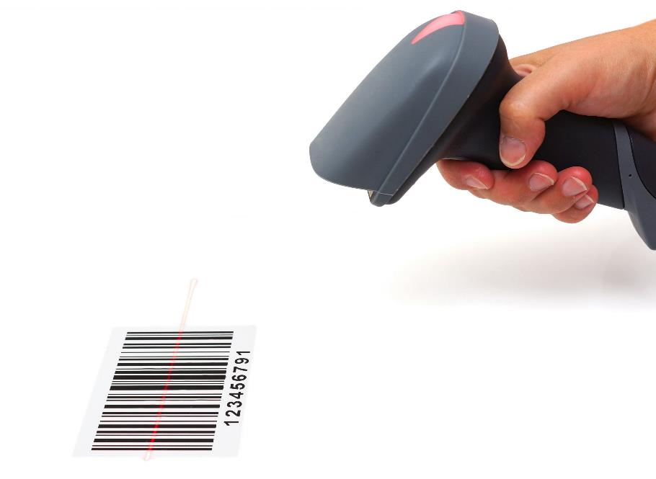
Stock control
Stock control systems will keep control of stock levels in a database
Items are scanned when sold and the stock level is updated
New orders are transmitted to suppliers via the Internet
Deliveries are tracked
RFID tags speed up counting items for stock control

Slide 7
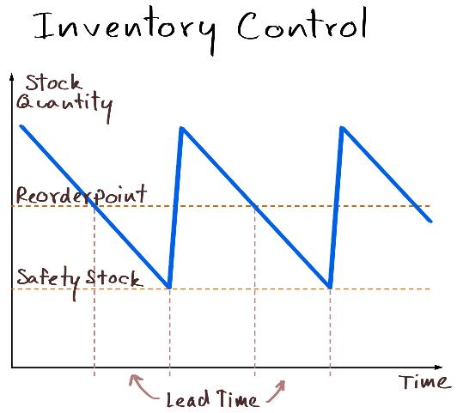
Stock control
An important function of any business is to track stock levels and reorder when low
If the business has too little stock then it won’t be able to keep up with demand
If they have too much stock they will have spent money that could have been better spent elsewhere; they will also need to pay more for storage
How do modern companies solve this?

Slide 8
Just in Time (JIT)
Companies use IT systems for stock control
Just in Time systems order products so they arrive ‘just in time’ to be used
Computers can automatically make orders based on current stock levels and production rates
Analysis of data can predict future ordering – for instance, hot weather in summer could predict the need for more barbecue related products

Slide 9
Case study: KFC
In 2018, KFC had a chicken shortage
They had moved to a new distributor – DHL
Their previous distributor had 6 warehouses; DHL was using just one single warehouse in Rugby
On February 14th, there was a vehicle collision on the M6 causing the road to close
By February 16th, KFCs were missing ingredients
By February 18th, 69% of stores had closed
What do you think was the main cause of the chicken shortage and store closures?

Slide 10
Case study: KFC
You may wish to read more about this case study at: https://www.wired.co.uk/article/kfc-chicken-crisis-shortage-supply-chain-logistics-experts. The cause of the failure was that whilst Rugby was a central location with access to the whole country there was one point of failure. The new IT systems were just being started with the new supplier. Just in Time meant that stores had limited supplies to cope with failure. Sufficient planning had not been carried out to assess what would happen if the location failed to deliver. Just in Time meant that there was not enough stock in stores to cope with the days needed to solve problems.What do you think was the main cause of the chicken shortage and store closures?

Slide 11
Worksheet 2
Now complete Task 1 on Worksheet 2

Slide 12
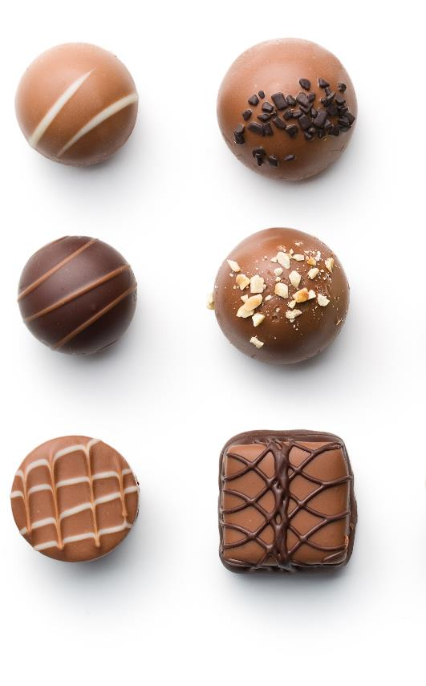
Manufacturing
IT is involved in the manufacture of a huge number of products. They will control:
Robots
Conveyor belts and motors
Sensors
Food items such as chocolate are also mostly manufactured by machine
Name five other products that will use IT in their manufacture

Slide 13
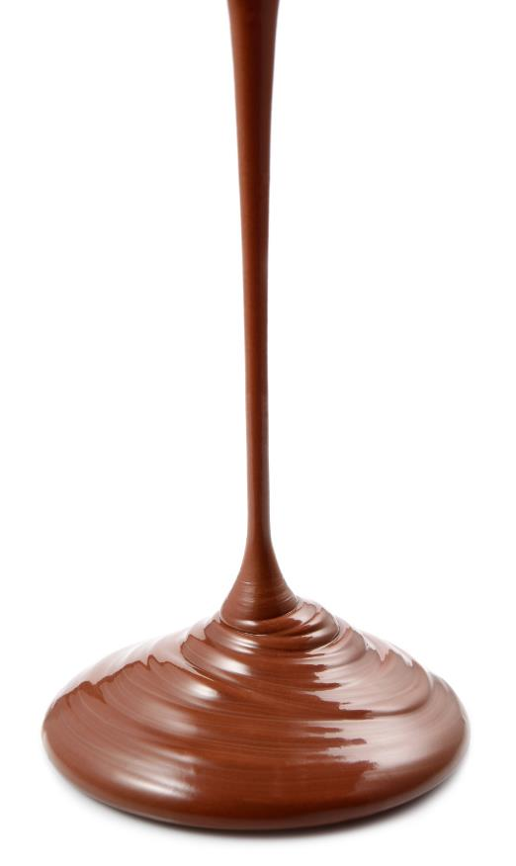
Data logging
A data logging system uses a robust data logger to record precise data from input sensors in real time
They can be used in any location including harsh environments
They can be used 24 hours a day
Weather data logging may measure temperature, rainfall and pressure
What data logging could be carried out in a chocolate factory?

Slide 14
Data logging
Manufacture:
Conveyor belt speed
Chocolate flow rate
Chocolate temperature
Product final weight
Weight/number of rejected chocolates
People:
Line staff clocking in and out
Staff productivity

Slide 15
Data analysis
Whilst data loggers and other IT systems produce data they do not interpret it
Data analysis viewing and transforming data so that useful information and conclusions can be made
These conclusions can lead to decisions
Data analysis could be used to predict sales of a particular line of products
What other examples could data analysis be used for?

Slide 16
Data analysis uses
Some examples:
Research to find if a particular drug is effective or not
Trends in climate change and their effects
Analysis of road traffic usage
How users interact with a website
Where to build a development of new homes

Slide 17
Case study: Chocolate box sales
A chocolate factory records their monthly sales
The raw sales have been transformed to a chart as part of a data analysis
What conclusions could be made about sales that could inform the company for next year?
 | Year 1 | Year 2 | Year 3 | Year 4 | Year 5 | Average
Jan | 362 | 370 | 338 | 392 | 354 | 363.2
Feb | 543 | 565 | 531 | 518 | 600 | 551.4
Mar | 378 | 351 | 308 | 353 | 399 | 357.8
Apr | 502 | 526 | 586 | 521 | 563 | 539.6
May | 396 | 354 | 331 | 351 | 383 | 363
Jun | 277 | 270 | 269 | 298 | 264 | 275.6
Jul | 271 | 223 | 267 | 289 | 277 | 265.4
Aug | 151 | 241 | 229 | 160 | 163 | 188.8
Sep | 194 | 215 | 168 | 247 | 168 | 198.4
Oct | 258 | 182 | 233 | 260 | 248 | 236.2
Nov | 354 | 329 | 393 | 383 | 358 | 363.4
Dec | 666 | 633 | 683 | 605 | 606 | 638.6

Slide 18
Chocolate box sales
Sales trends:
High in February (Valentines day)
High in April (Easter)
Low in summer
Very high in December (Christmas)
The company can expect these trends each year which will help them know when to recruit temporary staff

Slide 19
Worksheet 2
Now complete Task 2 on Worksheet 2

Slide 20
Automation of office tasks
The use of technology has resulted in many office tasks being automated
In the past, letters sent to customers would often be photocopies of the same letter with a handwritten name
Mail merge allows an individual name and address to be put on each letter
What other general office tasks now make use of IT systems?

Slide 21
General office tasks
Suggestions for general office tasks that have been automated:
Voicemail
Switchboard
Automated calling
Financial software and spreadsheets
Databases – including specialist software that makes use of databases
Customer Relationship Management (CRM) software
Clocking in/out software

Slide 22
More efficiency
Technology often makes work processes more efficient
It was predicted by economist John Maynard Keynes in 1930 that his grandchildren would only need to work 15 hours a week due to the advancement of efficiency in the workplace
To what extent do you think technology has made workers more efficient?
Why are we not all working 15 hour weeks?

Slide 23
More efficiency
Computers and machinery have made people more efficient. The question of why we are not all working a 15-hour week has many possibilities in its answer. In many respects people can work harder today. Some of this will be due to a higher standard of living and more money being spent on holidays and entertainment. There are certainly people who have achieved a less than a 15-hour week by being frugal and having simpler lifestyles.

Slide 24
Creative industries
Creative industries have seen many changes as a result of advanced in IT systems
2D animation is now carried out by computer which makes it more efficient for an animator
3D animation is now possible and virtual cameras can be used to take different angles of 3D models
What other changes have occurred in creative industries?

Slide 25
Creative industries
Some possible creative industries that have been impacted by advances in IT
Music production is recorded digitally and in high quality
Digital Audio Workstations / sequencers
Vloggers / YouTubers having access to streaming without needing to go through broadcast media
Bloggers / Social media influencers are able to use IT to reach wide audiences in niche interests
Newspapers and magazines are increasingly distributed through the web
Web design is an entire new creative industry

Slide 26
Case study: OBSBOT Tail
In 2019, the OBSBOT Tail video camera was released
The camera has AI tracking so can follow a person as they move
It moves on a 3-axis gimbal
Video quality is 4K at 60fps
What type of job will this type of technology replace?

Slide 27
Case study: OBSBOT Tail
Creative industries have seen huge changes due to IT. Take students through the changes in animation and ask them for other changes in creative industries. Some of these are given on the answers slide. Other creative areas include Computer Aided Design (CAD) and 3D printing. One major recent change has been towards user generated content. The standard of such videos has been ever increasing. The case study of OBSBOT Tail, which was funded by Kickstarter, shows how advanced some ‘prosumer’ level cameras now are. This camera has the ability to track a subject as they move and replaces the need for a camera operator. Play the video to show the OBSBOT working: https://www.youtube.com/watch?v=EeTlNzrtNMY [0m0s-2m24s]

Slide 28
Worksheet 2
Now complete Task 3 and Task 4 on Worksheet 2

Slide 29
Advertising
IT has had a profound impact on advertising
It is possible to track use of a website
The use of cookies allows this across numerous websites
Companies can use this information to make targeted advertising campaigns
Companies will track interaction, such as email open rates, with advertising campaigns
What other features of web and email usage can be tracked?

Slide 30
Advertising metrics
The following metrics can be tracked:
Email:
Open rate
Click through rate
Websites:
Pages visited
How long spent on each page
Where on a page the user clicks / hovers mouse; this can be used to build a ‘heat map’ of user interaction
When the page is visited

Slide 31
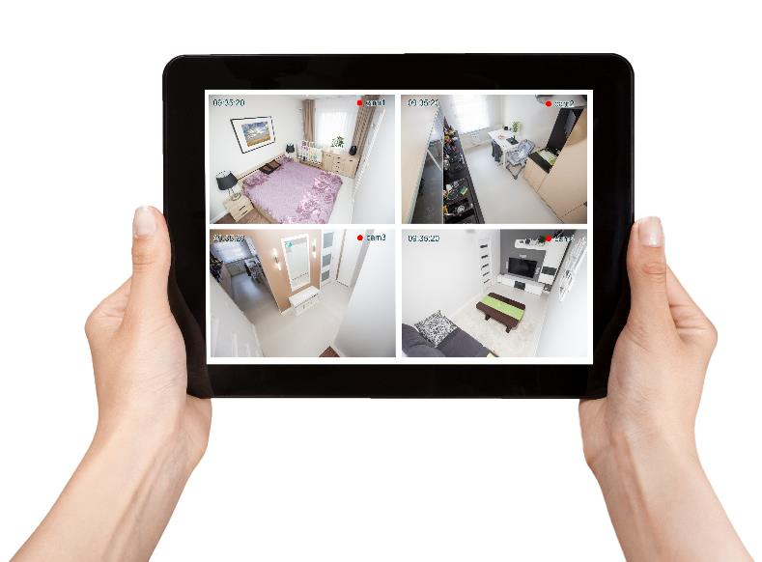
Security
CCTV systems used to have low picture quality and around two frames per second
This made it hard to identify criminals
Criminals could find the video recorder and destroy it
Modern CCTV systems are high quality
The video data can be stored remotely on the Internet
What other IT systems are used for security?

Slide 32
Security systems
Software to protect IT systems:
Antivirus, firewalls, monitoring software
Automatic Number Plate Recognition (ANPR)
Door/barrier entry and exit systems
Digital safes
Home alarms
Facial recognition

Slide 33
Worksheet 2
Now complete Task 5 on Worksheet 2

Slide 34
Plenary
Fill in the blanks below using the words at the bottom of the slide:
A clothes shop holds a supply of products in the shop and warehouse. They use software to keep track of products and what they need to order. is used to monitor the number of customers in each section of the store. The results of establish areas of the store that are popular and those which may need improvement. The company makes use of CCTV and RFID tags for its . IT is also used in such as . The company’s catalogue is edited on a computer and targeted at certain loyal customers.
Advertising, security, data analysis, data logging, stock control, creative tasks

Slide 35
Plenary
Fill in the blanks below using the words at the bottom of the slide:
A clothes shop holds a supply of products in the shop and warehouse. They use stock control software to keep track of products and what they need to order. Data logging is used to monitor the number of customers in each section of the store. The results of data analysis establish areas of the store that are popular and those which may need improvement. The company makes use of CCTV and RFID tags for its security . IT is also used in creative tasks such as advertising. The company’s catalogue is edited on a computer and targeted at certain loyal customers.
Advertising, security, data analysis, data logging, stock control, creative tasks

