Slide 1
Mainstream USA Film
E.T (1982)
Invasion of the Body Snatchers (1956)

Slide 2
What do I have to do in the exam?
You have to study two USA films (see next slide) and then answer three questions on them in the exam (see the three slides after the next one)
You will discover how the sci fi genre has developed and changed from the 1950s to 1980s
Only one of the questions (Q3) will be a comparison question and will reflect the time period of when the two films were made – 1950s and 1980s
One comparison we will make will be in regards to the theme of alien invasion - Invasion of the Body Snatchers reflects anxieties about Russia invading the USA whilst E.T highlights that we should be friendly towards people from different worlds (metaphor for immigration)

Slide 3
The Two Films Key Point: ‘The Time Period when both films were made was a time of profound socio-economic change in America.’

Slide 4
In the exam you will get one question on E.T.
Identify one example of cinematography used in your chosen film. [1]
Briefly explain what this example of cinematography typically suggests. [4]
Explore how this example of cinematography is used in one sequence from your chosen film [10]

Slide 5
In the exam you will get one question on Invasion of the Body Snatchers
Identify one genre convention used in your chosen film. [1]
Briefly outline why conventions are used in genre films. [4]
Explore how the convention you have identified is used in one sequence from your chosen film. In your answer, refer to at least one key element of film (e.g. cinematography, mise-en-scène, editing or sound).

Slide 6
In the exam you will get one question which will ask you to compare both films
Compare how the same theme is explored in each of your comparative study films.
In your answer, you should consider:
how characters and narratives illustrate the theme you have identified
similarities between the way the theme you have identified is explored in each of your films
differences between the way the theme you have identified is explored in each of your films. [20]

Slide 7
Possible Exam Questions Areas we have to study
Background/Context – Social, cultural, historical, technological, institutional
Key Elements of film – mise en scene, sound, editing, aesthetics and cinematography
Genre
Narrative
Representations

Slide 8
Science Fiction Genre - Starting Points
Science Fiction films have often been used to provide social commentary on political or cultural issues which are seen to be important at the time of the film’s release
The genre plays on audience’s hopes/fears by having a monster which represents (acts as a metaphor) the hopes/fears that society have at the time of the film’s release.
These hopes/fears change over time
History of sci fi on film
https://www.youtube.com/watch?v=Q9GiJENtc5o&list=PLrYIGpF9a49AIbzPmbXvZazKCxJX-cVQk

Slide 9
Science Fiction Films – Starting Points - What do the audience expect from this kind of film?
Spectacle - showing audiences sights and sounds they have never seen before, for example weird looking aliens, huge starships, distant alien worlds - all created using advanced special effects
Excitement/fear - conventions of sci-fi films are often mixed with action or horror films (Invasion of the Body Snatchers is mixed with Horror and Film Noir for example)
Exploring big, ‘what-if?’ questions: are we alone in the universe? What would aliens look like? What are the limits of science? What if robots took over the world?
Exploring social or political issues in an enjoyable and entertaining context (e.g. recent Star Wars films have female characters that challenge gender stereotypes).

Slide 10
E.T (1982)
Background/Context to the film

Slide 11
Context – Starting Point How is E.T. different to the science fiction films of the 1950s?
One key aspect which distinguishes “E.T. The Extra Terrestrial” from other alien “invasion” films dating back to the 1950s is the simple fact that the story’s alien being actually does “come in peace,” a trait the film shares with Spielberg’s earlier feature, “Close Encounters of the Third Kind.”
Unlike the Cold War inspired tales of alien conquest which dominated much of the science fiction landscape in the 1950s, it was Spielberg’s desire to bring the sense of wonder he felt while gazing at the stars as a child to the big screen.
E.T. is portrayed as an intergalactic botanist, a vegetarian whose very touch can heal the wounded and bring dying plants back to life.
The United States government agents are the villains of the piece. Their cold detachment and treatment of E.T. as a specimen to be studied stands in contrast to Elliot’s own psychic link and emotional attachment to the creature.
Spielberg has said that the story was partially inspired by federal cuts to the space programme at the time during which the film was made, and it is a film very clearly designed to inspire awe in the universe that surrounds us.

Slide 12
How does E.T represent this difference from older sci fi films and also the theme of hope in the film?
At the start of the narrative, Elliott was a lonely boy with an absent father, a scolding older brother and mother struggling to cope with her divorce
Through his friendship with E.T. he has acquired the courage and empathy necessary to face the challenges of adolescence and adulthood.
E.T. has healed more than just cuts and bruises; he has mended Elliott’s family, and perhaps introduced a new father figure into Elliott’s life in the form of Keys, who behaves supportively towards Mary throughout the final scenes of the film

Slide 13
AMERICA IN THE 1980’S
Background/Contextual Information

Slide 14
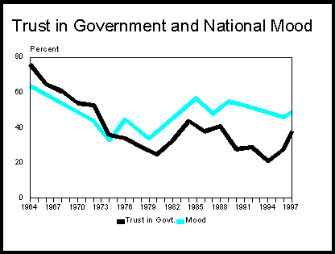
The Theme of Distrust
America in the early 1980’s was a place where the people had lost trust in its government, its army and with each other.
This graph (black line) shows the level of distrust that people had in its government at this time .
The reasons for this distrust are many and they influenced science-fiction films of the 70’s and 80’s.
In E.T. the United States government agents are the villains of the piece. Their cold detachment and treatment of E.T. as a specimen to be studied stands in contrast to Elliot’s own psychic link and emotional attachment to the creature.
https://www.youtube.com/watch?v=xLcbgz1oJJs&list=PLJFfJUeNupSTLiPqY3Vx3qK00m_7f1Bei&index=13

Slide 15
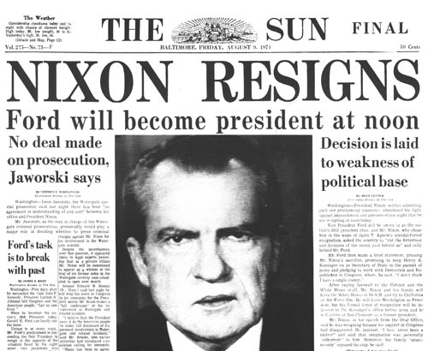
President Nixon – Watergate Scandal
The Watergate Scandal linked President Nixon to a break in committed by members of his party against the opposing Republican party where cash was stolen to help fund his re-election campaign.
He at first denied all knowledge of this, but as the truth began to dawn he was forced to resign from being President.
If the President of America directly lied to the American people you can see why the early 1980’s was seen as a period of distrust in American society.
That is why the government agents in the film are seen to be faceless authority figures
https://www.youtube.com/watch?v=sh163n1lJ4M&list=PLJFfJUeNupSTLiPqY3Vx3qK00m_7f1Bei&index=16

Slide 16
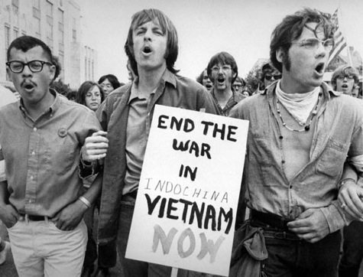
Vietnam War – Scarred America
Vietnam was the first war where a number of American people opposed the involvement of the American army in a campaign far away from American soil.
58,000 Americans died and for the first time in their history America didn’t ‘win’ the war due to effective guerrilla campaigns employed by the Vietnamese.
This led to prolonged protests in America opposing the war throughout the late 1960’s and 70’s.
Psychologically the War affected the American psyche with many American War Veterans ignored when they came home, many Americans didn’t want to admit defeat and they took out their frustrations against the Government

Slide 17
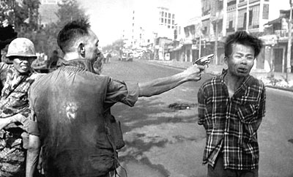
Vietnam War – Body horror
Vietnam was the first ‘televised’ war and Americans were confronted with many horrific images every night on their news programmes.
This focus on the destruction of the body led to a new focus for science fiction and horror films of the time, where the focus of the horror in the films became one of the destruction of the body.
We can see body horror in E.T. when the government scientists are trying to save Elliott and E.T. The camera focuses on the alien’s limp body and we get a sense of horror from watching the alien being treated like a specimen rather than a gentle creature.

Slide 18
Ronald Reagan brought hope to the USA
In 1980, confidence in the American economy and government was at a low point.
Looking for the promise of a better future, Americans voted to put Ronald Reagan, a former Hollywood actor, into the White House.
Reagan felt it was time to stop feeling guilty about the war in Vietnam and to start feeling like proud Americans again.
He set about cutting taxes in the hopes of stimulating growth and investment, and boosted military spending to make America a great military power once again.

Slide 19
Suburban Living and Economic Growth
The 1980s were an era of prosperity where the US had an economic boom because President Ronald Reagan encouraged business and capitalist/consumerist culture.
Rapid home growth in the 1960’s combined with cheaper mortgages, inexpensive air travel and cheaper cars meant that many people could afford to live in new large houses on the edge of cities called suburbia
The 1980s were built on the fact that the more money you earned the more you would spend and invest in business, this success would then as a result trickle down to everyone however what really happened is that rich people kept most of their increased wealth so the trickle down didn’t actually happen
Where can you see evidence of a wealthy, middle class lifestyle in the film?
Think about the scene where Eliot brings ET into his room and shows him his toys. What does this say about the importance of consumer culture?

Slide 20
Film in the 1980s – The Block Buster
The 1980s were defined by film ‘blockbusters,’ huge expensive films that which reflected the rising economic confidence in America – more money meant more expensive films that could use more expensive effects and this led to the rise of films such as ET – these films were called high concept films – a film which relied on action and special effects to make sure the audience are entertained
ET is an interesting film however because today we think of it as a nostalgic, family based small film which is different to the more explosive, action packed science fiction films of today

Slide 21
The Problem with Reagan’s policy on the economy
To pay for tax cuts, Ronald Reagan wanted to reduce the money spent on government welfare programs that supported the most vulnerable. This led to huge social problems among poor people in the USA, drug use went up, as did the divorce rate
The biggest difference between the 1950s and 1980s was thus an increase in lone parent families, families with only one parent rose by 74% in this time period
There was a huge rise in the divorce rates – the white picket image of a nuclear family which dominated 1950s culture was now transformed into a culture of divorce – this was a move away from the culture of marriage in the 1950s
Think about the representation of Elliott’s mum in the film

Slide 22
E.T. and the theme of divorce
Spielberg’s initial ideas for the film focused on a lonely, boy who is suffering the after effects of his parents’ divorce.
This was always the primary idea, the central one before anything else.
This focus on the child and his harried mother and siblings remained at the heart of the script even as the fairy tale/fantasy aspects of the story developed.

Slide 23
How E.T. goes against Ronald Reagan’s economic policy
Due to these cuts to welfare and an overall promotion of greed in the 1980s, Steven Speilberg decided to have a clear ideology of empathy, tolerance and acceptance at work in E.T.
“The adult world of harshness and competition that so many conservative films celebrate is looked on from the children or E.T.’s perspective, through frequent point of view shots, in a way that portrays it as menacing. The real aliens in the film are all over thirty or over three feet tall” (Ryan and Kellner, 1990)
This suggests that perhaps the film’s appeal to an audience was more than just simple, empty-minded escapism.
Instead, the film’s emphasis on love and empathy, qualities downplayed in a public realm that promoted wealth and strength, arguably spoke to the country’s desire for something more humane

Slide 24
America in the 1980’s A Paradox
More people had more money meaning that they could spend even more than before, however underneath this façade of happiness people still had fears
Problems of race and racism persisted – This led to the 1992 riots in LA
The government were not trusted – Vietnam and a whole series of events in the 1970s meant that Americans did not trust authority
There was rising drug and divorce problem in the USA
Greed is good – Human identity is no longer defined by what one does, but by what one owns
Immigration was also seen as a threat to American jobs

