Slide 2
Objectives
Describe the role of current legislation (and subsequent additions and amendments) in protecting users and their data from attack or misuse

Slide 3
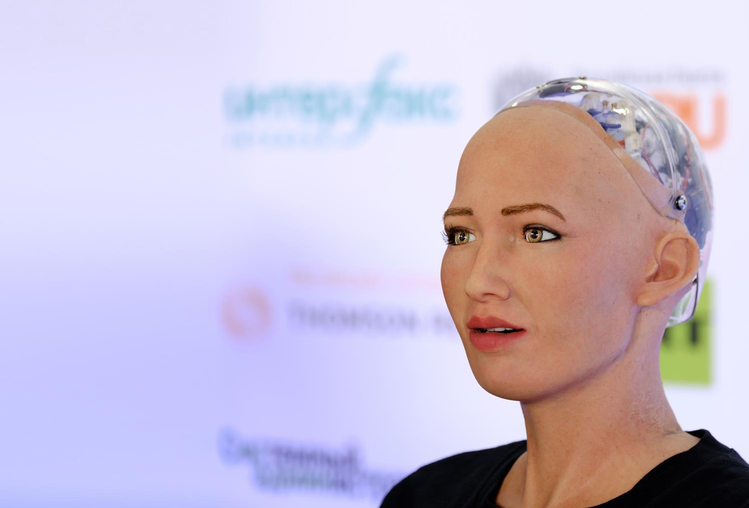

Technological progress
In the TV series
“Humans”, robots or
“synths”, created by
humans, start to have
real feelings and
eventually achieve
self awareness
  What would happen if robots
  started doing jobs faster
  than humans?
  What protections could the law give
  to cope with this?

Slide 4


Legislation
There are several laws governing
the use of computing devices
and the data they hold
  Name three laws related to
  IT, computing devices or data

Slide 5

Current legislation
These are laws designed to protect
users and their data from attack
and misuse:
  Computer Misuse Act 1990
  Police and Justice Act 2006 (Computer Misuse)
  Copyright, Designs and Patents Act 1988
  The Copyright (Computer Programs)
  Regulations 1992
  The Health and Safety (Display Screen
  Equipment) Regulations 1992
  Data Protection Act 2018
  Consumer Rights Act 2015

Slide 6

We are all potential victims
Statistics show that 1 in 22 adults is a victim of cyber fraud
17 million Britons were targeted in 2017 by phishing, ransomware, online fraud and hacking
Hackers stole £4.6 billion from British internet users in 2017
  The most common cyber crime was
  infecting a victim’s device with a virus

Slide 7

Computer Misuse Act 1990
This makes the following illegal:
  Unauthorised access to computer material
  Unauthorised access with intent to commit further offences
  Unauthorised modification of computer material
Prior to 1990, hacking computers was commonplace but there was no law
against it
  Technology moves so quickly, legislators
  sometimes have problems keeping up

Slide 8
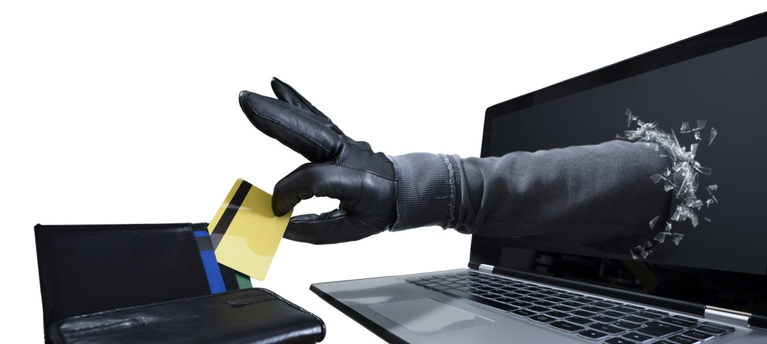
Computer misuse – unauthorised access
Accessing someone else’s computer or data without permission is an offence under the Computer Misuse Act
  A hacker may access data held by an individual or organisation simply to “find out how it’s done” but
  this is an offence
  and taken seriously

Slide 9


Computer misuse – with intent to commit further offences
Accessing someone else’s data without permission in order to carry out a different crime is serious offence
  The motive may be personal gain,
  blackmail or revenge
It could be carried out by
  First, finding someone’s password
  by phishing
  Then committing a further offence of stealing money from their online bank account

Slide 10
Computer misuse - unauthorised modification
This includes planting a virus which is intended to:
  cause damage, such as destroying or altering data
  slow down the operation of the computer
  cause frequent computer crashes
It would also include accessing a company’s computer system and altering how the programs work

Slide 11

Police and
Justice Act 2006
This Act is largely concerned with policing reform, but contains
some amendments to
the Computer Misuse
Act of 1990
  The amendments are designed to cover new forms of crime brought about by advances in technology over the previous 16 years

Slide 12
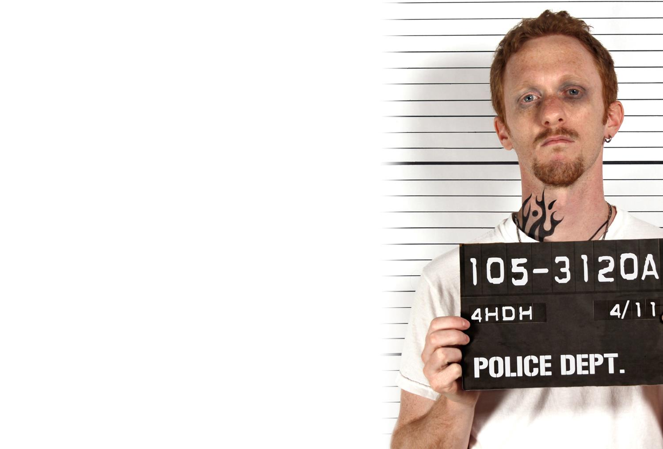
Police and
Justice Act 2006
The major amendments to the Computer Misuse Act of 1990 were:
  Making, owning or distributing hacking tools was made illegal if the person intends or believes it will be used for computer misuse
  Denial of Service attacks were made illegal with a penalty of up to 10 years in jail

Slide 13

Making, owning or
supplying hacking tools
This includes creating or spreading malicious software (“malware”) that can be used in computer misuse offences:
  Viruses
  Worms
  Trojans
  Ransomware attacks
  Denial of service attacks

Slide 14
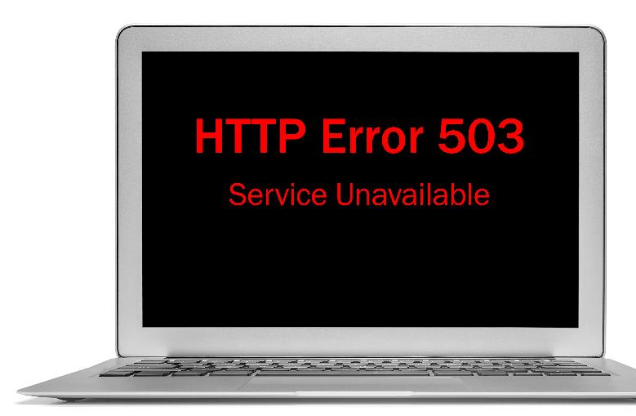
DoS and DDoS attacks
A denial of service (DoS) attack involves one computer or network resource flooding a server or network resource with requests which causes it to become unavailable
A distributed denial of
service (DDoS) attack
involves many computers
making the requests
  Not only is a DDoS more
  effective, but it is far
  harder to prevent

Slide 15

Titanium Stresser DDoS
The teenager who made this virus was eventually sentenced to two years in jail, at the age of 20
  His defence was that he had suffered relentless
  bullying at school as a result of having
  Asperger’s Syndrome
  The judge said: “It’s probably of little
  comfort to the victims of crime
  like this that the person
  responsible may not
  be motivated by
  money but by
  revenge, bravado,
  a wish to feel big,
  important or impressive.”

Slide 16
Worksheet 3
Now complete Task 1 on the worksheet

Slide 17
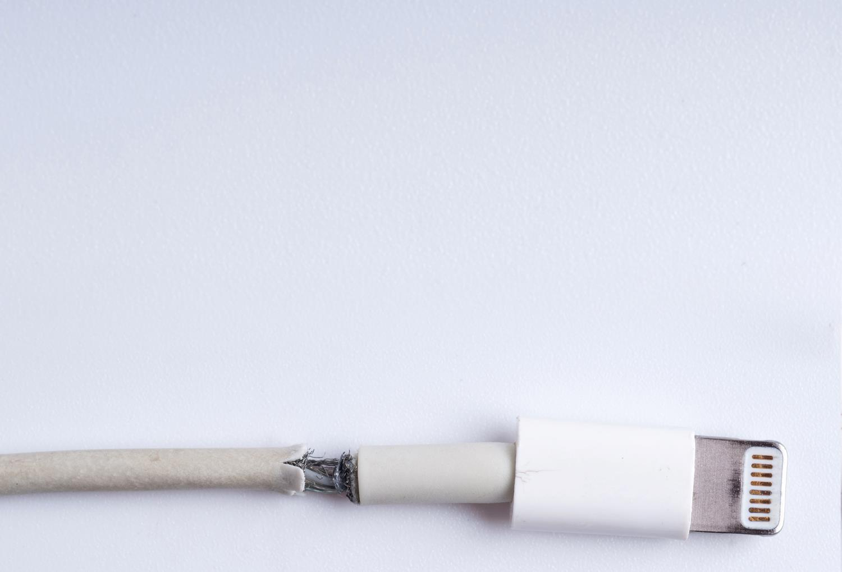
Consumer Rights Act 2015
Under this Act all products, whether digital or physical, must meet the following standards:
  Satisfactory quality – not faulty or damaged (taking into account, for example, that bargain bucket products won’t be held to as high a standard as luxury goods)
  Fit for purpose – for the purpose they are supplied for, or any purpose you made known to the shop when you bought them
  As described – matching any description given to you or samples shown to you at the time of purchase

Slide 18
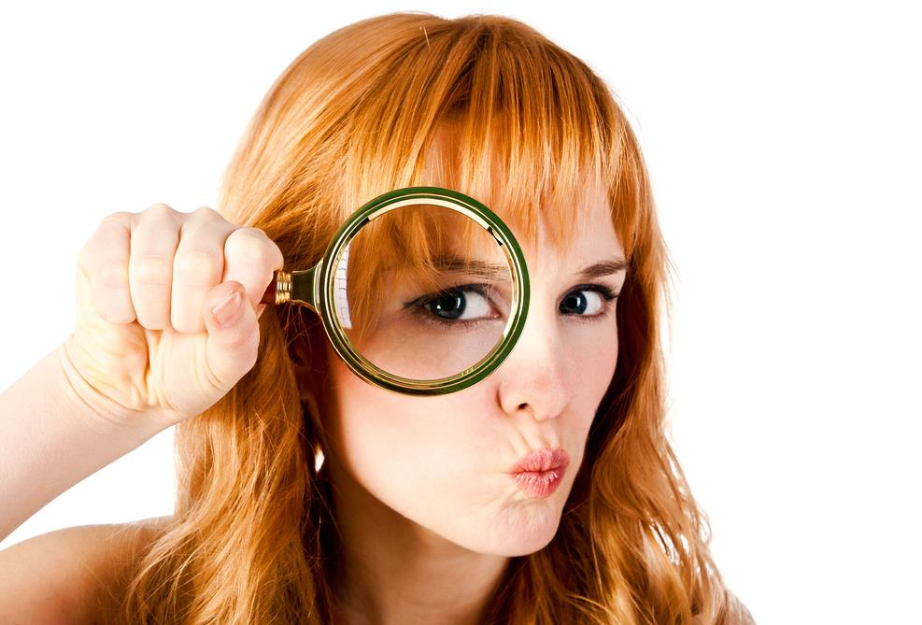
Data Protection Acts
(1998, 2018) & GDPR
These acts are essentially
about two points:
  The ethical use of
  personal data
  Keeping every
  individual’s personal
  data secure

Slide 19
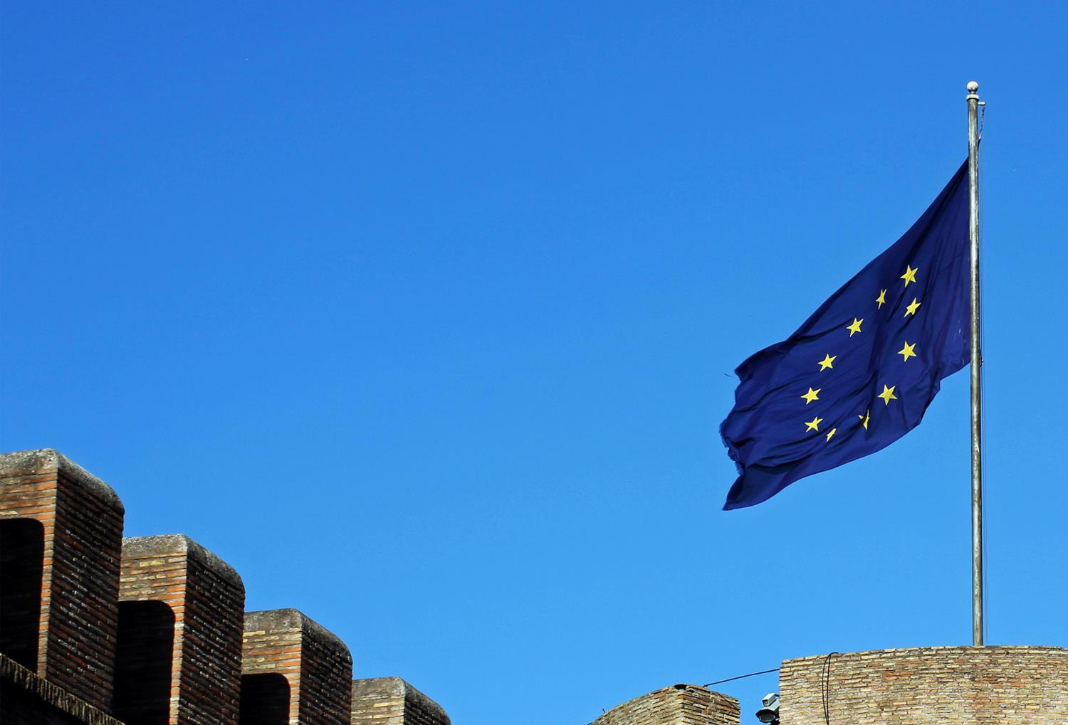
Data Protection Act 1998
A new Data Protection Act (2018) replaced the
Data Protection Act (1998) in May 2018
  Previous data protection regulations had
  struggled to keep pace with rapid
  technological changes
  The new law enforces in the UK, the
  General Data Protection Regulation
  (GDPR), which came into force in
  Europe on 25 May 2018

Slide 20
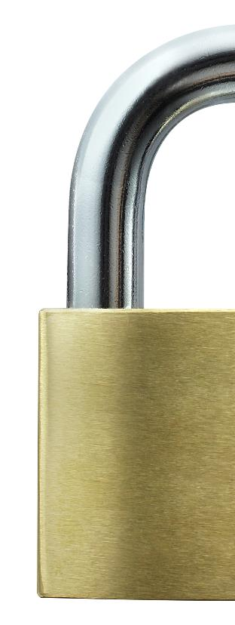
GDPR
The law says that people have a right to privacy
of personal data held on computer systems
The EU General Data Protection Regulations
2018 (GDPR), protects the privacy of all
EU citizens
  Companies that sell goods or services to
  people in other EU countries will need to comply
  with the GDPR
  For companies trading solely within the UK the
  equivalent legislation, Data Protection Act (2018)
  will apply

Slide 21

Data Protection Act 2018
Any organisation must make sure
that personal data is:
  used fairly, lawfully and transparently
  used for specified, explicit purposes
  only used where necessary
  accurate and kept up to date
  kept for no longer than is necessary
  handled in a secure way, including
  protection against unlawful or
  unauthorised processing, access,
  loss or damage

Slide 22

Your rights under the DPA 2018
You have the right to:
  be informed about how your data is being used
  access your personal data
  have incorrect data updated
  have your personal data erased
  stop or restrict the processing of your data in some situations
  copy and reuse your data for
  different services

Slide 23
Worksheet 3
Do Task 2 on the worksheet

Slide 24

Employer’s duty of care
An employer must obey health and safety laws
They also have a moral and ethical duty towards their employees, for example:
  to ensure they do not work excessive hours
  to keep them safe from harm
  to protect them from discrimination
  to provide adequate training
Legislation forces
companies to recognise
their moral obligations

Slide 25
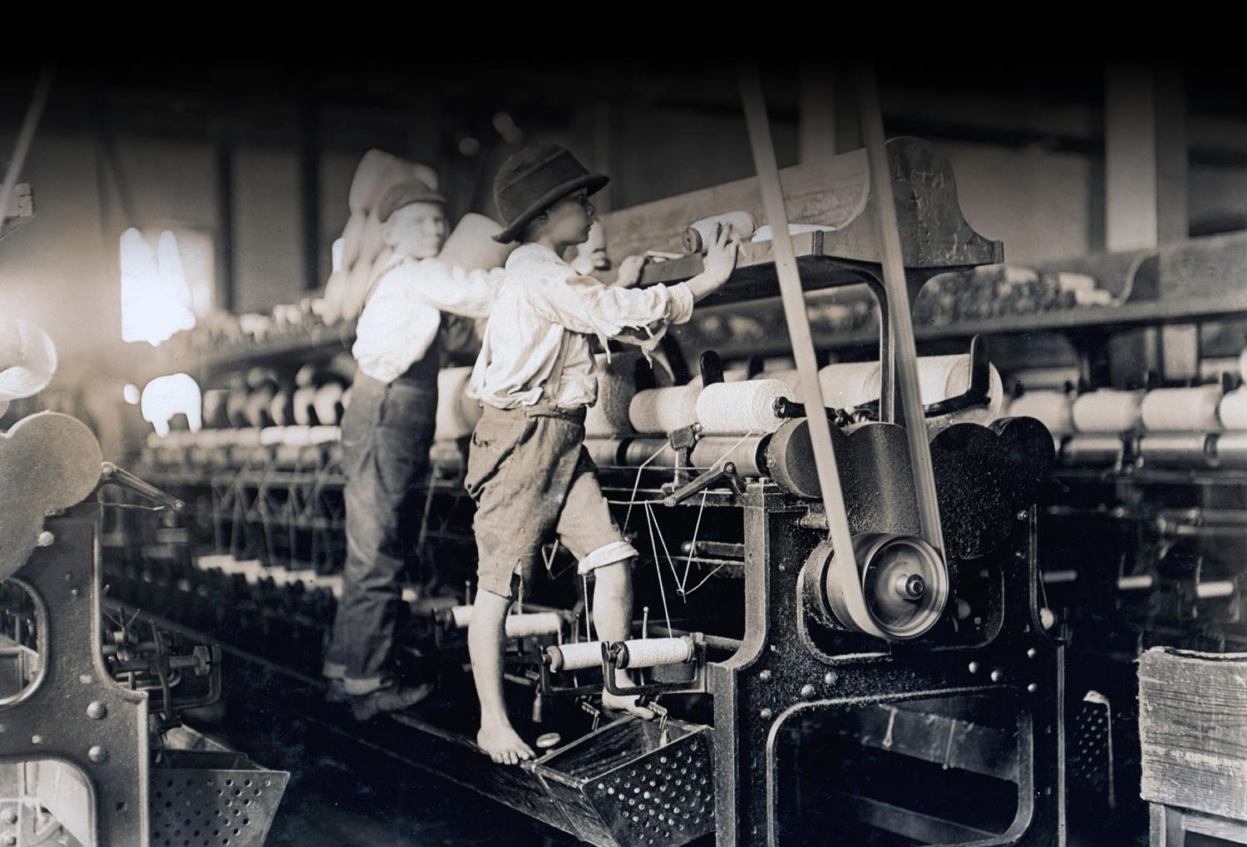
Safety has improved since 1909

Slide 26

Health and safety
There are regulations designed
to protect employees who spend
all day working at a computer
Health risks include:
  Back and neck pain
  Headaches
  Arm pain
  Repetitive strain injury

Slide 27
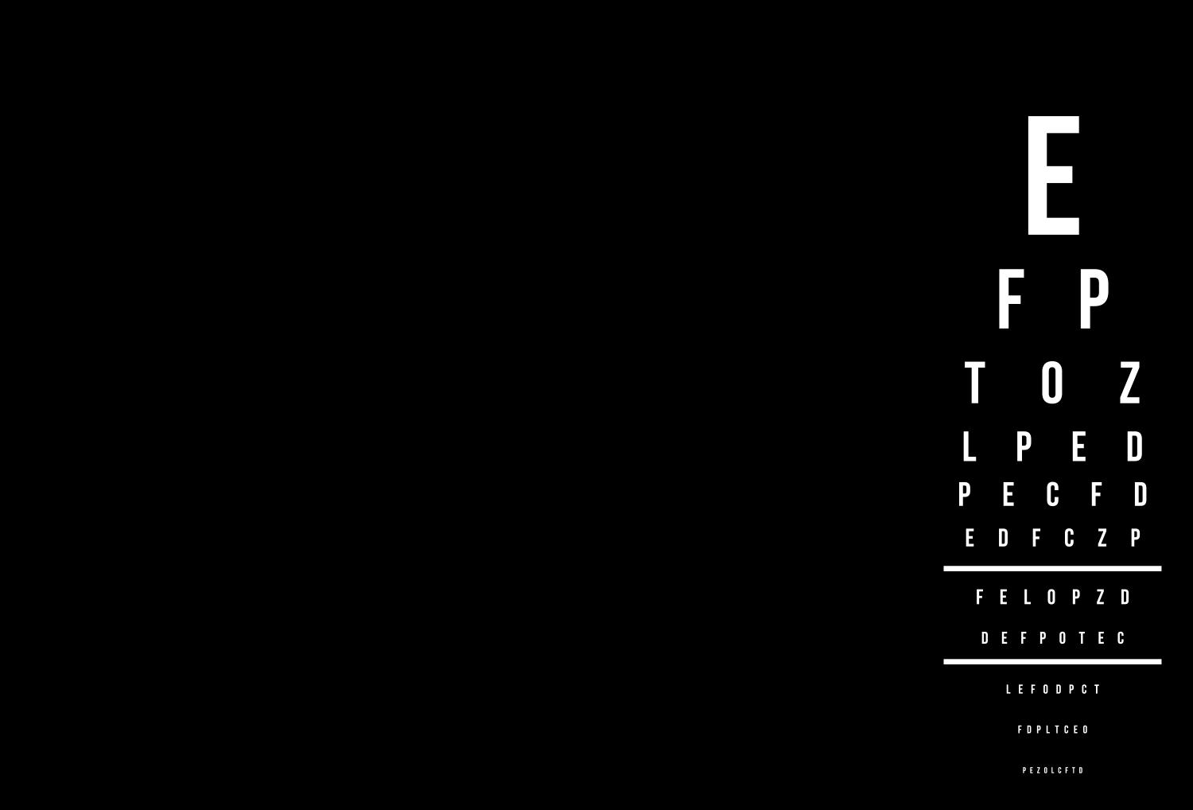
Health and safety regulations
1992 (Display Screen Equip.)
The main points are:
  Employers must carry out a risk assessment of
  workstations used by employees to reduce risks
  Employers must ensure that employees take
  regular breaks from looking at their screens
  Employers must ensure that employees are
  aware of their entitlement to yearly eye tests,
  with the cost met by the employer
  Employers must provide their computer users
  with health and safety training for any
  workstations that they use

Slide 28
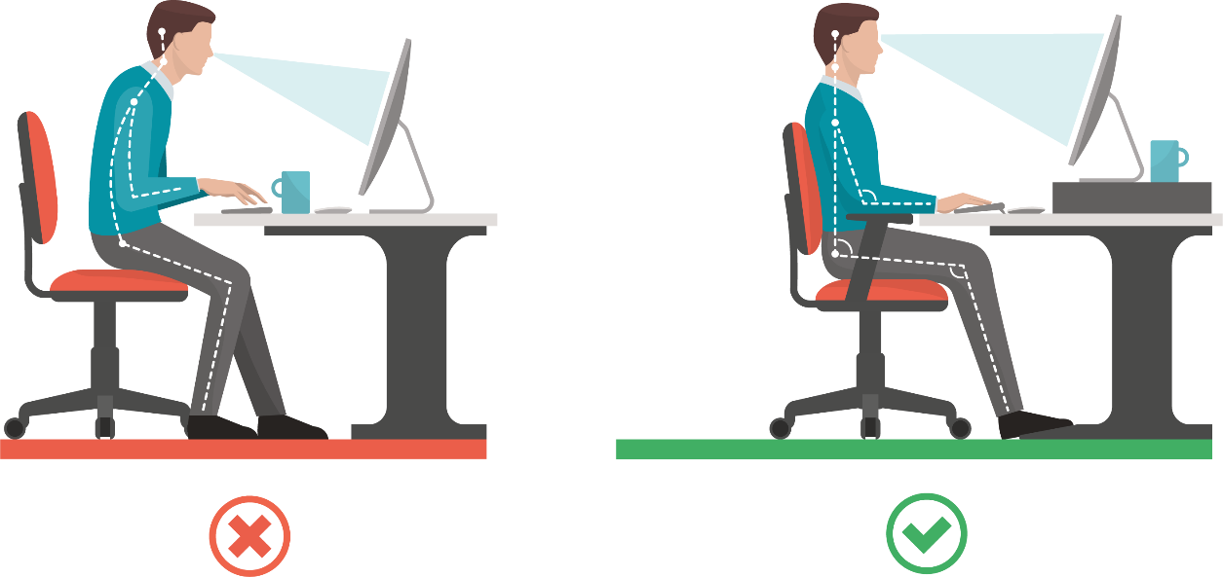
Correct body alignment
Wrong sitting position
Correct sitting position

Slide 29

Assessment of workstation
A risk assessment for screen use could include:
  making sure that lighting in the room or from a window does not cause glare or reflections in the screen
  checking that screens do
  not flicker and text is an
  appropriate size
  making sure that screens
  are clean and dust-free
Regular reviews should be
carried out for new staff or
when new equipment
is installed

Slide 30

Reducing risks of using screens all day
Staff should be trained to understand risks
and report or act on any problems
Screen glare can be reduced by:
  Adjusting the monitor’s brightness and
  contrast settings
  Fitting blinds on windows
  Adjusting the room lighting
  Using an anti-glare filter to reduce glare

Slide 31

Copyright, Designs
and Patent Act (1988)
This Act is not specific to
computer material
It gives the creators of literary,
dramatic, musical and artistic works
the right to control the ways in which
their material may be used
  It ensures that people are rewarded
  for their creative efforts
  It gives them protection from people
  copying their work without permission

Slide 32
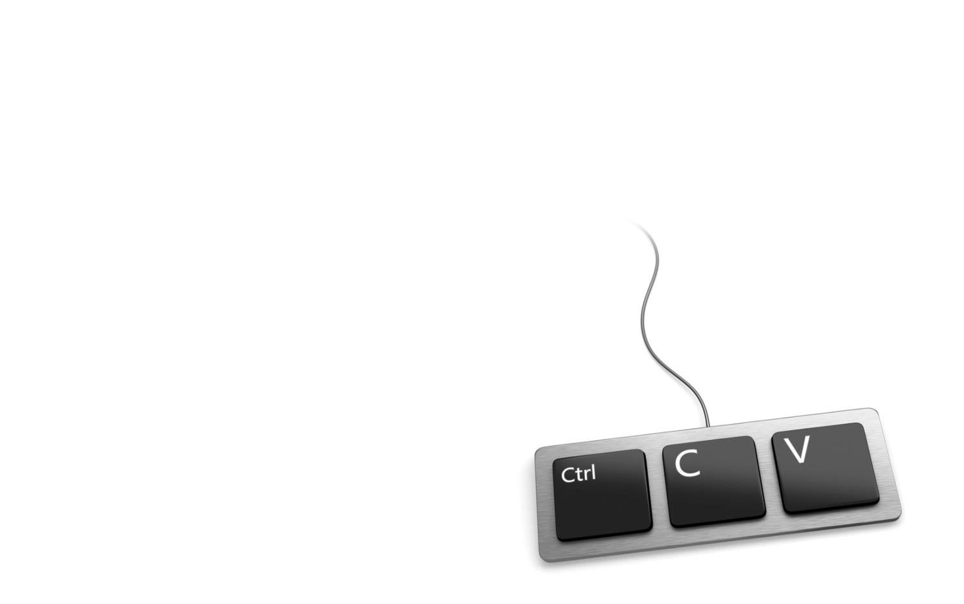
Ethics and copyright issues
It is so easy to copy articles images, music and videos from the Internet that is easy to forget that in many circumstances this is:
  unethical (plagiarism), or
  illegal (breach of copyright)
When you use text or images
from the Internet in your work,
you should always
acknowledge the source

Slide 33

Plagiarism and cheating
Some companies offer to write essays for students struggling with their assignments
Some students pay thousands of
pounds for essays to be written
  A study by academics at Swansea
  University in 2018 indicated that
  one in seven graduates may have
  cheated on essays in the past
  four years

Slide 34
Fighting back plagiarism
Plagiarism is a growing problem for universities
A petition started in August 2018 to make it illegal for companies to provide these services gathered 3,000 signatures in its first month
Online plagiarism detection software
can help universities to detect cheating

Slide 35

The Copyright (Computer Programs) Regulations 1992
These regulations updated the Copyright, Designs and Patent Act passed in1988
  The amendment made it clear that
  computer software was also subject
  to copyright
  It is illegal under this law to use
  copyrighted software without
  a licence
  How does this act affect
  open source software?

Slide 36
Open source software
Open source software allows people to view and change the source code which makes it work
  ‘Free’ means the freedom to run it, study it and change it,
  and to redistribute copies with or without changes
  It also often means that it comes at zero cost
Open-source licences may have some restrictions, such as:
  Stating the names of the original authors
  A requirement that an altered copy has the same licence
  as the original

Slide 37
Worksheet 3
Now complete Tasks 3 and 4 on the Worksheet

Slide 38
Plenary
Give two key features of each of the following acts:
  Computer Misuse Act 1990
  Police and Justice Act 2006 (Computer Misuse)
  Copyright, Designs and Patents Act 1988
  The Copyright (Computer Programs)
  Regulations 1992
  The Health and Safety (Display Screen
  Equipment) Regulations 1992
  Data Protection Act 2018
  Consumer Rights Act 2015

