Slide 2
Objectives
Describe the impact and implications for organisations of IT systems in terms of:
User experience – ease of use, performance, availability, accessibility
Employee and customer needs
Cost, productivity, working practices and user support
Implementation – timescales, testing, downtime
Replacement or integration with current systems
Staff training needs (initial and ongoing)
Security

Slide 3
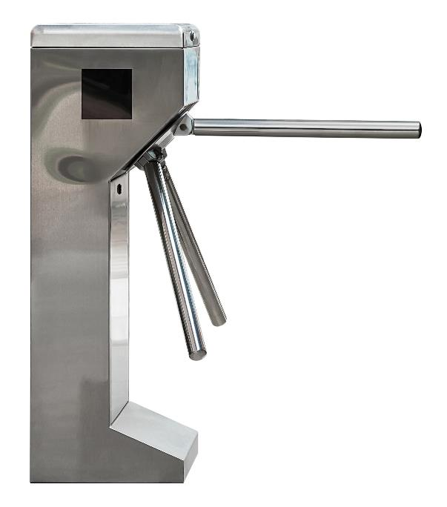
Starter
A head office wishes to improve security
They wish to implement an IT system that makes use of turnstiles for the entry and exit of employees
Each employee will have an ID card with a barcode printed on it
What considerations should the company make when installing such a system?

Slide 4
Considerations
Considerations may include:
What timescale is available for the installation?
Is the system secure enough? Barcodes could be photocopied
What are the employee needs? The system needs to work almost instantly to avoid frustration
How much testing will need to be done?
What happens if the computer network or electricity supply is down?
How much does the system cost?
What support will be given by the company that installs the system?

Slide 5
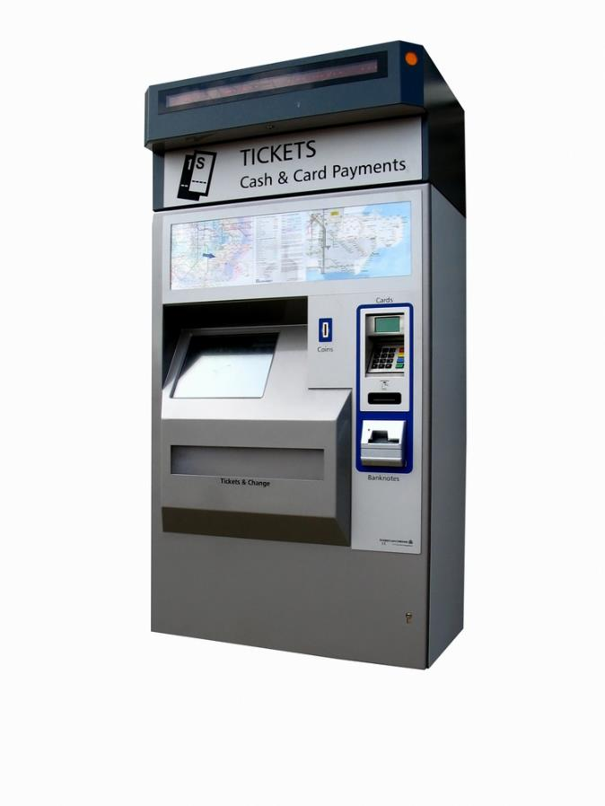
User experience
The IT systems that people use need to be designed to give a good user experience
This is judged by its ease of use, its performance, availability and accessibility
Consider a ticket machine at a train station
What are the positive and negative aspect of the user experience?

Slide 6
User experience
Positive aspects of the experience:
Clear instructions to use the machine
No training required to use
Generally reliable
Available 24/7
Negative aspects of the experience:
Touch screen can be unresponsive or slow
Discounted tickets and less used stations can be hard to find
Touch screen has poor accessibility for those with sight problems

Slide 7
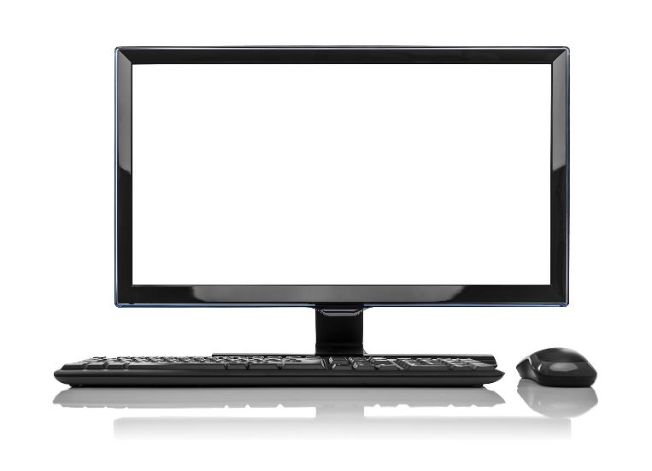
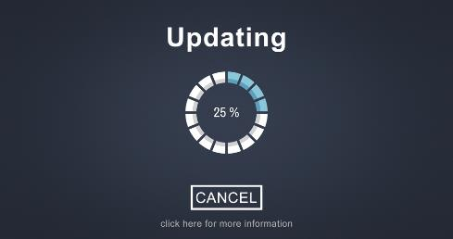
Performance and availability
The performance of a computer system can be affected by:
Hardware components such as amount of RAM and CPU and hard drive speed
Software and operating system efficiency
What are the effects to a business of a computer system
becoming unavailable
having poor performance?

Slide 8
Performance and availability
Poor performance and unavailable IT systems can lead to:
Inefficiency of employees leading to staff becoming stressed and reduced income for a company
Unhappy customers who have to interact using the IT systems or websites
Compensation payments where contracts cannot be fulfilled
Loss of reputation for an organisation

Slide 9
Case study: LAX Airport
On 30th April 2014, flights in and out of Los Angeles International Airport were delayed or cancelled
A bug in the $2 billion air traffic control system, caused by an unexpected aircraft, slowed and eventually crashed the system
What were the short and long term impacts and effects on the airport?

Slide 10
Case study: LAX Airport
A software bug caused the air traffic control system known as ERAM (En Route Automation Modernization). The effect of the system crash was caused by a spy-plane which had an unknown altitude. This cause the system to run out of memory. More information about the incident can be found here: https://www.reuters.com/article/us-airtraffic-bug-exclusive/exclusive-air-traffic-system-failure-caused-by-computer-memory-shortage-idUSBREA4B02320140512. Such incidents at an airport will cause people to have delayed and cancelled flights due to planes being grounded. Ultimately a loss of income and reputation will be the result for the airport and developers of the software.

Slide 11
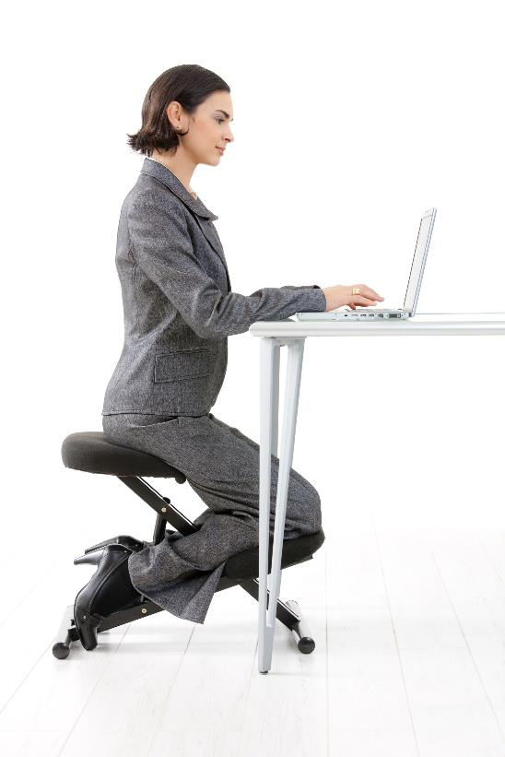
Accessibility
Computer systems need to be accessible for all users. The following can be used:
Text to speech
Voice commands / dictation
Braille displays and keyboards
Large displays / font size
What other hardware or software can help IT systems become more accessible?

Slide 12
Accessibility
Hardware or software features that are used to increase the accessibility of IT systems:
Screen brightness
Contrast and colours used
Larger on-screen keyboard and buttons
Responsive screens (to rotation and screen size)
Specially adapted mice or trackballs

Slide 13
Worksheet 3
Now complete Task 1 and Task 2 on Worksheet 3

Slide 14
Employee and customer needs
Look at each of the following scenarios:
Airline booking system
Restaurant payment system
Personal trainer system
For each scenario:
What are the employee needs?
What are the customer needs?

Slide 15
Employee and customer needs
For the three scenarios, there are different needs between the customer and employees. In an airline booking system, the employees need to be able to quickly find customer information and be able to update parts which may have errors. The system could be more complicated. For customers, it needs to be easy to use, but may take longer to go through the same options. In a restaurant payment system, customers may have a menu that shows the meals, whilst the kitchen will have just key details in text. Students may want to consider McDonalds self-service vs kitchen machines for this scenario. A personal trainer will a require a system that shows them many different clients and how they are doing, whilst the customer will only need their own information.

Slide 16
Costs of IT systems
Some costs of IT systems may be inexpensive:
For instance, purchasing a laptop for a home user may require one decision and the purchase of one product in a local electronics store
Larger IT systems may cost hundreds of millions of pounds to purchase
The cost of the IT system will be far more than just the hardware used
What other costs will need to be considered?

Slide 17
Costs of IT systems
Costs associated with larger IT systems:
Employee salaries to discuss the company’s needs
Time to write a specification or select off-the-shelf software
Development of the new system
Installation
Testing
Training staff with the new system
Support
System maintenance
Interest on loans if money needed to be borrowed for the new system

Slide 18
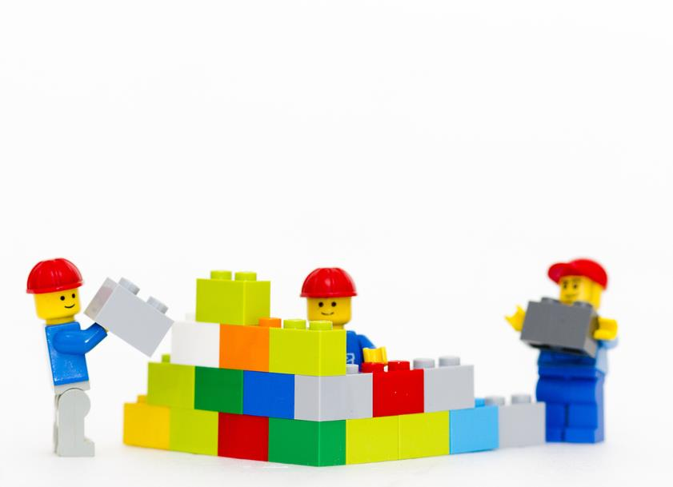
Implementation
Before a new system is implemented it is important that the following are carried out:
A specification is written for the new system based on employee and customer needs
A timeline needs to be made with clear milestones
Once implementation has started, progress needs to be constantly compared to the timeline
If costs start rise, it may be best to cancel the project before too much money is wasted

Slide 19
Testing
New IT systems need to be tested thoroughly before they can be released
The system must be tested to see that all features in the specification are working correctly
The system also needs to have user testing to see that customers and employees can use the system easily

Slide 20
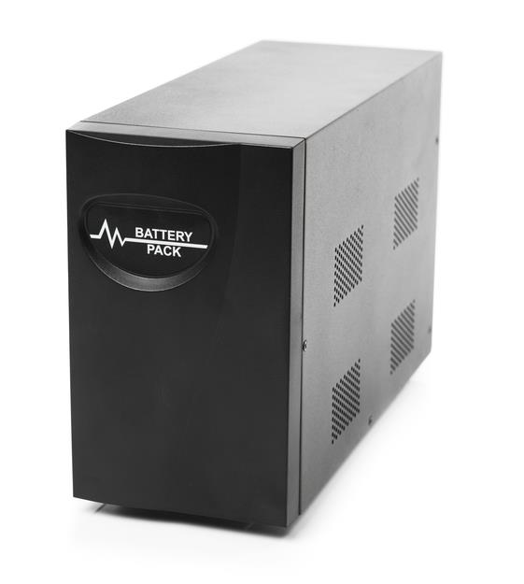
Downtime
IT systems need to have minimal downtime
A new IT system may require downtime of some services such as a website whilst it is installed
Important IT systems need to make sure they use redundancy to limit downtime
UPS (Uninterruptable Power Supplies) use batteries or generators as a secondary power source
How else can downtime be reduced?

Slide 21
Reducing downtime
Redundancy helps to reduce downtime:
Two hard disks can mirror the contents of each other – this is known as RAID (Redundant Array of Independent Disks) – If one breaks, the other one will take over
Two servers can both provide the same service and data
Two or more connections to the Internet can be provided. If one connection fails, the other one can be used
Fully testing IT systems and software
By carefully and thoroughly testing IT systems and software, the chances of a bug or error causing downtime will be reduced

Slide 22
Worksheet 3
Now complete Task 3 and Task 4 on Worksheet 3

Slide 23
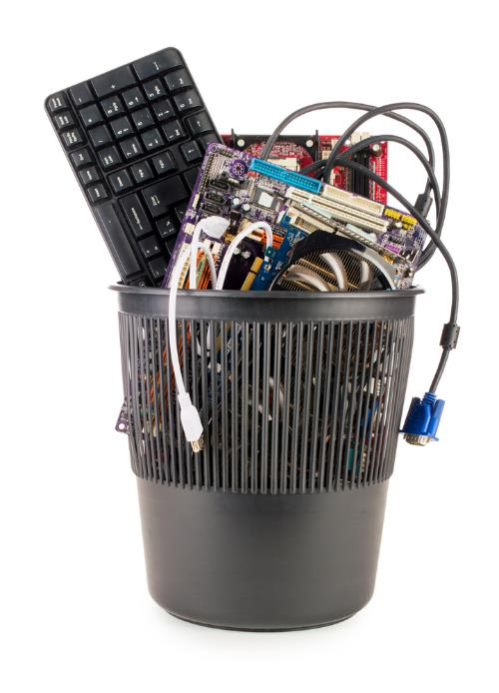
Replacement or integration
When an organisation needs a new IT system it has the choice of completely replacing the current system or integrating the new one
Very often the new and old system will run in parallel for a period of time
This can be costly and will mean extra work for employees
Integration can solve this problem
What new problems can integration introduce?

Slide 24
Integration problems
Integration of new systems to old ones can cause the following:
The new systems may not work properly with the old ones causing both to fail and significant downtime
As the systems get larger they become more complicated – this makes them harder to maintain and support
Old IT systems may have compatibility issues which cause them to not work with modern hardware or software

Slide 25
Case study: Universal Credit
In 2013, rollout of a new combined method of benefits payments called Universal Credit started
The complexity of the systems it replaced, and the number of claimants it dealt with, pushed the cost of the system from £2.2 billion to £12.8 billion
One major cost was the need to maintain and run older systems whilst the new system took over
Lack of consideration of the implementation complexities resulted in a large overspend

Slide 26
Productivity
Newer IT systems can increase an organisation’s productivity and therefore profitability
Collaborative software enables employees to work more efficiently
Cloud computing software allows the provider to employ experts to install/maintain/upgrade it – this saves a company from having to employ people to do these tasks
Newer software versions will have more advanced features allowing people to work more efficiently
New IT systems can replace repetitive tasks
Which tasks or jobs have been replaced in the last 25 years?

Slide 27
Working practices
IT systems can change how people work
This can lead to positive changes such as:
Remote working or working at home
Flexible working - the ability to work in a way that suits circumstances or outside of normal working hours
Some negative changes can occur though:
Employees may feel under pressure to answer emails and work at home – this may lead to stress
IT systems may not be well thought out, leading to inefficiencies in how employees have to work

Slide 28
Worksheet 3
Now complete Task 5 on Worksheet 3

Slide 29
Staff training and user support
New IT systems will need initial training sessions to help employees learn how to use them
Ongoing training will be needed to review content and learn more complicated features
User support will also be needed to answer queries from employees as they have encounter problems

Slide 30
Security
IT systems need to be secure to prevent unauthorised access to their hardware or data
Firewalls and anti-virus can reduce the risk of cyber attacks
Careful monitoring of records can help to identify an attack early and investigate it
Backups will allow systems to be restored if an attack occurs
How is personal and confidential data kept secure?

Slide 31
Protecting data
Physical security:
Safes to store hard drives and USB storage devices
Locked rooms and cabinets to protect servers
Security guards
CCTV and alarms
Software and hardware:
Username and passwords
Different levels of access for different users
Encryption – including hardware encryption
Two factor authentication

Slide 32
Worksheet 3
Now complete Task 6 on Worksheet 3

Slide 33
Plenary
Work in pairs:
What are at least five different considerations that organisations must make when commissioning or using an IT system?
Share your ideas with the class

Slide 34
IT systems
Impacts and implications for IT systems include:
User experience – ease of use, performance, availability and accessibility
Employee and customer needs
Cost
Implementation – timescales, testing, downtime
Replacement or integration with current systems
Productivity, working practices, user support and security
Staff training needs (initial and ongoing)

