Slide 2
Objectives
Describe the uses, processes and implications for individuals and organisations of accessing and using data and information in digital form
Explain reasons for ensuring data accuracy
Describe:
  Methods of ensuring accuracy: verification and validation
  Describe methods of extracting and sorting data
  Describe numerical and data modelling
  Describe the presentation of data and results

Slide 3

Starter
A small bakery currently
keeps paper records for all
their financial sales and customers
  What are the advantages of them switching to keeping all the data
  in a digital form?

Slide 4
Digital data advantages
Sales data:
  They can send data electronically to an accountant
  It will be easier to analyse
  A computer can process the data quickly to work out sales for a day or a month
  An online accounting package can calculate tax due, saving the owner time
Customer data:
  Customers can be easily emailed or contacted
  Analysis can be made to find high value customers

Slide 5
Digital data and information
Digital data and information is used to record:
  Personal and company finances
  Medical records
  Weather
  Scientific experiments
  Employee details
  Stocks and shares
  Stock
How does using such data digitally impact individuals and organisations?

Slide 6
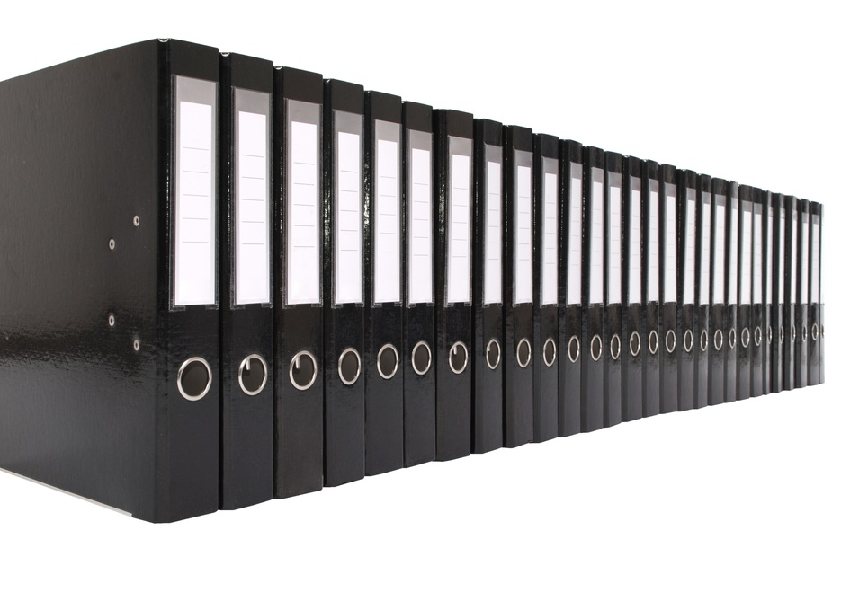
Impacts on organisations
Organisations have many advantages if their data is stored digitally:
  Shelves or rooms of paperwork do not need to be stored
  Data can easily be replicated an stored offsite, lowering the chances of a fire destroying the data
  The data can easily be
  processed by computer
  The data can quickly
  be searched
  Customer sales data can
  be analysed and may
  help with targeted marketing

Slide 7

Impacts on individuals
Having data stored and processed digitally helps individuals by:
  Reducing the amount of physical mail they receive
  It is faster to send and receive when receiving emails
  Documents are easy to backup
  and can then be recovered if
  lost or stolen
  Documents such as invoices
  and receipts can automatically
  be emailed making it easier
  to find and return products

Slide 8
Worksheet 5
Now complete Task 1 on Worksheet 5

Slide 9

Data accuracy
Data is only useful if it is accurate and up-to-date
  If data being processed is inaccurate then
  the information that results from any
  analysis or processing will not be
  helpful either
  This is a common concept in IT
  known as - ‘Garbage in, garbage out’
  or GIGO
Why may data be inaccurate?

Slide 10
Data inaccuracy reasons
Data may be inaccurate for the following reasons:
  Outdated
  Lack of data cleansing (detecting, correcting or removing inaccurate records from a database)
  Incomplete
  Bias during the data collection
  Mistyped
  Users not entering the correct data on purpose. For instance, they may need to complete an online survey, but make up answers to complete it

Slide 11
Validation
Validation is a technique to make sure that data is reasonable and conforms to a set of rules
  It does not say that the data is correct, but instead makes sure it conforms to one or more rules
  This helps to reduce errors
One form of validation is a range check
  This could, for example check that ‘test scores’ entered are between 0% and 100%
  Notice that mistakes can still be made, but invalid data, such as 120% will not be possible
What other forms of validation exist?

Slide 12
Types of validation
Type of validation | Meaning
Type check | Is it the correct data type? For example, text or a number
Range check | Is the input in a certain range of numbers or dates?
Format check | Does the data conform to some format, such as a postcode format?
Length check | Is the length of the data entered correct? For example, an account number may need to be eight digits long
Presence check | Has the data been entered? For instance, when asking a yes/no question in a survey, has one of the options been selected?

Slide 13
Verification
Verification is checking data with a second source to see that it has been entered correctly
Common verification methods include:
  Double entry verification – for example, verifying a password by entering it a second time
  Checking a postcode against a database of postcodes
  Asking for a link in an email to be clicked to verify a correctly entered address and ownership of the email account
  Checking again against the original documents or source

Slide 14


Case study: GP patients
In 2019, the NHS fraud squad started to investigate a number of GPs in England
  73.6 million people were registered
  at GPs in England
  For verification, this was compared to the
  population of England which was 70.0 million
GPs receive an average of £150
funding per registered patient, so
at least 3.6 million too many
patients were registered
  Other than fraud, why may
  they have been registered?

Slide 15
Worksheet 5
Now complete Task 2 and Task 3
on Worksheet 5

Slide 16

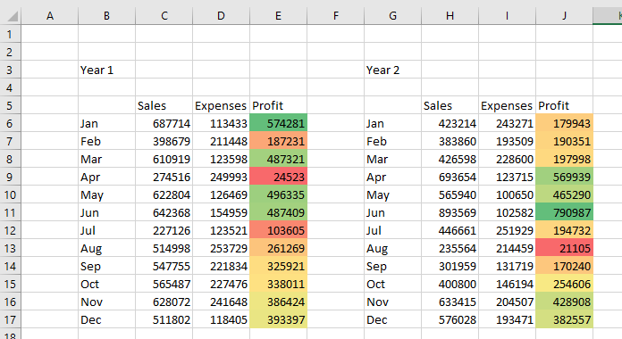
Analysis of data
Once data has been collected and checked for accuracy, it needs to be processed to obtain
useful information
In a spreadsheet, formulae such as
=AVERAGE(C2:C50) are
used in analysis
  How else can data stored
  in a spreadsheet or
  database be analysed?

Slide 17
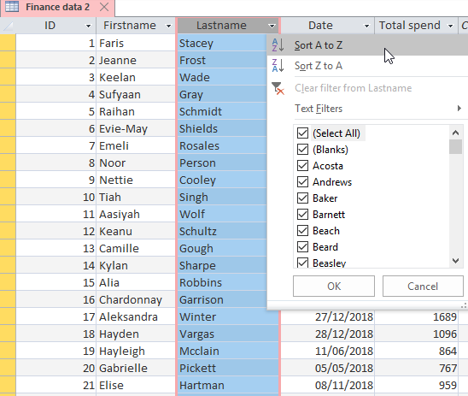
Sorting data
In both a database
and a spreadsheet
data can be sorted
  Data can be sorted
  ascending (A to Z) or
  descending (Z to A)
  In a spreadsheet,
  filters are used to
  sort data
  In a database, queries
  are used to sort data
  What else can queries be used for?

Slide 18

Queries
Queries can be used to select certain information from a database
  Only certain fields may wish to be selected
  Criteria can be added such as only asking
  for sales data for a certain year
SQL (Structured Query Language)
is used to make queries
  What are three example queries
  that may be used for analysis in
  a school database?

Slide 19
Example queries
The following queries show both the purpose and some example SQL queries that may be written
Purpose | Example SQL
Find absence for a student | SELECT absence FROM attendance WHERE studentID=1821
Find exam results for a class, order these by highest exam first | SELECT name, result FROM exams WHERE class=“13ITA” ORDER BY result DESC
Find all students in the school. Group them into tutor groups. Sort them into alphabetical order | SELECT name, tutorGroup FROM students GROUP BY tutorGroup ORDER BY name ASC

Slide 20
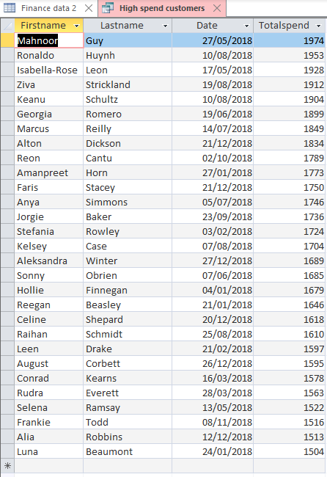
Database queries
A database is used to store
a furniture store’s sales
  They wish to find all customers
  who spent at least £1,500 with
  those who spent most at the top
  They use the query:
  SELECT * FROM [Finance data 2]
  WHERE Totalspend > 1500
  ORDER BY Totalspend
What is the criteria for
this query?

Slide 21
Worksheet 5
Now complete Task 4 on Worksheet 5

Slide 22

Numeric and data modelling
Numeric modelling allows businesses to predict costs and performance
An entrepreneur wants to set up a hair salon so they set up a financial model in a spreadsheet
  They first enter all the expenses
  They then estimate how many
  customers they will have and
  the costs they will charge
  The model allows them
  to find out whether the
  business is viable
  before they begin

Slide 23
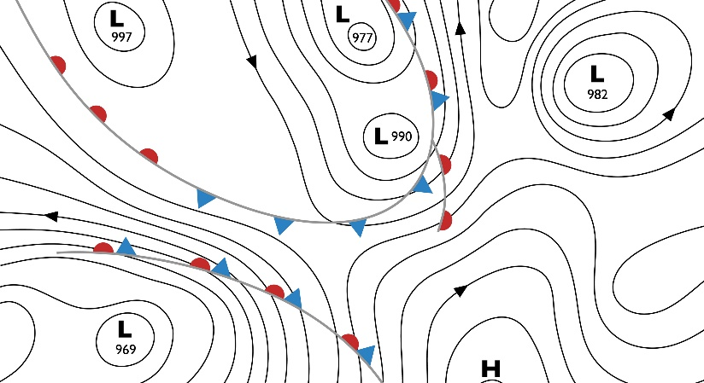
Case study: Weather forecasts
Weather forecasts are produced by data modelling
  Measurements such as temperature, air pressure and humidity are collected from a large number of weather stations around the world
  This data is put into a ‘supercomputer’ to be processed
  Meteorologists will further
  analyse the data to decide
  how to present it and whether
  any warnings need to be
  issued
  Why are weather forecasts
  sometimes wrong?

Slide 24
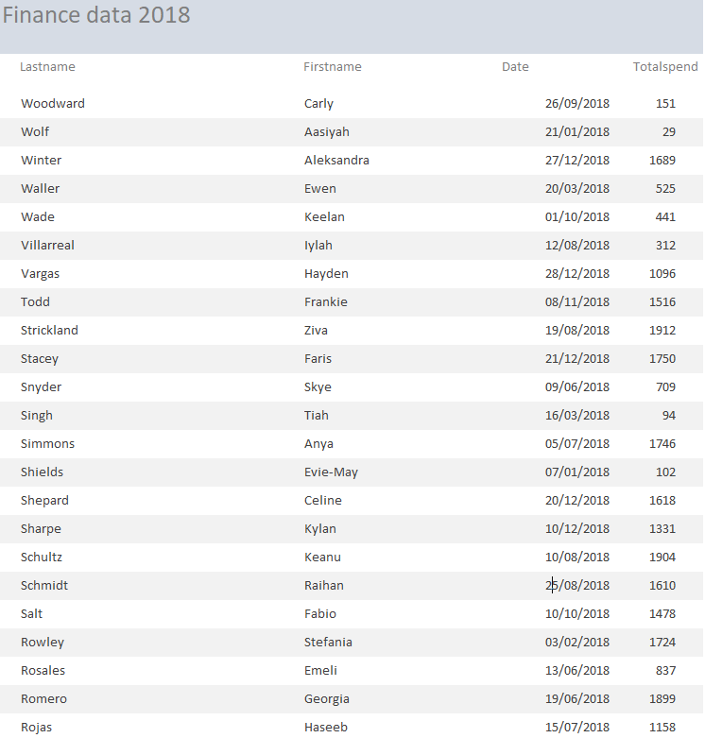
Reports
Once data has been
collected and analysed
it can be presented in a
number of ways
  One way is in a report
  Reports can combine data
  charts and text
  They can be printed or
  produced as a PDF
How else can data
be presented?

Slide 25
Charts
Charts are a more visual way to present
numeric data
  They can
  quickly reveal
  trends in data
What trends,
can be seen
from the chart?

Slide 26
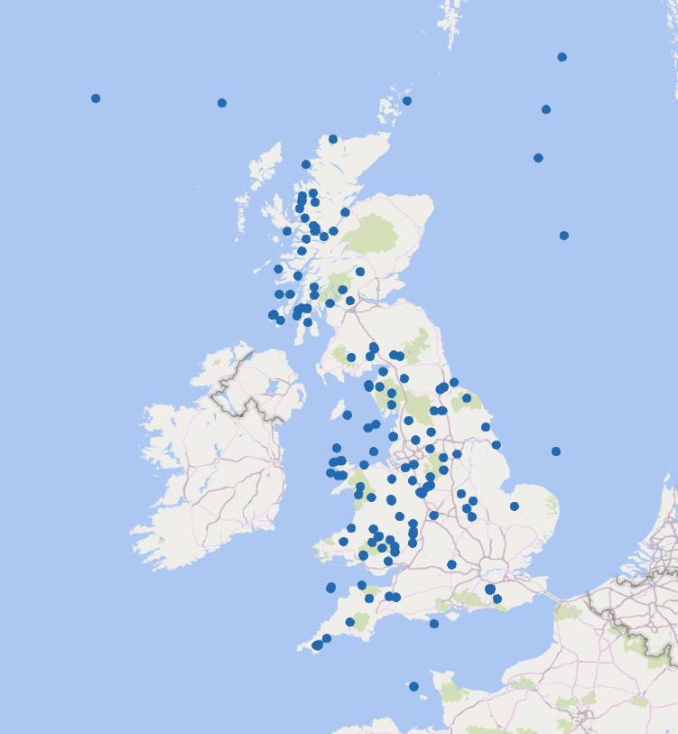
Maps
Maps are often used in the presentation of data
The map shows earthquakes
in the UK in 2018
  Each of these earthquakes registered
  between 3 to 5 on the Richter scale
How else can maps be used to
present data?

Slide 27
Worksheet 5
Now complete Task 5 on Worksheet 5

Slide 28
Plenary
Explain each of the following words:
Data presentation
Verification
Sorting data
Validation
Queries
Numeric and
data modelling

Slide 29
Plenary
Key word definitions:
  Verification – Checking data against an alternative source, the original source or double entry verification
  Validation – Checking data conforms to a set of rules and
  is reasonable
  Sorting data – Organising data numerically or alphabetically
  Queries – Selecting data by a specific criteria
  Numeric and data modelling – Allows, for example, financial decisions to be tested in different scenarios
  Data presentation – how data is shown, e.g. reports, charts, maps

