Slide 1
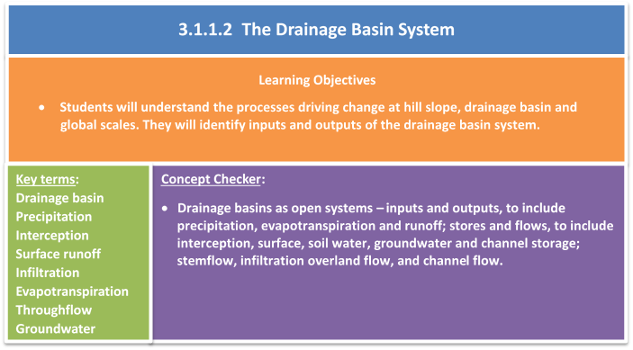

Slide 2
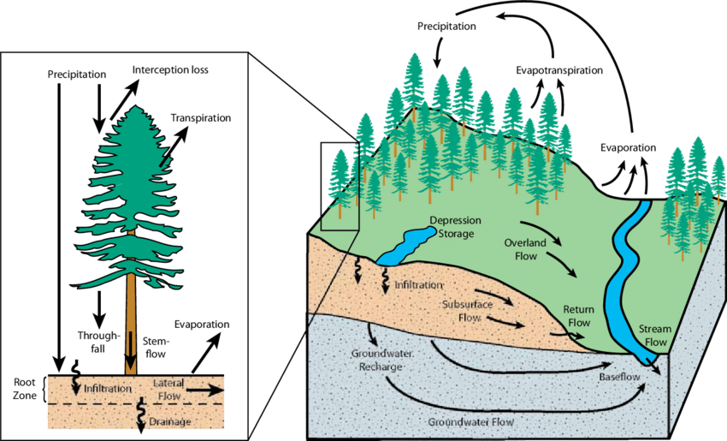
What processes influence water stores at the local scale?

Slide 3
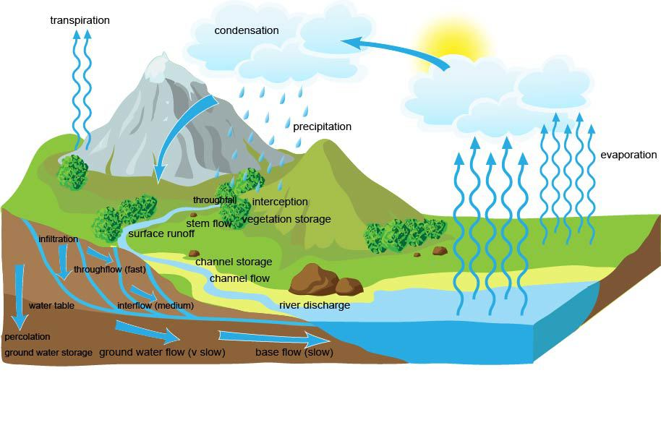
The hillslope water cycle
The amount of water held in each of the stores will depend on many factors operating over relatively short timescales. One of the most influential processes in the magnitude of stores is infiltration – the movement of water from the ground surface into the soil.
Water that is effectively trapped on the ground surface – either because the soil is saturated or frozen or because the rate of precipitation exceeds the capacity of the soil to absorb it – will either be stored as surface storage, evaporate or start to flow downslope as overland flow.

Slide 4
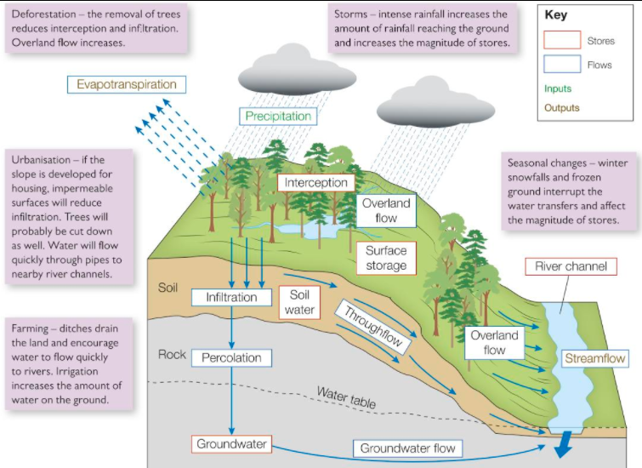
Add the key terms to your copy of the diagram:
OVERLAND FLOW
GROUNDWATER
INFILTRATION
THROUGHFLOW
INTERCEPTION
PRECIPITATION
GROUNDWATER FLOW
OVERLAND FLOW
PERCOLATION

Slide 6
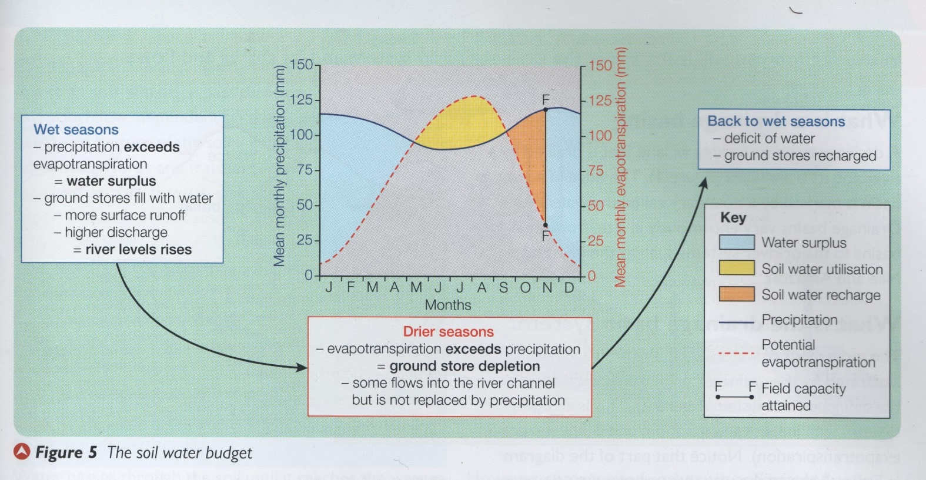
What is the soil water budget?
The soil water budget describes the changes in the soil water store during the course of a year.

Slide 7
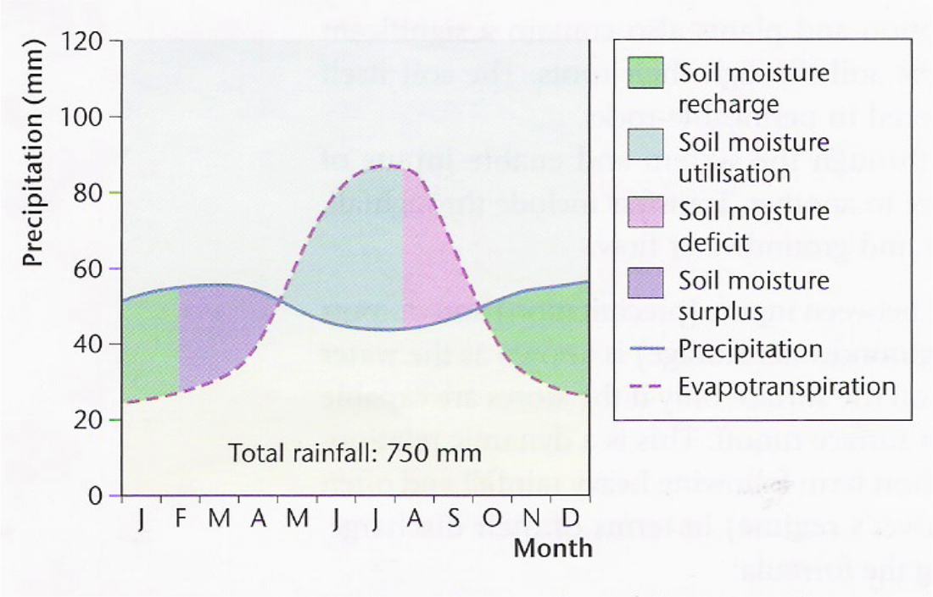
The soil water budget…
Shows the annual relationship between precipitation and evaporation
Dry seasons
Inputs < outputs
Wet seasons
Inputs > outputs
Who might be interested in this?

Slide 8
Soil moisture deficit: In extremely arid climates such as in the Mediterranean, so much water may be removed from the soil in summer that there can be a soil moisture deficit.
Soil moisture surplus: During the winter when precipitation is relatively high and evapotranspiration (as well as temperatures) are lower, there is a soil moisture surplus.

Slide 9
Explain how the water budget in a drainage basin changes throughout the seasons:
Try to include the following terms:
Precipitation, evapotranspiration, temperature, soil moisture, soil moisture recharge, field capacity
Winter in Britain
Summer in Britain
Autumn in Britain

Slide 10
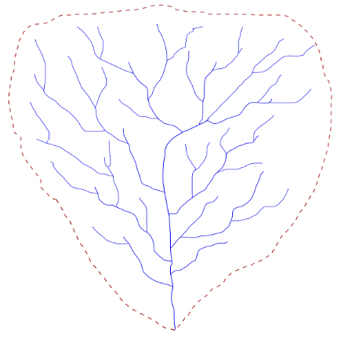
The drainage basin system
A drainage basin is the area of land that is drained by a river and its tributaries. Drainage basins are separated from each other by ridges of higher land called watersheds.
Drainage basins vary hugely in size, from small local basins to major river systems such as the Mississippi and Amazon.

Slide 11
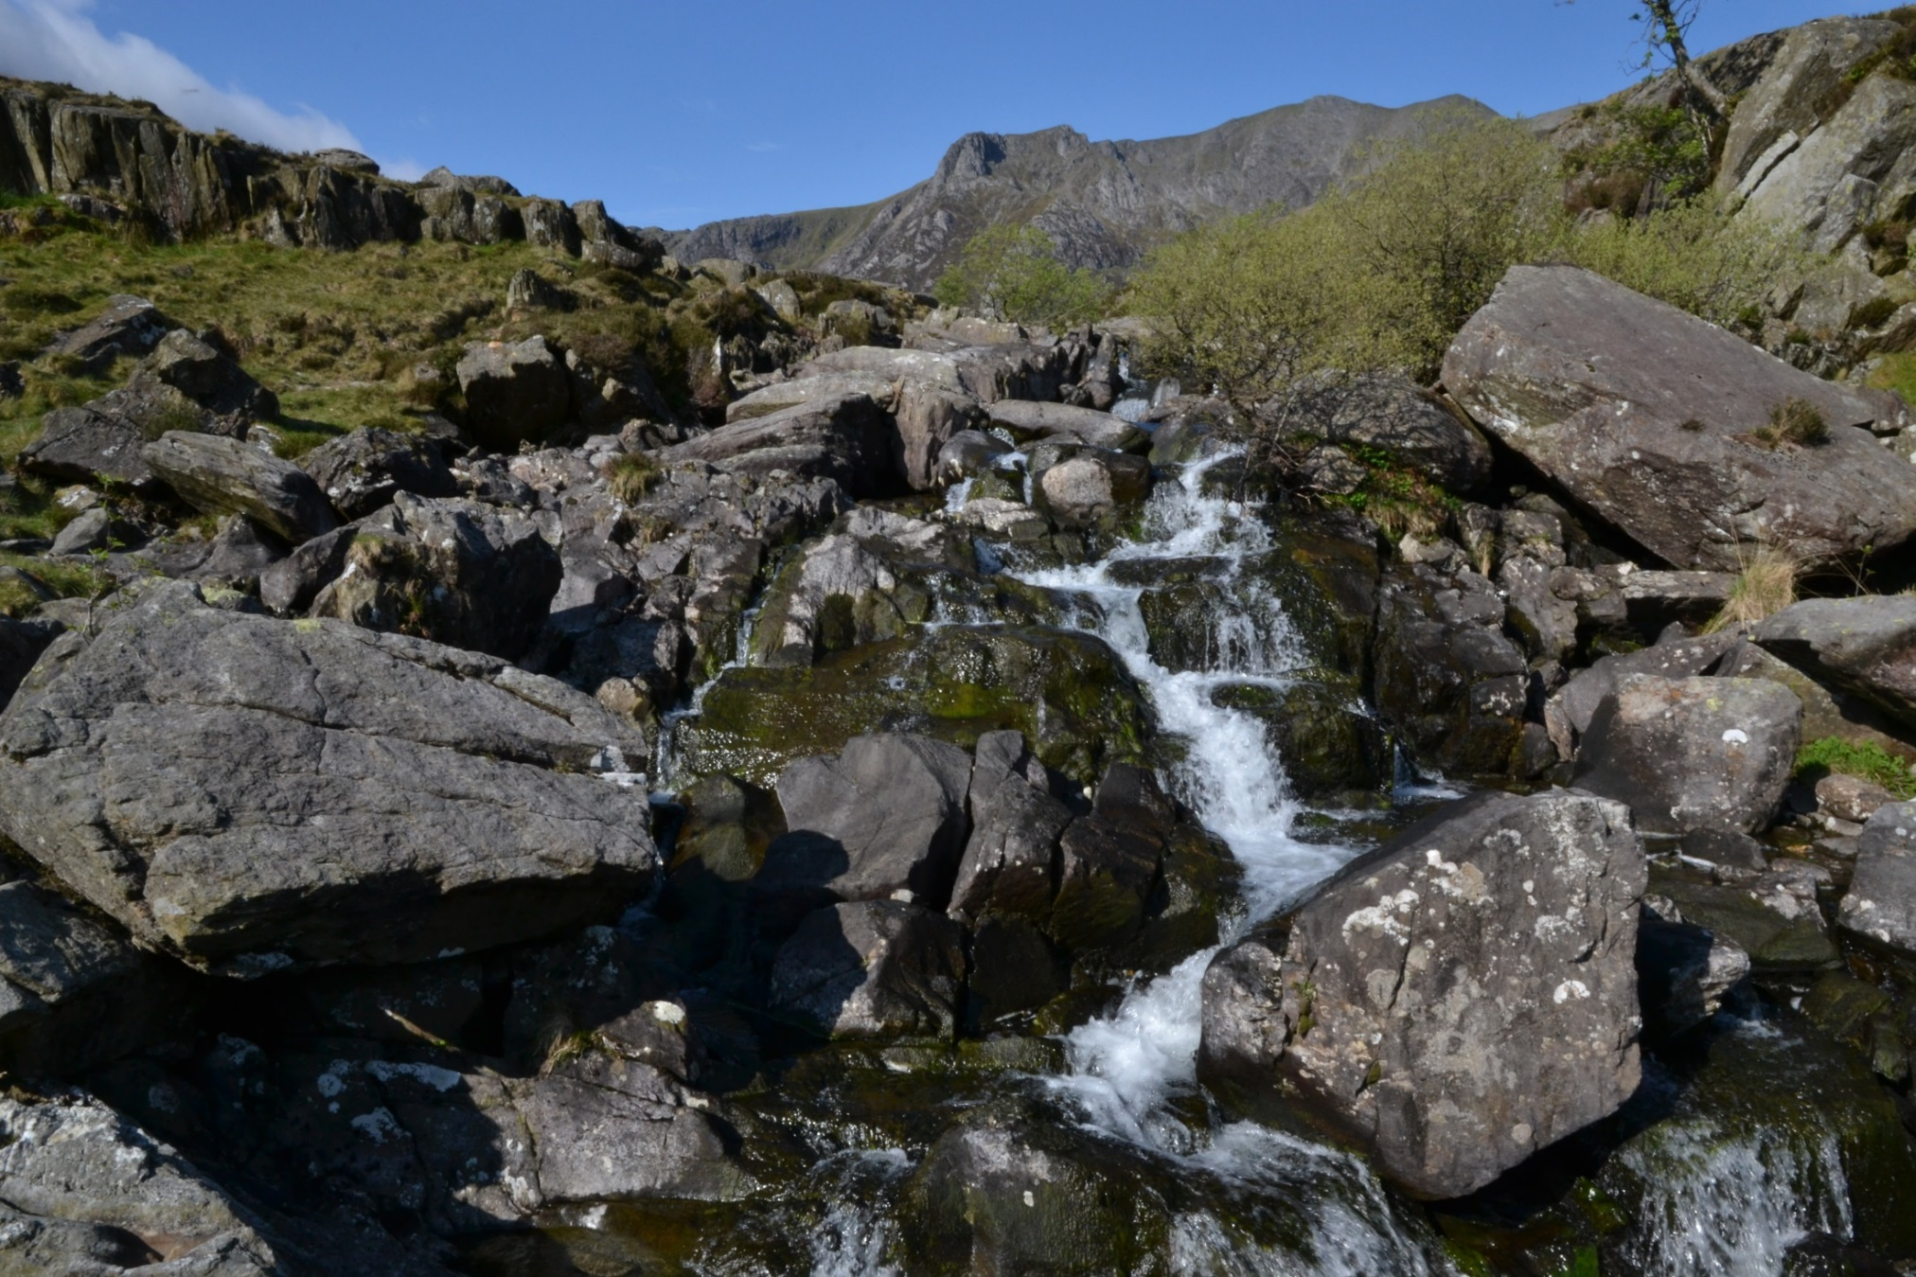
Drainage basin video: http://www.bbc.co.uk/education/clips/zn3qxnb

Slide 12
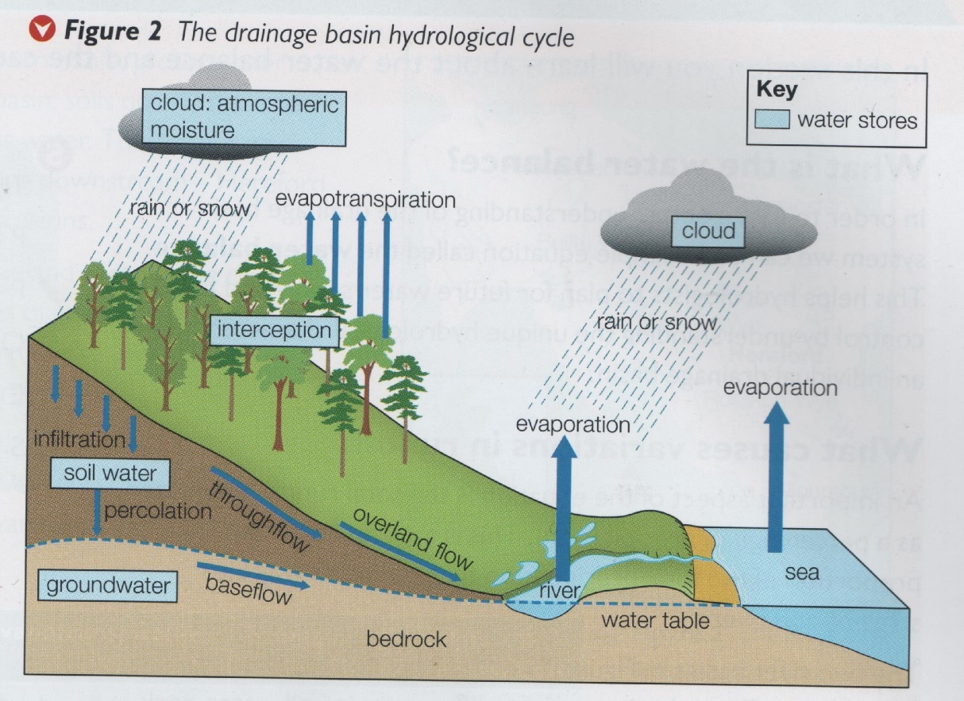
What is the drainage basin system?
The movement of water within the drainage basin is illustrated by the drainage basin system, an open system, with inputs and outputs.
Although its links with the water cycle make it an open system, when it comes to flood management and planning it is considered a closed system because what happens in a drainage basin is contained within that basin and won’t affect neighbouring basins.

Slide 13
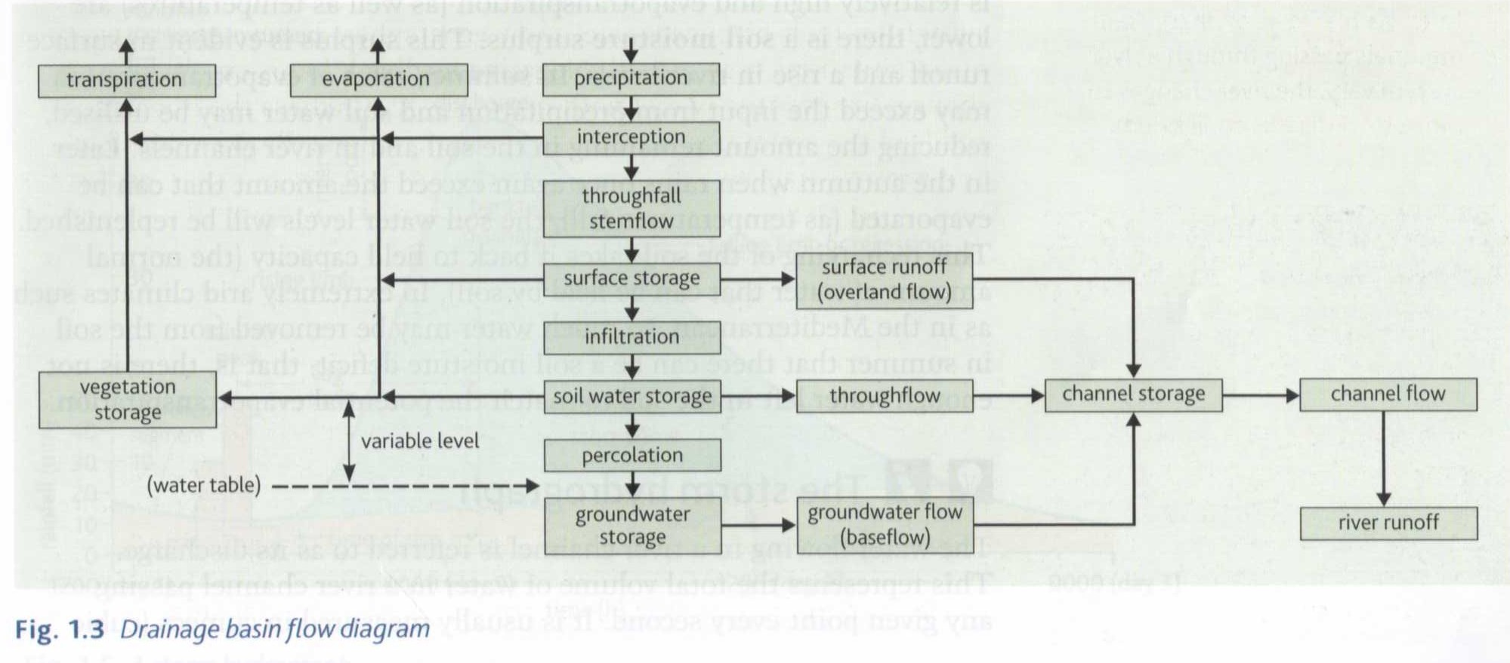
On the drainage basin flow diagram shade in the stages: inputs (blue), stores (green), flows (yellow) and outputs (red).
Describe at least two different paths that water could follow from an input to an output stage.
Explain how different paths might exist depending on whether the environmental conditions were:
a) Extremely hot and dry
b) Very cold

Slide 14
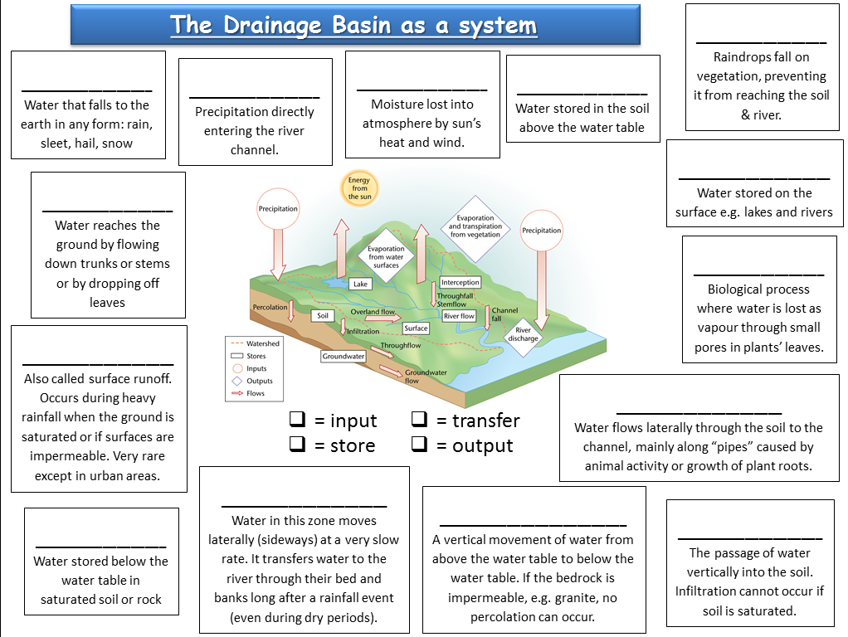
https://www.youtube.com/watch?v=al-do-HGuIk

Slide 15
Use p16 Oxford to help you answer the following questions:
1) Describe the different possible pathways of precipitation.
2) Explain the link between groundwater flow and rivers.
3) Why is infiltration and infiltration capacity such as important factor?
4) Why is overland flow more likely in urban areas?
5) Explain how water moves through soil and account for different transfer speeds.

Slide 16
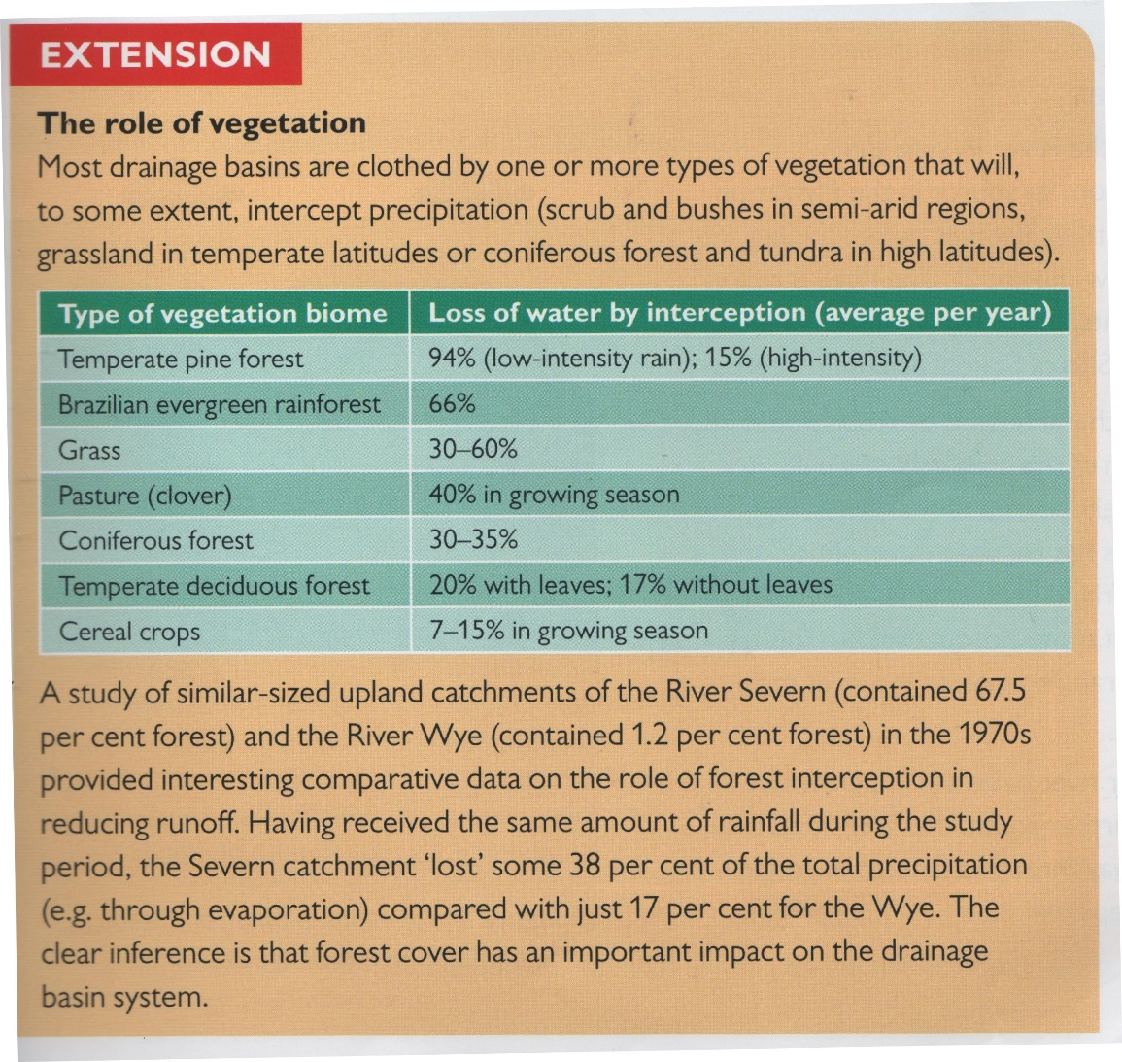
What is the role of vegetation?
Why is forest cover an influential factor?

Slide 17

Exam style question:
Describe the different ways that water can enter a river channel
[4 marks]

Slide 18
Exam style question…
Describe the different ways that water can enter a river channel
[4 marks]
Water can enter a river channel in several different ways.
Firstly, water can enter directly through precipitation, such as rain or snow.
Water can also flow overland, or as throughflow through the soil itself. Here water flows from the surrounding area into the river under the force of gravity.
Water can also enter the river via groundwater flow.
Additional streams and rivers joining the river channel as tributaries can also add water to the river channel.

