Slide 2
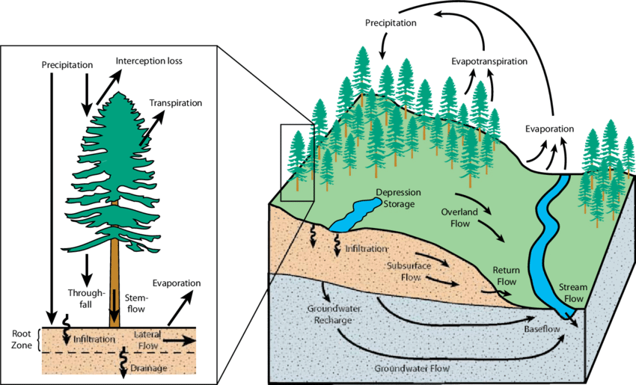
What processes influence water stores at the local scale?

Slide 3
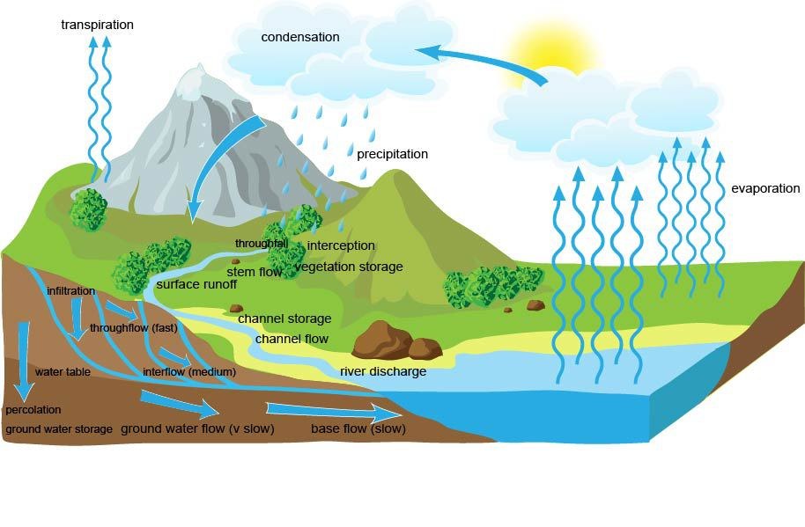
The hillslope water cycle
The amount of water held in each of the stores will depend on many factors operating over relatively short timescales. One of the most influential processes in the magnitude of stores is infiltration – the movement of water from the ground surface into the soil.
Water that is effectively trapped on the ground surface – either because the soil is saturated or frozen or because the rate of precipitation exceeds the capacity of the soil to absorb it – will either be stored as surface storage, evaporate or start to flow downslope as overland flow.

Slide 4
Add the key terms to your copy of the diagram:
OVERLAND FLOW
GROUNDWATER
INFILTRATION
THROUGHFLOW
INTERCEPTION
PRECIPITATION
GROUNDWATER FLOW
OVERLAND FLOW
PERCOLATION

Slide 6
Infiltration
The rate of infiltration is controlled by gravity, capillary action and soil porosity.
Soil porosity is the most important factor. This is controlled by:-
Texture
Structure
Organic content
Coarse textured soils have larger pores and fissures than fine-grained soils and therefore allow for more water flow. The rate of infiltration normally declines rapidly during the early part of a rainstorm event.

Slide 7
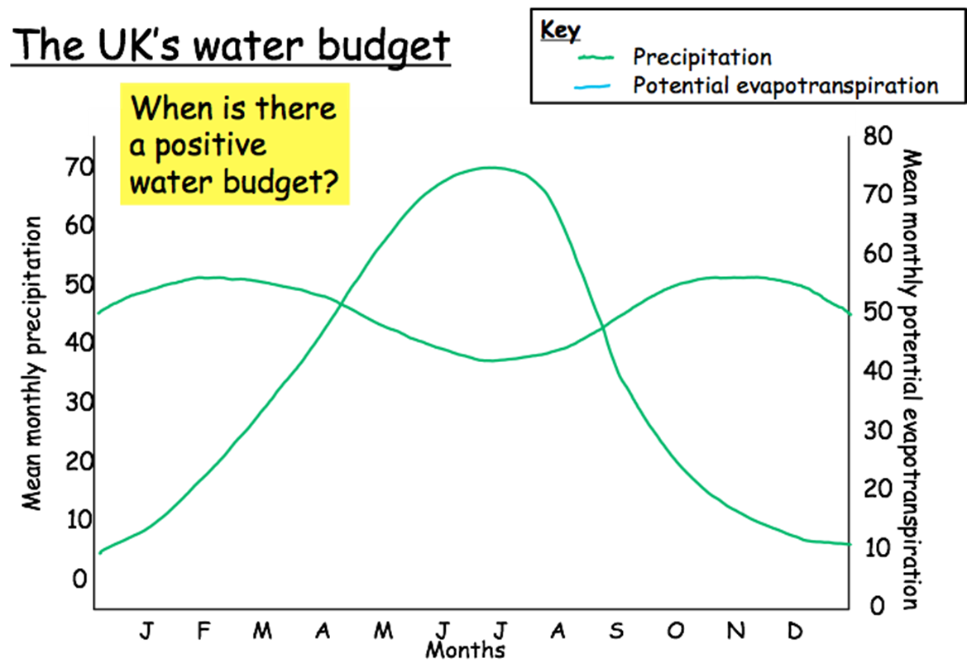
The water balance
The balance between inputs and outputs is known as the water balance or budget. The water balance can be shown using the formula:
precipitation (P) = streamflow (Q) + evapotranspiration (E) +/- changes in storage (S)
The water budget can either have a
positive water balance (where there is a surplus of water)
negative water balance (where there is a deficit of water)
The most important parts are the relationship between precipitation and potential evaporation.
Potential evapotranspiration is the amount of water that could be evaporated or transpired (or both) from an area if there was sufficient water available.

Slide 8
Explain what is meant by evapotranspiration and why it is important to the water balance.
Describe and explain how you would expect the water balance of a drainage basin in the UK to change throughout the course of one year.

Slide 9
Soil Water Budget Graph
Soil moisture deficit
Label on where there is: a water surplus, a water deficit, water recharge and water utilisation and explain what these terms mean.
During which months is there:
a positive water balance?
a negative water balance?
Soil moisture recharge
Soil moisture utilisation
Soil moisture surplus

Slide 10
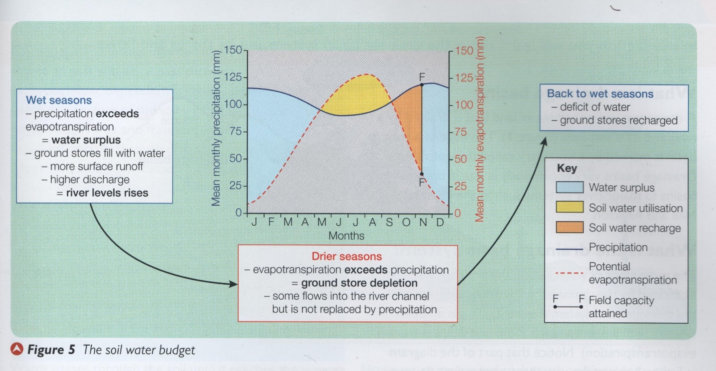
What is the soil water budget?
The soil water budget describes the changes in the soil water store during the course of a year.
Why is there not a water deficit in summer?
Why is there a water surplus between November and April?
Why was significant precipitation needed in October and November to recharge soil water

Slide 11
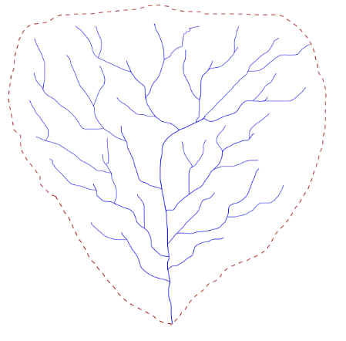
The drainage basin system
A drainage basin is the area of land that is drained by a river and its tributaries. Drainage basins are separated from each other by ridges of higher land called watersheds.
Drainage basins vary hugely in size, from small local basins to major river systems such as the Mississippi and Amazon.

Slide 12
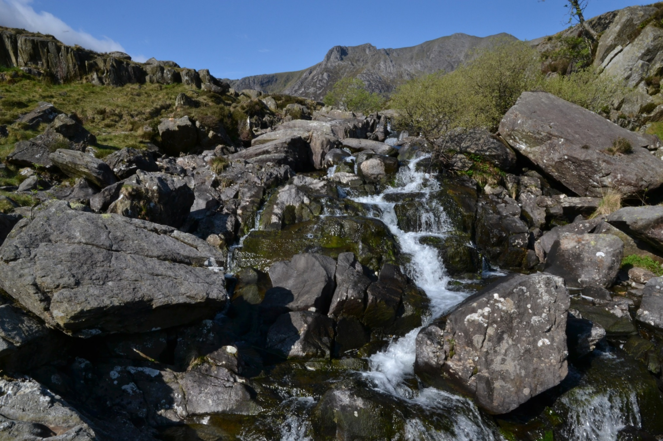
Drainage basin video: http://www.bbc.co.uk/education/clips/zn3qxnb

Slide 13
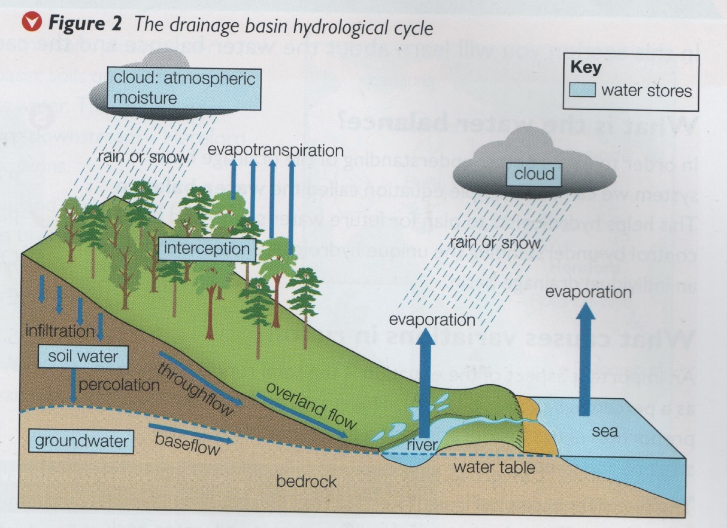
What is the drainage basin system?
The movement of water within the drainage basin is illustrated by the drainage basin system, an open system, with inputs and outputs.
Although its links with the water cycle make it an open system, when it comes to flood management and planning it is considered a closed system because what happens in a drainage basin is contained within that basin and won’t affect neighbouring basins.

Slide 14
On the drainage basin flow diagram shade in the stages: inputs (blue), stores (green), flows (yellow) and outputs (red).
Describe at least two different paths that water could follow from an input to an output stage.
Explain how different paths might exist depending on whether the environmental conditions were:
a) Extremely hot and dry
b) Very cold

Slide 15
https://www.youtube.com/watch?v=al-do-HGuIk

Slide 16
Use p16 Oxford to help you answer the following questions:
1) Describe the different possible pathways of precipitation.
2) Explain the link between groundwater flow and rivers.
3) Why is infiltration and infiltration capacity such as important factor?
4) Why is overland flow more likely in urban areas?
5) Explain how water moves through soil and account for different transfer speeds.

Slide 17
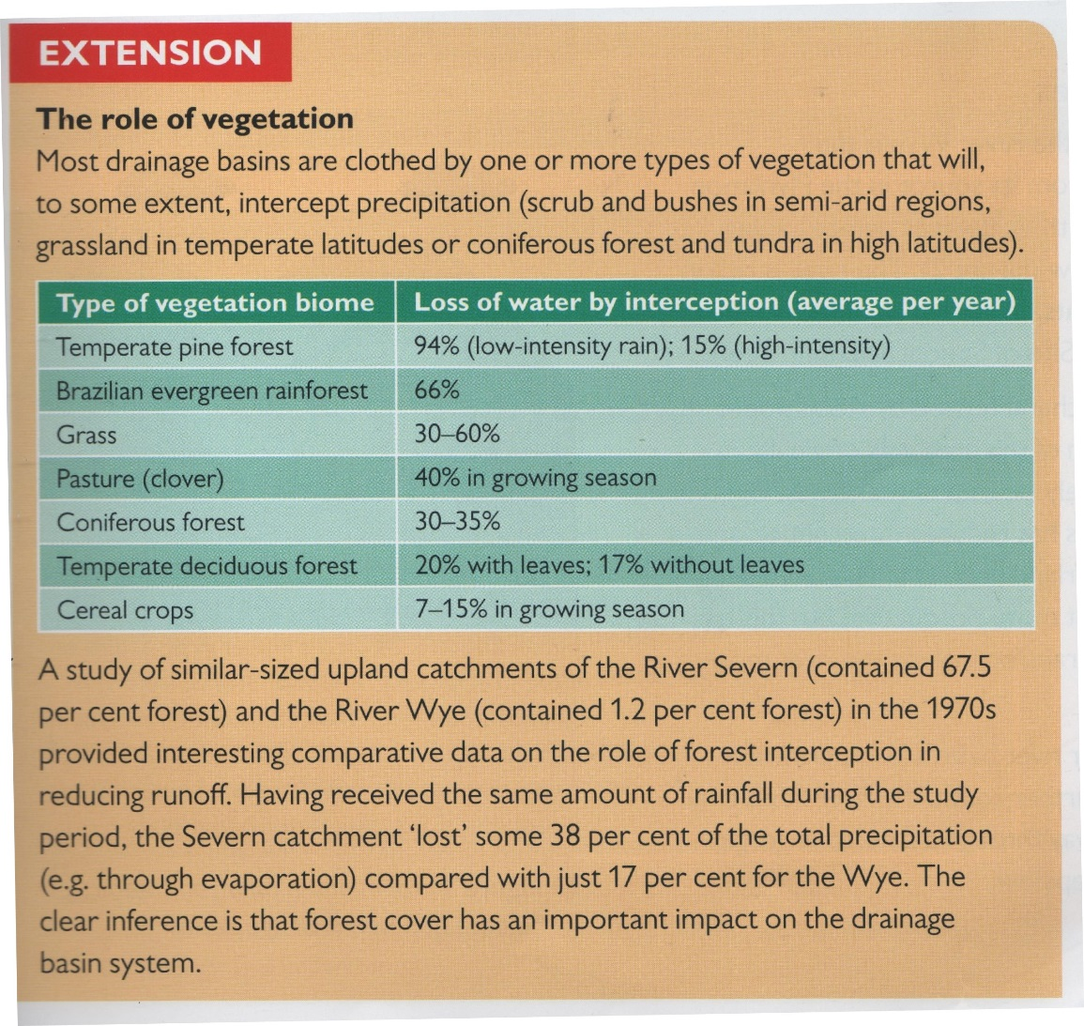
What is the role of vegetation?
Why is forest cover an influential factor?

Slide 18
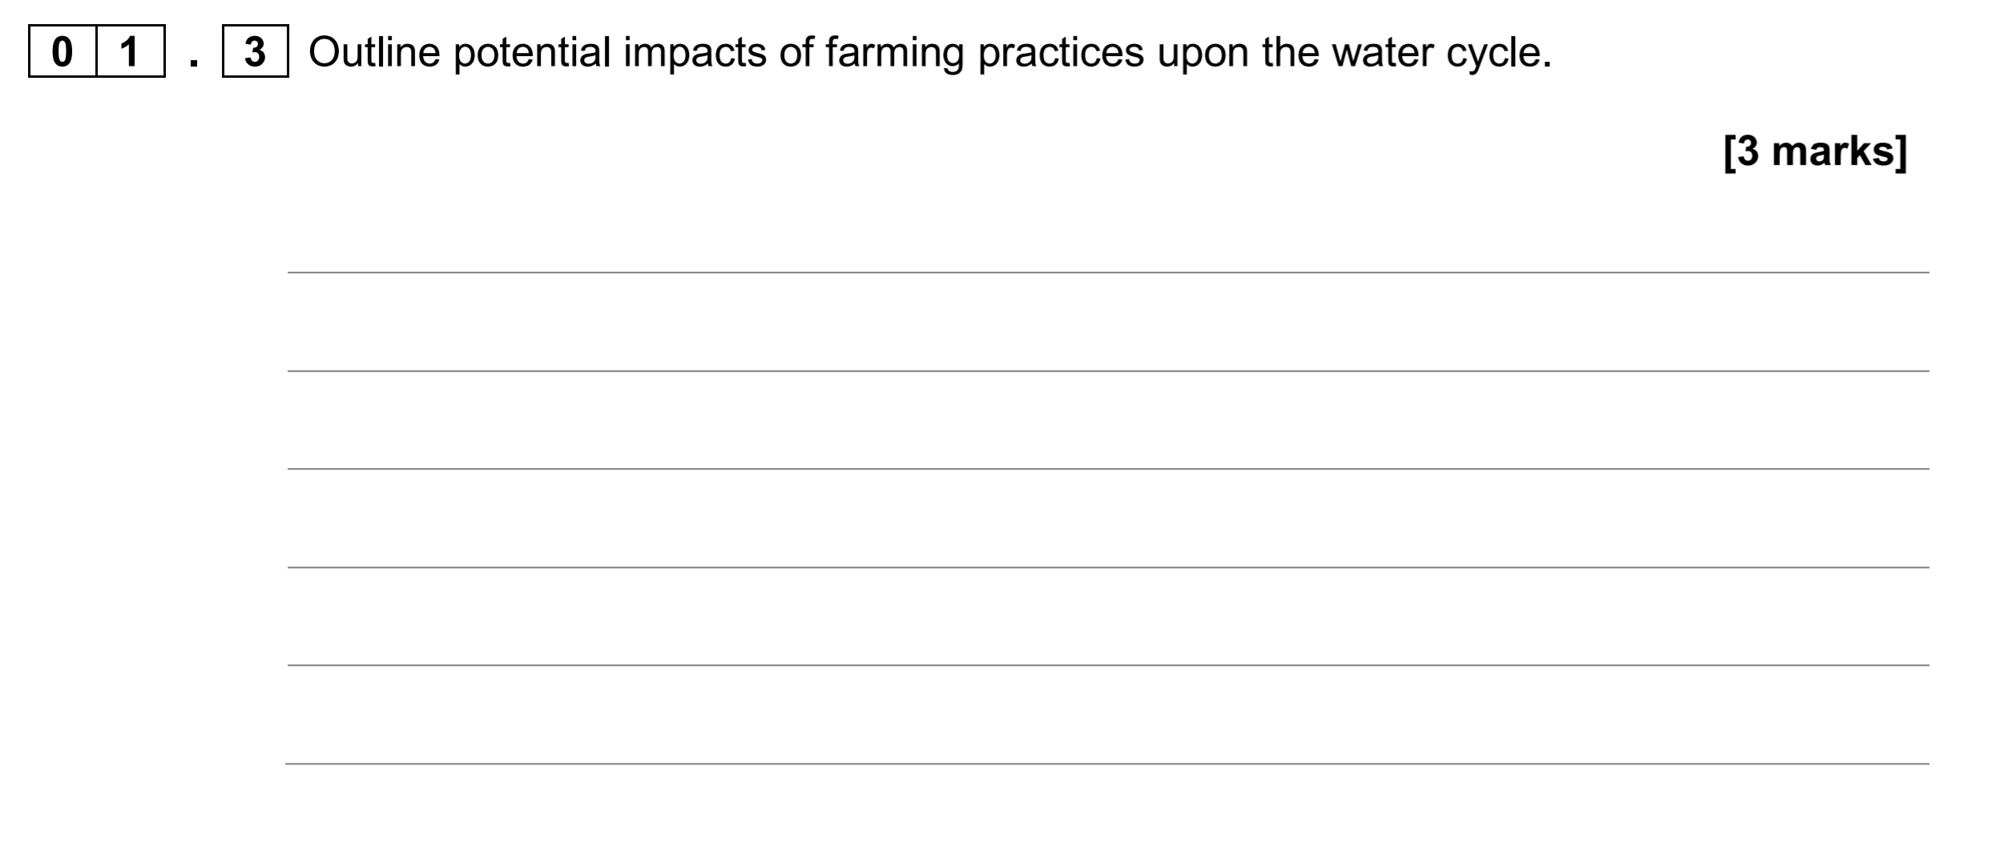

Slide 20
Exam style question:
Describe the different ways that water can enter a river channel
[4 marks]

Slide 21
Exam style question…
Describe the different ways that water can enter a river channel
[4 marks]
Water can enter a river channel in several different ways.
Firstly, water can enter directly through precipitation, such as rain or snow.
Water can also flow overland, or as throughflow through the soil itself. Here water flows from the surrounding area into the river under the force of gravity.
Water can also enter the river via groundwater flow.
Additional streams and rivers joining the river channel as tributaries can also add water to the river channel.

