Slide 2
Objectives
Describe the moral and ethical factors relating to the use of information technology:
Online behaviour and netiquette
Privacy
Freedom of speech and censorship
Acceptable use

Slide 3
Netiquette – What is it?
“Etiquette” is a framework of rules and customs governing how people behave, and what constitutes good manners
“Netiquette” applies to Internet etiquette
What are the rules of etiquette when you are eating at home?

Slide 4
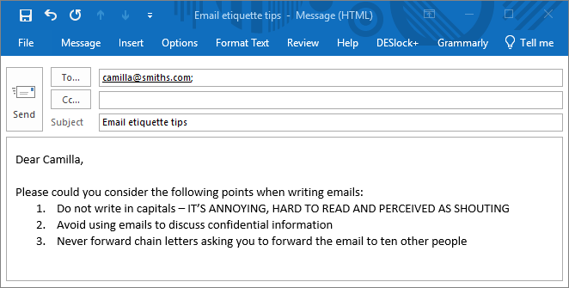
Email etiquette
Always include a subject line and use the recipient’s name in the greeting line
Suggest three other rules of email etiquette

Slide 5
Workplace netiquette
Don’t use email to:
discuss confidential information
give bad news
send information that could hurt, shock or embarrass the recipient
Don’t use texting abbreviations in workplace emails – it’s not professional
Read your email through before you press Send…
Make sure its contents are clear, appropriate, necessary and correctly spelt

Slide 6
Emails are forever
Consider carefully what you write in an email at work – try to be positive
Emails will remain on the company server and could be used as evidence against you in the future

Slide 7
Online behaviour
YouTube (owned by Google) is regarded as a social media platform
More than 1.8 billion YouTube users log in every month
Almost 5 billion videos are watched on YouTube every day

Slide 8
Online behaviour
Among the billions of hours of content watched on social media sites every day, there is a substantial number of videos portraying:
violence
content harmful to children
hate speech
traumatising content
Why do people post such content?
Is it ethical?

Slide 9
Hate speech or merely offensive speech?
The Racial and Religious Hatred Act 2006 restricts speech which threatens people because of their religion or religious beliefs
However, speech which discusses, criticises, ridicules or insults a religion or beliefs is allowed

Slide 10
Violent and abusive content
Google has faced widespread criticism for allowing videos of violent and offensive content that is harmful to young children to flourish on YouTube
Should an ethical company allow this to happen?
What are the consequences for the company and for society?
What can they do about this situation?

Slide 11
Vloggers
Vloggers, or “video bloggers”, record themselves talking about their lives, businesses, travels or interests
A vlogger who has thousands of followers and millions of views gets paid according to how many people click Like or watch the advertising video before the blog
The more sensational the vlogs posted, the more revenue for the vlogger
Unfortunately, certain types of inappropriate content have a wide following

Slide 12
A YouTube celebrity
Logan Paul created a furious backlash with a shocking and offensive video that he posted in December 2017
It had 6m views before its removal 24 hours later
Some YouTubers post videos for money, regardless of morality or ethics
Should YouTube censor inappropriate content like this or allow it as free speech?

Slide 13
Worksheet 1
Complete Task 1 and Task 2 on the worksheet

Slide 14
Privacy on the internet
Details about every part of your life is on some computer database, somewhere
Name two organisations that hold data about you

Slide 15
Your digital footprint
A digital footprint is the information that is stored about us as we visit websites, send email and use social networks
We all have an “active” footprint and a “passive” footprint

Slide 16
“Active” digital footprint
Your “active” digital footprint is publicly traceable information that you choose to share on the web:
Facebook updates
Message board posts
Tweets
Be careful what you post – it may come back and bite you when you apply to a university, or for a job

Slide 17
Your “passive” footprint
Your “passive” footprint is the information that companies harvest behind the scenes through “cookies”
It is used to build your customer profile and target advertisements
This data is not publicly searchable

Slide 18
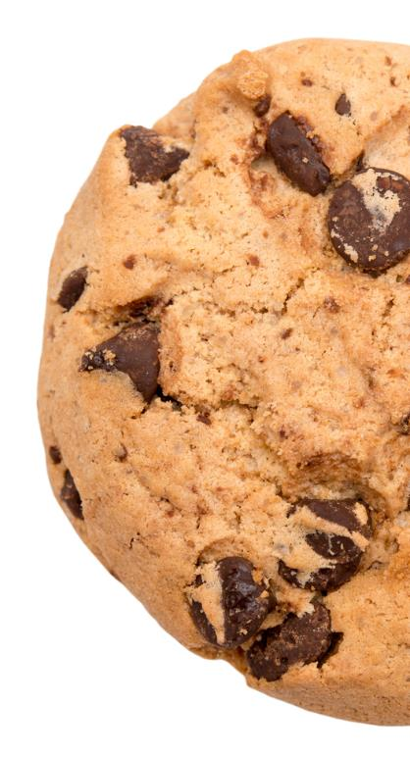
Internet cookies
Most modern websites use “cookies” to store data on your PC
The data typically contains the site’s domain name and a unique user ID
The next time you visit the site, your browser sends your user ID to the site which confirms that you are a repeat visitor
Cookies are used to:
keep you logged in
remember items you stored in a shopping cart
track your usage on the website

Slide 19
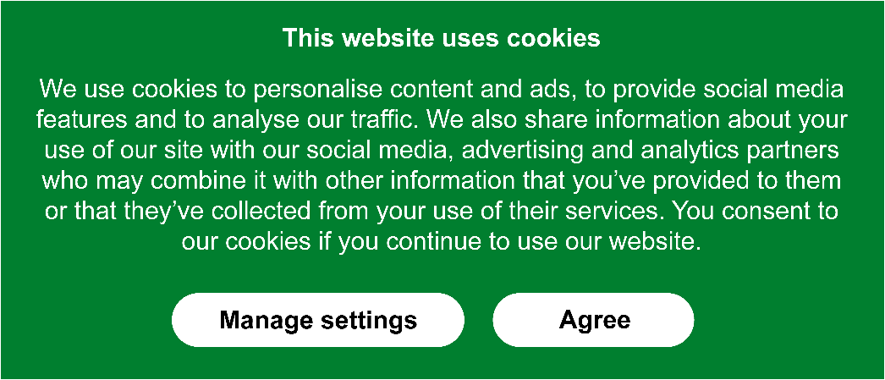
Internet cookies
By law, all sites that use cookies have to seek your express permission to store and retrieve information about your browsing habits:

Slide 20
Personalised advertisements
When you log on to a search engine or a social media site you often see advertisements for products or services
Most people find random advertisements annoying or irrelevant
Research shows that consumers find well-targeted advertising more engaging, informative, time-saving and memorable
Are your browsing habits part of your passive or active digital footprint?

Slide 21
Targeted advertising
Top data-collecting search engines can make use of demographic data such as age, gender and personal interest so that targeted advertisements can be sent to the user
These often include products you have recently searched for
A look at the search engine’s Privacy Policy reveals what information they collect

Slide 22
Google’s Privacy Policy
Look up Google’s Privacy Policy to find out what information they collect about you, including information about:
your apps, browsers and devices
your activity
your location

Slide 23
Store loyalty cards
A supermarket makes use of a loyalty card system and tells customers the benefits are:
Free rewards such as ‘days out’
Discounts
The loyalty card also allows the supermarket to track customer spending
How is information gathered?
How is it used?

Slide 24
Information used for security
Governments and security organisations are highly sophisticated information gatherers
They may collect huge amounts of information about:
emails, telephone calls, messages and internet activity
How can the information they gather be used (or misused)?

Slide 25
Worksheet 1
Complete Task 3 on the worksheet

Slide 26
Finding potential customers
Suppose a local gym decides to start classes for the over 60s…

Slide 27
Finding potential customers
They cannot ask a social media site such as Facebook for a list of emails of people over 60, living within 15 miles of a particular city, who might want to join a class – this would be illegal
However, they can write an advert and pay Facebook to target only people satisfying their criteria, and who have “Liked” fitness or weight-watching tips

Slide 28
Freedom of speech
The right to freedom of speech is recognised as a fundamental human right
The Human Rights Act guarantees under the law the rights to freedom of speech and expression
However, this right must be used responsibly and there are exceptions
For example, making comments that are specifically designed to incite racial hatred can be deemed to be a hate crime, and is illegal

Slide 29
Censorship
Internet censorship in the UK is carried out under a variety of laws, regulations and voluntary arrangements
These include:
Regulations regarding indecent images of children
English defamation law
Regulations against incitement to terrorism
Copyright law

Slide 30
Internet censorship
Internet customers are prohibited from visiting certain sites, because Internet access is blocked by their Internet Service Provider (ISP)
Do you think that ISPs should be allowed to block certain sites?
If so, what sort of sites do you think should be blocked?

Slide 31
Internet censorship
The range of content sometimes blocked by ISPs includes:
Drugs
Alcohol and tobacco
Gambling
Suicide and self-harm
Cyberbullying
Criminal skills
Hacking
Hate

Slide 32
Acceptable use
Organisations often have their own Acceptable Use Policies, which cover the use and security of their IT systems
Suggest five areas that a school policy may cover

Slide 33
Acceptable use
A typical school Acceptable Use Policy may include statements on:
Cyberbullying
Use of the internet
Security
Password policies
Netiquette and privacy
Use of personal devices
How the school will monitor students

Slide 34
Worksheet 1
Complete Task 4 and Task 5 on Worksheet 1

Slide 35
Plenary
There are moral and ethical factors relating to online behaviour and netiquette
Freedom of speech is a fundamental human right but must be used responsibly
Speech which incites violence must be censored by law
A range of other content may be censored
The freedom to discuss or criticise religion or religious beliefs is still permitted

Slide 36
Plenary
Acceptable Use policies are created by individual organisations
These are mostly based on:
sensible, decent behaviour
thoughtfulness for the feelings of others
protection of data and computing equipment

