Slide 2
Objectives
Describe the moral and ethical factors relating to the use of information technology
Globalisation
Unequal access to information technology
Environmental factors
Describe the implications of moral and ethical factors of using IT:
on individuals
on organisations

Slide 3
Globalisation
The world is becoming increasingly interconnected, thanks largely to advances in transportation and information technology
Give three examples of globalisation in today’s world

Slide 4
The role of technology
Globalisation involves the increasing integration and interdependence of national economies
Improved technology makes it easier to communicate and share information
Companies based in the UK often employ call-centre staff abroad, where labour is cheaper
Parts of a business such as web development are often outsourced
Who are the winners from globalisation?

Slide 5
Winners from globalisation
High-tech software firms
Apple products are typically designed in California but assembled in China
Corporations
Often take advantage of lower tax rates in some countries
Globalisation causes increased competition between different firms and countries
This causes firms to become increasingly efficient and offer better prices to consumers

Slide 6
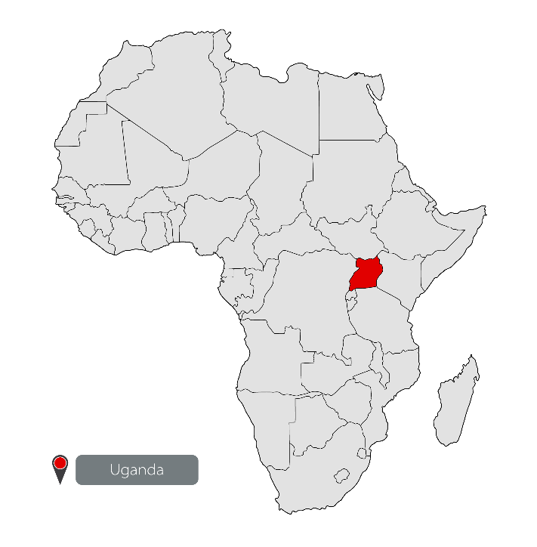
Problems of globalisation
Developing countries may struggle to compete
Many countries in Africa, for example, do not have universal access to information technology
They are unable to take advantage of globalisation because their infrastructure is inadequate
In Uganda, for example, only 22% of the country had access to electricity in 2017

Slide 7
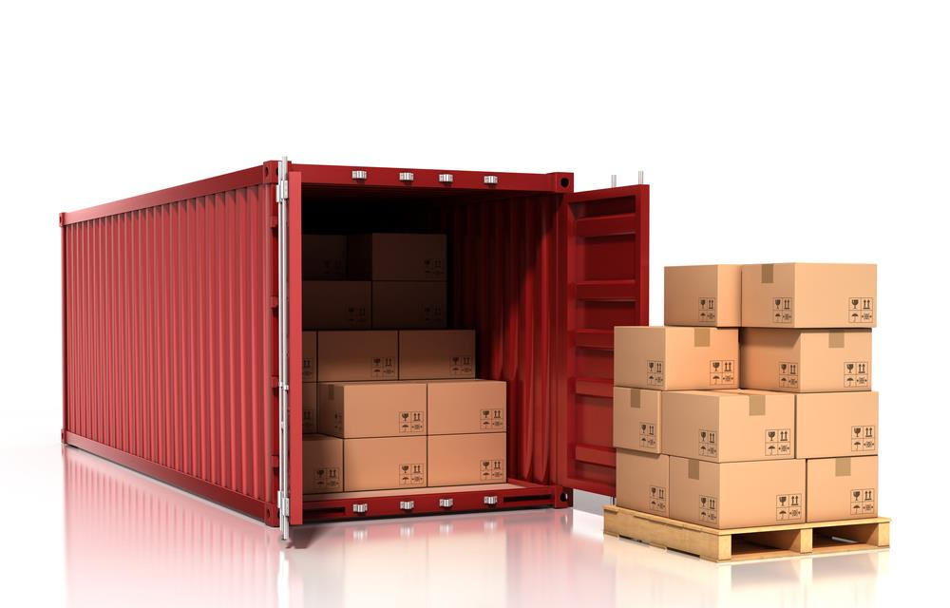
Sending computers to developing countries
Charities in the UK try to help by sending donated computer equipment and other tools to developing countries

Slide 8
Unequal access to IT
Although many schools in countries in Africa have computers donated by UK charities, there are significant problems:
Inadequate electricity supply means frequent power cuts
Intermittent internet access and no broadband connections makes any internet use in class impractical
Old computers which are donated use more power and do not have the latest software installed
There are few qualified teachers of Computer Science and IT
Books and teaching resources are unavailable or too expensive for schools to purchase

Slide 9
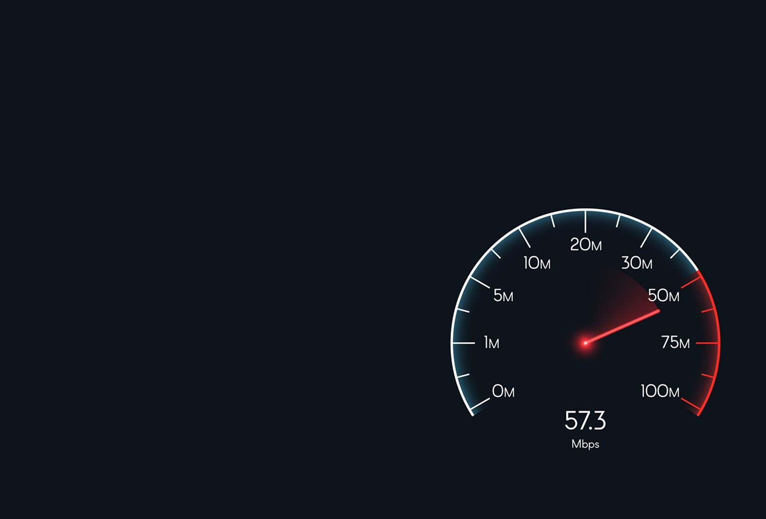
Digital divide in the UK
By June 2018, 95% of homes and offices could get broadband speeds of 24Mbps or faster
However, around 1.1 million homes and offices (4% of properties) could not get a fast broadband connection of even 10Mbps
Around 17% of rural premises, and 2% in urban areas, cannot get the broadband speeds necessary to meet their typical needs

Slide 10
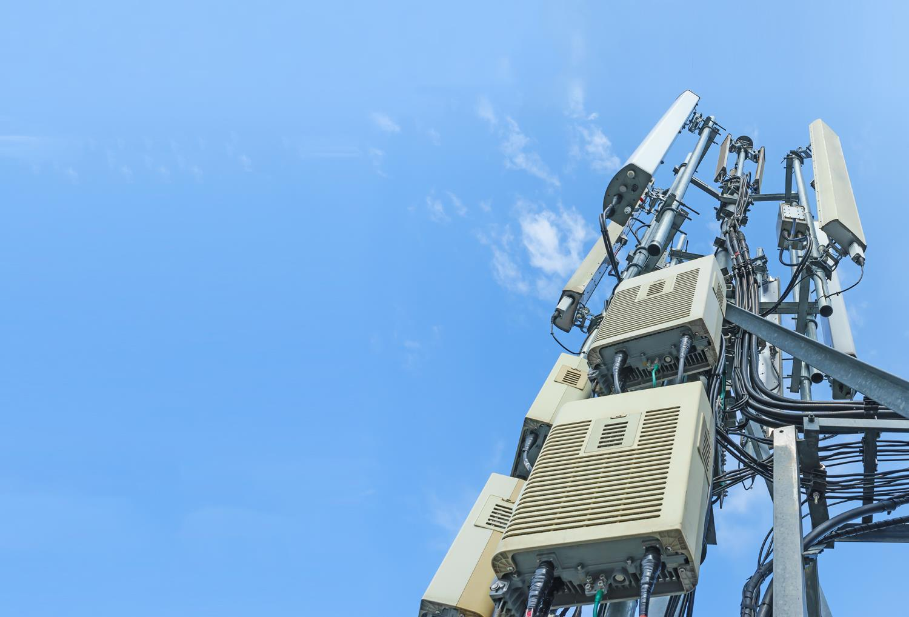
Mobile coverage
In December 2017, it was reported that for calls and text messaging, 30% of the UK’s geography does not receive a signal from all four operators
This is down from 37% the previous year
Nationally, in 2017 we were using 13 times more mobile data than five years before

Slide 11
Worksheet 2
Do Task 1 and Task 2 on Worksheet 2

Slide 12
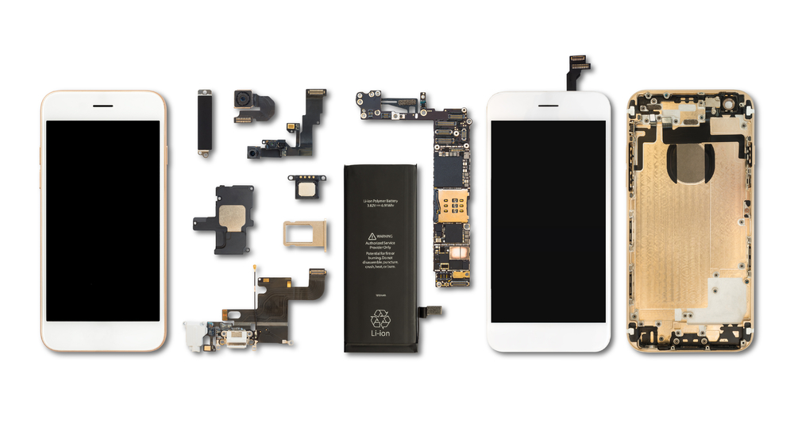
Environmental issues
Billions of IT devices are used every day around the world
What resources are used in the manufacture of these devices?

Slide 13
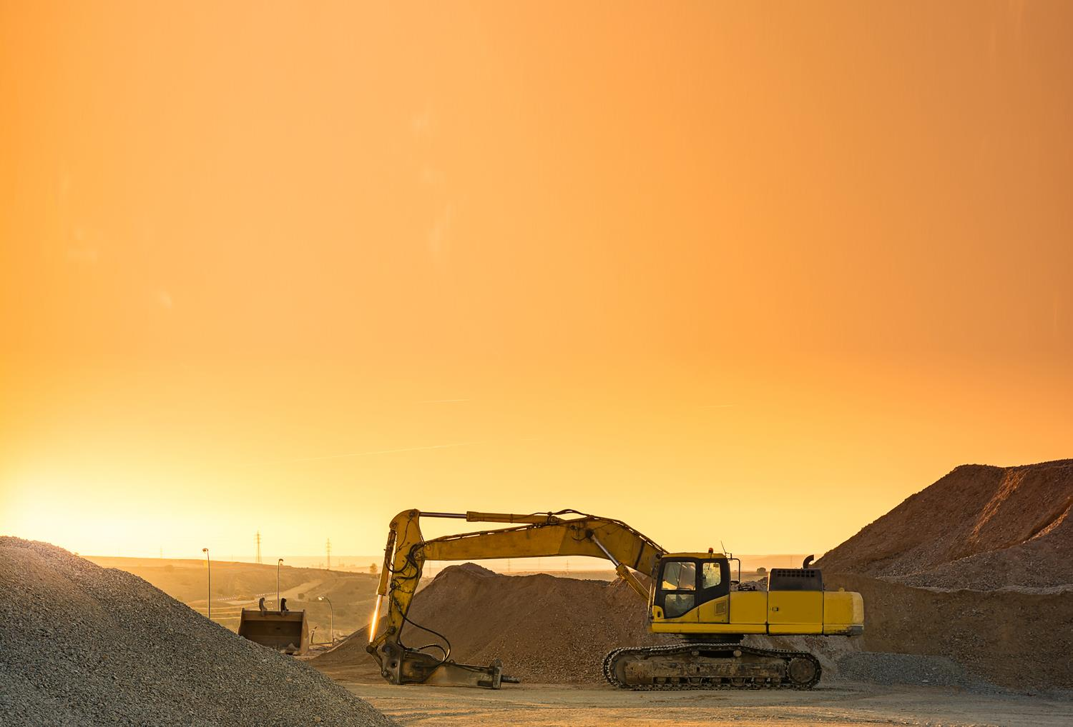
Manufacture of IT devices
Raw materials, including rare earth minerals such as copper, gold, lithium and platinum need to be sourced
Some mines, where these are extracted, can expose workers to toxic substances and dangerous working conditions
Mining poisons soil and groundwater supplies
Rainforests in places such as Guyana, Brazil and the Amazon are destroyed

Slide 14
Resources used
As well as all the raw materials used in manufacture, there is also a need for:
Materials for packaging
Electricity and gas to power the factories
Diesel and petrol for transportation of raw materials and parts
All these lead to the emission of greenhouse gases
Huge amounts of water are also used in the manufacture of computers

Slide 15
Lithium mining
Now complete the research for Task 3 on Worksheet 2

Slide 16
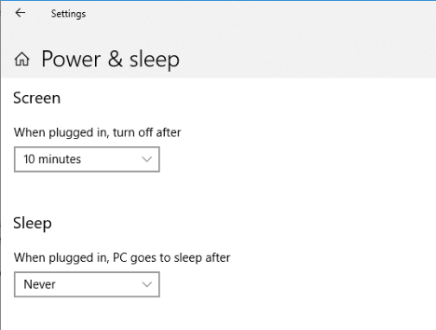
Saving energy
IT devices require power to run:
PCs and monitors account for more energy consumption than servers and communication technology
Although many systems include a “sleep” mode or an option to turn the screen off after a set time, many users do not activate these options and leave devices on unnecessarily

Slide 17
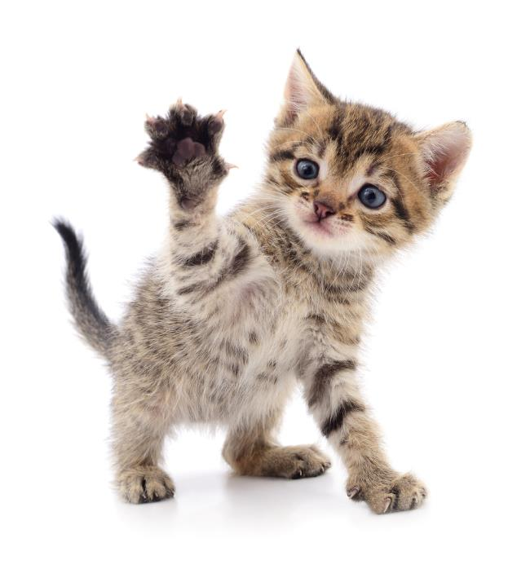
Data storage
Enormous data centres consume huge amounts of electricity, with bills of £3m per annum or more
Emails, social media posts, holiday snaps, pet pictures and old, forgotten files are all saved in the cloud by billions of people worldwide …
Start deleting!

Slide 18
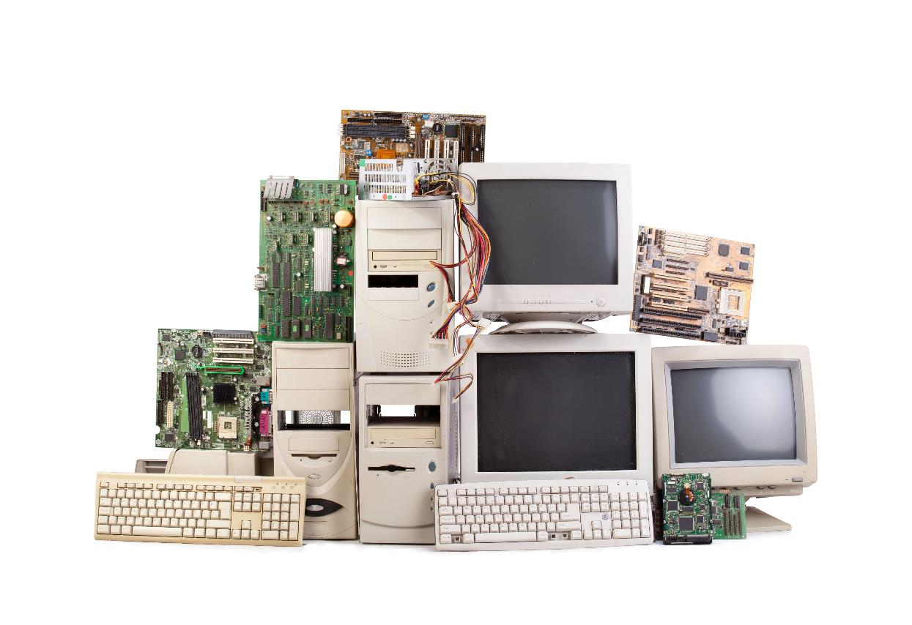
Disposal of devices
How much can be recycled?

Slide 19
The WEEE directive
The Waste Electrical and Electronic Equipment (WEEE) directive makes it the retailer’s responsibility to dispose of your old equipment when you buy a new model

Slide 20
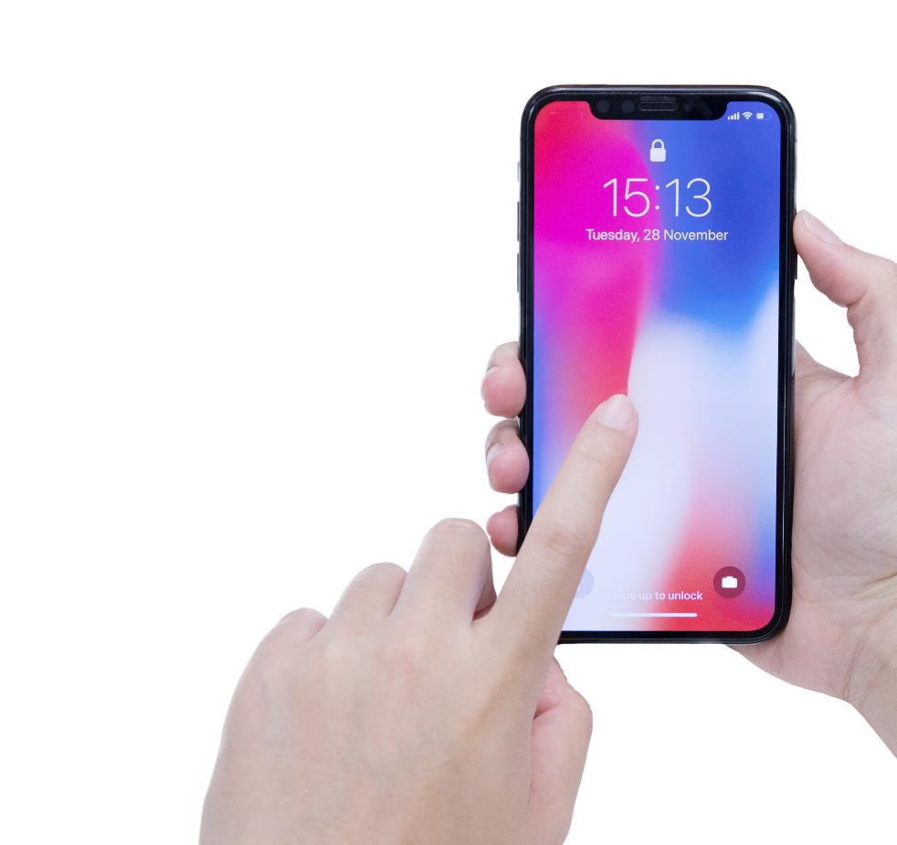
What can be done?
In 2017 Apple announced plans to stop relying on mined rare earth minerals to make their products, and to use only recycled sources
They have not yet figured out how to do this
Apple is not planning to find ways to extend the lifespan of its products … iPhones work for about three years

Slide 21
Reducing e-waste
Improved product design can ease the dismantling, recycling and reuse of electronic equipment
Producers and retailers can be made to meet the cost of collection and processing of electrical and electronic waste
Refurbished IT equipment can be sent to communities in Africa, Asia and South America
But ultimately, will this equipment be recycled or put in landfill sites?

Slide 22
Positive environmental impact
Devices such as smart thermostats and motion-activated lighting have the potential to reduce energy usage both at home and in businesses

Slide 23
Less paper
Invoices, newsletters and other communications are commonly sent by email rather than by post

Slide 24
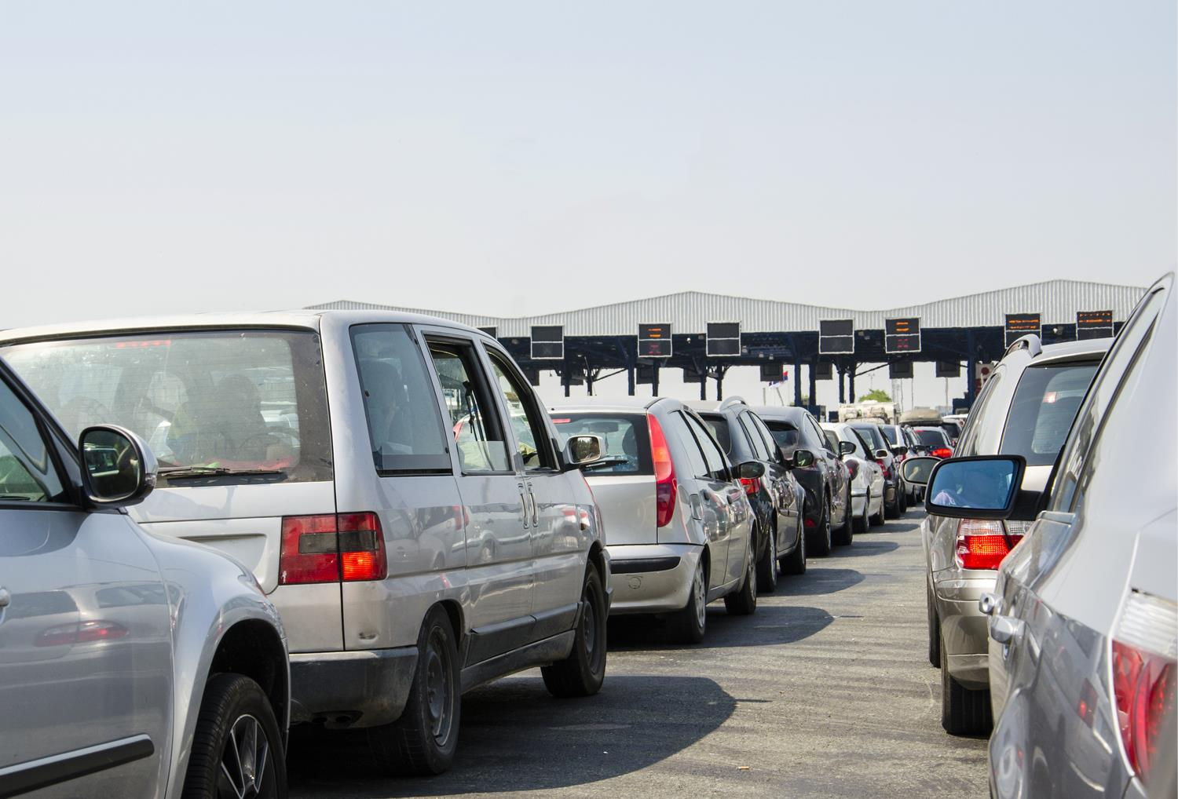
Less commuting
Some people are able to work from home and communicate electronically with their Head Office

Slide 25
Worksheet 2
Now complete Task 4 and Task 5 on Worksheet 2

Slide 26
The implications of using IT
There are implications for individuals, organisations and wider society, of using IT
Some countries, and some individuals in the UK, are getting left further and further behind because of unequal access to IT

Slide 27
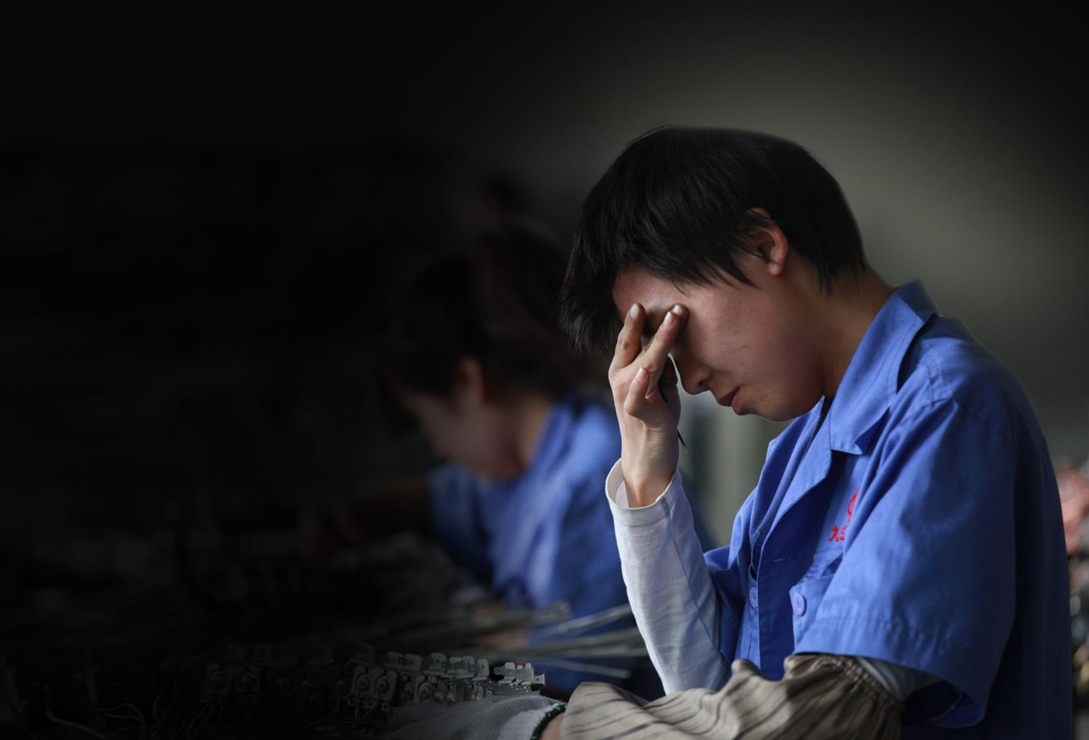
Moral and ethical issues
Globalisation means that many large companies use workforces in developing countries with lower workers rights and standard of health and safety
Are they ensuring that workers’ rights are enforced?

Slide 28
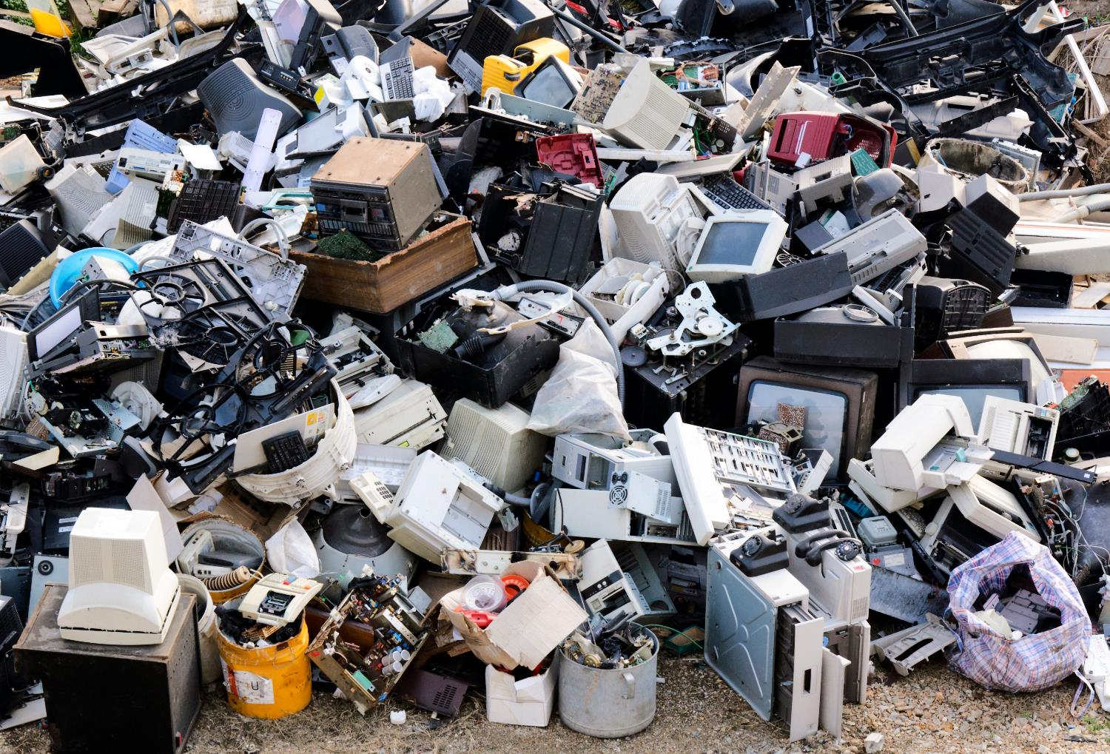
Environmental pollution

Slide 29
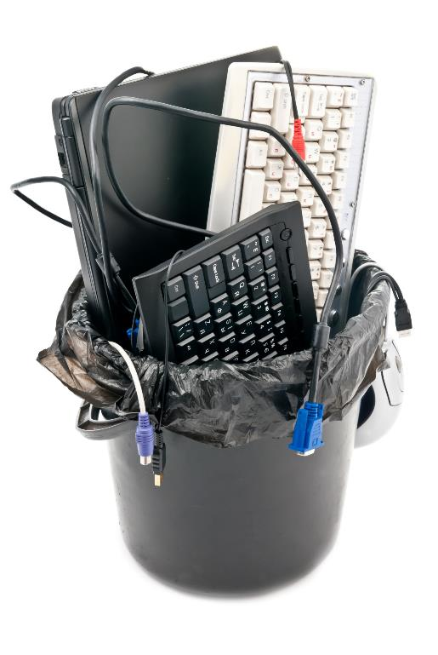
Our moral responsibilities
We must all take responsibility for the environment through conscientious use, recycling of equipment and minimising the use of electricity
What could you do to help the environment?

Slide 30
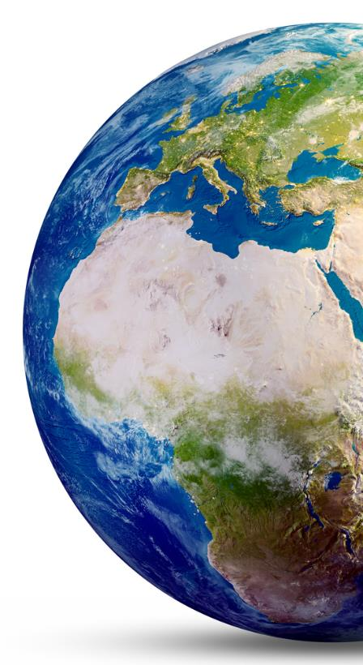
Plenary
We need to be aware that there are moral and ethical factors relating to the use of information technology, such as:
Globalisation
Unequal access to information technology
The environment
The earth’s resources are limited

