Slide 2
Objectives
Describe guidelines and current legislation designed to ensure the accessibility of IT systems

Slide 3
Stephen Hawking
Stephen Hawking (1942-2018) was the most famous physicist and cosmologist of our time
He had a rare form of motor neurone disease, which gradually paralysed him
How was Stephen able to communicate his ideas with the world?
What other ways did technology help him to overcome his disability?

Slide 4
Stephen Hawking
Stephen Hawking used a speech synthesiser to speak words he had entered into a computer
Although the speech later sounded robotic, he felt it was ‘his’ voice and so refused a more natural sounding one
When he had some movement he used a hand-held switch to control his computer
Later when he had almost no movement, he used a single cheek muscle

Slide 5
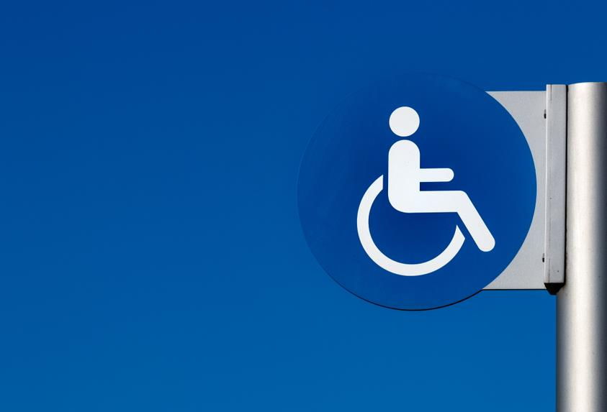
What is accessibility?
Accessibility means making it possible for devices or computers to be used by all people, regardless of any disabilities. This can be achieved by:
Specialist hardware
Specialist software
What are two types of disability that would make a computer difficult to use without specialist hardware or software?

Slide 6
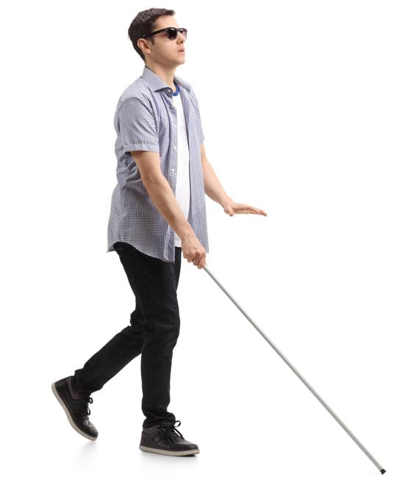
Barriers to use of IT
Complete or partial blindness
Colour blindness
Hearing-related disabilities
Motor or dexterity impairment such as paralysis, cerebral palsy, or repetitive strain injury (RSI)
Cognitive impairments such as head injury, autism, or learning disabilities such as dyslexia or ADHD

Slide 7
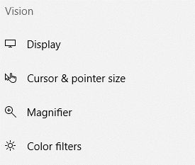
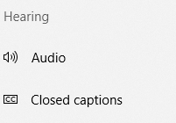
Ease of access settings
Operating systems such as Windows have built-in accessibility options which can be turned on
Type “Ease of access” in the search bar to see available options

Slide 8
Sticky keys
Sticky keys are an accessibility feature to assist users who have disabilities or RSI
Instead of pressing multiple keys at the same time for a shortcut (e.g. Ctrl + S), sticky keys can be activated to press keys one at a time
The user can press and release a modifier key such as Shift, Ctrl, Alt, and have it remain active until another key is pressed
This functionality is available in Windows, macOS and Unix

Slide 9
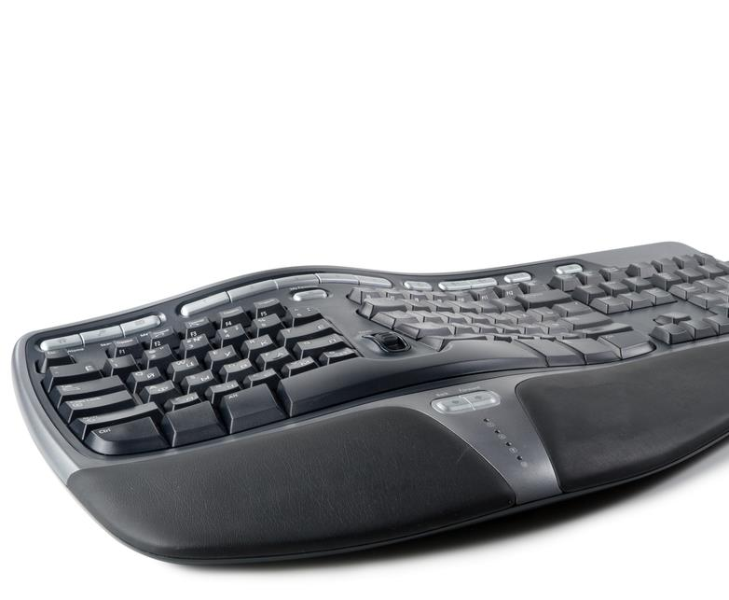
Specialist hardware
Specialist hardware could include:
A high contrast keyboard to help someone who is partially sighted or has dyslexia
A braille keyboard to help blind or partially sighted people
An ergonomic keyboard and wrist support to help people who have RSI or arthritis
What are two other devices that could help people with disabilities?

Slide 10
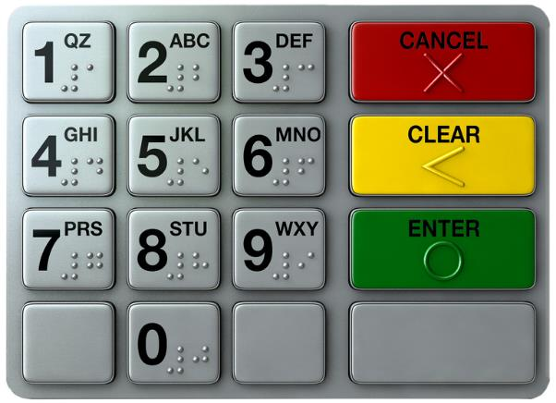
Specialist hardware
What are two other devices that could help people with disabilities?
High contrast keyboard for people with dyslexia
Foot mouse for those who cannot use a hand mouse
Braille keyboard / number pad for blind people
Microphone for dictation voice commands
Speaker / headphones for speech synthesis
Notes:
https://www.dyslexic.com/product/geemarc-multimedia-keyboard/

Slide 11
The value of accessibility
Creating IT systems that meet disabled users’ needs will result in:
them being able to access employment
increased job satisfaction
improved morale
increased productivity
An organisation can build a reputation for being accessible to all, including people with special needs

Slide 12
Worksheet 5
Now complete Task 1, Task 2 and Task 3 on the worksheet

Slide 13
Equality Act (2010)
The Equality Act replaces the Disability Discrimination Acts (DDA) (1995, 2005)
People now have equal treatment regardless of the following protected characteristics:
Age
Disability
Gender
Race
Religion or belief
Sexual orientation

Slide 14
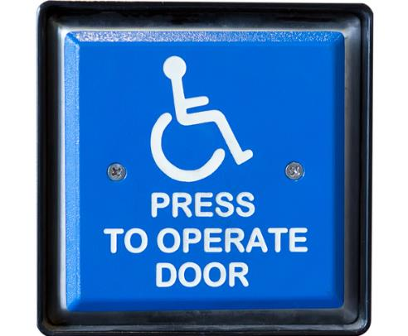
Equality Act (2010)
Employers must make reasonable adjustments for those with disabilities. This includes:
The provision of accessible IT equipment and devices
The provision of information in alternative formats such as braille, audio or large print
Allowing employees who become disabled to make a phased return to work
Allowing flexible working hours or part-time working

Slide 15
Worksheet 5
Complete Task 4 on the worksheet

Slide 16
The World Wide Web Consortium
Known as W3C and led by Sir Tim Berners-Lee, inventor of the World Wide Web
This is the international standards organisation for the web
Standards include HTML for web pages and CSS for style sheets
Web Content Accessibility Guidelines 2.1 (WCAG) were published in June 2018 with recommendations for making web content more accessible

Slide 17
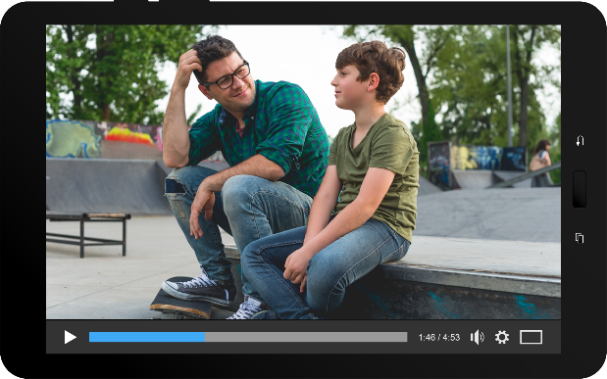
Website Content Accessibility Guidelines (WCAG 2.1)
Guidelines are given on how to make content more accessible to people with disabilities including:
Blindness and low vision
Deafness and hearing loss
Limited movement
Speech disabilities
Photosensitivity
So then, where do you want to go for dinner tonight? [dog barks]

Slide 18
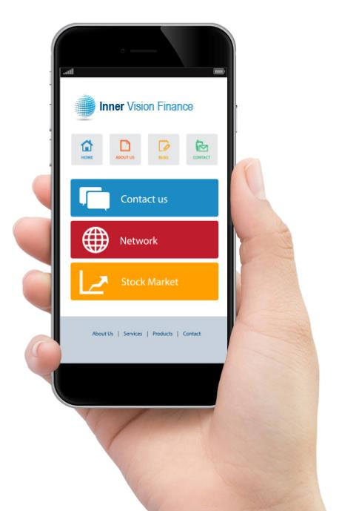
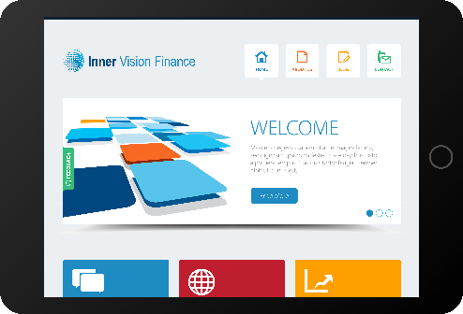
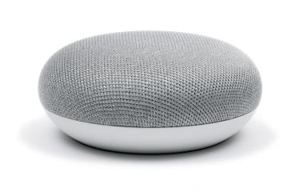
Web browsers
By following WCGA guidelines, it is possible to make webpages that work on many different devices:
Desktops / Laptops
Smartphones
Speech only

Slide 19
PAS and BS numbers for the teacher guide
British Standards Institution
The British Standards Institution (BSI) is a standards organisation for the UK. It makes technical standards for products and services such as:
Web accessibility (PAS 78)
Software testing (BS 7925)
Electrical wiring (BS 7671)
Fire detection (BS 5839)
Products or services that meet the quality standards can use the BSI Kitemark™

Slide 20
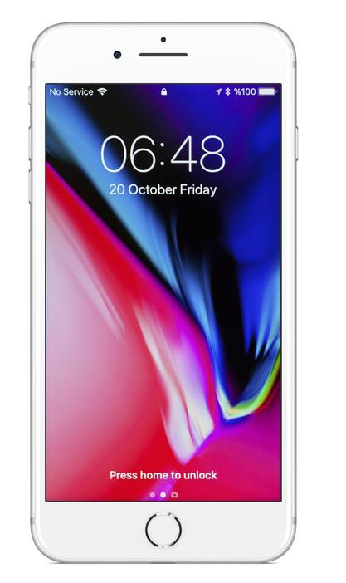
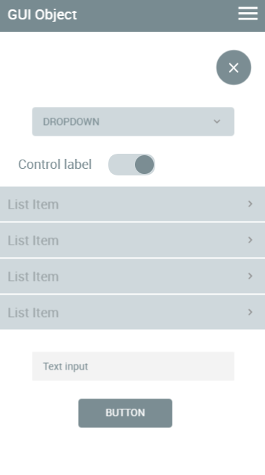
Open Accessibility Framework
The OAF gives six steps to make sure that computers and devices are accessible. The first three are:
Define what accessible means for the software or device
Use standard / stock user interface components so that software or apps all look and function in a similar way
Provide developer and authoring tools which can improve accessibility – this may include manuals and tutorials

Slide 21
Open Accessibility Framework
The last three steps of the OAF are:
Provide platform support for accessible features such as screen readers and voice input
Provide the app itself
Include assistive technology such as screen readers, magnifiers and voice control to users

Slide 22
Worksheet 5
Now complete Task 5 on the worksheet

Slide 23
Plenary
Name four laws, codes of practice or guidelines designed to ensure the accessibility of IT systems

Slide 24
Plenary
Name four laws, codes of practice or guidelines designed to ensure the accessibility of IT systems
Equality Act 2010 (This replaced the Disability Discrimination Acts 1995 and 2005)
British Standards Institute (BSI) codes of practice
Web Content Accessibility Guidelines (WCAG) 2.1 and the World Wide Web Consortium (W3C)
Open Accessibility Framework (OAF)

