Slide 2
Objectives
Describe:
systems that enable and support remote working: VPNs, remote desktop technologies
factors affecting the use and selection of online systems: security, cost, ease of use, features, connectivity

Slide 3
Starter
Most organisations will have a number of IT technicians who can offer support to users
What systems are used to help support people who are remote working?

Slide 4
Supporting remote working
Remote workers benefit from using online software (Software as a Service / SaaS)
As it is all online, they usually don’t need any software installation beyond a web browser
In addition to this, remote workers can also be helped by using:
Virtual Private Networks (VPN)
Remote desktop technologies

Slide 5
Remote working security
There are a number of places where remote working can take place. These include:
homes and home offices
co-working spaces
coffee shops
These places may not have the same security precautions as dedicated offices
What security risks to data exist for remote workers?

Slide 6
Security risks
Security risks are often higher for remote workers. They include:
Wi-Fi security – many public locations make use of unencrypted Wi-Fi or shared passwords
Public locations allow for members of the public to see confidential information – they are also vulnerable to shoulder surfing
Physical security will typically be less in public locations or home offices. This increases the risk of equipment and data being stolen
How can you securely connect from a remote computer to a company’s private network?

Slide 7
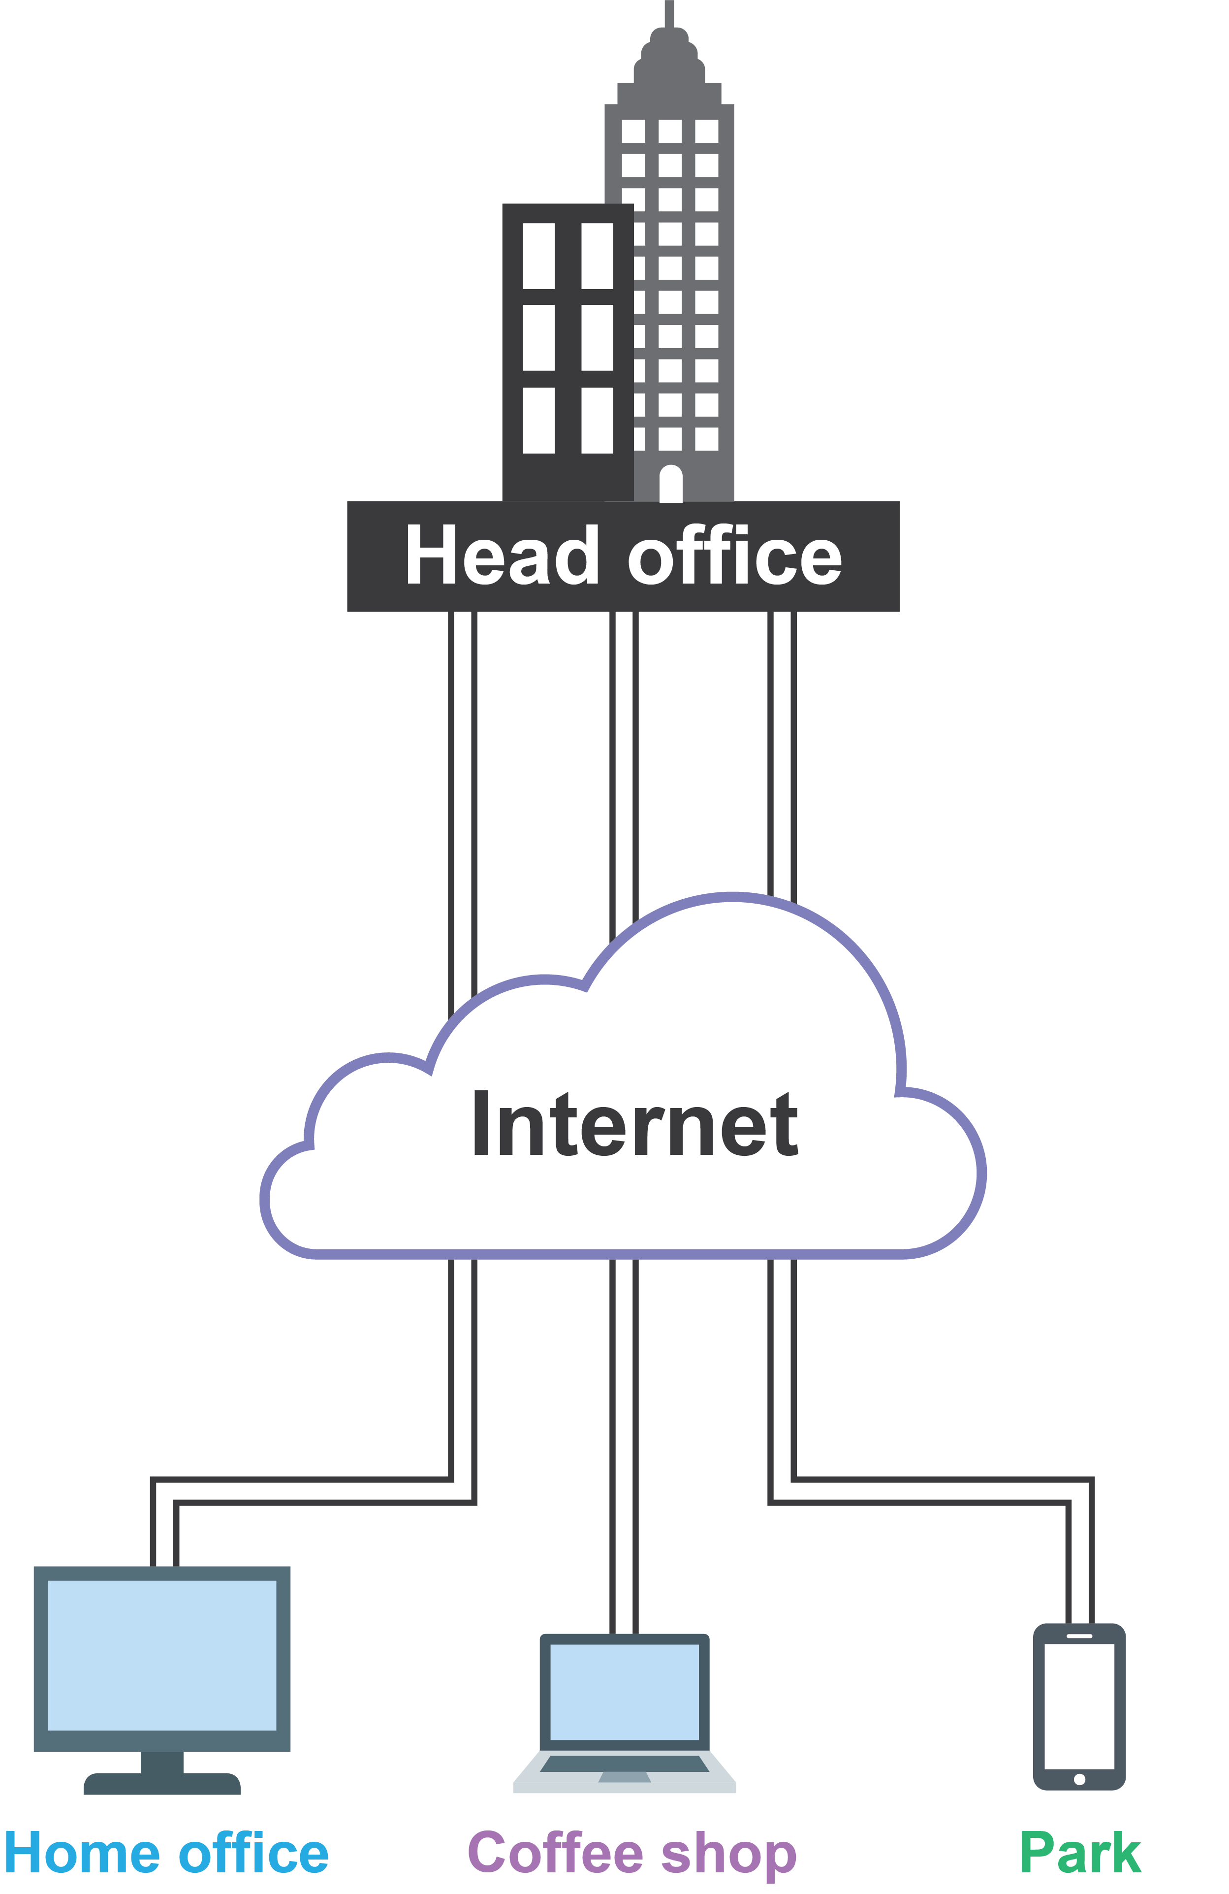
Virtual Private Networks (VPNs)
VPNs allow devices to connect to other networks via the Internet
All connections are encrypted
These connections are known as VPN tunnels
When a device is using VPN the user doesn’t need to worry about the security of the Wi-Fi access point that they use

Slide 8
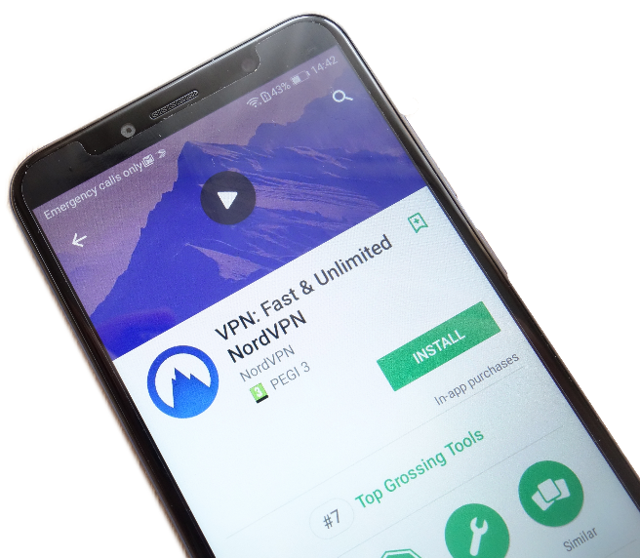
Case study: Nord VPN
Nord VPN allows ordinary users to use VPN to access the Internet
This encrypts connections to the Internet even if unencrypted Wi-Fi is used
It protects users on public transport, at airports, hotels, restaurants and coffee shops
NordVPN doesn’t track users or store logs of usage
For additional privacy, traffic can be routed over the Onion network

Slide 9
Worksheet 2
Now complete Task 1 on Worksheet 2

Slide 10
Scenario: Remote support
An employee who used to work in the head office of their company has become a remote worker
They work using a laptop in an office in their home
They live 20 miles from head office
In the past, when they had an issue with their computer they an IT technician would come and fix the problem
How does the employee now have their IT problems fixed?

Slide 11
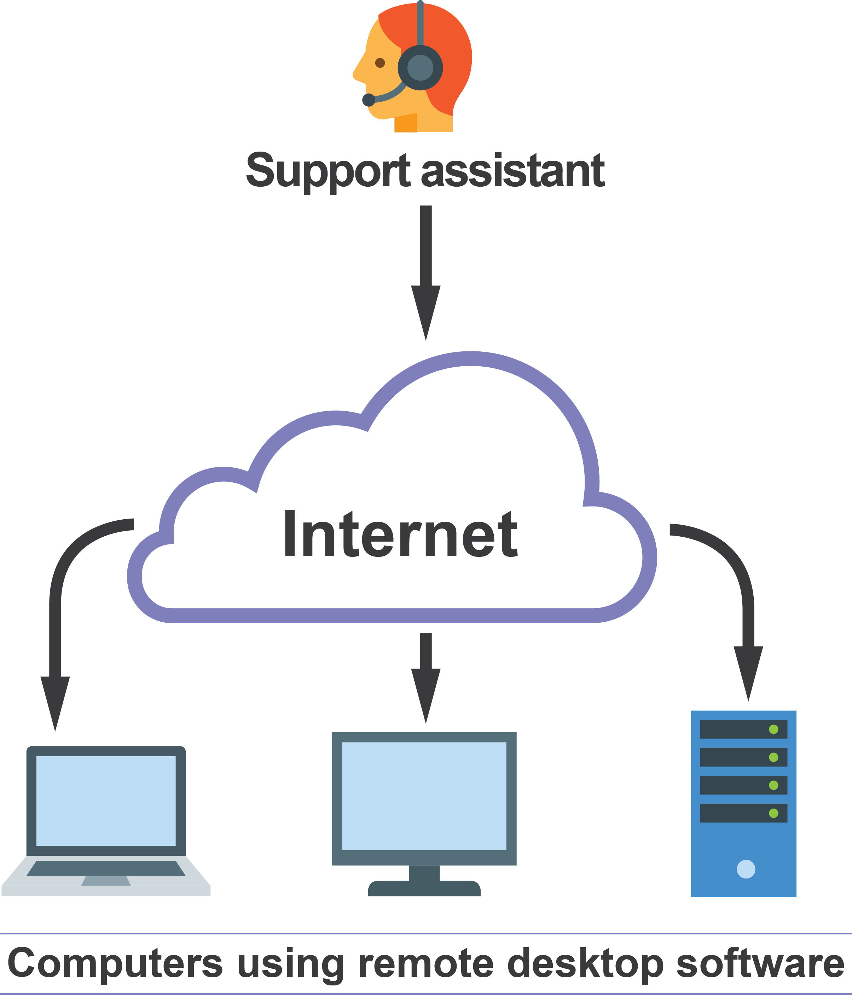
Remote desktop technologies
IT support are able to take control of computers remotely
They use remote desktop software
Each computer that is to be controlled remotely must have the software installed
A password is required to prevent hackers from controlling the computer

Slide 12
Remote working technologies
A number of technologies are needed in order for people to work remotely and receive support via remote desktop
Give at least five technologies that are required to work remotely

Slide 13
Required technologies
Remote workers will typically require:
A laptop, or mouse/keyboard/computer/display
A second display
A good Internet connection
VoIP telephone / mobile phone
For remote desktop they will require:
The ‘client’ version of the remote desktop software
Headphones and microphone may also be required if the support staff do not have telephone access

Slide 14
Productivity
A 2015 survey of remote employees found:
23% were willing to work for longer hours to get more done
52% said they were less likely to take time off
77% confirmed improved productivity when working from home
A 2018 survey found that 67% of employees aren’t engaged in their work
What do you think the effects of remote working are?

Slide 15
Worksheet 2
Now complete Task 2 and Task 3 on Worksheet 2

Slide 16
Online system choice
There are many factors that affect the use and selection of online systems
One factor is the security of these systems
Use of VPN
Use of HTTPS/SSL
Is personal data held securely and encrypted (Data Protection Act)?
Other than security, what are four other factors that affect the selection of online systems?

Slide 17
Choosing online systems
Factors affecting the selection and use of online systems include:
Cost – What will the cost of using the online system be?
Ease of use – Will the online system be compatible with devices, browsers and operating systems? Will it be easy for people to use?
Features – What features are required by the organisation?
Connectivity – How fast a connection do you need to access the service?

Slide 18
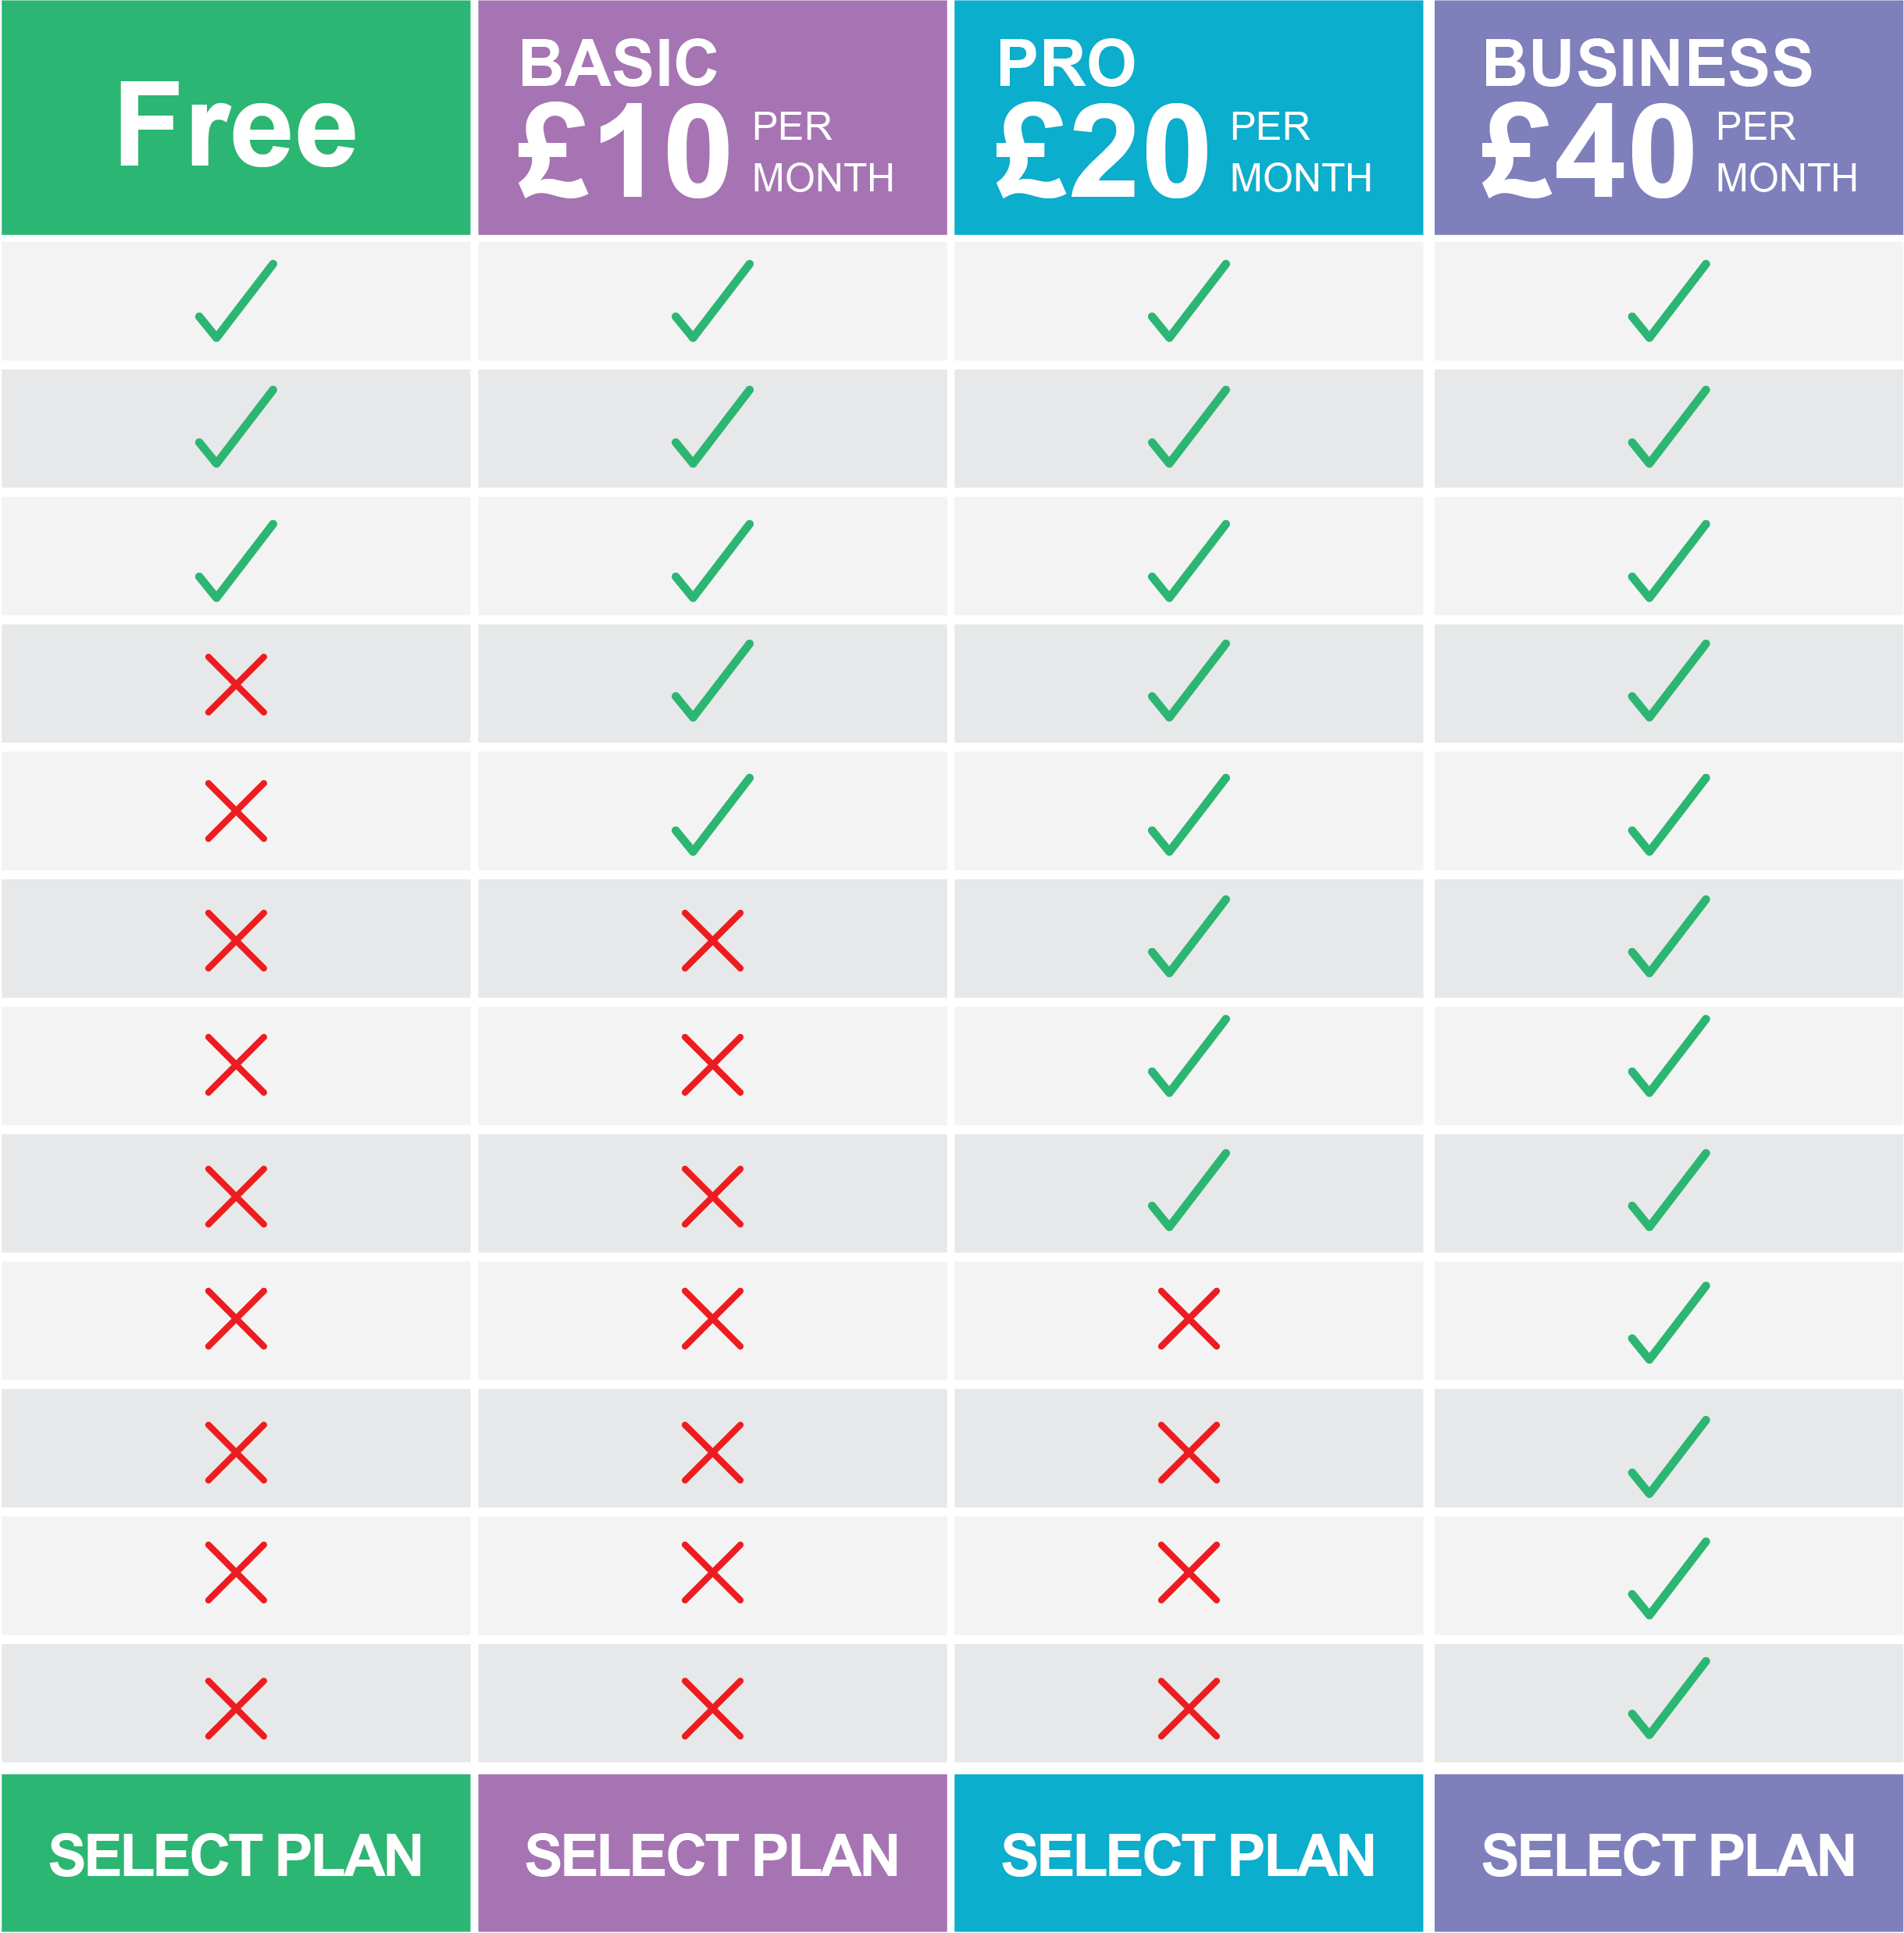
Cost
Costs for online services can be charged in a number of ways
An organisation may pay a fixed monthly or yearly fee
There may be a fee for each additional user
There may be a fee for the different features that are made available
What other costs will need to be considered?

Slide 19
Costs of online systems
Beyond the cost of the online service, there are usually a number of other costs such as :
Migration – there will be a cost to move users and data to the new system
Training – staff will need to be trained in the new system
Internet connections – these will need to be sufficient to cope with the additional data used with an online system
Mobile phone data – this may need to be increased if users need to work on online systems whilst travelling

Slide 20
Ease of use
It is important that online systems are easy to use
The system needs to work with a variety of devices. It should be responsive to the screen size and orientation
They need to take into account the typical knowledge of their users. For instance, an online stock trading platform may have an advanced mode for professional investors with a basic mode for ordinary people
In pairs, think of one online system that you use
What makes it easy (or hard) to use?

Slide 21
Worksheet 2
Now complete Task 4 on Worksheet 2

Slide 22
Features
Features of online systems may include:
amount of storage space
number of users
level of technical support offered
Many features in online IT systems go unused. Think of an online IT system that you use
What features does it offer?
How many of these features do you not use?

Slide 23
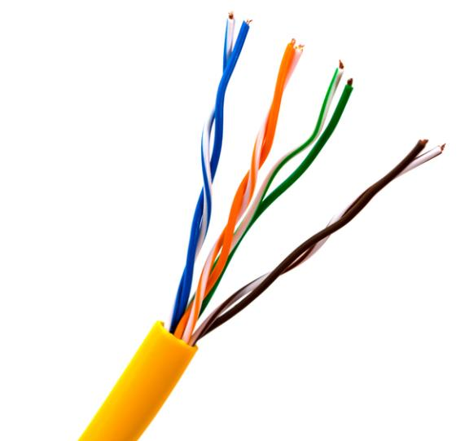
Connectivity
For any online system, VPN or remote desktop to work, there must be a connection to the Internet
The connection needs to be reliable and fast enough for the online systems that are being used
What happens if the Internet connection is lost?
How can a remote worker carry out their work if they lose their Internet connection?

Slide 24
Connectivity
If the Internet connection is lost to an online system:
Users will not be able to access the system
Work cannot be saved
Users may still be able to work with no connection
The software may cache work until the connection is restored
The users may have a cached local copy they can work on, using offline software
Remote workers may have a second backup connection such as mobile broadband
Users may have other offline tasks which they can undertake

Slide 25
Worksheet 2
Now complete Task 5 on Worksheet 2

Slide 26
Plenary
Many companies now make use of remote workers. They connect to the corporate LAN with VPN This gives them an encrypted connection via the Internet.
Lots of organisations use online systems. Organisations must consider the features available and the cost of such systems. If workers have connectivity issues they may not be able to use the online systems.
Cost | Features | Connectivity
VPN | Encrypted | Remote workers

Slide 27
Plenary
Many companies now make use of remote workers. They connect to the corporate LAN with VPN This gives them an encrypted connection via the Internet.
Lots of organisations use online systems. Organisations must consider the features available and the cost of such systems. If workers have connectivity issues they may not be able to use the online systems.
Cost | Features | Connectivity
VPN | Encrypted | Remote workers

