Slide 2
Objectives
Describe:
the features of online communities and the implications of their widespread use for organisations and individuals
ways of communicating and interacting with online communities: social media, blog, microblog, vlog, wiki, chatrooms, instant messaging, podcasts, forums
the implications for individuals of using and accessing online communities:
user experience – ease of use, performance, availability, accessibility
meeting needs, cost, privacy, security

Slide 3
Starter
There are now over 3.5 billion people in the world who make use of social media
Social media is used by both individuals and organisations
Which social media apps do you use?
Why do you use these apps?
What is the purpose of the posts that you make?

Slide 4
Blogging
The term weblog was first used in 1997
The shortened term blog was first used in 1999
Blogs are regularly updated websites that follow a discussion or give information
Blogs often cover just one topic
Blogs can be edited by multiple authors
What are microblogs and vlogs?

Slide 5
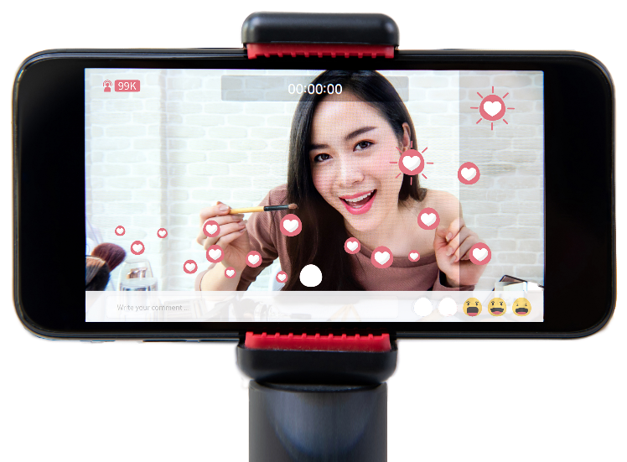
Microblogs and vlogs
Microblogs are much smaller in size than blogs
They may contain just one or two sentences or a single image or video
They will often be updated far faster than a blog
Vlogs are video blogs
They tend to be based on a particular topic
They are shared on video streaming sites such as YouTube

Slide 6
Case study – Chris MD
Chris MD is Christopher Dixon’s YouTube channel
He has an estimated worth of £1.5 million from this channel
The channel features FIFA videos and football challenges
4.5 million subscribers
900 million views
An average of 500,000 views per day
How does Chris earn money if the videos he makes are free to watch?

Slide 7
Worksheet 3
Now complete Task 1 on Worksheet 3

Slide 8
Microblogging
Microblogs are places where short, frequent posts are made
They are designed for the audience to quickly interact
Software used for microblogging:
Facebook
Instagram
Pinterest
Twitter
Microblogging is often carried out by influencers
What is an influencer?

Slide 9
Influencers
An influencer is a person who influences potential buyers of a product or service by recommending it on social media
Examples of influencers are:
Cristiano Ronaldo – 160m followers
Ariana Grande – 150m followers
Selena Gomez – 148m followers
The Rock – 137m followers
Kim Kardashian West – 133m followers

Slide 10
Wikis
Wikis are websites that are developed collaboratively by the public or a community of users
Anyone can make changes, including editing, adding and deleting content
The word ‘wiki’ is Hawaiian for ‘quick’
Public wikis can be edited by anyone
Companies may have their own wikis which cover internal documentation and procedures

Slide 11
Case study - Wikipedia
Wikipedia began in January 2001
It is used by around 500 million people a month
Over 15 billion pages are viewed per month
There are over six million articles in the English version
What are the advantages of using Wikipedia over a traditional encyclopaedia such as Britannica?

Slide 12
Worksheet 3
Now complete Task 2 on Worksheet 3

Slide 13
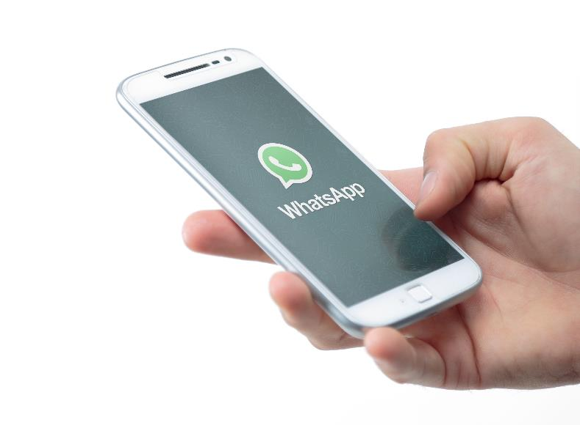
Online communication
There are many ways in which people can communicate with each other online
One method is chat rooms
These are text based methods of communication
They allow for comments to be searched
Multiple rooms are available for group discussion
What other types of online communication are available?

Slide 14
Online communications
There are a number of different ways in which people can communicate online
These include:
Instant messaging – These can be private messages or to a group of people. Communication can be encrypted
Podcasts – These are discussed in the next slides
Forums – These allow people to post comments or questions on topic. They tend to be based around a particular topic or activity

Slide 15
Podcasts
The word ‘podcast’ comes from the words ‘iPod’ and ‘broadcast’
Audio files are created, most often of one or more people discussing a topic
They can be listened to from dedicated apps or directly streamed from websites
Most are free to access
You can subscribe to a podcast to automatically receive future episodes
What hardware and software is needed to make a podcast?

Slide 16
Creating podcasts
Hardware for podcasts
High quality microphone(s)
Computer or laptop
Headphones
Microphone pop filter and shock mount
Software
Software for editing the audio files
A podcast hosting account such as Buzzsprout, Blubrry or Podbean

Slide 17
Use of podcasts
Podcasts allow people to subscribe, so it is possible to build an audience of regular listeners
A relationship can be built up with an audience
It is convenient for listeners
Podcasts can find niche audiences
Unlike traditional broadcast media, the length of podcasts can be much longer
Businesses can make podcasts which can increase customer numbers

Slide 18
Case study – TED Talks Daily
TED Talks are thought provoking talks around a wide variety of topics
They are videos which are usually watched via streaming
TED Talks daily is the podcast version
Talks are given as an audio podcast
They can be played through music players or on home assistants such as Amazon Alexa or Google Home

Slide 19
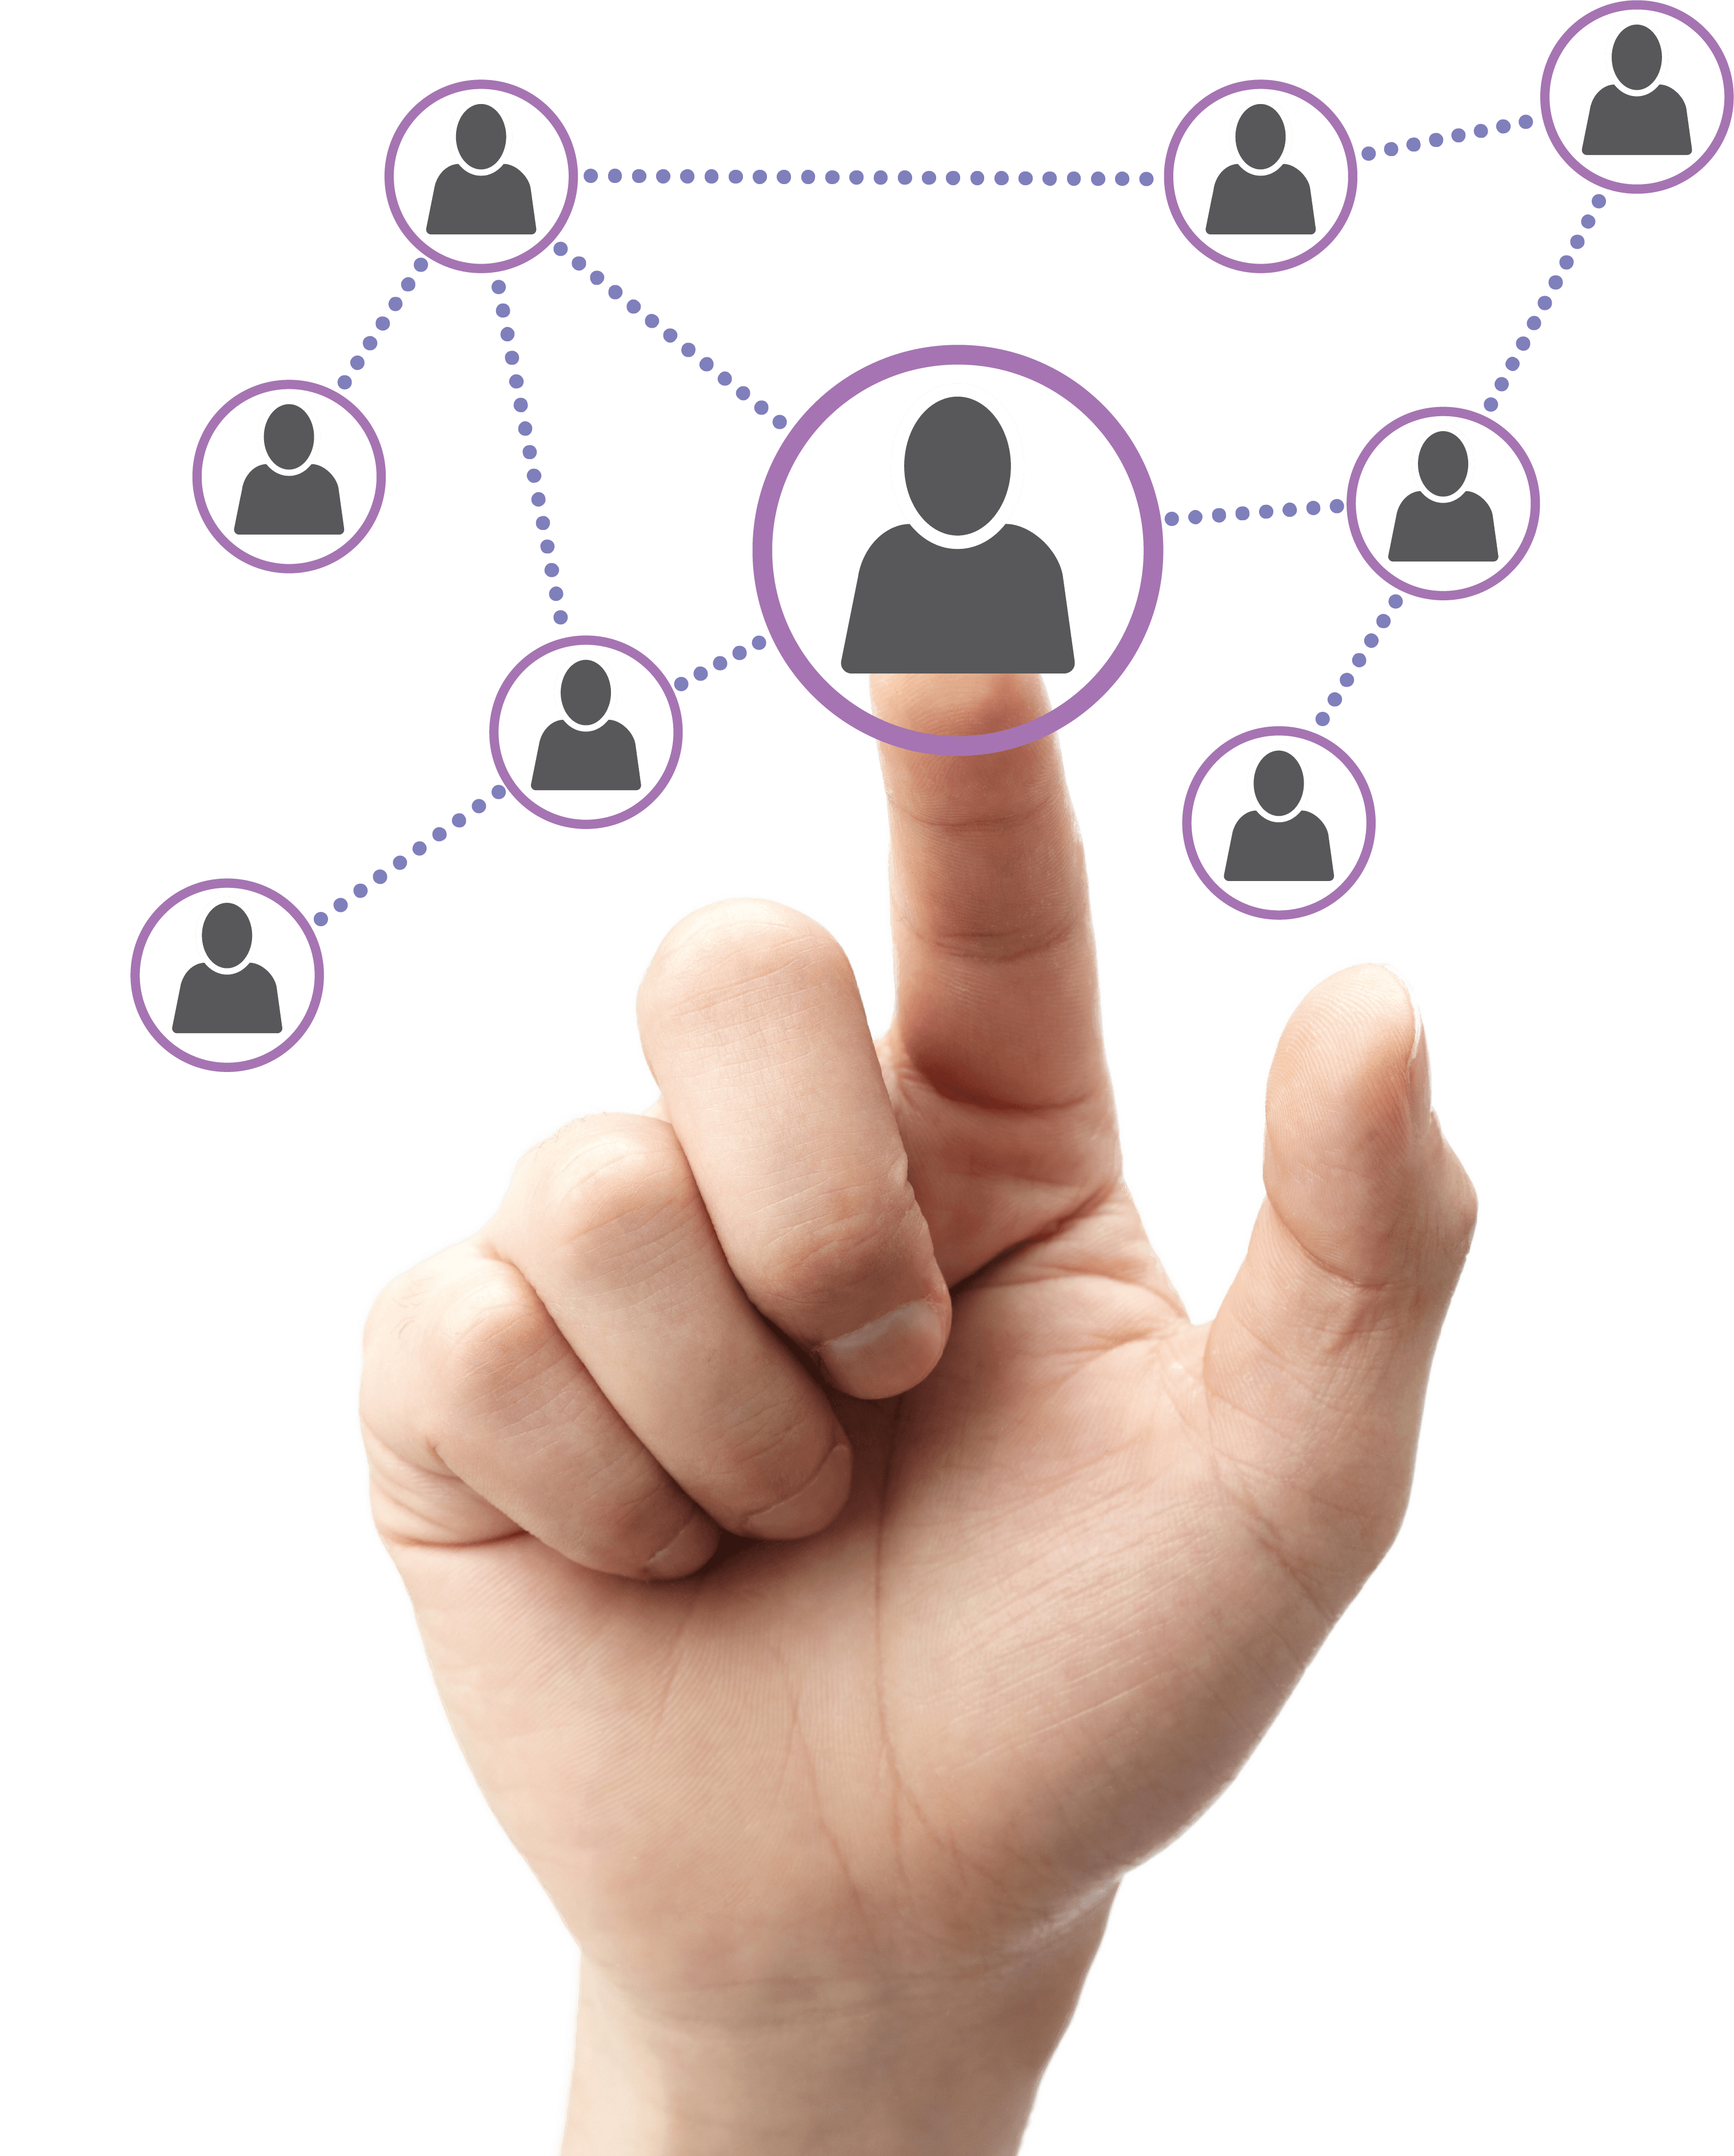
Online community use
Online communities are often used by individuals
Some reasons they are used may include:
To stay up to date with news and current events
To fill up spare time
For entertainment
Work in pairs to discuss which online communities and social media you use and the reasons you use them

Slide 20
Worksheet 3
Now complete Task 3 on Worksheet 3

Slide 21
User experience
A user’s experience can be affected by a number of factors. These include:
Performance – How quickly does the website or app respond? How much data needs to be downloaded or uploaded? What type of connection is being used?
Availability – Is the connection reliable? If a mobile connection is used, will there be coverage? If an online service is used, is it reliable and do they use redundancy?
What other factors affect the user experience?

Slide 22
User experience factors
Ease of use
How easy is the system for users?
Is the interface clear and is online help available?
Accessibility
Is the app or service available for a variety of devices and operating systems?
Have people’s disabilities been considered?

Slide 23
Poor user interfaces
Many interfaces give a poor user experience. This can be due to:
The design being in the interest of the company, not the user
Missing navigation elements such as a menu or search box
Outdated content – for example using animated GIFs
Adverts that pop up or overlay
Auto playing video
Slow performance

Slide 24
Other implications
There are other implications for individuals when using online communities
Meeting needs – are the user’s needs of the online service being met?
Cost – how is the online service paid for?
Privacy – how secure is the online system?
Security – how secure is the online system?
Work with a partner:
Choose an online service that you use
How does the service meet individuals needs for the above points?

Slide 25
Other implications
Some possible answers
Meeting needs – What functions does the system have? Do they solve problems that users are having?
Cost – Is the system free? If so, how is it paid for? – e.g. advertising, monthly subscription, government funding
Privacy – Does the system have a privacy policy? How do they keep data safe under the Data Protection Act / GDPR?
Security – What security methods are used? For instance HTTPS/SSL for websites, encryption for data storage and transmission. Employing security specialists

Slide 26
Externalities
Externalities are costs which people have to pay, which they have no control over
Mobile phones, social networks and gaming all have externalities
Use of social media can lead to anxiety and depression
Use of mobile phones in cars can lead to traffic accidents
It is people and the government that must pay for these costs not the companies

Slide 27
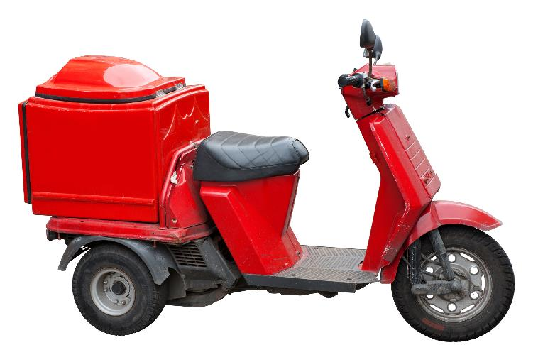
Scenario: Delivery driving
Apps and online services such as ‘Just Eat’ have made it easier to purchase products and food online
This has led to a large increase in the number of home deliveries being made
Discuss home delivery online services and apps for their:
ease of use (performance, availability and accessibility)
ability to meet needs
privacy and security
cost

Slide 28
Worksheet 3
Now complete Task 4 on Worksheet 3

Slide 29
Plenary
Who can give the correct answer to all the following questions first?
Give:
Five types of online community
Four implications for the user in utilising and accessing online communities
Three advantages of interacting online
Two ways that online system are made secure
One way in which privacy is protected with online communities

Slide 30
Online communities
Some possible answers:
Five types of online community – social media, blog, microblog, vlog, wiki, chatrooms, instant messaging, podcasts, forums
Four implications for user in using and accessing online communities – user experience, ease of use, performance, availability, accessibility, meeting needs, cost, privacy, security
Three advantages of interacting online – any advantages
Two ways that online system are made secure – SSL/HTTPS, encryption
One way in which privacy is protected with online communities – privacy policy, encryption

