Slide 1
AQA
    AS Level
      Computer Science
      Paper 2
Hardware and software
  Unit 4
  Hardware
  and software

Slide 2
Objectives
Define the terms hardware and software and understand the relationship between them
Explain what is meant by system software and application software
Understand the need for, and attributes of, different types of software
Understand the function of operating systems, utility programs, libraries and translators

Slide 3

Hardware or software?
How best could you define and distinguish between hardware and software?

Slide 4
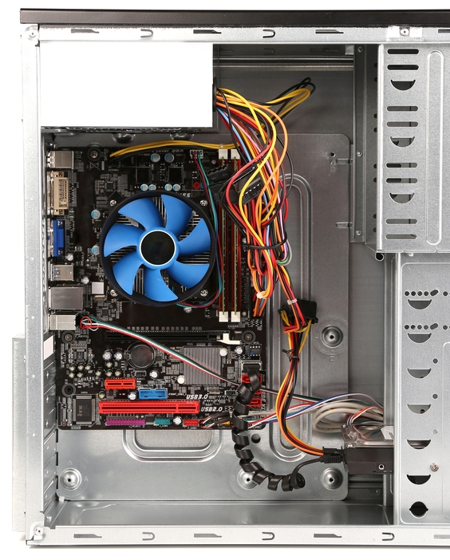
Hardware
Hardware describes the electrical or electro-mechanical parts of a computer system
  These comprise the physical, tangible parts of the computer and its input, output and storage devices

Slide 5

Software
Software comprises all of the programs that make the computer function
  Like the music on a CD, it doesn’t have a physical presence – you can’t touch the 0s or 1s that make up the program
  Software programs fit into one of two categories: system software and application software

Slide 6
Hardware and software
Identify which is hardware and which is software:
  What are the hardware and software components of a contactless payment system?
 | Hardware | Software
Webcam
RAM Memory chip
Android Operating System
Microphone
Virus checker

Slide 7
Hardware and software
Identify which is hardware and which is software:
 | Hardware | Software
Webcam | ✓
RAM Memory chip | ✓
Android Operating System |  | ✓
Microphone | ✓
Virus checker |  | ✓

Slide 8
Classifying software
Software can be organised into the following groups:
Software
System Software
Application Software
Operating Systems
Utility Programs
General Purpose
Special Purpose
Library Programs
Translators

Slide 9
Systems software
System software is required to run and manage the computer’s hardware and application programs
Examples include:
  Allocating jobs to the processor
  Peripheral management
  Maintaining security and checking for viruses
  Software installation
  Translating program code into machine code

Slide 10
Operating System
  An OS serves as a middle-man for communication between the computer’s hardware and software
  Software applications cannot talk directly to the hardware
  OS examples include Windows, Mac OS, Linux and Android
The tasks of an OS include:
  Resource management (Processor scheduling, memory management, backing store management and IO management)
  Provision of a user interface
  (Command line, Menu driven or GUI)

Slide 11
Utility software
Some utility software is designed to analyse, configure, optimise or maintain a computer system
  Defragment a disk, install/uninstall software, keep software up-to-date, monitor resources and performance
Some utilities perform additional common tasks needed by most or all users
  Virus checkers
  Automatic backup and restore
  File compression software such as WinZip to reduce file sizes before transmission

Slide 12
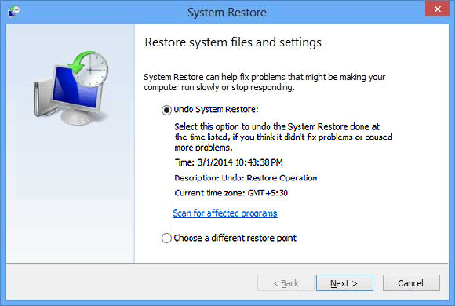
Example of a utility program
If your Windows PC goes badly wrong and you seem to have lost all your settings, you can run a utility program called System Restore

Slide 13
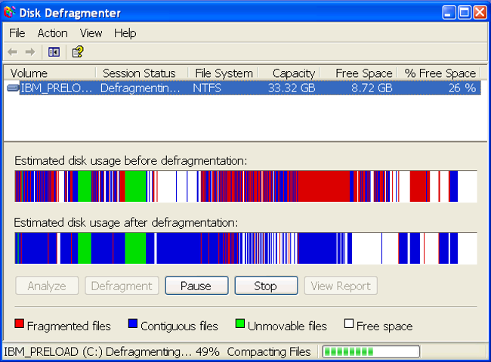
Hardware and software
Complete Task 1 of Worksheet 1

Slide 14
Libraries
A library is a collection of pre-compiled routines that can be used by other programs
  Programmers can invoke library subroutines to save having to re-write code
  Python has math, random and turtle libraries for example
  Similar libraries exist in most programming languages
What libraries have you imported into any of the programs you have written?

Slide 15
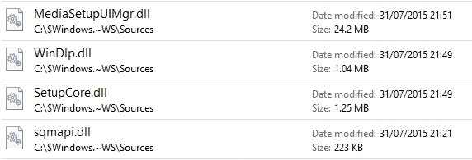
Operating system libraries
Most operating systems have hundreds of library files which can be shared by multiple processes
  In Windows, library files are given the extension: .dll

Slide 16
Translators and machine code
Machine code is the lowest level of instruction comprising pure binary
  All computer instructions need to be converted into machine code
A translator is used to translate code written in assembly language or other high level code into machine-code
  There are three types of translator
  Can you name them?
  Are translators utility programs?

Slide 17
Types of translator
Assemblers translate assembly language into machine code
Compilers translate high-level language programs into object code (machine code) which can be saved and run whenever needed, without the compiler having to be present
Interpreters also translate high-level language programs – more detail in another lesson
Translators are not classified as utility programs

Slide 18
Application software
Application software allows you to complete different tasks. Examples include:
  Word processors
  Image editors
  Accounting packages
  Internet browsers
  Email clients

Slide 19
Application software categories
Application Software
General Purpose
Special Purpose
Off-the-shelf
Bespoke

Slide 20
General purpose software
General purpose software packages can be used for a range of generic tasks
These include:
  Word processors – for letters, posters or textbooks
  Graphics packages – for image retouching, photo editing or drawing diagrams
  Spreadsheet software – for modelling, creating tables of data or lists

Slide 21
Special-purpose software
Special-purpose software performs tasks for a single, specific job
Examples include:
  Payroll or accountancy software
  Media players
  Calendar programs
  Online payment systems

Slide 22
Application software
Complete the table below:
 | General purpose | Special-purpose
Presentation software
Driving simulator
Route finding application
Calculator
Video editing suite

Slide 23
Application software
Complete the table below:
 | General purpose | Special-purpose
Presentation software | ✓
Driving simulator |  | ✓
Route finding application |  | ✓
Calculator |  | ✓
Video editing suite | ✓

Slide 24
Off-the-shelf software
Special purpose software can be off-the-shelf, or bespoke
What are the benefits and drawbacks of off-the-shelf software?

Slide 25
Off-the-shelf software
Benefits:
  Off-the-shelf software is readily available for anyone to use
  The cost is usually lower because development costs are shared among all the buyers
  It is likely to be well-documented and well-tested
Drawbacks
  You have little or no control over what features there are
  It may not do exactly what you want

Slide 26

Bespoke software
Bespoke software is created to fulfil your own exact specifications
  This can significantly increase
  the cost
  It may take several weeks, months or even years to develop
  Complete control over the process gives you all the functionality you need

Slide 27
Hardware and software
Complete Task 2 on Worksheet 1

