Slide 1
FAMILY ASSESSMENT
SPRING 2022

Slide 2
Purpose of this video/presentation
To review the requirements of the AQA paper 2
To understand the mark schemes for this paper and be able to apply them to your own work
To review your own work and determine the marking level that you have achieved
To reflect on what approaches you could adopt when revising for your mock on 21 February

Slide 3
You will need
This powerpoint
Copy of the video so that you can pause https://web.microsoftstream.com/video/c708b863-7066-4604-8753-b8f61e213807
Copy of the example answers to these questions
These can all be found HERE
Godalming online, Sociology Year 2, Revision, Family, scroll down to the bottom

Slide 4
Paper 2
2 hours long
First part is FAMILY (Questions 4, 5, 6)
Second part is STRATIFICATION (Questions 22, 23, 24)
10 mark questions roughly take 15 minutes, 20 mark questions roughly 30 minutes.
Plan on your answer booklet, rather than the question paper
The paper includes lots of other options, so you need to turn to the correct sections to answer. An example paper can be found here to see what a whole paper looks like
Question paper (A-level) : Paper 2 Topics in Sociology - June 2019 (aqa.org.uk)

Slide 5
Question 4: Outline and explain two ways in which the functions of the family may have been affected by changes to its structure [10 marks]
Functions of the family | Changes to structure
Primary Socialisation Stabilisation of adult personalities Sexual Reproductive Economic | By structure you want to think about who is in the family. The mark scheme below indicates a more modern answer was required – this is because functions emerged as a the nuclear family became the main family type and society became more developed e.g. before this the extended carried out a huge range of functions. Other good answers discussed the increase in single parents being unable to fulfil the socialisation function – New Right argument
Need to clearly state which function has been changed and how the structure has changed

Slide 6
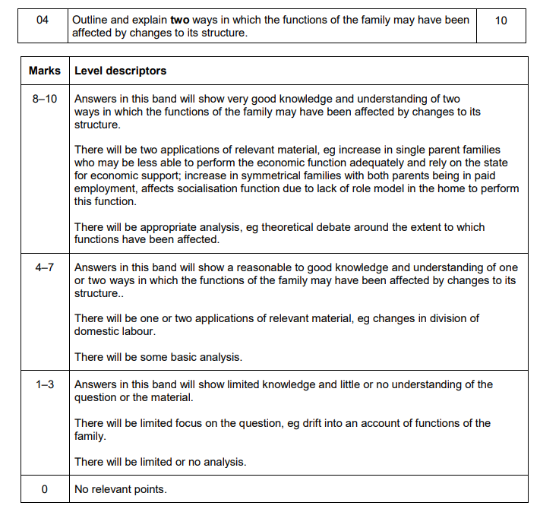
Level 3
Level 2
Level 1

Slide 7
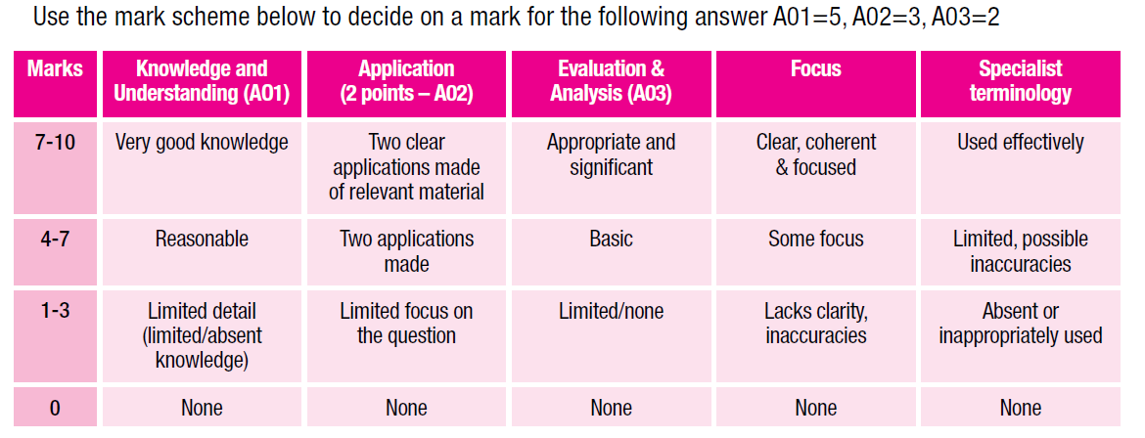
10 mark questions
2 clear paragraphs that have different points. The evidence is developed i.e. use of studies. There is some analysis i.e. comparison of ideas or some evaluation
1 point may be stronger than the other. There may not be any analysis or evaluation, but the knowledge is good
The evidence is very thin. There may only be one paragraph or if there is 2 there is not a lot of evidence,
Let’s look at some examples of this question in different levels – turn to the example sheet

Slide 8
Pause: mark your own
Look at the example answers to this question, reading the commentary as you go.
Once you have done this go back to your own answer and determine which level you are in, and then whether you think you are at the bottom, middle or top of this level.
Make a note of this

Slide 9
Two dimensions to this question 1) need to identify a form of family diversity from the item, 2) then consider how government policies have influenced this.
The analysis in this question needs to come from questioning whether government policies have had the biggest impact on the types of family diversity identified.

Slide 10
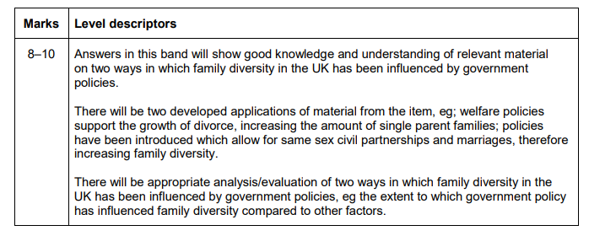
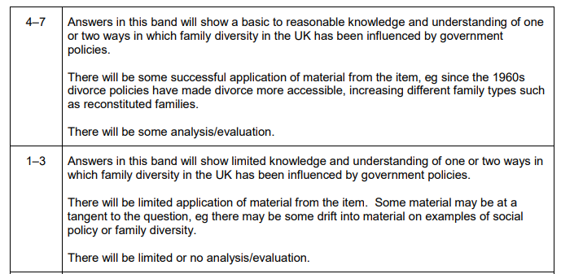
Level 3
Level 2
Level 1

Slide 11
10 mark questions
2 clear paragraphs that have different points. The evidence is developed i.e. use of studies. There is some analysis i.e. comparison of ideas or some evaluation
1 point may be stronger than the other. There may not be any analysis or evaluation, but the knowledge is good
The evidence is very thin. There may only be one paragraph or if there is 2 there is not a lot of evidence,
Let’s look at some examples of this question in different levels – turn to the example sheet

Slide 12
Pause: mark your own
Look at the example answers to this question, reading the commentary as you go.
Once you have done this go back to your own answer and determine which level you are in, and then whether you think you are at the bottom, middle or top of this level.
Make a note of this

Slide 13
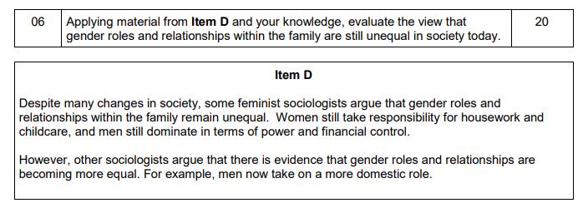
DEBATE: GENDER ROLES AND RELATIONSHIPS ARE UNEQUAL
VS
THEY ARE NOW MORE EQUAL OR THAT THEY ARE BECOMING MORE EQUAL BUT NOT THERE YET

Slide 14
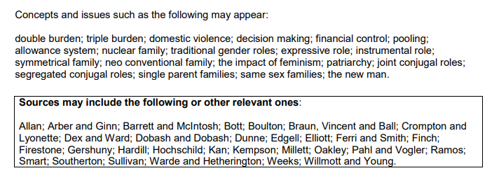

Slide 15
Ideas/feedback
Lots of introductions didn’t include the debate
Lots of use of historical theory/evidence e.g. Parsons or Marxist arguments but without considering their relevance today.
Sometimes differences between different types of feminism e.g. liberal and radical not made explicit enough. And different views combined as if they were the same e.g. Parsons (warm bath theory) and Ansley (safety valve), these are making very different points on the same issue.
Ways to add in more analysis:
Even with greater equality women still take on burden in the home – triple shift.
Canalisation and manipulation still provides high expectations for mothers and wives.
Relationships vary – chosen, cultural differences, same sex couples

Slide 16
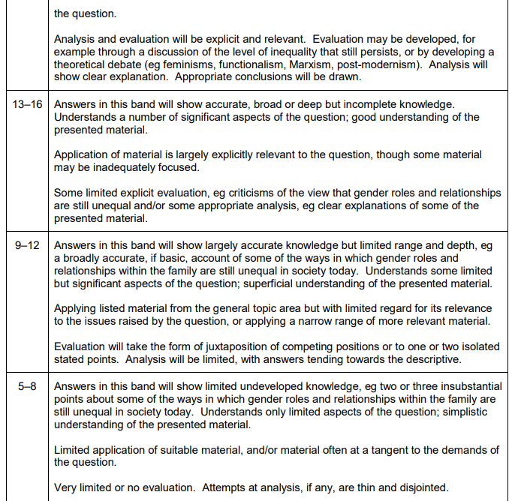
Level 5
Level 2
Level 4
Level 1
Level 3

Slide 17
With the essays
Points
Evidence – studies (developed?), theory (developed/explained?)
Accuracy?
Relevant?
Evaluation/analysis – critique? Compare?
Point, evidence, explain, evaluation, linking?

Slide 18
Pause: mark your own
Look at the example answers to this question, reading the commentary as you go.
Once you have done this go back to your own answer and determine which level you are in, and then whether you think you are at the bottom, middle or top of this level.
Make a note of this

Slide 19
What has been shown
Questions in paper two will often get you to link different areas of the course together. This means using your sociological imagination is important to be able to pull from different areas of the topic.
Revising lots of studies and then regurgitating them doesn’t help in answering these questions, which require you to make an argument and build up a chain of reasoning.
BUT, being able to support your argument with well explained studies and theory is ESSENTIAL to get into level 4 in a 20/30 mark essay as this demonstrates breadth and depth.
Practising questions is key – just remembering lots of stuff is not – you have to be able to apply the evidence.

Slide 20
Revision suggestions
START EARLY
Make a list/ or use pre-existing lists in your booklets/ revision books of the content areas you need to revise.
Use a range of resources – look at Godalming online, access revision books from the library or buy one.
Make your revision active – split into 20 minute chunks. Go over a topic, making notes/flash cards/quizzes and then apply this by planning questions

