Slide 1
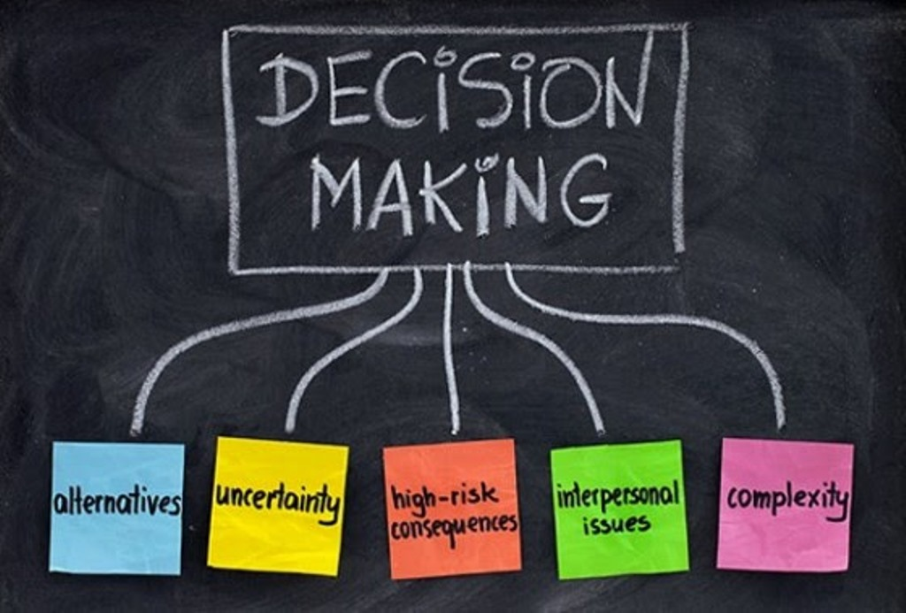
Lesson 2 A2
Influencing Customer Decisions and Meeting Needs.

Slide 2
‘Every product you buy, every service you use, every store you visit, every media message you receive and every choice you make, has been influenced by the forces of marketing’
Source: The Chartered Institute of Marketing.

Slide 3
Different types of visitors
Individuals: Individuals can be solo adults or children. Anyone that is visiting that attraction on their own.
Families: Families can be of any age e.g. Two adults with two children 10. You always need to consider the age of the children as this will change the expectations of the parents.
Groups: This could be school groups, elderly coach tours or a specific tour group.
Overseas Visitors: Not all overseas visitors will speak English so it is important to consider what their needs and expectations are.
People with specific needs: This can be anything from a visible disability to allergies. It is important to consider all needs, even ones that you cannot see.
Business: A business tourist will have very different needs to that of a leisure tourist from transport, accommodation and working needs

Slide 4
Market Segmentation (again!)
Market segmentation allows the marketing team to analyse these basic groups more specifically to provide detail on who is purchasing products and services and why. They can then use this information to tailor the marketing mix to best meet the needs of these different customers.

Slide 5
Market Segmentation

Slide 6
Socio-Economic Segmentation
Group | Type | Example
A | Upper Middle Class | Higher managerial, administrative or professional
B | Middle Class | Intermediate managerial, administrative or professional
C | Lower Middle Class | Supervisor or clerical, junior managerial, administrative or professional
C2 | Skilled Working Class | Skilled manual workers
D | Working Class | Semi-skilled and unskilled manual workers
E | Those at lowest level of subsistence | State pensioners, casual or lowest-grade workers.

Slide 7
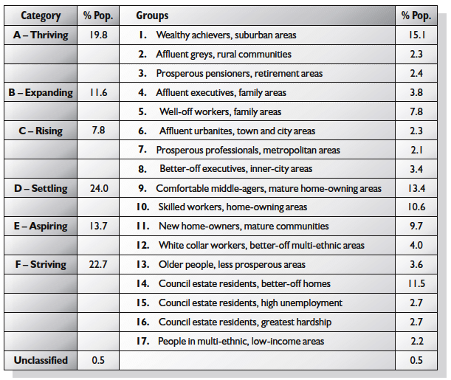
ACORN Classification

Slide 8
Task: Market Segmentation
Using your knowledge of market segmentation what sort of people are likely to be interested in these tourism activities?
A week in a caravan on the Isle of Sheppey.
A last minute break to a summer sun destination.

Slide 9
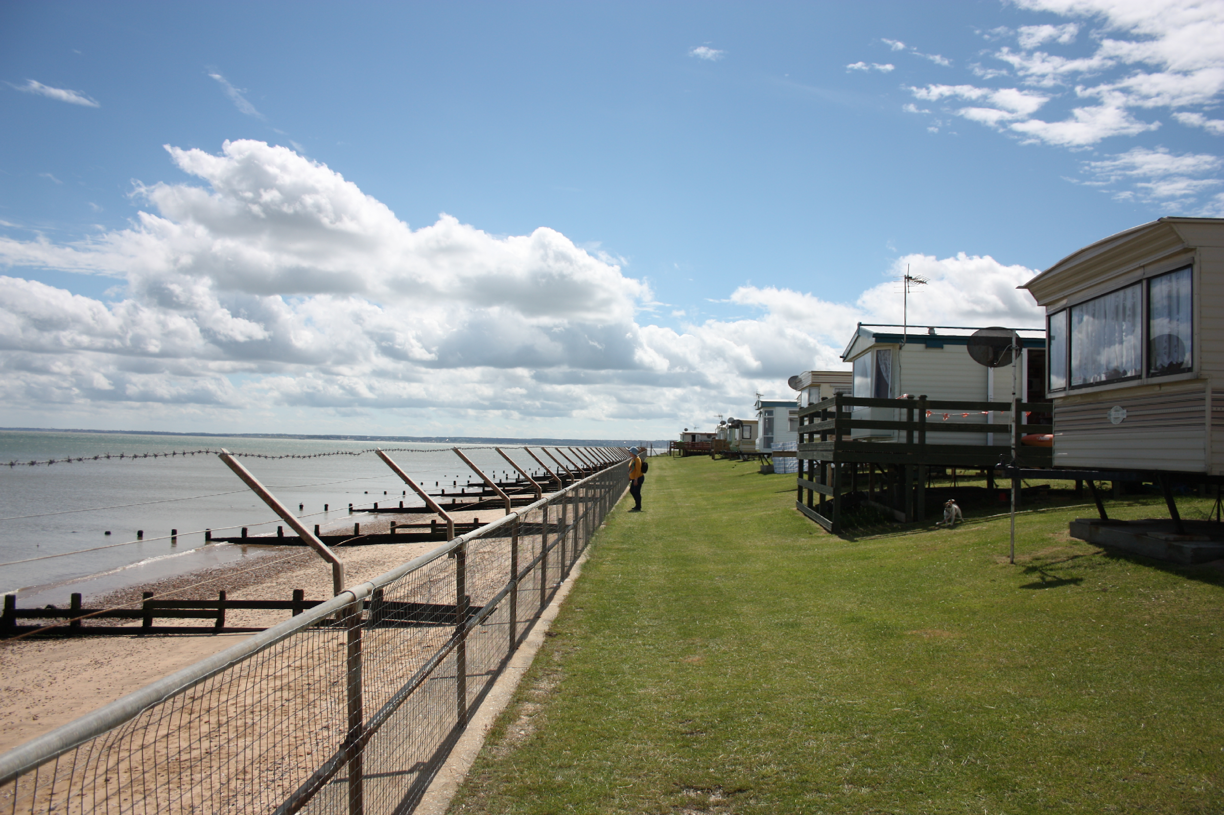
Geographic
Location
Region
Urban/Rural
ACORN
Geographic
A week in a caravan on the Isle of Sheppey.
Demographic
Demographic
Age
Gender
Occupation
Socio-economic group
Behavioural
Rate of usage
Benefits sought
Loyalty Status
Readiness to purchase
Psychographic
Personality
Lifestyle
Attitudes
Class
Behavioural
Psychographic

Slide 10
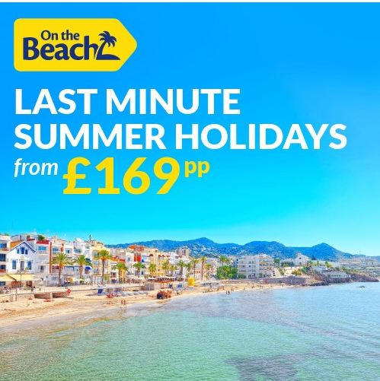
Geographic
Location
Region
Urban/Rural
ACORN
Geographic
A last minute break to a summer sun destination.
Demographic
Demographic
Age
Gender
Occupation
Socio-economic group
Behavioural
Rate of usage
Benefits sought
Loyalty Status
Readiness to purchase
Psychographic
Personality
Lifestyle
Attitudes
Class
Behavioural
Psychographic

Slide 11
But who has Influence in making decisions?
Who generally has the influence over purchasing decisions?
Think about the following situations
A multigenerational family holiday on a cruise?
A stag party of 20 to Budapest?
A birthday party for twenty 8 year olds to Go Ape?
A school trip for thirty students to Dubai?
A gap year holiday around the world?

Slide 12
Task: Individual Needs – match up
Stated Needs
Those products and or services that you think the customer might need.
Unstated Needs
Needs the customer tells you about.
Anticipated Needs
Needs that’s will affect the customer’s choice of product – but which they do not tell you about.

Slide 13
Activity
Mr Waters wants to go on a summer holiday to Italy for ten days.
He wants to take his bicycle.
He doesn’t speak Italian.
He likes visiting towns, and eating in a different place each night.
He can’t sleep when it’s too hot at night.
He likes booking things online.
He saves up all year for his summer holiday.
He’s a bit of a (hotel) snob.
What are his needs (stated and unstated) for his holiday? What will affect his decision making?

Slide 14
Stated Needs
Unstated Needs
10 day holiday
Italy - destination
Taking his bicycle
Likes visiting Towns
Booking online
Hotel Snob
Saves up for his holiday
Can’t sleep when it is too hot.
Doesn’t speak Italian

Slide 15
Marketing different products
Watch these videos for different tourism products and answer the questions on your hand out.
Amber Dale Luxury Hotel and Spa
PGL
Who are the target markets for these holidays?
What are the needs of the customers?
What products and services are offered to meet the needs of the customer?
What factors might influence a customers decision to book the holiday?

Slide 16
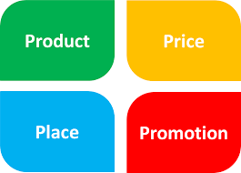
Factors that can influence customer decisions
Is it a desire or a need?
Confidence in the organisation/brand
Perceived and actual quality of product/service. E.g. B.A ‘v’ Easyjet
Reputation/image
Effective marketing communications such as use of direct marketing, social media, TV adverts
Customer service
Value for money
The 4Ps of the Marketing Mix:
Product
Place
Price
Promotion

Slide 17
Considering customer needs when carrying out marketing activities and communications.
What do marketers need to consider about their potential customers?
Customers’ stated and unstated needs
Do customers have any cultural and language needs? E.g. dietary requirements
Do customers have any special needs? E.g. medical conditions, mobility problems
Do customers have any needs relating to age? Gender? Socio-economic group? Family circumstances?
These needs must be considered when carrying out marketing activities for example; making sure that content is unlikely to cause offence to different cultural groups, do leaflets need to be in different languages and promoting accessibility measures at hotels/attractions

Slide 18
Why do both marketing and customer service teams need to work together with their social media campaigns and posts?
Find some examples of social media reviews which would involve both departments, explain why and evaluate the benefits of this collaboration (use class activity to help you inform your answers).
https://www.tripadvisor.co.uk/Attractions-g635924-Activities-Godalming_Surrey_England.html
https://uk.trustpilot.com/review/www.hilton.co.uk
https://www.feefo.com/en-GB/reviews/tui-uk?displayFeedbackType=BOTH&timeFrame=YEAR

Slide 19
Activity (homework)
Look at the customer reviews for the five different tourism organisations and answer the following questions:
Describe the problem
Suggest how the problem could be resolved
Identify any issue which could affect the marketing of the product or service.
What information might the marketing department need from the customer service department?

Slide 20
How can both departments work together to encourage repeat business?
Which tourism organisations use Loyalty schemes well to retain new customers – research and discuss the benefits to the business? Why do both teams need to work together on this approach?
https://rocketmarketinggroup.com/5-reasons-why-customer-loyalty-programmes-are-so-important/
https://www.travelperk.com/blog/best-corporate-hotel-loyalty-programs-europe/
https://www.travelperk.com/blog/airline-loyalty-programs-comparison/
https://www.tiqets.com/venues/blog/attracting-repeat-visitors/

Slide 21
Which organisations are using technology to its best and leading the way with its marketing and customer approach?
Analyse the effectiveness of the following organisations approach to marketing and how it ultimately benefits the organisation and the customer. How will this benefit the marketing and the customer service team ultimately? https://www.brandwatch.com/case-studies/virgin-holidays-digital/view/
https://www.brandwatch.com/case-studies/american-airlines/view/

Slide 22
Balancing Customer satisfaction with organisational aims and objectives
Customer satisfaction is of the utmost importance to the reputation and commercial success of a business. However, there may be times when customer expectations are unrealistic, unsafe or too costly to meet. A good example of this is Stonehenge, where the public may expect to be able to go up to and touch the stones and walk within them, but for the protection of this historic site, restrictions and zoning have been put in place to meet the organisational aims of protecting one of our most important historic sites in the UK.
Specific access to the site, such as Midsummers Night/Day needs to be pre-arranged with English Heritage and take place within non working hours of the attraction.

