Slide 1

Water and carbon exam practise questions
Sample Set 1

Slide 2
Water and carbon – structure of the exam
1 x 4 marks | AO1
2 x 6 marks | AO3 AO1 2 marks AO2 4 marks
1 x 20 marks | AO1 10 marks AO2 10 marks

Slide 3
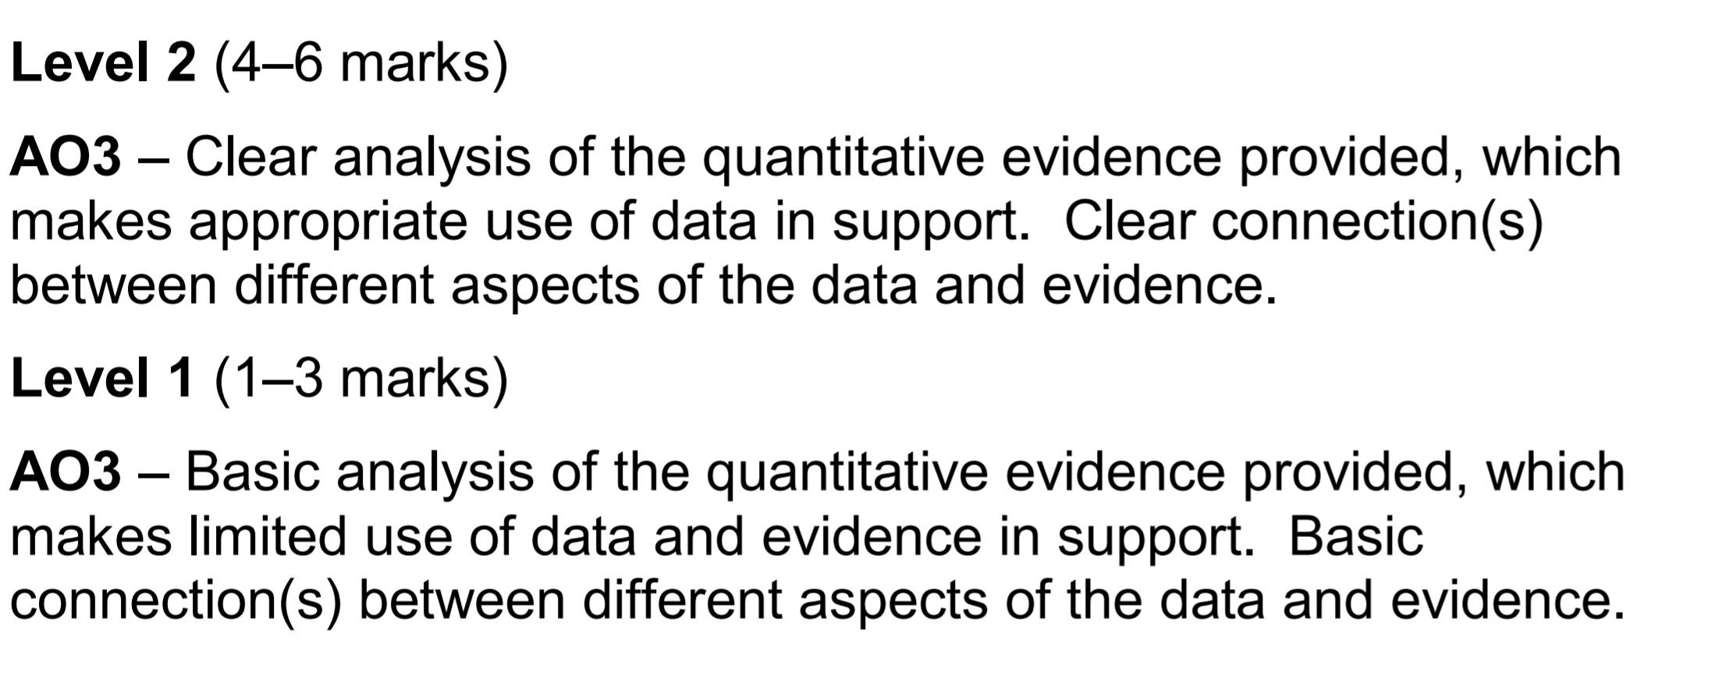
Analyse Question – Generic mark scheme

Slide 4
6 mark assess – generic mark scheme

Slide 5
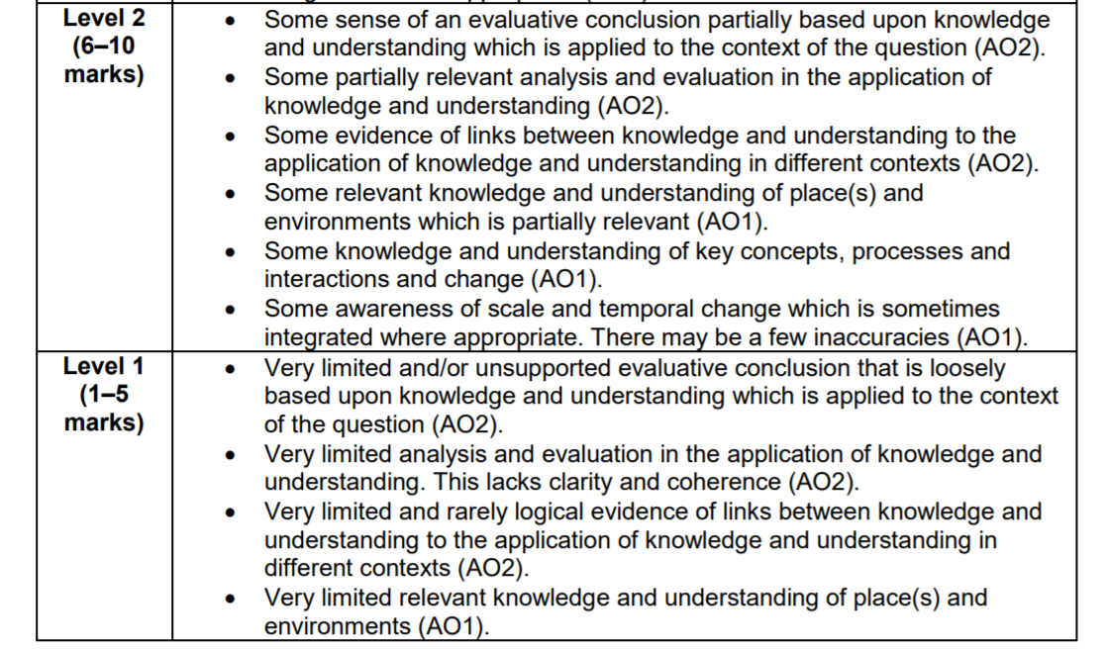
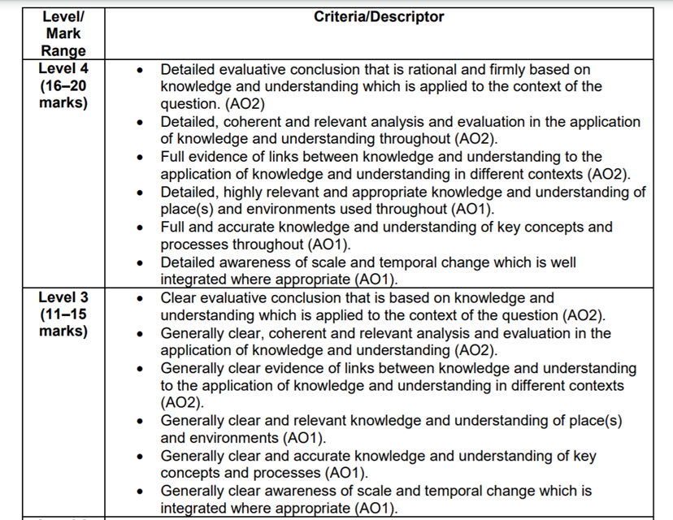
20 mark essay – Generic mark scheme

Slide 6
Other possible questions:
Explain the concept of positive feedback in relation to the water cycle.
Explain the concept of negative feedback in relation to the water cycle.
Explain the concept of a system in relation to the water cycle.

Slide 12
You could use the Amazon rainforest case study to exemplify the inter-relationships in your answer.
Other possible questions:
Assess the extent to which there are inter-relationships between processes in the carbon cycle and factors driving change in the water cycle.

