Slide 1
COMPONENT 1 Portfolio Requirements
Component 1 = 40% of your final grade

Slide 2
THE PORTFOLIO
The portfolio is worth 60 marks in total
A01 carries 40 marks and relates to:
Interpreting, creating and developing a devised piece from one key extract from a performance text and applying the methods of a practitioner
Creating and developing ideas to communicate meaning as part of the theatre-making process
Making connections between dramatic theory and practice

Slide 3
THE PORTFOLIO
The portfolio is worth 60 marks in total
A02 carries 20 marks and relates to:
Analysing and evaluating the creative process and the devised performance

Slide 4
3000 words
THIS IS THE MAXIMUM BUT IT IS WHAT WE ARE DEMANDING OF YOU ALL – aim to hit this figure
You can use small diagrams (i.e. floor plans, effort graphs etc), and small photographs of you working to illustrate your ideas – so start taking photos as evidence NOW.

Slide 5
You will use FOOTNOTES to reference your sources throughout this portfolio
Approx. 10 per question

Slide 6
REFERENCING RESEARCH
REFERENCING AND FOOT-NOTES
As you mention ANY piece of research, any text or book, any DVD or web-site, you MUST reference it:
Give the web-address Give the ISBN number Give the director / reference number Say where and when you saw the performance
So the reader of your work can find the reference and check it for themselves.
The easiest way to do this is to use the REFERENCES function on the top tool bar in WORD.
Highlight to word you want to reference.
Click on References
Click on INSERT FOOTNOTE
Write the reference in the foot note so the reader can find it
I would not include FOOTNOTES in my final word count. You can ask the word counter in WORD to exclude footnotes

Slide 7
You must give DATE ACCESSED in footnotes, for web-based sources
Internet research on Frantic Assembly, http://physicaltheatreessay.blogspot.co.uk/2013/02/essay.html (Dated Access 09/01/2021)

Slide 8
On GOL there is a section called GROUP PERFORMANCE
This is where you will find this POWERPOINT
This is where you will upload YOUR WEEKLY HOMEWORK

Slide 9
We will look at a different question each week, and upload a draft answer each week (starting next term)
This is a non-negotiable homework task. Your work will be checked to see if it is there, you are uploading to keep you focused on this important element of the component. The deadline will be negotiated now with your tutor …..

Slide 10
We will give SOME FEEDBACK – not weekly – but we aim to give you feedback ON AT LEAST HALF THE QUESTIONS you upload
We will then return to the portfolio and spend more time improving your answers ONCE YOU HAVE PERFORMED THE PIECE

Slide 11
EACH WEEK WE WILL FOCUS ON A DIFFERENT QUESTION
This week our focus is QUESTION 2

Slide 12
Connect your research material/s to key stages in the development process and to performance outcomes (AO1) 600 words

Slide 13
RESEARCH
RESEARCH MUST BE EMBEDDED THROUGHOUT. THIS IS WHAT GETS
YOU THE MARKS. A structure for this answer is as follows:
This is the area we researched / needed to research
This is why we needed to carry out that research
This is where I researched (FOOT NOTED/ date accessed)
This is exactly what I learnt from my research (some info could be in FN)
This is how we used that information in our work – THIS IS HOW IT
INFLUNECED PROCESS AND/OR PERFORMANCE
THEN REPEAT THE STRUCTURE

Slide 14
The research refers both to the extract, play text and playwright and any individual research that has been undertaken either for specific scenes or as a general way in to your piece. You are also asked to identify ‘significant stages’ – that is, key moments in rehearsal when practical advances were made in the development of your material and your piece.
The key focus here must be on the PRACTICAL APPLICATION of your research. How did the research influence your piece in terms of plot outline, style of presentation, images of themes? Your personal research might include articles, DVD and film extracts, blogs, paintings or poetry.
Write about ideas that were both accepted and rejected as a result of exploration, giving full reasons to justify the choices made. Remember to be specific here.

Slide 15
QUESTION 2
THIS IS ABOUT RESEARCH so – continually mention the word RESEARCH or PRACTICE AS RESEARCH
This must have an abundance of
footnotes! Each piece of research must have a FN source and briefly, share some findings in the FN

Slide 16
QUESTION 2 Connect your research material/s to key stages in the development process and to performance outcomes (AO1) 600 words
How did you use your research into character/context/genre/playwright to help you devise in response to the extract?
How did YOU contribute to the rehearsal process and the work of the theatrical ensemble? What sort of resources did you bring to the group?
How did your research impact on the final performance outcome?
How did you use practitioner methodologies to begin your development the final piece?
How did the performance of ???? (research) influence your piece?

Slide 17
We will go back to the previous slide …
You may not have done the work yet, but is there a question you don’t understand?
(This is different to us asking – is there a question you can’t do because you haven’t done the work yet?)

Slide 18
IN YOUR PERFORMANCE GROUPS …
DISCUSS:
What research you have already undertaken.
Share sources.
If there isn’t much to discuss then that is very telling!!

Slide 19
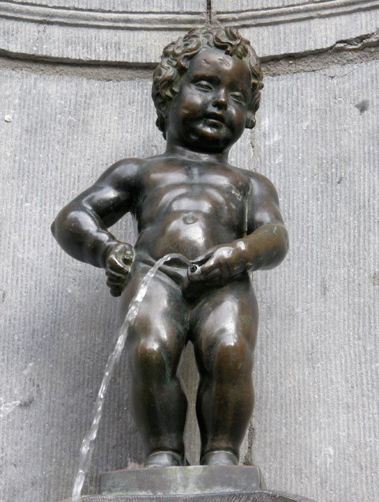

Slide 20
No IFS or BUTS you will write in the P.E.E. three point structure …….
P | Point - Make you simple point, your statement of fact – tell me what you did, what you researched
E | Example – give details of your research, your findings, your information, what you are doing in rehearsals
E | Evaluate it – discuss whether it is successful or not
L | Link back to your PERFORMANCE, your WORK Is it clear how the above has FED THE DEVELOPMENT OF YOUR PERFORMANCE PIECE?

Slide 21
You are to upload a DRAFT of question TWO (answering all the sub questions) by your agreed weekly deadline.
ENSURE YOU TITLE THE DOCUMENT – DRAFT QUESTION 2

Slide 22
USE ALL THE RESOURCES THAT ARE AVAILABLE TO YOU
On GoL are TWO example C1 portfolios.
Use them to guide you as you write each question …. They are there to help you SO USE THEM

Slide 23
Your role / your part / your character
For next week please have a think about what CHARACTER you are playing in your piece.
Think about CHARACTER DEVELOPMENT exercises for this time next week

