Slide 1
BTEC NATIONAL IN BUSINESS Unit 2 Developing a Marketing Campaign Lesson 1 What is marketing? Let’s get started!

Slide 2
Marketing is a FUNCTION of Business
Production
Human Resources
Training and Development
Finance
Record keeping
Marketing
Product
Price
Place
Promotion
Recruitment
Workforce Planning
New product development
Production techniques
Quality
Financial Accounts
Budgeting
Notes:
Brief info slide to explain that marketing is a key functional area but no need to dwell on the other functions

Slide 3
What does marketing involve?
Identifying needs (market research)
Brand development
Promoting products/services
Pricing strategies
Place and Distribution
Notes:
TEXTBOOK P61-69
Brief overview of MR and the Marketing Mix
Market research gathering and analysing information of consumers, the marketplace and competition
Market analysis examining market conditions to identify new opportunities
Marketing objectives setting of marketing goals to support the company objectives
Marketing strategy a plan detailing how the marketing objectives can be achieved
The marketing mix the 4Ps of marketing, getting the price, place, product and promotion right

Slide 4
Key roles of marketing
Anticipating demand (eg seasonal demand, new product launch, blockbuster film etc)
Recognising demand (monitoring sales and competitors
Stimulating demand (advertising and promotion, special offers)
Satisfying demand (ensuring correct price, product and stock availability)
Notes:
TEXTBOOK P61-62

Slide 5
Marketing aims and objectives (see separate ppt)
Understanding customer needs and wants
Developing new products
Improving profitability
Increasing market share
Diversification
Increased brand awareness and loyalty
Notes:
NEEDS AND WANTS – ignore textbook on this one
Needs are things that we consider to be essential – food and shelter, hot running water
Wants might be a new phone, a bigger house, a better car etc
The trick of marketing is to turn a want into a perceived need – a must-have essential
Developing new products refer back to Dyson, Apple etc, previous work on innovation
Improving profitability – by reducing costs, improving efficiency or increasing no of sales or selling price. Again be wary of the textbook on this one.
MARKET SHARE (value or volume) see slides 10 & 11
The percentage of an industry or market's total sales that is earned by a particular company over a specified time period.
Market share is calculated by taking the company's sales over the period and dividing it by the total sales of the industry over the same period. Gives a general idea of the size of a company in relation to its market and its competitors
Increasing market share helps with market control
DIVERSIFICATION
Corporate strategy: When a firm enters an industry or market different from its core business.
Reasons for diversification include
(1) reducing risk of relying on only one or few income sources,
(2) avoiding cyclical or seasonal fluctuations by producing goods or services with different demand cycles
(3) achieving a higher growth rate and
(4) countering a competitor by invading the competitor's core industry or market.
Increased brand awareness and loyalty
Consider food brands, technology brands, retail outlets etc that students recognise and rate. Good for diversification eg Sainsbury’s and Sainsbury's Bank etc (strategy also used by Tesco, John Lewis, M&S)
Marketing objectives of FOUR organisations: profit business, a social enterprise, a charity and a public sector organisation

Slide 6
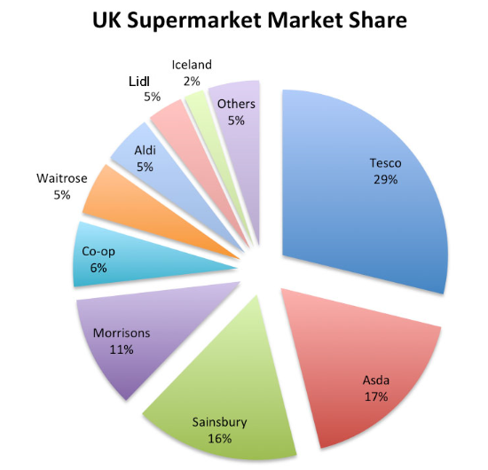
What is a market? A market is a place where goods are bought and sold in exchange for money
Markets can be defined by type
The supermarket market
The confectionary market
The mobile phone market

Slide 7
Types of market local/global mass/niche trade/consumer product/service seasonal

Slide 8
Local & Global markets
LOCAL
Where a business targets local customers
eg Godalming Taxi rank, Daisies sandwich shop
GLOBAL
Where a business sells across the world
eg MacDonald's, Vodafone, Kellogg's, BP, Coca Cola

Slide 9
Product & Service markets
Products are tangible
Clothing
Computers
Cars
Houses
Services are intangible
Hairdressing
Holidays
Accountancy
Law
Dentistry

Slide 10
Seasonal markets (dependent on time of year)
Christmas items
Summer fashion/winter fashion
Easter eggs
Ski holidays

Slide 11
Trade and Consumer markets
B2B
Business sells to other businesses
Corn, wheat etc
Petrol/fuel
Metals for engineering
Coca Cola, L'Oréal etc (goods are sold to the supermarket)
B2C
Business sells to consumers
Sainsbury's
Boots
Amazon
Topshop
MacDonald's
Both
Some businesses sells to both the trade and consumers
Stationers
Utilities (water, electricity etc)
Milk

Slide 12
Niche and Mass markets
Where a business targets smaller segment of a larger market, where customers have specific needs and wants
Organic chocolate
Farmers market produce
Environmental cleaners
Where a business sells into the largest part of the market, where there are many similar products on offer
Car Market
Confectionary
Phone
Food

Slide 13
ADVANTAGES Less competition Clear focus Builds up specialist skills Can charge higher prices Higher profit margins Customer loyalty
Niche Market (likely for your case study)
DISADVANTAGES
Lack of economies of scale
Risk of over dependence on a single product
Attract competition if successful
Vulnerable to market changes

Slide 14
Now turn to your Case Study Read through the information and decide: What type of market they are in and why? What are the advantages of this market? Who are their competitors? Do some research.

