Slide 1
Market Segmentation A way of breaking down the market into segments (sub-groups) These groups have common features or individuals who make purchasing decisions on common factors

Slide 2
What makes targeting a segment worthwhile?
A segment must be recognisable
Must have critical mass (be big enough to be worthwhile)
Targetable – have their own identity that can be promoted to

Slide 3
Typical forms of segmentation
Demographic segmentation – groups based on age, sex, ethnic background, occupation and income
Geographic segmentation – where do customers live, where do they buy?
Behavioural segmentation – looking at usage patterns, levels of brand loyalty, elasticity of demand
Psychographic segmentation – lifestyle groups, personal values and attitudes

Slide 4
Reasons for segmentation
Targeted marketing
Better serving of customers needs and wants
Higher profits
Opportunities for growth
Sustainable customer relations
Stimulating innovation
Higher market share

Slide 5
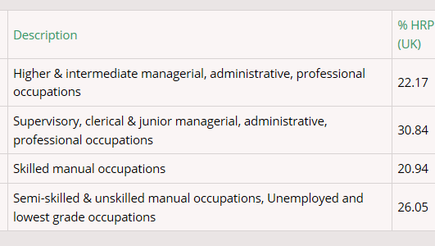
Socio-economic groups

Slide 6
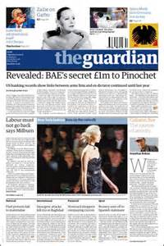
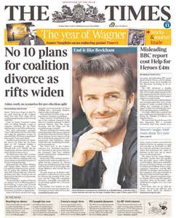
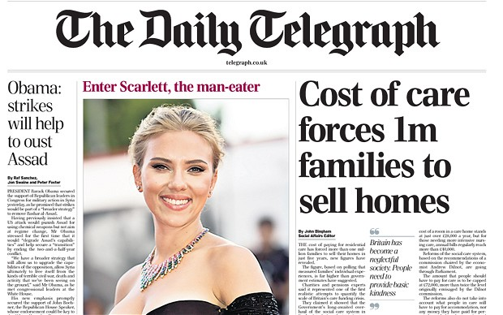
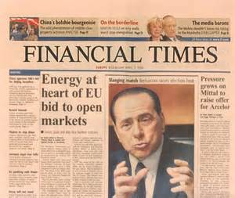
Can you link the newspapers to socio economic groups?
Why would a newspaper want to do this?

Slide 7
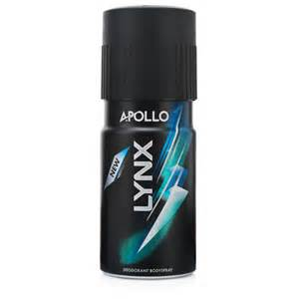
Can you segment these products?

Slide 8
Conclusion - why segment a market?
To identify the requirements of your customers more precisely
To meet the needs of your customers more effectively than the competition
To avoid wasteful marketing that is not targeted
To avoid having to sell a wide range of differentiated products

Slide 9
What is a brand?
A name, term, sign, symbol, design or any other feature that allows consumers to identify the goods and services of a business and to differentiate them from those of competitors.
A brand is a product consumer’s rely upon for quality, value and service
A brand involves a distinctive identity for a product which users can identify
McDonald’s ‘golden arches’, Nike ‘swoosh’, Adidas three stripes, Coke bottle, Virgin font/colour

Slide 10
Why use branding?
To create customer loyalty
To increase price inelasticity of demand
To increase the value of the firm
To ease customer choice
https://www.youtube.com/watch?v=JKIAOZZritk
Notes:
Disadvantages of branding
High cost of advertising
Loss of value of one product can affect a whole range of similarly branded products
Branding invites competition
High cost of R & D
Advantages
Brands offer long-term profitability to firms, giving some predictability on sales and revenue.
In order to maintain the brand a firm must:
Be sure of brand identity
Offer value to customers
Advertise and promote
Carry out market research
Continually develop the brand
Remember what made the brand successful
Protect the brand from competition

