Slide 1
BTEC NATIONAL IN BUSINESS Unit 2 Marketing Market Research Developing the rationale PESTLE, SWOT, Competitor Analysis
Notes:
TEXTBOOK page 73-78
Different research methods
Primary & Secondary
Qualitative vs Quantitative
Benefits and drawbacks of each method

Slide 2
What is Market Research?
The gathering of information regarding consumers, competitors and distributors within a target market

Slide 3
Purpose of Market Research
To identity target markets
To identify market size, structure and trends in the market
To identify competition

Slide 4
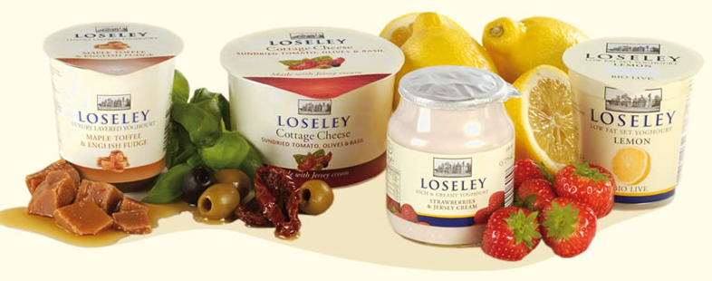
QUICK PRACTICE TASK
The Loseley Bakery are considering launching a range of jams.
Research and identify:
The target market?
Size/type of market?
Any trends in the market?
Their competitors?

Slide 5
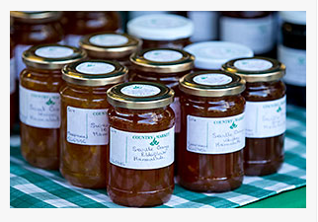
Other farm produce jams (farmers markets)
Garden centres and gift shops like Secrett’s
Niche market jams in supermarkets
Competitor Analysis
Country Markets

Slide 6
Types of Market Research
Primary or secondary
(field or desk)
Qualitative or quantitative (opinions or data)
Notes:
TEXTBOOK page 73-78
Different research methods
Primary & Secondary
Qualitative vs Quantitative
Benefits and drawbacks of each method

Slide 7
Primary Research (Field) New original information (specific to your needs)
Original data, information that has never been collected before.
Survey
Interview
Observation
Trials
Focus groups
Notes:
TEXTBOOK page 73-78
Different research methods
Primary & Secondary
Qualitative vs Quantitative
Benefits and drawbacks of each method

Slide 8
Secondary Research (Desk) Existing information (that has already been collected)
Internal
Business data on customers
Financial records to include loyalty cards and sale records
External
Commercially published reports
Government statistics
Trade Journals
Media sources (internet)
Notes:
TEXTBOOK page 73-78
Different research methods
Primary & Secondary
Qualitative vs Quantitative
Benefits and drawbacks of each method

Slide 9
Primary Research
Advantages
Specific information tailored to your needs, so should be more useful
Up to date information
Original, no one else has your data
Disadvantages
Takes time to gather the information
The information is only good if the research is appropriate, valid, reliable etc
More expensive to gather
Skilled researcher required

Slide 10
Secondary Research
Advantages
Quick and therefore Less expensive to gather
Disadvantages
Not specific information so may not exactly meet your needs
Not original data so anyone can access this info
Notes:
The reverse of the Primary slide
Advantages of secondary
Quick, easy, cheap to obtain
Disadvantages of Secondary
May not be specific
May not be completely relevant or up to date
Data is generic and can be accessed by anybody

Slide 11
Questions can be asked in a certain way to generate either quantitative or qualitative data
Quantitative
closed questions giving statistical information
Qualitative
open questions giving opinions

Slide 12
Market Research considerations
Research must be appropriate and find out the information that you really need
The methods must be reliable so that you can count on the results (validity)
Costs and benefits need to be considered
What type of information is required, Quantitative or qualitative or both?
Selection and extraction of data should be considered
There must be a sufficient amount of research to justify decision making

Slide 13
Interpretation, analysis and use of data and other information to make valid marketing decisions
When you are issued your research pack you need to read through the data and extract information to:
Set marketing objectives
Create a SWOT analysis
Create a PESTLE and Competitor Analysis (external factors)
Determining the right strategy
Action planning and budget setting
Implementation and monitoring

Slide 14
Identification of any further sources of information that may be required, eg
Government statistics
National economic statistics
Global statistics
Environmental factors
Academic research and articles

Slide 15
Reliability & Validity of data
You are required to comment on the reliability & validity of data. The two can’t be merged and must be discussed separately – they are two different concepts:
Validity – is it the right info to use for the c/s (primary research may not be).
Reliability – can you trust the data?
You should assess and comment on the reliability and validity of the data throughout and not just one paragraph at the end.

Slide 16
Research write up
You should assess and comment on the reliability and validity of the data throughout and not just one paragraph at the end.
Every time you mention a new piece of research it should be in a new paragraph
You should address the following:
What the fact is
What does the fact tell us/mean/what is its significance?
How can it be used – link to the case study
Is that fact providing an opportunity or threat?
Then analyse the reliability/validity. Ask yourself can I trust the data? Is it the right information to make a decision on.

Slide 17
Notes:
TEXTBOOK page 78-79

