Slide 1
BTEC NATIONAL IN BUSINESS Unit 2 Marketing The Marketing Mix (C2) PRICE

Slide 2
Pricing Strategies
Skimming
Penetration
Competitor Based
Notes:
TEXTBOOK P89

Slide 3
Skimming
A high price is set to yield a high profit margin during the introduction of a product, when it appeals to early adopters.
In the long term, firms use this strategy for products that they hope will ‘skim the market’. This means appealing to a more exclusive, up-market type of customer.
It is suited to marketing objectives such as maximising value added or profit margins and establishing a prestigious brand name.
Notes:
TEXTBOOK p91-92

Slide 4
Penetration pricing
This is the opposite of price skimming. Low prices are set to break into a market or to achieve a sudden spurt in market share.
Many firms use this strategy when a product is first released or to entice new customers so that market share can be increased.
It is suited to marketing objectives such as maximising sales volume (rather than value) and increasing market share.
Notes:
TEXTBOOK p91-92

Slide 5
Competitive Pricing aka competitor based/going rate
This is when you price alongside competitors
Used more for price elastic goods eg Supermarkets, Petrol Stations
What is the problem with pricing in this way for smaller businesses?
Notes:
TEXTBOOK P89

Slide 6
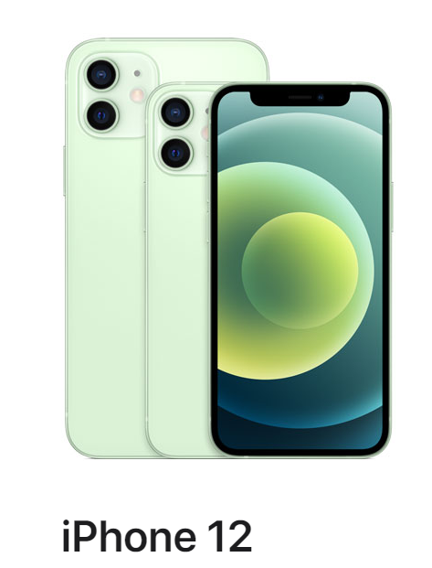

Slide 7
Activity
Jane is starting a new coffee shop on Godalming High street.
She is looking at pricing strategies for
Coffee and hot drinks
Smoothies
Croissants and pastries
Paninis and sandwiches
What sort of strategies would you suggest? Justify your answers. Consider short term and long term possibilities. Be prepared to discuss with the class.
Notes:
TEXTBOOK p91-92

Slide 8
Building your Case Study answer
Looking at the Case Study, Part B.
Who are you targeting?
What is the average selling price?
Notes:
TEXTBOOK P89 -90
Animals in advertising – Meerkats in Go Compare, annoying jingles etc to make the product distinct

Slide 9
Building your Case Study answer
Looking at the Case Study, write a strategy for the PRICE.
Use these points to help.
Who is the target market?
Who is the competition? How much are they charging (research)
Can you justify charging more? (what price are you going to charge?)
Is your product elastic/price sensitive?
Notes:
TEXTBOOK P89 -90
Animals in advertising – Meerkats in Go Compare, annoying jingles etc to make the product distinct

