Slide 1
BTEC NATIONAL IN BUSINESS Unit 2 Marketing The Marketing Mix The Other 3 Ps Physical Environment People Processes

Slide 2
Services
These 3 Ps allow businesses to make intangible products more tangible.
Therefore, they are used for SERVICES.
Remember, services include retail and customer service, so please ensure you include these in your proposal.
https://www.tutor2u.net/business/reference/the-extended-marketing-mix-7ps

Slide 3
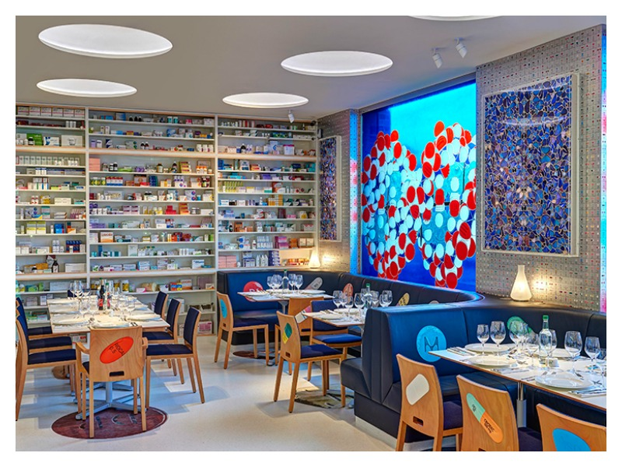
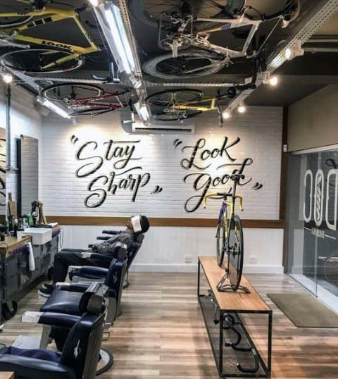
Physical Environment
Interior design
Colour schemes
Merchandising
Layout
Feng shui
Ambience
What will make yours special?

Slide 4
People
Services are provided by PEOPLE so the people are key
Customer service
Training
Uniforms?
Hair & Make-up?

Slide 5
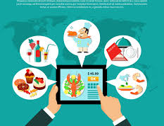
Processes
Speed of information, systems etc
Ease of purchase?
Ease of payment?
Customer service?
After sales service
Special delivery options?

Slide 6
Quick Discussion Task 1
Think of a business that focuses on any of these 3 Ps.
How have they used either Physical Environment, People or Processes in order to beat the competition?
Can you find a business that is really good in each category?

Slide 7
What is good about these businesses?
Yo Sushi!
Amazon
Nandos
Apple Store
Jacks of London
Deliveroo

Slide 8
Building your Case Study answer
Looking at the Case Study, explain the final 3ps for your proposal
Remember to consider
The objectives of the campaign
How will you best reach the target market?
Who is the competition and what could you do better?
Can any of these Ps be a USP?

