Slide 1
BTEC NATIONAL IN BUSINESS Unit 2 Marketing The Marketing Mix PROMOTION

Slide 2
What is promotion?
The process of communicating the products/services of the business
to raise awareness and generate sales

Slide 3
Why promote?
To provide customers with information
To increase sales or market share
To give products an image
To establish a corporate image

Slide 4
Aims of promotion AIDA
Attention
Interest
Desire
Action

Slide 5
Stages of promotion
Being unaware of the product’s existence
Becoming aware of the product’s existence
Understanding the benefits of the product
Establishing a liking for or a commitment to the product
Finally, the PURCHASE of the product

Slide 6
Choice of media? Depends upon…
Target market
The cost of the media
The reach of the media
The type of product
The amount of information to be conveyed

Slide 7
Promotion – often a combination of
Above the line
Usually advertising e.g. TV, radio, cinema, newspapers, internet, digital/e-media
Below the line
Tends to support the main forms of advertising e.g. Public Relations (PR), merchandising, sponsorship, direct marketing, personal selling, competitions

Slide 8
Other forms of promotion on the BTEC specification
Sponsorship
Paying to have your corporate identity promoted on merchandise or at an event
RBS at the 6 Nations Rugby
Adidas & DHL sponsor Manchester United FC
Sainsbury’s sponsor Channel 4 dramas
Notes:
AIDA page 93
TEXTBOOK P93-95

Slide 9
Other forms of promotion on the BTEC specification
Social and other media
Google
You Tube
Facebook
Twitter
Instagram
Notes:
AIDA page 93
TEXTBOOK P93-95

Slide 10
Other forms of promotion on the BTEC specification
Guerrilla marketing
Creative and unconventional methods to attract attention
Flash mobs
Graffiti
Events/stunts
Maximum impact if it can go viral on social media
Examples? Click here
Notes:
AIDA page 93
TEXTBOOK P93-95

Slide 11
Other forms of promotion on the BTEC specification
Personal Selling
A seller presents the product direct to the customer
Face to face
Telesales
An expensive method requiring a skilled sales team
Notes:
AIDA page 93
TEXTBOOK P93-95

Slide 12
Other forms of promotion on the BTEC specification
Digital marketing
Promotion of products or services using digital media
Websites
Social media
Text messaging
Emails
Notes:
Impact of the internet
Pricing
Access to customers
Niche products
Internet promotion (eg junk email, pop ups, click throughs, meta tags, search engine listings and search engine advertising)
TEXTBOOK P93-95

Slide 13
Other forms of promotion on the BTEC specification)
Corporate image
What sort of image does the company want to project?
Google, Microsoft – almost a family image, friendly
Apple – successful, thinking out of the box
British Airways – patriotic, popular, the favourite
Notes:
AIDA page 93
TEXTBOOK P93-95

Slide 14
Quick discussion – promoting a coffee shop Jane needs to promote her new coffee shop in Godalming High Street. How should she go about this? What methods would you suggest and why?

Slide 15
Building your Case Study answer
Looking at the Case Study, write a campaign (a mix of promotions) using a range of the methods you have just learned
What do you want to achieve with your campaign
How will you best reach the target market?
Who is the competition and what sorts of promotion do they use?
How much money do you have to spend on the promotion (the budget)?

Slide 16
Content of the marketing message What does the campaign want to achieve?
brand awareness
lead generation or conversion
loyalty
Is the message clear or cluttered?
Creative and/or memorable?
How can the selection of an appropriate marketing mix make a product successful?
Notes:
TEXTBOOK P98-99
Marketing plan needs a timeline – see Gantt Chart page 99
Consider the 4Ps for a product or a brand such as MacBook.
Also consider elements of the extended marketing mix such as
Trained professionals employed at the point of sale
The systems that are in place to sell and deliver the product or to train the customers how to use the product (processes)
The layout and ambience of the stores/website (physical environment)

Slide 17
Select a range of appropriate media
Range of media (website, print, internet, signage, product placement, mobile devices, sponsorship, other opportunities such as till receipts)
Market reach of the media (audience numbers and demographic scope)
Length of exposure, ability to track responses and suitability for the product/message
Notes:
TEXTBOOK P100

Slide 18
Allocation of the campaign budget
8 marks for the budget, 4 marks for the timeline
Break down costs for each method of promotion chosen eg Leaflets would need a graphic designer, printing and distribution
Make sure that the timeline reflects how long each method would be used for and the cost each month for using that method
Notes:
TEXTBOOK P100
How to set a budget (eg as a percentage of revenue, by working out what the business can afford, matching competitors spend etc)

Slide 19
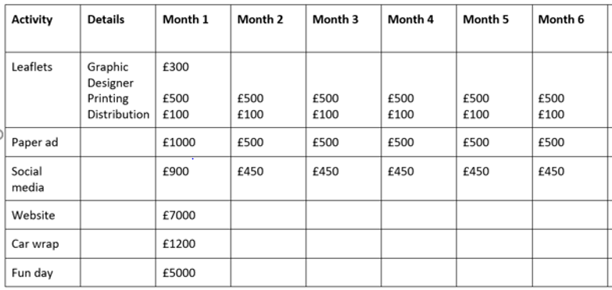
Template for a campaign budget
Notes:
TEXTBOOK P100
How to set a budget (eg as a percentage of revenue, by working out what the business can afford, matching competitors spend etc)

Slide 20
How could your campaign be evaluated?
Carrying out a Monitoring Review & Evaluation (MRE)?
Implementing feedback into the finished campaign?
Checking if the message was conveyed clearly?
Measuring if the campaign changed has the perception of the market?
Checking if the brand is clear?
Judgement: was the campaign well executed?
Judgement: was the correct target market chosen?
Notes:
TEXTBOOK P101
Measuring success or failure
Marketing return on investment – formula (return-investment)/investment
Number of units sold
Gross profit generated
Likes on social media
E-stream – Coke’s Water Bomb (Dasani)

Slide 21
Appropriateness of the Marketing Campaign
Is the campaign appropriate for the business/brand?
Does a campaign reinforce brand values and if so, how?
Are marketing activities sustainable over time with justification?
Can the campaign be changed if internal or external influences change?
Does the campaign meet the stated goals?
Does the campaign reach the right target audience?
Are there any legal or ethical considerations that need to be addressed?
Notes:
Investigate a recent campaign for a major brand
You tube – Irn Bru campaigns and website
BENCHMARK Assessment practice 2.3 page 105

