Slide 1
COMPONENT 1 Portfolio Requirements
Component 1 = 40% of your final grade

Slide 2
SPELLING, GRAMMAR SENTENCE STRUCTURE
You can not access top band marks with weak ‘writing’
Grammar
Sentence Structure
Fluidity of writing style
Spelling
Use of key terminology
YOU MUST EDIT AND CHECK YOUR WORK BEFORE YOU HAND IT IN
If SPaG is too weak, we will not feedback on the work because you can absolutely edit / check your work or get someone else to f
We will let you know if SPaG is weak – but will not correct all mistakes

Slide 3
To achieve you need to be editing and checking your work OR ensuring someone else edits and checks your work.

Slide 4
These need to be mature pieces of reflective writing that are academically under pinned and informed by RESEARCH

Slide 5
FOOTNOTES
A reminder for some of you (again!)
10-15 footnotes per question
Websites must have a (Date Accessed 29/01/22) after them
For each source you give a very brief one sentence summary of your findings from that site
Do not change the spacing font / font size of the footnotes that WORD generates

Slide 6
This week our focus is QUESTION 1

Slide 7
Outline your initial response to the key extract and practitioner and track how it developed throughout the devising process (AO1) 500 words

Slide 8
Outline your initial response to the key extract and practitioner and track how it developed throughout the devising process (AO1) 500 words
Ensure you are discussing EXTRACT and whole text as separate items
STATE WHY YOU CHOSE Frantic Assembly (not that you were just given them) AND NOTE THE CAPITAL LETTERS!!
We need to feel a sense of DEVELOPMENT – how ideas formed and how ideas were developed / changed
In this early stage of process you have already done enough / rejected enough o be able to do it

Slide 9
THERE IS A DIFFERENCE BETWEEN … Extract Whole play text
Refer to them as these two different elements.
You are devising from THE EXTRACT making reference to THE WHOLE TEXT

Slide 10
To achieve you should have read the whole play-text by now.
If you haven’t ….. !!!!!

Slide 11
Outline your initial response to the key extract and practitioner and track how it developed throughout the devising process (AO1) 500 words This draft will obviously focus on YOUR INITIAL RESPONSES. When you come back to edit and improve this draft after performance, you will then add in the THROUGHOUT THE PROCESS information as your piece continues to develop

Slide 12
How did you initially respond to the whole text? Which themes and characters were you initially interested in?
BRIEFLY (note that word) mention the WHOLE TEXT – what was your initial response to it?
Which themes grabbed you?
Why did the characters intrigue you?
P | Point – After initially reading INSERT NAME OF PLAY and FOOTNOTE DETAILS I felt ….. For me the key themes of ….. And …. Jumped out and intrigued me.
E | Example – Discuss a key theme or key character or key narrative climax here (briefly)
E | Evaluate it – Why did these moments / points intrigue and excite you??
L | Link back to your PERFORMANCE, your WORK Is it clear how the above has FED THE DEVELOPMENT OF YOUR PERFORMANCE PIECE?

Slide 13
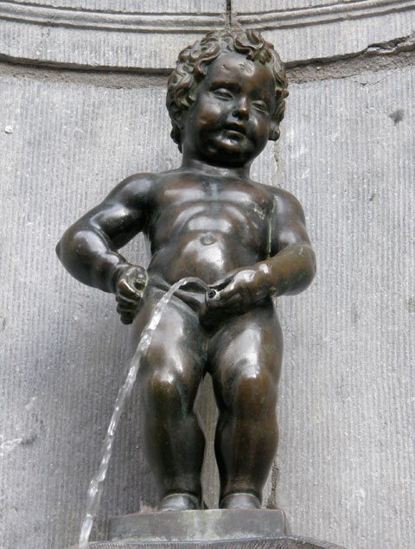
What sort of research did you do into playwright/ socio-historical context of the period?
LOTS OF FOOTNOTED SOURCES HERE
Details about the playwright
What was going on in the world at the TIME OF WRITING (TOW) that may have influenced the playwright?
REMEMBER THE 3 PART SENTENCE
Here is my POINT
Here is me EXPANDING on that point
Here is my EVALUATION of that point

Slide 14
What did you discover about the first performance of the play?
FOOTNOTE sources
How has this research influenced your work
What ideas / techniques / design aspects are you taking from that first performance
If you are rejecting the above completely justify why you have made that decision
SOME EXAMPLES ….

Slide 15
What is the relationship between the chosen extract and the rest of the play?
Why did you chose the extract you did?
How does that extract fit into the rest of the play?
Is the extract typical (in style, form, structure, technique, genre etc) of the rest of the text?
For this you need to be invested in the extract and kow THE WHOLE PLAY and how the extract fits within it

Slide 16
This is often a focus that is forgotten. You need to tell me how similar or different the extract is to the rest of the play text

Slide 17
What are the key themes in the play and how did you personally encounter them during the rehearsal process?
Eg through rehearsal activities and discussions

Slide 18
Exercises we Used During the Development of our extract
Exercise and a description of it | Why we did it and how we did it | How the exercise developed the extract and changed our ideas
Brainstorms
Depiction Work
Research
Discussions
Character Development
Scratch Performance

Slide 19
You are to upload a DRAFT of question ONE (answering as many of the sub questions as you have word count for) by a deadline that your lead tutor for C1 sets you. GoL upload
ENSURE YOU TITLE THE DOCUMENT – DRAFT QUESTION 1

Slide 20
Please note – if the work is not submitted by the deadline you will forfeit any feedback and may grade at a U for that question and therefore U over all for C1

Slide 21
Think about your responses to the text – how did you feel when you first read it
For next week please ensure you have begun to think about roles and characters you play and WHAT STANISLAVSKIAN exercises should you have undertaken to develop that role – and if you haven’t done some of these WHY NOT!!!!

