Slide 1
3.1.1.3 Carbon Cycle
Learning Objectives
To able to describe, explain, analyse and comment on factors leading to change in the carbon cycle, including; wildfires, volcanic activity, natural climate change, hydrocarbon fuel extraction and land use
Concept Checker:
What is the relationship between forests and CO2 emissions and what impact does forest fire have on this relationship?
To what extent do volcanic emissions have an impact on global warming?
What impact does natural climate change have on the carbon cycle?
What are the anthropogenic causes of climate change and how significant are these?
Key words:
Anthropogenic causes
Hydrocarbon fuels
Tipping point

Slide 2
Case study – The Siberian Tundra and changes to the carbon store
What are the effects of the melting tundra?
What has caused a vast amount of carbon to be locked up in the permafrost?
Explain the different conditions that result in the release of CO2 and methane
Why is the Yedona region of Siberia important and how does it compare to global permafrost?
Despite the release of CO2 and methane from melting permafrost, the tundra is acting as a carbon sink. Why is this?
What are the future concerns and what might happen when the ‘tipping’ point is reached?

Slide 3
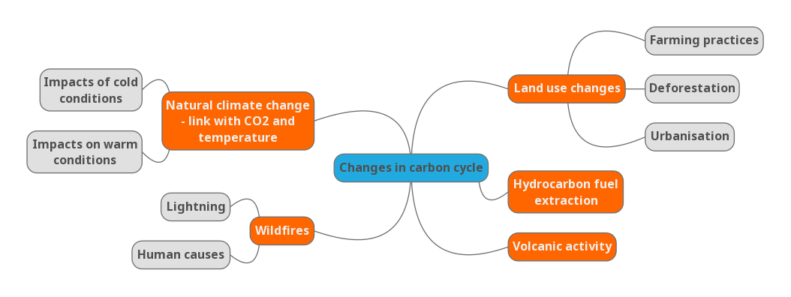
Use the Oxford and Hodder textbooks to make notes on the causes of change in the carbon cycle
Hodder p31
Oxford p31
Hodder p31 - 32
Oxford p31
Hodder p32-33
Hodder p30-31
Oxford p31
Hodder p30
Which are natural causes and which are human?

Slide 4
Assess the extent to which changes to carbon stores are a result of human action or natural systems (20 marks) Tutor 2 U
Remember to use the PEEL structure and quote key facts and figures to back up your argument.
In the conclusion you MUST state to what extent (small/large/partial) changes are a result of human or natural (physical) systems.

Slide 5
Activities p32 Oxford
Describe the patterns of temperature and carbon dioxide over the last 800,000 years.
Describe the pattern of temperature during the last 450,000 years.
Suggest how the carbon cycle was affected by cold glacial periods during the Quaternary period. How did this affect the magnitude of the stores and the operation of the transfers?
How do volcanic eruptions contribute to the carbon cycle?
How can trees be both a carbon store and a carbon sink at different times or locations?

Slide 6
Tutor2U Global carbon stores and changes in magnitude worksheet
Complete Q1-3

Slide 7
Discuss in groups:-
Rank (& justify selection) the following carbon stores in terms of their current rate of change where 1 is fastest and 4 is slowest rate of change
Cryosphere
Hydrosphere
Atmosphere
Biosphere

Slide 8
1 Atmosphere
Atmospheric CO2 is rising at an increasingly rapid rate.
The rate of change is greater than any other carbon store and the rate of increase is getting faster.
It is nearly all due to the burning of fossil-fuel hydrocarbons

Slide 9
2 Biosphere
What may be a surprise is the increase in the biospheric carbon store as global vegetation mass actually increases (and marine biomass is largely stable).
Additional atmospheric CO2 is thought to be responsible for stimulating more vegetation growth on earth, despite widely reported forest loss.
The greening of previously farmed areas in Russia, and the deliberate afforestation of land in China and much of Africa is thought to be responsible also.

Slide 10
3 Cryosphere
The cryosphere is changing slowly, although this may be more rapid in future.
At the moment there is a net carbon sink in tundra areas as warmer, longer growing seasons stimulate vegetation growth.
Although CO2 and methane are being released from melting permafrost, the rate is still one of slow net absorption of carbon.
However, this may change to a net output if atmospheric temperatures increase rapidly.

Slide 11
4 Hydrosphere
The oceans are one of the most stable carbon stores, exchanging surplus carbon with the atmosphere and recycling carbon through ocean currents, marine sediments and marine biomass.
However, there are signs that oceans are beginning to warm which will reduce their capacity to absorb CO2 from the atmosphere, limit the capacity for shell-forming marine organisms to absorb calcium carbonate and may inhibit marine biomass.

