Slide 1
3.1.1.3 Carbon Cycle
Learning Objectives
To able to describe, explain and draw conclusions about the nature of the impacts of carbon cycle, and possible future changes for the land, the oceans and the atmosphere and global climate.
Concept Checker:
What impacts on the land might future changes in carbon have?
How significant are the changes in the oceans for future marine and human life?
Why is the greenhouse effect important and why is the enhanced greenhouse effects a threat?
Key words:
Enhanced greenhouse effect
Geo-sequestration
Radiative forcing
Soil organic carbon

Slide 2
How might changes in carbon impact the land?
In groups/pairs - create a spider diagram of any impacts that there may be on the land from possible changes to the carbon cycle
e.g. melting of permafrost and the increased growth of vegetation in the tundra

Slide 3
Increased CO2 – increased vegetation (limited by water availability)
Global warming – increased global growing season (limited by water availability)
Changing climate – increased risk of floods and droughts in some areas
More wildfires
Increased temp – more decay and soils being formed
Migration and/or extinction of some species e.g. polar bears
Melting of permafrost – increased growth of vegetation
Some possible suggestions – there may be many more that you have thought of.

Slide 4
The impact of increasing atmospheric CO2 on the land has been subject to intense research.
Unfortunately, the results are unclear because the study has, so far, been over a relatively short period of time.
There are also many other variables that have an impact on the land and the atmosphere. These variables are both human and physical. What do you think these may be?

Slide 5
Impacts on the ocean
Again it is very difficult to predict the impacts on the oceans due to the complexity of the processes and a lack of understanding as to how they interact
We do know that it will have an impact on the:-
Acidity
Temperature
Sea ice
Salinity
Sea level

Slide 6
Ocean acidity
About 30% of the CO2 that has been released into the atmosphere has diffused into the oceans
This creates carbonic acid which makes the oceans slightly less alkaline
Since 1750, the pH of the ocean’s surface has dropped by 0.1, a 30% change in acidity

Slide 7
Ocean acidity impacts
Coral reefs
Plankton and shellfish

Slide 8
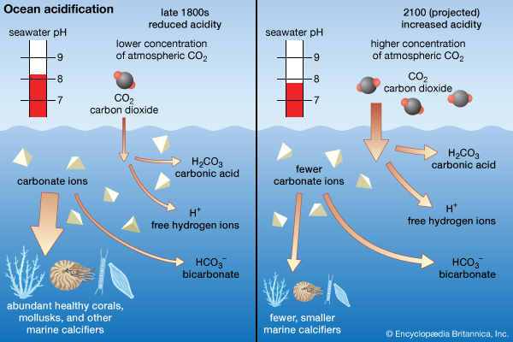
Carbonic acid reacts with carbonate ions in the water to form bicarbonate.
However, those same carbonate ions are what animals like coral and many planktonic species need to create their calcium carbonate shells.
With less carbonate available, the animals need to expend more energy to build their shells. As a result, the shells end up being thinner and more fragile.
https://www.youtube.com/watch?v=6SMWGV-DBnk
Watch and add any additional information to your notes

Slide 9
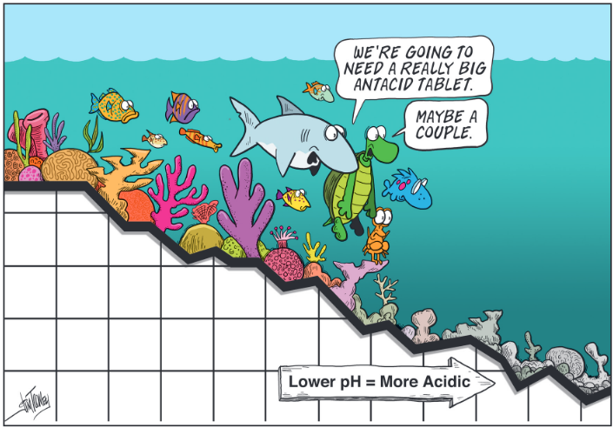
Coral reefs provide food and livelihood security for some 500 million people worldwide.
Significant reef loss and the consequent fall in marine biodiversity threatens the survival of coastal communities through reduced food availability and a reduced capacity of oceans to buffer the impact of sea level rise, including increased storm surges.
https://www.youtube.com/watch?v=dMdeZfvyJzc
https://www.youtube.com/watch?v=7oy-viAbKSM
Watch and add any additional information to your notes

Slide 10
Ocean warming
What do you think are the negatives and positives of ocean warming?
CO2 is essential for plant growth and phytoplankton. An increase in CO2 would increase their growth and so take more CO2 from the water
A decrease in the abundance of phytoplankton, which grows better in cool, nutrient rich waters. This could limit the ocean’s ability to take carbon from the atmosphere through the biological carbon pump and lessen the effectiveness of the oceans as a carbon sink.
Ocean warming kills off the symbiotic algae which coral reefs need to grow, leading to bleaching and eventual death.

Slide 11
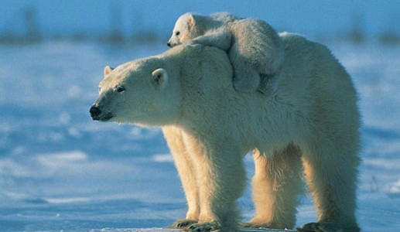
Melting sea ice
Other impacts include:-
The loss of algae found in more concentrated form in the sea ice. This has a large impact on the ocean food chain.
Reduction of ice for polar bears to walk on to reach their main source of food, seals.
In the last 35 years satellites monitoring sea ice in the Arctic have measured its retreat at 40%.
When sea ice melts, it is not just an indicator of a warming climate but also part of the feedback mechanism because the highly reflective ice is replaced by more heat absorbent water. When it starts to melt the ocean is able to absorb more sunshine, which in turn amplifies the warming that caused it to melt in the first place.
Is this an example of positive or negative feedback?
Use the information provided in the paragraph above to produce a flow diagram to show this feedback.

Slide 12
Ocean salinity
Remember this diagram of the thermohaline circulation?
The water in the far North Atlantic is cold and very saline (salty), which makes it denser and heavier – causing it to sink.
There has been an observed decrease in salinity in the North Atlantic. This is probably due to higher river run-offs and the melting of the Greenland ice sheet.
These changes have been linked to a possible slowing down of the large scale oceanic circulation in the North-East Atlantic.
What effects might the disruption of the North Atlantic Drift have on the climate of NW Europe?
https://www.youtube.com/watch?v=UuGrBhK2c7U

Slide 13
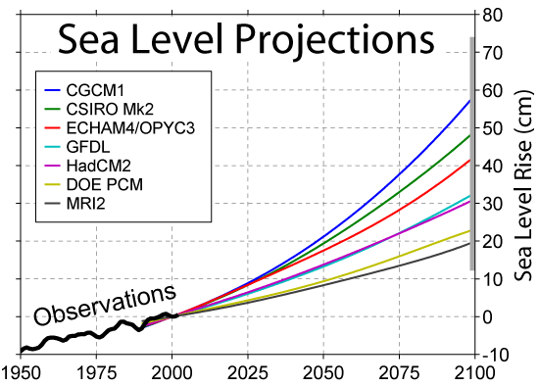
Sea level rise
Research now indicates that sea levels worldwide have been rising at a rate of 3.5mm/year since the 1990s
Causes include:-
Melting of terrestrial ice
Thermal expansion
If the earth continues to warm up then we can expect the oceans to rise between 20 and 60cm by 2100. This is not an exact science. Notice the huge variation in predictions?
What are the likely effects of the predicted sea level rises on coastal communities?
How might the response of those communities depend on their level of development?

Slide 14
Impacts on the atmosphere
The Natural Greenhouse Effect
Although the land and oceans will take up most of the extra CO2, as much as 20% may remain in the atmosphere for many thousands of years. This is significant because CO2 is the most important gas for controlling the Earth’s temperature.
The natural greenhouse effect is explained in the following slides. However, it is important to note that the greenhouse effect is good for life on earth. Without it the earth would be frozen
https://www.youtube.com/watch?v=SN5-DnOHQmE

Slide 15
100% enters the atmosphere
30% reflected back into space
Further radiation occurs, some of which is reflected again
50% radiated back into the atmosphere but 5% absorbed/reflected back to earth’s surface by greenhouse gases
20% absorbed by the gases in the atmosphere
50% absorbed by the land and the oceans
Earth absorbs reflected radiation and warms more
Use the information in the following powerpoint to add the % figures for radiation in the boxes in the diagram, and add an explanation for the steps into the table.

Slide 16
Step 1 Short wave solar radiation enters the atmosphere (currently at 100%)
Step 2 About 30% of the heat radiation is reflected by the atmosphere and clouds and sent back to space (70% remaining)
Step 3 After travelling through the atmosphere about 20% of the radiation is absorbed by the gases in the atmosphere (50% remaining)
Step 4 The Earth’s land and ocean surface absorbs the remaining 50% heating the land and oceans. This radiation will be released later as longwave radiation.
Step 5 The Earth’s land and ocean will naturally release the 50% of heat radiation back into the atmosphere. But approximately 5% of the radiation will be absorbed or reflected by greenhouse gases
Step 6 The Earth’s land and ocean will absorb the reflected greenhouse radiation warming even more
Step 7 The Earth’s land and ocean will again release this radiation, where some will be trapped in the greenhouse again to reflect back to earth. Eventually, all the beginning radiation will be released back into the atmosphere.

Slide 17
The Enhanced Greenhouse Effect
The problem that we are facing us is that of an enhanced greenhouse effect. This is where the extra CO2 and other greenhouse gases in the atmosphere are causing something called radiative forcing.
The concept of radiative forcing is that if the balance between the incoming and the outgoing energy is anything other than zero there has to be warming (or cooling, if the number is negative) going on.
The amount that the Earth’s energy budget is out of balance is called the radiative forcing and is a measure of recent human activities. It is measured in watts/m2 of the earth’s surface.
Studies have shown that prior to 1750 radiative forcing was negligible. Since then it has increased, not only because of increased greenhouse emissions but also changing albedos due to land use changes.
Measurements of the actual amount of radiative forcing is difficult because of many complicating factors including natural changes in solar radiation and the effects of aerosols such as carbon particles from diesel exhausts.
How might the way people live in various parts of the world contribute to rising levels of CO2?

Slide 18
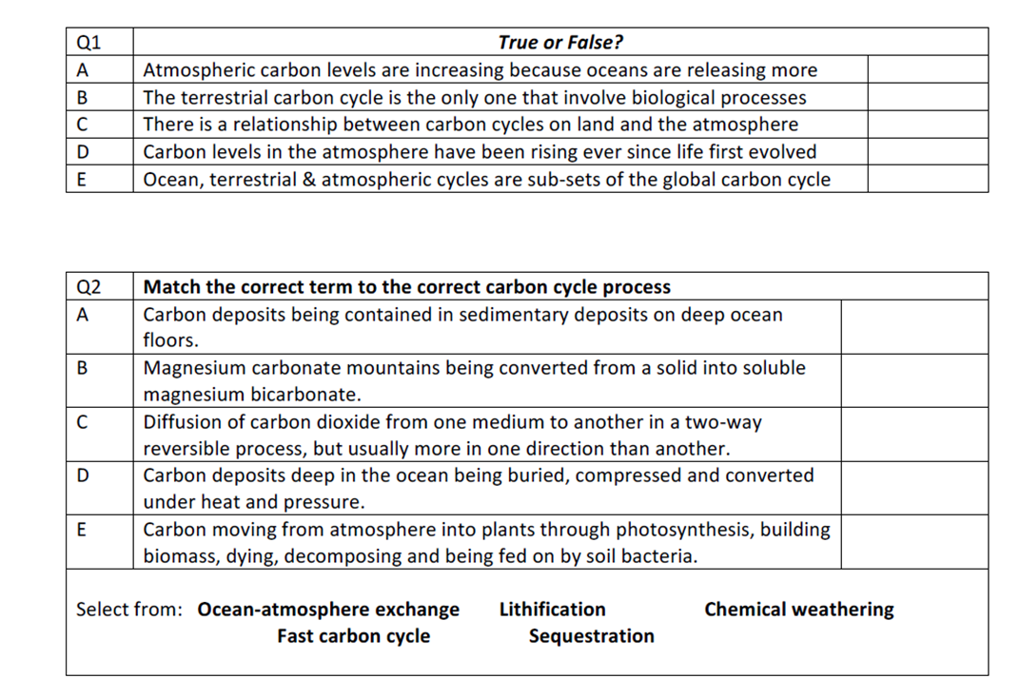

Slide 19
