Slide 1
20 mark methods in context
In Paper 1 (education) you will answer a research methods question that looks at whether a method is the best one for studying a particular education issue
https://www.tutor2u.net/sociology/reference/research-methods-and-methods-in-context-webinar
Last 10 minutes of video

Slide 2
Aims
To recap the structure of a 20 mark, methods in context question
To consider the who, what and how of the question
To be able to analyse the item for the question and use hooks in your answer
To be able to plan a mic question
Understand how these questions are assessed/marked
To write your own mic questions

Slide 3
Resources to go with this powerpoint
Tutor2U Topic Companion for Theory and Methods p.62-67 (but this booklet also includes evaluations for each of the methods and example 10 mark questions)
Tutor2U ‘Marking MIC questions and example’
Pack of 10 top band essays
MIC model essay (blank) and with marking bands
Essay planning sheets for questions
Example questions to have a go at

Slide 4
How the 20 mark question works:
The question will include an Item, which you will need to refer to.
They always have the same format:
Applying material from Item B and your knowledge, evaluate the strengths and limitations of using [a method] to investigate [an issue in education e.g. parental attitudes, classrooms, pupils, teachers, schools, setting and streaming, material deprivation, cultural deprivation etc].
The method could include: questionnaires (face to face or postal), interviews (structured, semi-structured, unstructured), participant observation (cover or overt), experiments, longitudinal approaches, documents and official statistics.

Slide 5
Answering the question
One of the more challenging aspects of the Methods in Context (MIC) question is being able to explain the strengths and weaknesses of a specific method in the context (related to) the context of education.
Students end up writing about strengths and weaknesses of PET factors but without mentioning the topic or group being researched – this will put your answer in the middle mark band (max of 12/30: C)
To help solve this each paragraph needs to cover at least 2 of the following considerations (and all 3 if you want to get into top band)
WHO/WHERE
WHAT
HOW

Slide 6
WHO, WHAT, HOW
WHO/WHERE is the sociology researching? e.g. Parents, pupils, teachers, schools, classrooms
WHAT is the sociologist researching? e.g. material deprivation, setting and streaming
HOW is the sociologist conducting the research? e.g. the methods used [this is covered from your evaluation for each method and is included in the Tutor2u topic companion]
We are going to complete some exercises for the WHO and WHAT to get you to really think about the context of the question

Slide 7
WHO, WHAT, HOW
Example
Applying material from item A and your knowledge of research methods, evaluate the strengths and limitations of using written questionnaires to investigate pupils’ levels of cultural capital (20 marks
WHO/WHERE: Pupils BUT – some of this may be found out by asking parents, so a stronger answer would consider asking parents too
WHAT: cultural capital
HOW: written questionnaires (which could be a mix of quantitative and qualitative)

Slide 8
WHO
Tutor2u videos covering these areas (MAKE NOTES ON EACH ONE):
Methods in Context: Researching In-School Factors
Methods in Context: Researching Pupils
Methods in Context: Researching Teachers
Methods in Context: Researching Parents
Methods in Context: Researching Home Factors

Slide 9
CERTAIN ISSUES WITH THE WHO/WHERE
Access/ gatekeepers | Gaining access to schools is difficult, teachers are busy and school leaders don't want students learning environment interrupted- do school leaders want their schools under scrutiny?
Vulnerability | Young people are a vulnerable group- students with learning difficulties/ difficult home environments or very young children are the most vulnerable - there are ethical concerns researching these groups
Language capabilities | Very young children or students with EAL may not understand researchers questions- a questionnaire is not appropriate for students with a limited ability to read/ write – potential issues of the restricted/ elaborated language codes for working class students
Recording data | Gaining and recording data from students is difficult when doing covert research – access to data is problematic as so much is classified
Memory status | Asking students/ parents or teachers to recall information from the past could cause issues of validity if remembered inaccurately
Group pressure | Group interviews or focus groups maybe effected by dominant group members- observations may have reduced validity if students " play up" due to having a researcher present.
Authority | Adult researcher maybe intimating for some students, especially in a 1:1 situation like an interview
Getting " backstage" | can a researcher gain access to areas like a staff room to get more understanding? What about a students common room?
Impression management | The Hawthorne effect may impact the validity of the research if the students/ teachers or parents change their behaviour or answers – is the researcher getting a true reflection?

Slide 10
Using the item: hooks
Item A:
One explanation that has been offered for the underachievement of different social groups is the level of cultural capital that they possess. Sociologists have examined differences in skills, language, attitudes and tastes between pupils of different social backgrounds and found differences in educational achievement based on their knowledge of what is seen as ‘good knowledge’. Research suggests that this is passed down from parents to their children. However, what constitutes ‘good knowledge’ is a matter of debate for sociologists.
One way in which sociologists have conducted research into this area is through written questionnaires. These can be administered quickly and across a broad range of parents and pupils. However, they do have a lower response rate than some other methods.
Applying material from item A and your knowledge of research methods, evaluate the strengths and limitations of using written questionnaires to investigate pupils’ levels of cultural capital (20 marks)
Hooks?
Unlike the 20 and 30 mark essays we have done in family/education, there is no requirement to use the item, however the item contains many hints and tips

Slide 11
Using the item: hooks
Item A:
One explanation that has been offered for the underachievement of different social groups is the level of cultural capital that they possess. Sociologists have examined differences in skills, language, attitudes and tastes between pupils of different social backgrounds and found differences in educational achievement based on their knowledge of what is seen as ‘good knowledge’. Research suggests that this is passed down from parents to their children. However, what constitutes ‘good knowledge’ is a matter of debate for sociologists.
One way in which sociologists have conducted research into this area is through written questionnaires. These can be administered quickly and across a broad range of parents and pupils. However, they do have a lower response rate than some other methods.
Applying material from item A and your knowledge of research methods, evaluate the strengths and limitations of using written questionnaires to investigate pupils’ levels of cultural capital (20 marks)
Hooks?
Unlike the 20 and 30 mark essays we have done in family/education, there is no requirement to use the item, however the item contains many hints and tips

Slide 12
structure
Introduction (WWWE):
What - define the method and the issue in the question
Who – would generally use it? (Positivist, Interpretivist, Realist)
Why – would they use it to study the education issue in the question? (e.g. to compare results, to gain validity, reliability, representativeness etc.)
Evaluation- who would not use the method to study the education issue in the question and why? (Positivist, Interpretivist, Realist)
Notes:
Look at two examples from the O’Leary revision book- p.59 and p.64- think about how they are different and whether they have applied the approach

Slide 13
Structured- continued (main body)
Each paragraph should include a strength and weakness of the method (HOW)
The key thing is that every paragraph has to consider using the given research method to study the education issue in the question. You need to be specific about how particular groups e.g. pupils, parents, teachers etc. might respond to the method. Referring to WHO/WHERE & WHAT
This means including examples of studies or research characteristics that will help back up your argument. Application is key- you need to demonstrate that you are able to relate what you know about a method to its application in real life.
You should aim for:
Introduction ( using WWWE)
Four to six short paragraphs
A conclusion that weighs up how effective the method is for studying the issue in the question

Slide 14
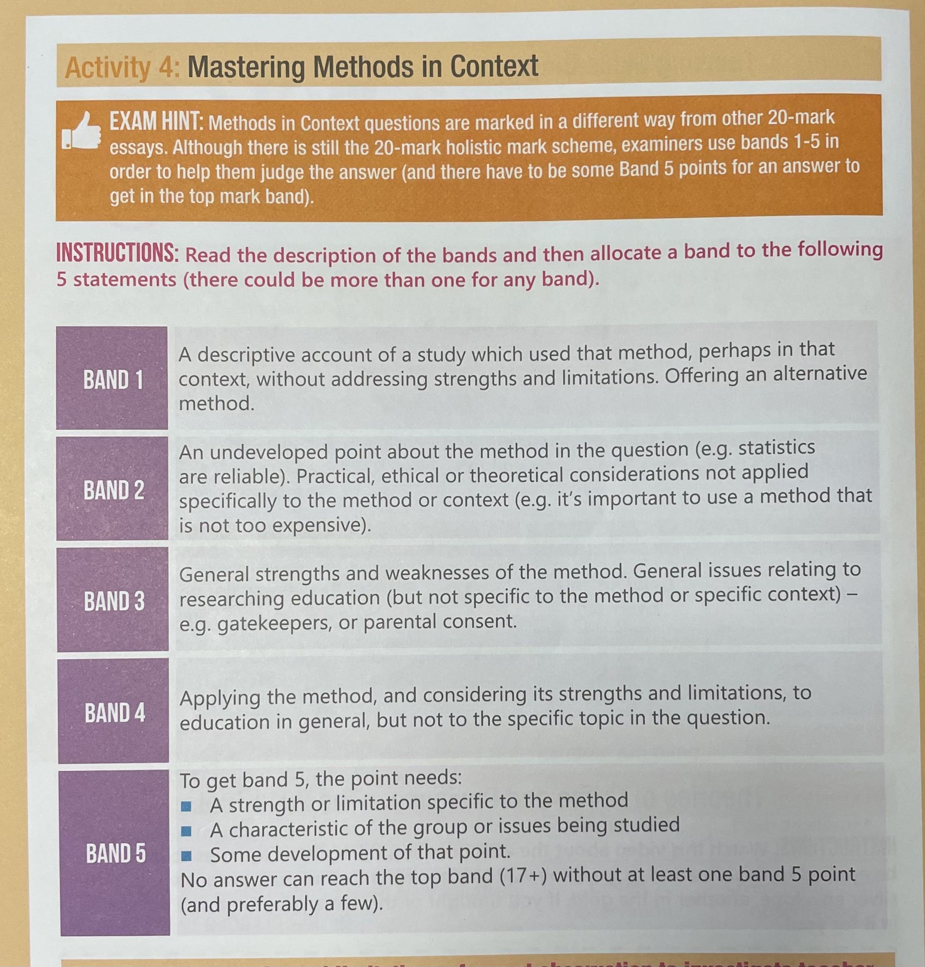
How the essay is marked
Each paragraph is marked individually and placed in a band. To get into top band you need at least one band 5 response and consistent band 4 responses.

Slide 15
Look at a range of examples
Look at one of the examples you have been given, identify:
WHO/WHERE- where the research is taking place and who is it with
WHAT – what is the issue being studied
HOW: Practical issues, Ethical issues, Theoretical issues
Remember to get a band 5 mark you need to include all three of these elements in your paragraphs
Plan and write your own
Notes:
Use p.59-61 of the O’Leary revision book at the 20/20 question- use this to get students to highlight where the research context has been addressed. Then use the example of the 13/20 answer on p.64-65, get them to write a list of the factors that have not been covered.

