Slide 1
Learning Aim B:
The development of brands and brand extensions in different travel and tourism organisations
LO: To describe and explain how travel and tourism organisations develop brands and identify markets.

Slide 2
Starter Activity
British Airways.
Iberia.
International Airlines group.
What do these 3 organisations have in common?
They are the same organisation

Slide 3


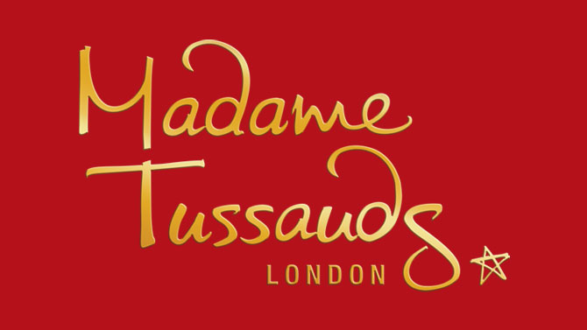


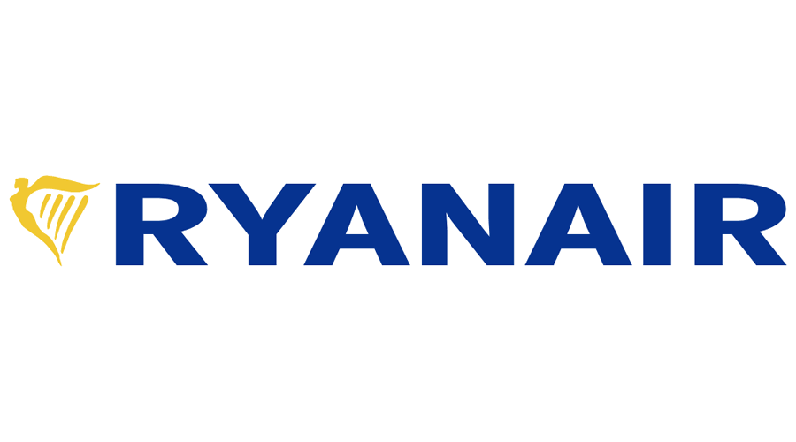
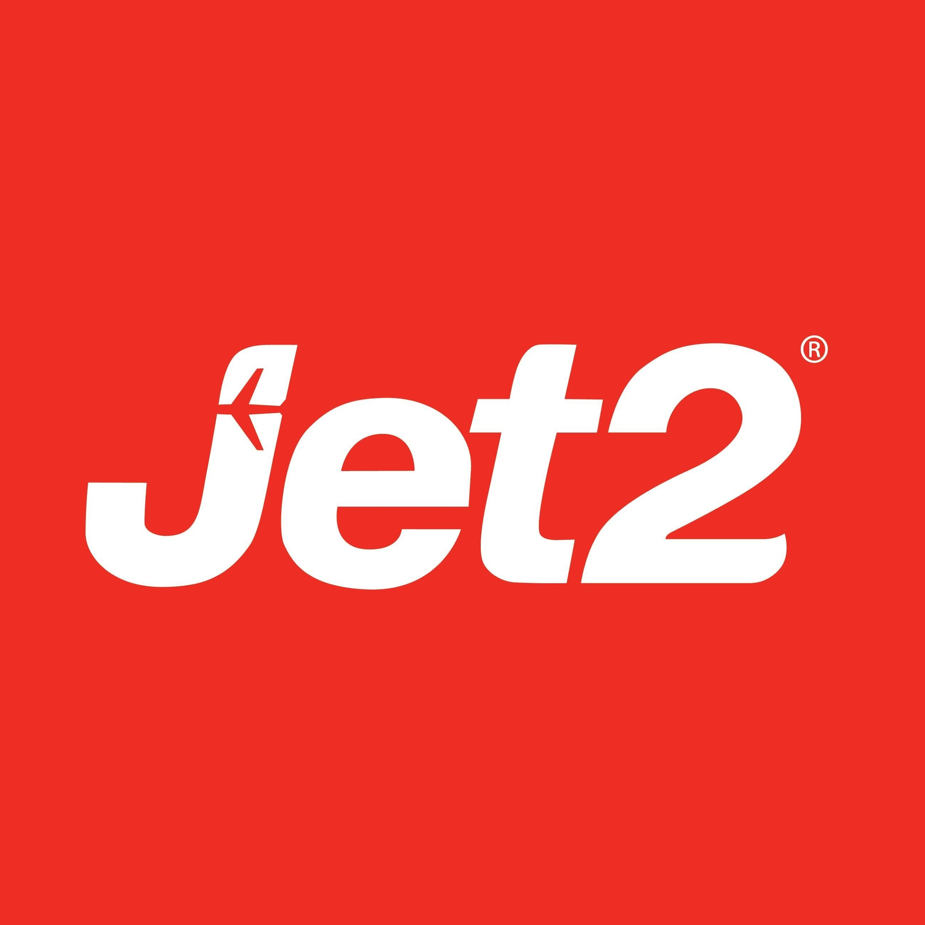

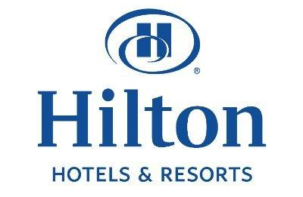
Who do these logos belong to?
Are they instantly recognisable?
Does their branding tell you anything about the company?

Slide 4
Branding
Branding is how a company is recognised by its customers, and how it is different from its competitors. It contributes to the image that the public have of the organisation.
A brand represents the company’s values and gives the customer something to talk about, so it is vital for its reputation.
An organisation builds its brand awareness through its name, logo, website, social media presence, and most of all, through its customer experience.
Many businesses have more than one brand under their main company name; building up brand extensions or a family of brands. AccorHotels group, for example, has more than 20 brands. This allows it to target different markets with different brands, from budget to luxury.

Slide 5
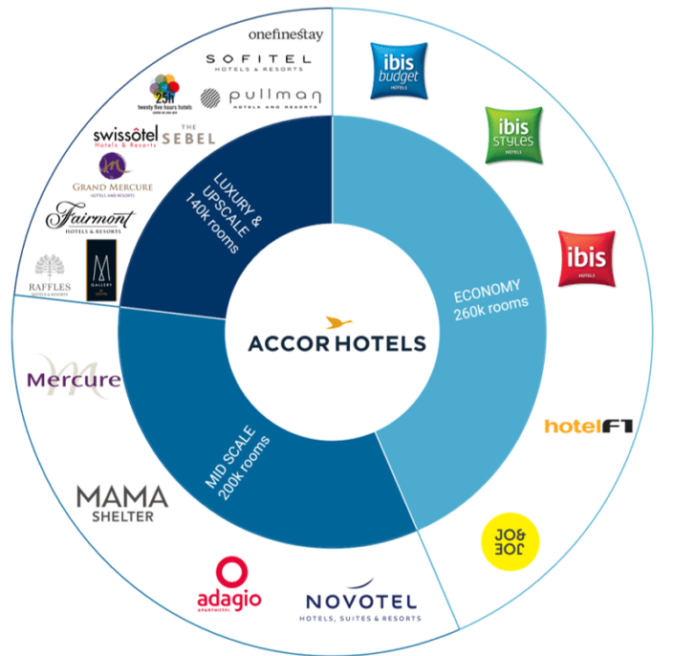
Accor Hotels operate a number of different brands of hotel.
https://www.youtube.com/watch?v=nz_s1v-QzNA

Slide 6
Brand Values
When building a brand, the marketing activities should try to achieve the following brand values.
Differentiation – something that’s unique about the brand that others do not have.
Knowledge – the extent of the customer’s knowledge about the brand and how they perceive it.
Esteem – the extent to which the customer perceives the brand to be of good quality and popular.
Relevance – How appropriate the brand is for a customer.

Slide 7
Task: Expedia
Research the different brands owned by the Expedia group.
Make a list of these brands – which component industries do these fit into?
Why do you think Expedia don’t have one name for all of their brands?

Slide 8
Implications of organisation size for marketing activity
Large organisations often have functional department with specialist staff to provide expertise in a certain area and serve the whole organisation. These might include:
HR
Research and Development
Sales
Marketing
Purchasing
Product Development
Finance and Accounting
IT
Customer Service
Dividing an organisation into functional areas can be useful as it allows employees within each department to become highly specialised and expert in their area.
However it can lead employees to think they have no responsibility for functions outside their own functional team. E.g. employees in IT may feel they have no responsibility for customer service.
Smaller organisations cannot afford to have all these departments and may have to manage different areas with few staff.
Marketing roles ideally require specialist expertise, but the number and status of roles depend on the budget available.

Slide 9
Mass and Niche Markets
Mass market products and services appeal to large numbers of people and are related to the maturity stage of the product life cycle – where a product or destination has reached a stage of such high popularity that everyone wants to try it.
A product that appeals to a niche market is one which is a specialist product or service that appeals to a small target market with very similar interests; for example diving holidays generally only appeal to divers. Some tourism businesses choose to specialise in a niche market and can be very successful if there are few competitors and the can easily achieve the main market share.
Companies which specialise in each type of market are likely to very different in size. E.g. TUI is mass market and The Wedding Travel Company are niche market.
Task: How might their marketing differ?

Slide 10
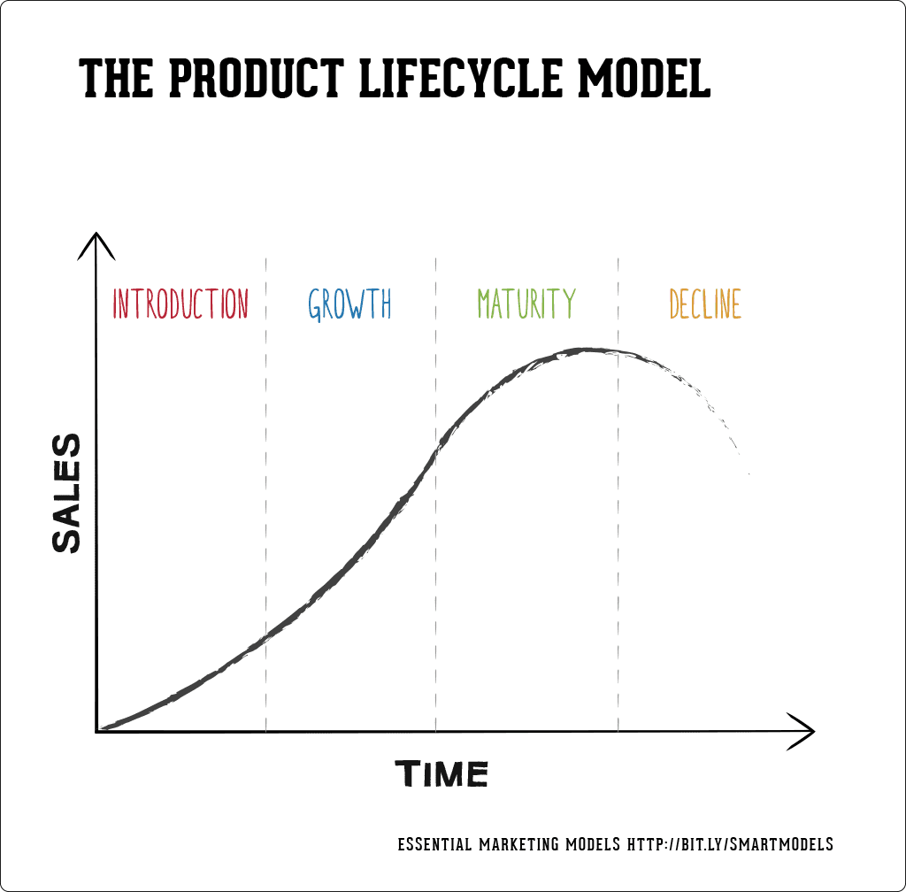
Recap: The Product Life Cycle Model
This model allows an organisation to identify the stage of growth or decline for an individual product from within its portfolio at any given time.
Some products will be earning large amounts of profit and will grow in popularity whilst others are struggling to maintain a hold in the market and are making little revenue for the organisation.
This graph allows you to plot the sales volume and profitability of a product, service or destination in the T&T industry.

Slide 11
Mass and Niche Markets
TUI
The Wedding
Travel Company
Advertising on TV
Expensively produced adverts
Prime time TV advert slots
High Street Travel Agents
Large adverts in newspapers and magazines
Radio Advertising
Low cost print adverts
Occasional radio adverts
Adverts in specialist magazines
Wedding Fairs

Slide 12
Task – TUI Group
The following is an extract from an article in Travel Weekly about TUI’s proposed branding strategy.
‘TUI group confirmed it will adopt TUI as a single brand today, saying the process could take 5-10 years. There will be 2 phases of ‘brand migration’, beginning in the Netherlands, France and Belgium.
The UK will fall in phase 2 of the programme, with the Thomson brand giving way to TUI. Fritz Joussen, TUI joint chief executive, said “I don’t think it is a big risk, The TUI smile is known in all our main markets. It is a bit like when you have an old house and you decide to renovate it a little. It is the right thing to do. You over-estimate the risks and underestimate the benefits. Rebranding is always a chance to reach new customers”.’
What do you think are the reasons for the rebranding strategy?
What are the risks of rebranding a business? What could be the benefits?
Do you prefer Thomson or TUI as a brand name? Why?

