Slide 1
B2: How does marketing contribute to the success of travel and tourism organisations?
LO: To describe and explain how marketing contributes to the success of Travel and Tourism organisations.

Slide 2
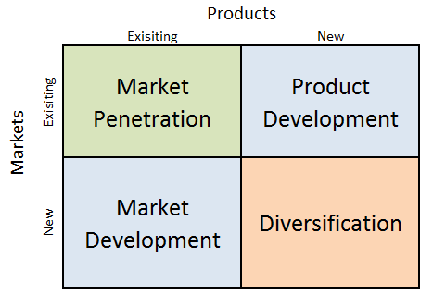
What is this?
What is the importance?

Slide 3
Recap…
What can you recall about Business Objectives.
How can marketing contribute to business objectives?

Slide 4
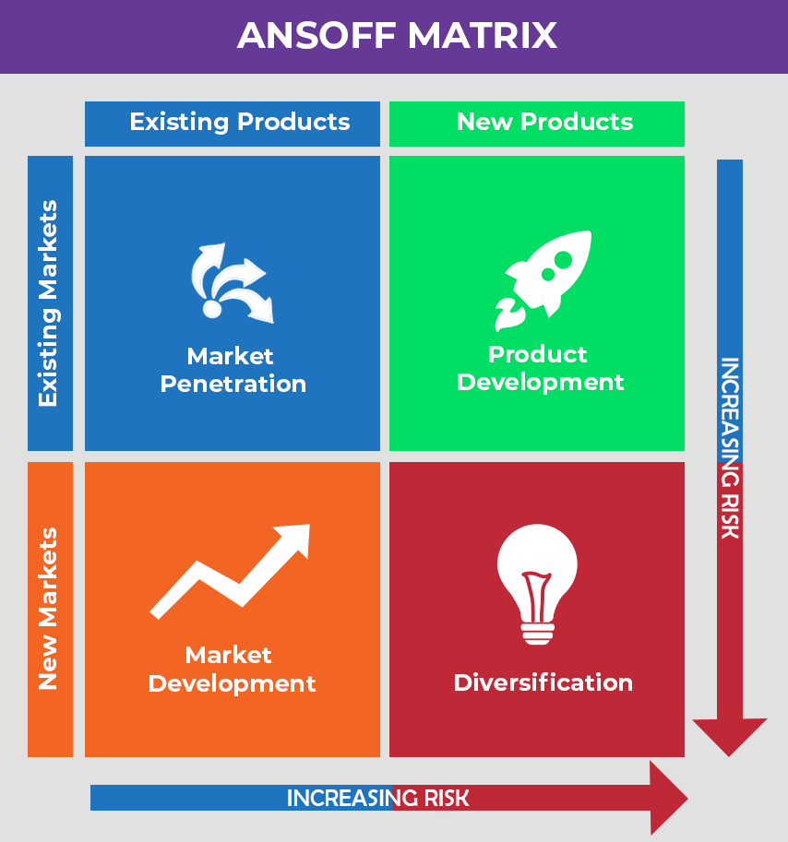
Growth - The Ansoff Matrix
Watch this video and make notes.
https://www.youtube.com/watch?v=CMFXsJxi05U (13 mins long)
How does The Ansoff Matrix work?

Slide 5
Growth - The Ansoff Matrix
Market Penetration: The products or services are unchanged and are marketed to existing customers. The organisation tries to increase market share through more promotions and advertising.
Market Development: A new market is found for existing products or services. This could be a new target market domestically or internationally.
Product Development: The products or services are improved or amended. Modified products are marketed to the same customers who have purchased them previously, but with the new features included.
Diversification: The organisation goes into new areas; for example, by offering new destinations or offering brand-new products.

Slide 6
Task – Ansoff Matrix
Complete the worksheet on the Ansoff Matrix describing the different boxes and explain why it is useful as a strategy.
Support with examples from your two travel & tourism organisations.

Slide 7
What are the links between marketing and achieving an organisation’s aims and objectives?
All marketing activity must link back to the organisation’s aims and objectives to ensure that marketing activity is another means to help the organisation achieve its goals.
This can take some time, particularly where objectives are difficult to achieve; for example, building a brand and gaining recognition in a crowded market may be a longer-term goal.
Directors of travel and tourism organisations will rely on their marketing departments to ensure that they all doing they can to help make the business successful by careful and strategic marketing.

Slide 8
Approaches to Marketing
Push and Pull Approaches
Pushing a product or service is letting a customer know bout a product directly by showing it to them and offering incentives to buy. E.g. sending targeted emails direct to the consumer, showcasing products at trade shows/ exhibitions.
Pulling customers takes longer but is when customers demand the product and ask for it. The ‘Pull’ is created by building up interest and desire perhaps through influencers on social media or guerrilla marketing to create lots of excitement and interest.

Slide 9
Approaches to Marketing
Business to Business (B2B) & Business to Customer (B2C)
Travel and tourism marketing may be business to business (B2B) for example a travel app developer would market its services to tour operators, or business to consumer (B2C) for example a travel agent selling directly to customers.
Some organisations may run two different marketing strategies, one aimed at businesses such as a tour operator marketing int products to travel agencies (B2B) and another strategy marketing directly to customers (B2C).

Slide 10
B2B and B2C
Business to Business (B2B)
Business to Customer (B2C)
Watch this video and complete the table on how B2B and B2C marketing are different:
https://www.youtube.com/watch?v=OqcTwveJmRU
B2B | B2C

Slide 11
B2B in Travel and Tourism
Close Relationship with other businesses, sharing of information over a long period of time.
Organisations working with a small number of other businesses with strong element of trust on an ongoing basis.
High value orders in volume (hotel beds / flight seats)
Purchasing decision are complex and involve many people

Slide 12
B2C in Travel and Tourism
Mass marketing based on purchasing products.
Based on wants rather than needs, customers making emotional decisions.
Organisations work with a large number of customers, usually over short period of time, or even just one purchase
Low value orders, low volume (one hotel room purchased at a time)
Purchasing decisions are on an individual basis.

Slide 13
Approaches to Marketing
Customer Relationship Management (CRM)
CRM is the management of all the strategies and processes that lead to providing excellent service and, therefore, retention of customers.
One of the keys to successful marketing is knowing and understanding what your customers’ needs are. Every time a travel and tourism organisation takes a booking, it receives information about the customer, such as their personal details and their preferences. This provides data that can be analysed to understand customer trends.
Many organisations have a variety of databases to store information about their customers. This can lead to inaccuracies. The technological response to this is to a CRM system that holds a single view of customers with all their details and purchase history in one place. This means that the data can be meaningfully analysed and used by the marketing department to help make marketing decisions.

Slide 14
Customer Relationships and Loyalty
One of the functions of marketing is to build strong customer relationships. The aim is to generate customer loyalty so that customers return again and again.
Methods of creating customer loyalty include:
Using partners such as hoteliers or agents who themselves provide excellent service.
Manage word-of-mouth promotion and social media to generate positive images and reputation.
Make it easy for customers to do business by offering different channels and mobile apps.
Communicating new products and services to existing customers.
Creating loyalty schemes to encourage your customers to keep on returning to your product.
Train employees to deliver excellent service.
Organisations have to keep monitoring all these activities to assess whether the are effective and what may need to change.

Slide 15
B2B and B2C
Study your profiles of Travellanda and Premier Inn, and from the marketing activity section:
Identify why Travellanda is B2B and why Premier Inn is B2C.
How are their approaches to marketing different as a result?

Slide 16
Membership of Trade Organisations
Attending trade shows e.g. World Travel Market, London
Dedicated Account Managers for each client.
Reports and articles on the company in industry media.

Slide 17
Direct marketing with the public e.g email communications.
Bookings can be made through the Premier Inn website
Stressing quality and price – an emotional approach.
Use of celebrity advertising on the tv.

Slide 18
What are the impacts on customers?
Good marketing will…
Attract new business e.g. new target market, more customers from other competitors.
Retain customers/repeat business.
Encourage customers to spend more or make additional purchases.
Build and retain customer loyalty e.g. collecting points on an incentive scheme.
Build on CRM techniques.

Slide 19
What are the impacts on the organisation?
Good marketing will…
Develop clearer links between marketing and an organisation’s aims and objectives – e.g. to develop a budget/premium brand
Develop the brand and brand extensions e.g. niche markets, relationship to product lifecycle where brand is rejuvenated after moving towards decline
Increase profits – leading to greater budget for marketing activities and larger dividends to shareholders.

Slide 20
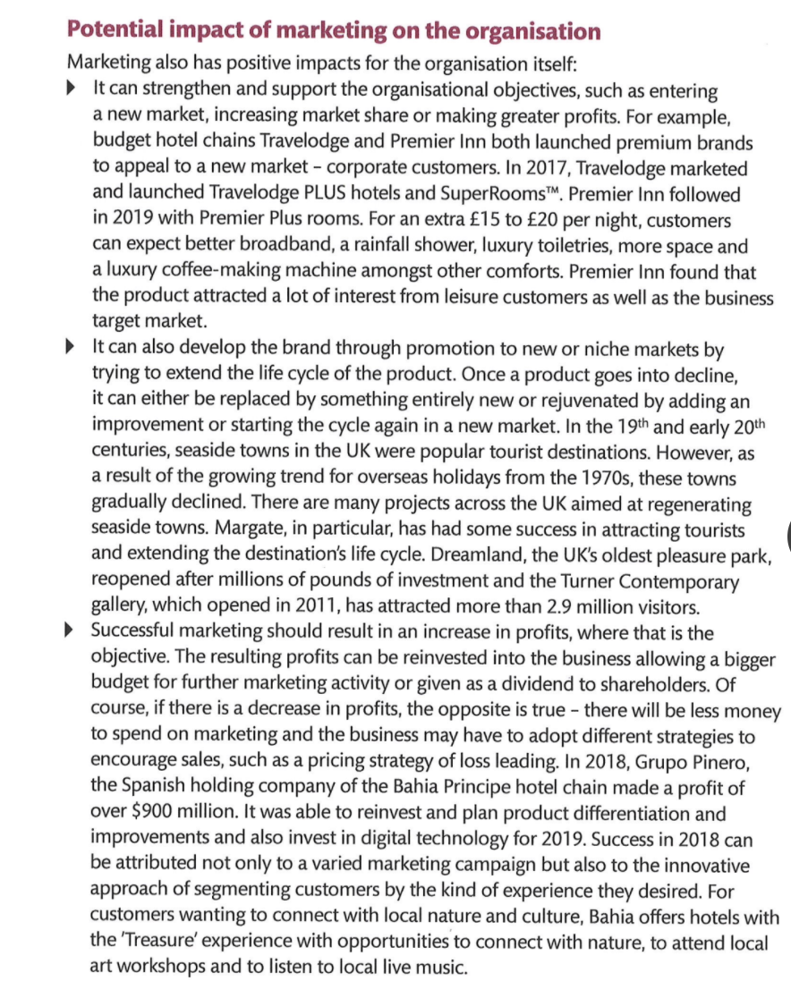
Example of
impacts on
organisations

