Slide 1
Internal and external influences
Internal influences are factors which are within the control of the business.
External influences are factors which are outside the control of the business.
Watch this video and mind-map the different influences on a business marketing objectives.
https://www.youtube.com/watch?v=fdxfYWl4ol4

Slide 2
External Influences
POLITICAL
Unrest
War
Terrorism
International Political Relations
ECONOMIC
Recession
Exchange rates
Interest rates
Customer disposable income
SOCIAL
Responsible Travel
Demographic & consumer trends
Increase in older/younger consumers
New experiences
POLITICAL
ECONOMIC
SOCIAL
What influences fit into these categories?
Can you think of any specific examples?
TECHNOLOGICAL
Social media
Apps
Transport Development
LEGAL AND ETHICAL
Advertising standards
Sector codes of practice
Current legislation
ENVIRONMENTAL
Extreme weather
Natural disasters
Sustainable tourism
TECHNOLOGICAL
LEGAL AND ETHICAL
ENVIRONMENTAL

Slide 3
Internal Factors
What impact does each of these have on marketing activity?
Size of the organisation
Organisational aims and objectives
Culture of the organisation
Budget
Resources

Slide 4
Case Study - Travellanda
Using your case study information explain which internal and external factors influence marketing within Travellanda, and how the marketing is conducted as a result.

Slide 5
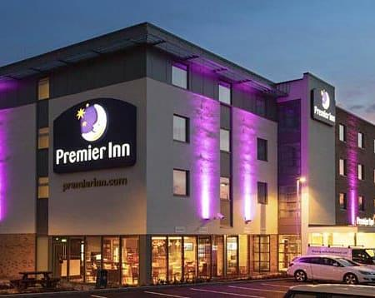
Case Study – Premier Inn
Using your case study information explain which internal and external factors influence marketing within Premier Inn, and how the marketing is conducted as a result.

