Slide 1
Impacts/potential impacts on growth, customer relationships & organisational success

Slide 2
Potential impacts on customers

Slide 3
Attracting new business
Different target markets, either domestically or internationally – Expansion of new hotels in new destination markets?
Premier Inn – Hub and Zip products
New destinations for Travellanda?
Gaining customers from a competitor (who are their closest competitors, how can they capture their market?)

Slide 4
Retaining customers/repeat business
Increasing current customer spend by encouraging more premium business or extra product purchase
Premier Inn Plus Rooms
Business services
Family rooms
Comfort of beds
Awards won

Slide 5
Building and retaining customer loyalty
Collecting points on an incentive scheme
Strengthening the organisation’s brand
Keeping standards consistent
Special offers

Slide 6
Building on CRM techniques
Investing in technology to capture customer feedback and make improvements
Moving away from overseas call centres
Increasing the methods in which customers can get in contact
Online chat functions on their website
Use of social media to respond to customer queries

Slide 7
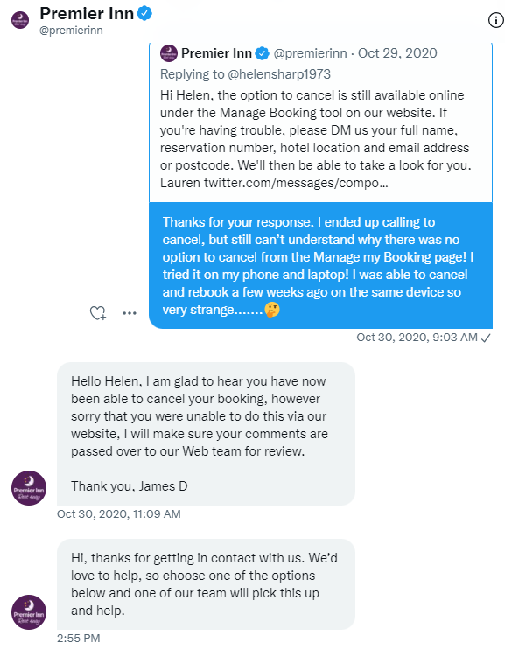
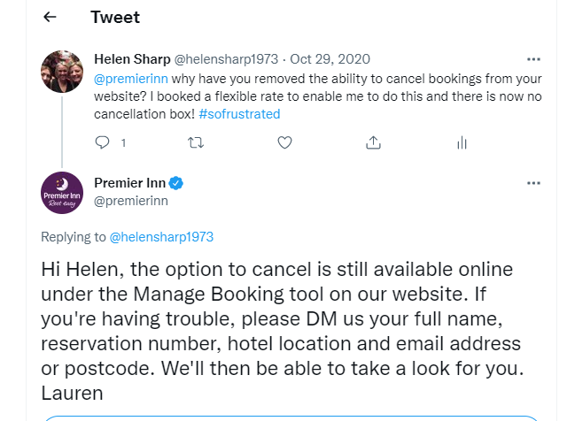

Slide 8
Globalisation
Changes in the competitive environment
Adaptation of marketing activity for different markets in travel and tourism (different advertising strategies)

Slide 9
Recommended marketing improvements
Are there any other marketing approaches the organisation could use to help them meet their business aims and objectives?
Do some competitor analysis, what do they do that the organisation do not use? How has it benefited their competitors?

