Slide 1
COMPONENT 1 Portfolio Requirements
Component 1 = 40% of your final grade

Slide 2
THE PORTFOLIO
Please keep up to date with these uploads
There will be C4C for those that don’t and letters home for failing a homework
A consequence of persistent lateness will be the withdrawal of tutor feedback and support later down the line and a grading of a U for that question

Slide 3
HOW DO I SEE MY FEEDBACK / THE GENERAL GROUP FEEDBACK?
Has everyone found THE FEEDBACK FILES on GOL?
Does everyone know how to ‘click on the red lines and click on comments?

Slide 4
You will use FOOTNOTES to reference your sources throughout this portfolio
Approx. 10-15 per question

Slide 5
This week our focus is QUESTION 3

Slide 6
Evaluate how your chosen role/s emerged and developed from initial ideas through to the final performance (AO4) 300 words

Slide 7
Evaluate how your chosen role/s emerged and developed from initial ideas through to the final performance (AO4) 300 words
You could be playing more than one character – that’s ok.
You may also be a different kind of ‘supporting role’
Where did your ideas come from? How are they linked to the EXTRACT / your key themes?
What function does your character play in the piece?
DEVELOPED:
We have spoken about a lot of STANISLAVSKI character development exercises. You should be utilising these (!!!) at home as part of practical homework to develop your performance, or as a group in rehearsals
Development and discussion should have also been occurring as you wrote and developed the text together.

Slide 8
These are your characters so this should be easy to write about as you have ownership over them.
This is a developing document so you are writing about characters as they stand today – there will of course be changes as your piece develops and grows through the process

Slide 9
TASK: Make a list of as many character development exercises that you can remember
We will share the exercises – use these within your answer

Slide 10
WHICH OF THESE EXERCISES (HAVE YOU) UTILISED WITHIN YOUR CHARACTER DEVELOPMENT PROCESS FOR THIS PRODUCTION?
Thinking Time
Annotation

Slide 11
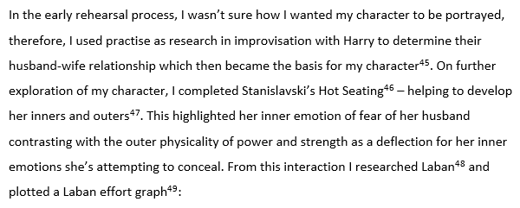

Slide 12
What was your role? Where did the ideas for it come from? How was it developed from the stimulus? How did it change through the process? What skills did you use enact this role?
Was your piece character-based or ideas based?
Did your choice of genre determine the type and range of characters used?
If you were working using physical theatre skills, was your character clearly defined as a separate being?

Slide 13
ONE PERSON TO HAVE A GO AT ANSWERING:
What was your role?
Where did the ideas for it come from?
How was it developed from the stimulus?
How did it change through the process?
What skills did you use enact this role?

Slide 14
ONE PERSON TO HAVE A GO AT ANSWERING:
Was your piece character-based or ideas based?
Did your choice of genre determine the type and range of characters used?
If you were working using physical theatre skills, is your character clearly defined as a separate being?

Slide 15
How did your role emerge during rehearsals? As a result of interaction with another character or to fulfil a function?
How did you communicate it in terms of physicality, movement, tempo-rhythm, relationship with the audience, vocal expression, dialogue, Proxemics etc?
Choose key moments from rehearsal into performance to illustrate this.

Slide 16
TASK: Make a list of all the vocal key terms that you can remember.
We will share this subject terminology – use these within your answer

Slide 17
WHICH OF THE VOCAL KEY TERMS APPLY TO YOUR PERFORMANCE AT THE MOMENT? What are you doing vocally to communicate character to the audience?
Thinking Time
Annotation

Slide 18
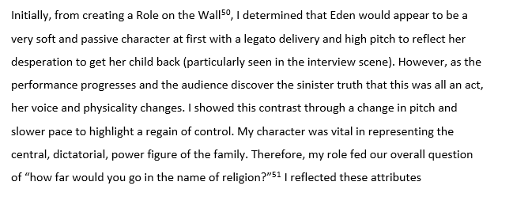

Slide 19
Outline the specific nature of your role/s
What is your character / ensemble role?
Briefly define / discuss them
Reference Laban terminology
Reference vocal techniques
Reference their physicality
THERE ARE LOTS OF KEY TERMS AND SUBJECT TERMINOLOGY YOU SHOULD BE EMPLOYING HERE

Slide 20
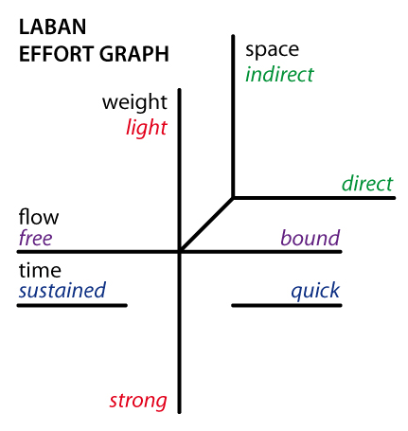
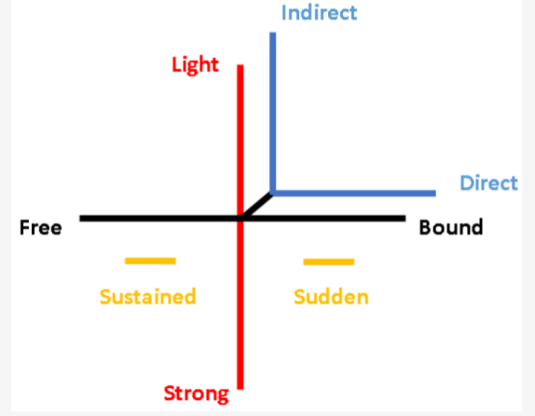
LABAN KEY TERMS:
A REMEINDER OF A LABAN EFFORT GRAPH AND HOW TO COMPLETE IT AND HOW TO USE THE KEY TERMS IN SENTENCES …..

Slide 22
Describe the development of your role/s from the start to the end of the process
What were the initial ideas?
Did these change as you began working on your piece?
What exercises and techniques did you employ to explore the role?
Emerging Role Initially from the brainstorming sessions my character was as follows | (Describe the character and their role in the piece)
At the half way point my character had developed - | (Outline how it had changed and why)

Slide 23
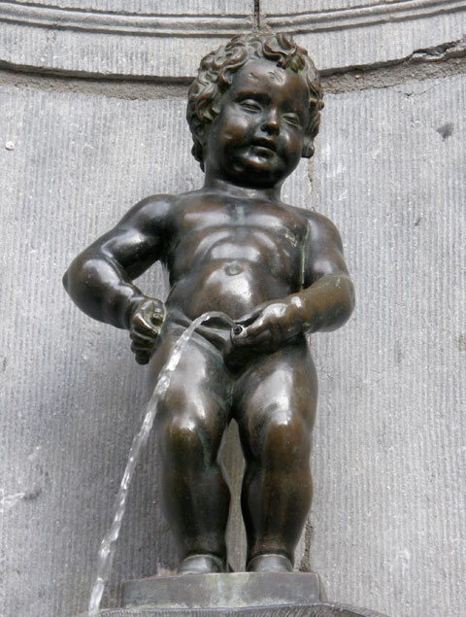

Slide 24
Due to the single-role nature of our portrayal of characters, my personal role within the piece became the mother - based on the character of Maud in the original text. This was further confirmed after I undertook a Stanislavski Crossing the Space workshop. I aimed to lose my own physicality and embrace her authoritative and strict role. My low shoulders, raised chest and fast direct walk conveyed my character’s view of her own power status as head of the family.

Slide 25
You are to upload a DRAFT of question THREE (answering all the sub questions) by your agreed deadline
ENSURE YOU TITLE THE DOCUMENT – DRAFT QUESTION 3

Slide 26
We will complete the other 2 questions after your performance
Whilst you have a little breathing space, maybe use the opportunity to go back and do some redrafting of previous questions.

