Slide 1
UNIT 4
PROMOTING A BRAND Learning aim a

Slide 2
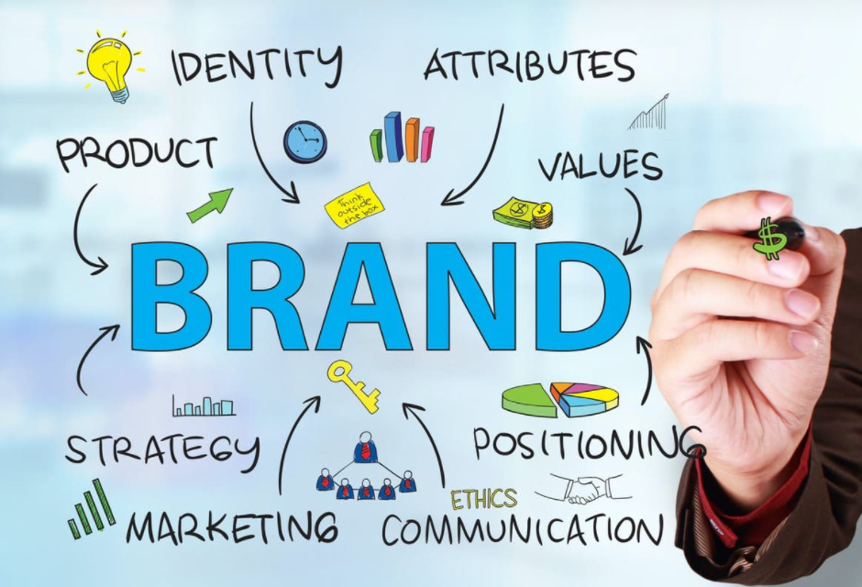
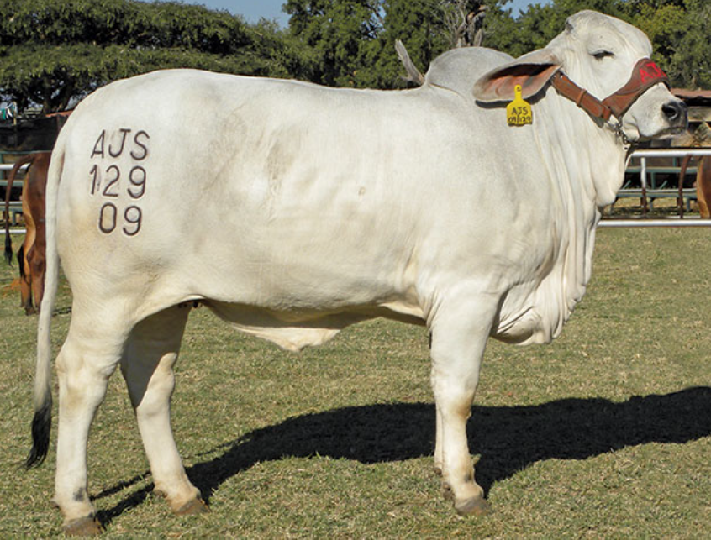
What is a brand?
“A brand is much more than a product you buy. It is much more than a name, a logo, a symbol or a trademark. A brand has a unique set of values that defines its character and works like a contract, promising to deliver satisfaction by providing consistent quality each time it is bought, used or experienced.” From Creating a Brand Identity by Catharine Slade-Brooking
Brands seek to connect emotionally with their consumers and create lifelong relationships.
Brands are relevant to businesses as well as to services, they can be applied to ideas and contects as well as to products – a brand can even represent an individual celebrity.
USEFUL FOR SLIDE 1 OF YOUR POWERPOINT

Slide 3
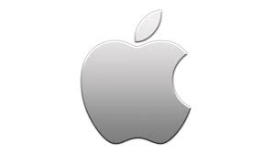
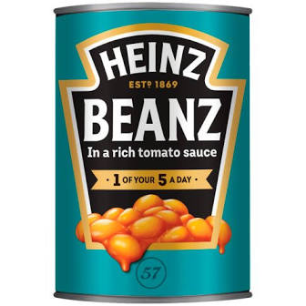
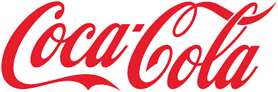

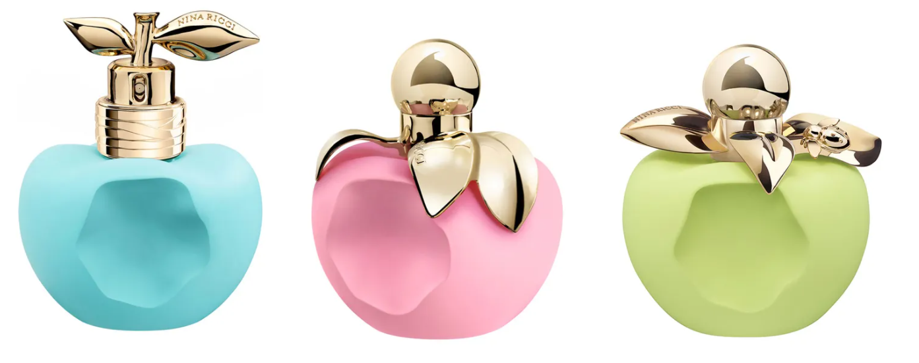
What is a brand?
Things that contribute to a brand:
Business Name
Symbol
Logo
Package design
Corporate colours
Jingle
Catchphrase / strapline
Any feature to identify or differentiate products of one business from products of another business.
How all these things together make a customer feel
USEFUL FOR SLIDE 1 OF YOUR POWERPOINT

Slide 4
What is a brand?
Perception of customer e.g. Innocent drinks has a pure & natural brand image.
A logo – symbol placed on product e.g. Nike
A legal instrument – exclusive property of its owners
A company e.g. Virgin applies its name to a range of different companies, all of which benefit from the name.
USEFUL FOR SLIDE 1 OF YOUR POWERPOINT

Slide 5
What is a brand?
A personality – customer perceptions of a brand include how they feel a brand may behave e.g Innocent as quirky & imaginative.
A vision - brands can be created with the intention of using them on a whole range of brands e.g Nestle.
An image e.g BMW has an image of reliability.
USEFUL FOR SLIDE 1 OF YOUR POWERPOINT

Slide 6
What is THE Brand DEFINITION?
“the intangible sum of a product’s attributes.” (David Ogilvy)
“a person’s perception of a product, service, experience, or organization.” (The Dictionary of Brands)
“a brand is a person’s gut feeling about a product, service, or organization.”(Marty Neumeier)
USEFUL FOR SLIDE 2 OF YOUR POWERPOINT

Slide 7
What is brand PERSONALITY? When products are based upon human characteristics
The idea of brand personality was first developed by the advertising agency, J Walter Thompson, who said brands should be given personality traits – like people – to help them stand out from the crowd. For example, a brand could be a hero, a villain, an underdog.
What’s the personality of the two brands you’ve chosen to write about? (see next slide)
Can you think of any brands that have each ‘Personality’?
USEFUL FOR SLIDE 2 OF YOUR POWERPOINT

Slide 8
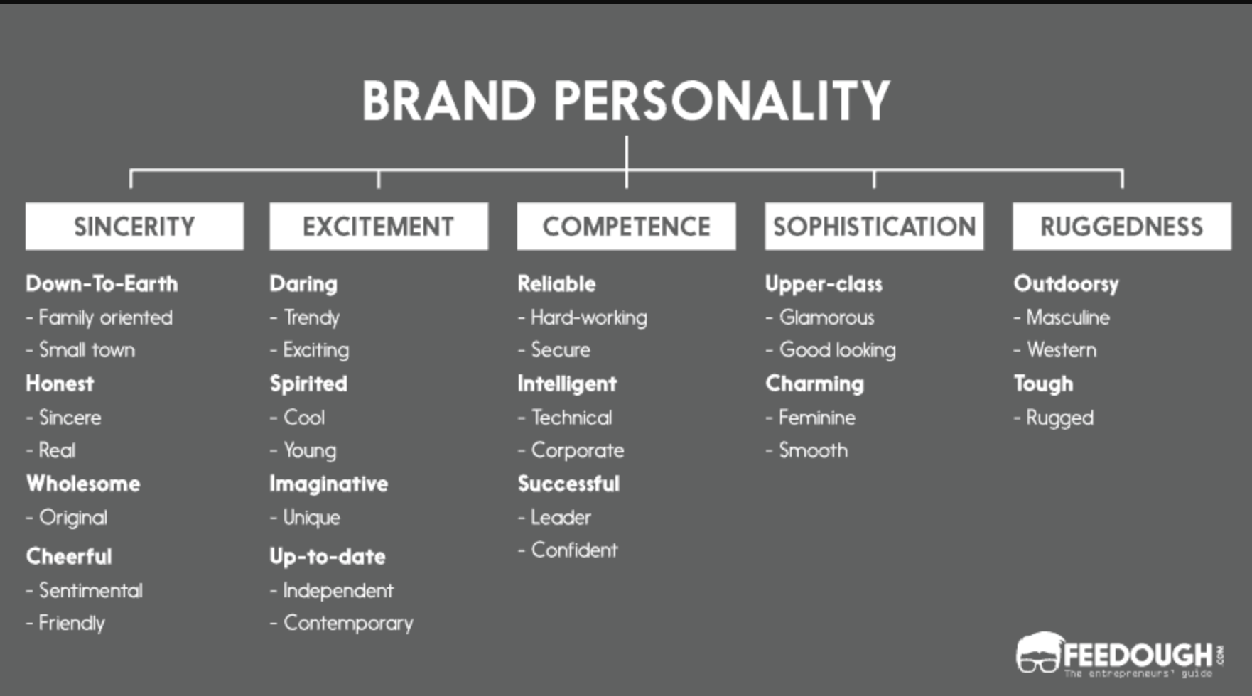
What is brand PERSONALITY? When products are based upon human characteristics
From the above, what is the personality like of each of the brands you’re writing about?
USEFUL FOR SLIDE 2 OF YOUR POWERPOINT

Slide 9
Types of Branding
Businesses use different types of branding:
Product Branding – this brand represents a specific product e.g. Jaffa cakes.
Service Branding – this brand represents a specific service e.g. Netflix.
Corporate Branding – this brand represents a company and can be applied to all their products and services e.g. Kellogg's and Nestle.
USEFUL FOR SLIDE 3 OF YOUR POWERPOINT

Slide 10
Why businesses use branding
Must deliver a true, clear message to businesses.
Must motivate customers to buy repeatedly.
If brand is successful and is associated with excellent quality and value for money, this will encourage loyalty, repeat purchases and increased profits.
Note it is arguably harder to brand SERVICES as they are INTANGIBLE. Not much for customers to ‘get to grips’ with.
Also, note it is often sensible to do CORPORATE BRANDING as well as either PRODUCT or SERVICE branding, so customers understand the product is one more in a RANGE or FAMILY. Helps new products off to a flying start instead of the company having top start their branding from scratch.
USEFUL FOR SLIDE 3 OF YOUR POWERPOINT

Slide 11
The importance of branding to business
Branding should identify the features and benefits of the product.
A business will need to know the needs and expectations of their customers.
Brand needs to be easily recognisable.
Must be associated with good quality or service.
Business will need to use appropriate advertising and promotions.
USEFUL FOR SLIDE 4 OF YOUR POWERPOINT

Slide 12
Benefits of successful branding
Image - A brand associates in people’s minds about the image of a product e.g. Costa Coffee
Quality - Customers will link the brand with high quality products and/or an excellent service.
Recognition – e.g McDonald’s logo is well known worldwide.
Long-lasting perception – A well-established brand creates a long lasting impression on customers e.g John Lewis adverts at start of Christmas preparations.
USEFUL FOR SLIDE 4 OF YOUR POWERPOINT

Slide 13
Benefits of successful branding
Trust – Customers know that a product with a familiar brand will meet certain standards e.g Travelodge
Marketing multiple products - New products could be introduced under the same brand name.
Repeat purchases - When a brand meets or exceeds customers needs and expectations this will result in repeat purchases and customer loyalty.
Recommendations - Customers will pass on recommendations by word of mouth which could improve sales and profit margins.
USEFUL FOR SLIDE 4 OF YOUR POWERPOINT

Slide 14
Adding Value
The point of branding is to make more money and deliver higher performance for a product/service/company than if it were not branded
Added value = difference between what a product costs to make and how much it can be sold for.
The better the branding, the bigger the difference between what it costs to make something and how much it sells for – and how successful the company will be. Great branding convinces customers to pay more for their goods.
With added value a product is clearly differentiated from competitors which gives opportunity to gain customer loyalty and improve profit margins.
USEFUL FOR SLIDE 5 OF YOUR POWERPOINT

Slide 15
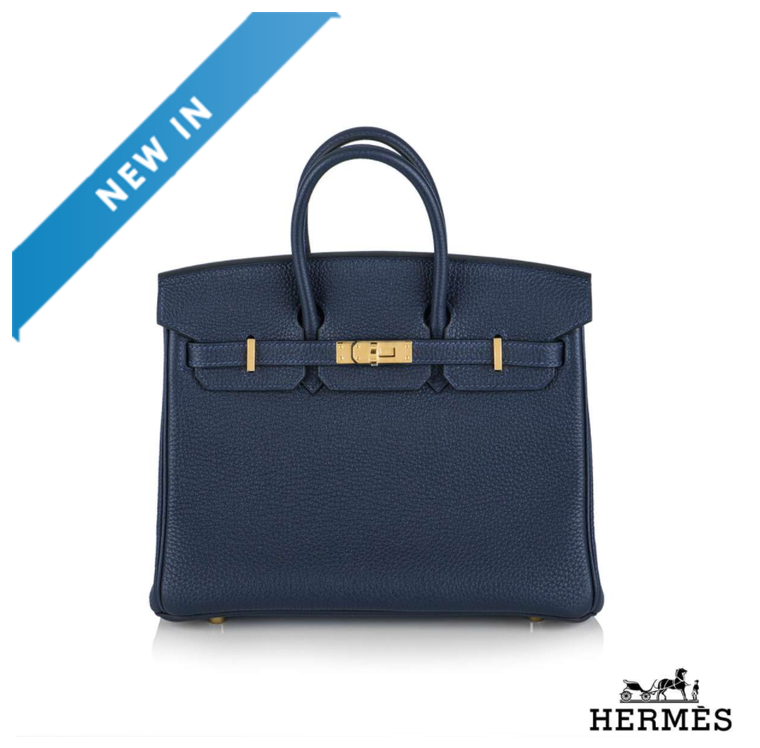
Example of added value through branding
Q. How much do you think Hermés charge for this handbag?
£15,900
Why do customer pay this price? Clue: it isn’t made out of unicorn hide.

Slide 16
Activity 1 (P1 and M1)
Go to the P1 and M1 Student Instructions word document on GOL.
Create a PowerPoint presentation that covers all elements outlined.

Slide 17

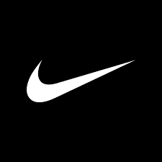
M1 similarities and differences

Slide 18
M1 similarities
Notes:
Although they stand for totally different businesses in different sectors, the brands of Nike and Google have many similarities.
Brand definition and personality
Firstly, both brands are instantly recognizable and world famous. Their logos don’t need any explanation – they have completely owned the look, feel, colours and typeface of their branding with an image that needs no explanation. Their meaning is communicated instantly in just a glance without needing the company name either in full, or even at all. Both brand personalities are bold, strong and open for everyone.
Both brands have history in their name and each captures the story of the company. Nike takes its name from the name of the Greek goddess of victory – symbolizing how the brand is associated with winning. Google too has history in its name – originally, it was meant to be called Googol which is the mathematical term for the number 1 followed by a hundred zeros – but hinting at the company’s playfulness, it was misspelled and became Google instead. Google is now so famous that its entered the language – you can tell someone to “google” something and they know immediately what to do. Similarly, Nike’s slogan “Just do It” has also become part of everyday speech. Google’s most famous slogan is “Don’t be evil” but in 2015 it changed this to “Do the right thing” – maybe a nod in the direction of Nike’s long standing phrase.
Types of branding
As huge global companies, both companies use their brands in just about every way you can think, in every context and every media. The brands appear on screens (big and small), on apps, in multimedia adverts, on social media and in sponsorship.

Slide 19
M1 similarities
Notes:
Why branding matters
Branding matters enormously to both companies. Both have many competitors and operate in fast changing global markets. So making sure their customers know what they stand for and exactly what you’ll get from them matters very much. Therefore, for each of them, the brand lives as a contract that guarantees to the customer that they can trust what they’re getting will be high quality and worth paying extra for.
How the brands add value
For both companies, the brand adds value by setting them apart from the competition and instantly communicating the added value that the customer will get if they choose this brand, not a rival brand. These are brands that customers actively choose because they believe they’ll get something they value – and they’re prepared to pay extra for it. When you choose Nike, you may pay a bit more for very similar clothing, but you know that you’re going to be wearing Nike quality, not Primark and or Sports Direct. When you Google something, you trust the results you get will be simple and easy to use – in a way that’s very different from Bing or Yahoo. And because the brands are so strong and so famous, they help the company stretch and grow well outside their original sectors.
You get a literal sense of the value both brands add when you look up their financial worth. In 2021, Google’s brand is worth an estimated $191 bn. Nike’s brand was valued at over $30bn.

Slide 20
M1 DIFFERENCES
Notes:
Much as they have in common, there are differences between the two brands
Brand definition and personality
Nike’s brand is positioned more closely with leisure, relaxation, fun and youthfulness whereas these days despite its start-up beginnings, Google is an increasingly corporate and rigid brand. Whereas Nike has largely kept its “good” reputation, Google is often associated with global power and over intrusive invasion of people’s privacy.
Types of branding
Although both brands appear in multiple locations across all media, one of the biggest differences in the types of branding they use is that Nike’s logo is a prominent part of the clothes worn by people right across the world. The Google logo typically doesn’t need to feature on physical products – and not on clothing – its natural place is on screens, particularly laptops, tablets and phones.
Why branding matters
Arguably, branding matters more to Nike than it does to Google. For Nike, their continued success is dependent on billions of people around the world choosing and enjoying wearing the Nike brand – whether it’s on their trainers, their joggers or their hoodie. The actual brand and logo is a very meaningful part of Nike’s product. By contrast, Google’s product is about the service it gives you – of quickly finding out what you want to know. Once you’re using it, the logo is much less part of the service.
How the brands add value
Nike’s brand is worth less financially than Google’s – just as Nike’s revenue is less than Google’s. But as discussed just now, arguably, Nike’s brand adds more value to its products – and is a must-have part of the product in a way that Google’s maybe matters less.

