Slide 1
Learning Aim C Collecting Market Research
Develop a marketing plan using research data that provides a viable business case.

Slide 2
What will I need to produce for coursework evidence?
P5- Identify a new travel and tourism product or service through the use of data obtained from primary and secondary market research.
M3- Identify a new travel and tourism product through the analysis of data obtained from primary and secondary market research.
D3- Identify a new travel and tourism product or service, justifying the data obtained from primary and secondary market research.

Slide 3
What is market research?
Market research is the planned process of collecting, analysing and evaluating information and data about customers and markets. Effective market research helps organisations to make decisions about the types of products their customers want, the price they are prepared to pay, where they prefer to buy the product and how it should be promoted (the 4P’s). The market research process is therefore closely linked to the development of an effective marketing mix and underpins an organisation’s marketing strategy.

Slide 4
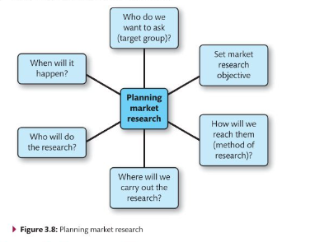
Prepare a Market Research Activity
A market research plan will identify:
The objectives of the market research activity (in line with their organisational aims and objectives)
The research methods that are most suitable to achieve the objectives using primary and secondary sources
The target group in which to focus research on

Slide 5
Purpose of market research
Organisations use market research to see whether a business idea is viable or to help identify a gap for a new product or service in a particular sector. So, the research can:
Identify or review the target market
Identify trends and fashions
Establish customer needs
Identify a gap in the market or changes in the market
Identify competitors
Effectiveness of promotional activities.
This data will support the marketing and other business decisions that the organisations makes and reduce the risk involved in making those decisions.
Notes:
Travel and tourism organisations need to know who their customers are and the type of products and services they want. In addition, organisations seek to evaluate the effectiveness of their promotional activities to ensure that future promotions are appropriate. To achieve this it is crucial that effective market research is one of their key marketing activities.
Market research is the planned process of collecting, analysing and evaluating information and data about customers and markets. Effective market research helps organisations to make decisions about the types of products their customers want, the price they are prepared to pay, where they prefer to buy the product and how it should be promoted. The market research process is therefore closely linked to the development of an effective marketing mix and underpins an organisation’s marketing strategy.

Slide 6
Primary research
Primary market research is also known as field research. It refers to any research that involves contact with past, existing or potential customers
Research is carried out with the named objective, for the first time to answer specific questions.
This research is carried out in many ways.
Notes:
Primary market research is also known as field research. It refers to any research that involves contact with past, existing or potential customers. Primary market research is what most people think of as market research and includes methods such as:
Surveys
Observation
Focus groups
Primary research methods include self-completion questionnaires which are a series of open ended, closed or multiple choice questions which is given directly to the customer or potential customer to fill in. Telelphone surveys and Internet surveys are also common forms of primary research in which existing or potential customers are contacted either by telephone or by email or are randomly targeted when visiting a website on the internet and asked questions relating to travel and tourism products or services.
Exit surveys are carried out as a visitor leaves an attraction in which opinions about the overall visitor experience whilst at a particular facility are sought. This may be done through face-to-face interview with a member of staff at the facility, asking direct questions of a visitor. Postal Surveys are also sometimes carried out, although the response rate for these is often very poor; relying on the customer to fill them out in their own time and then take responsibility for returning them. Focus groups are sometimes called together by an organisation, where a number of customers are led by a member of staff to discuss their views of a certain product or service. These are costly and take time to organise.

Slide 7
Online survey/ E- marketing
Advantages | Disadvantages
Large sample sizes Inexpensive | Limited to people with internet access

Slide 8
Postal survey
Advantages | Disadvantages
Inexpensive No interviewer training needed | Questions must be simple and easy to answer Response rate very low, incentives sometimes needed.

Slide 9
Face to face interview
Advantages | Disadvantages
Two- way communication Researcher can encourage respondent to answer Mistakes and misunderstandings can be cleared up right away | Personal interviews can be expensive Researchers have to be selected and trained Home interviews are unpopular with consumers
Notes:
A personal interview involves a researcher talking to individual visitors to find out about customer preferences of buying behaviour. These may be carried out at the tourist information centre or elsewhere. Most interviews are short and tend to rely on closed questions. The interviewer can assist the respondents by clarifying any misunderstood questions. This could however lead to unintentional bias.

Slide 10
Telephone Interview
Advantages | Disadvantages
Can reach a large geographical area Inexpensive | Response rate may be low as people may view it as a ‘nuisance call’
Notes:
Surveys are usually carried out as a quantitative research method based on a questionnaire given to a large sample of people. Questionnaires are one of the most widely used research methods in the travel and tourism industry because they are relatively quick and easy to administer and analyse.
The success of a survey depends to a large extent upon the quality of the questionnaire used. A well-designed questionnaire, including structured questions with answers classified into predetermined categories is quick to administer and the resulting data easy to process.
Compiling a questionnaire is a skilled process that needs careful consideration. One of the most difficult aspects of compiling an effective questionnaire is writing questions that are easily understood and interpreted in the same way by all respondents. If you really want to ensure that your questionnaire is effective you need to carry out a pilot survey. This means testing the questionnaire on a small group of respondents to make sure that all of the questions are easily understood and cannot be misinterpreted. Once you have carried out the pilot you will probably find that some of the questions will need re-wording to make them more effective.
There are three main ways (contact methods) in which survey information can be gathered:
By mail
By telephone
By personal contact.
Many organisations send questionnaires through the post. The advantage of this method of research is that it is quick to administer and that a large sample can be reached relatively cheaply. The drawback is that the reply rate can be very poor – as low as three per cent in many cases. Some organisations carry out surverys by asking respondents questions over the telephone. This is more expensive and time-consuming than using the mail but usually has a higher response rate. However, because so many organisations use the phone as a sales tool, responders are often suspicious, thinking that the purpose is to sell them something. A further method is through personal contact between the researcher and the respondent. Face-to-face contact is clearly more time-consuming and therefore expensive, but the response rate is usually higher than responses from mail and telephone surveys. The contact method used depends largely on the type of research being conducted and the amount of time and money available.

Slide 11
Observation
Advantage | Disadvantages
Quantitative information gathered Real life and behaviours in action | Samples are often random and not representative of all customers Only shows actions, does not explain attitudes and feelings.
Notes:
Observation is a research method in which information is obtained by observing customers’ behaviour or events taking place. For example, much research into visitor traffic is conducted by local tourism departments counting the number of cars that pass different points at various times. In travel and tourism there are many different situations in which observation methods can be used to provide valuable information. For example, observational research has shown that up to 90% of customers automatically go to the right when entering a souvenir shop. This is valuable information for providers in terms of what they decide to display at the first point of customer contact.

Slide 12
Focus group Focus group research is when a group of people is encouraged to discuss their opinions and feelings about a particular organisation, product or service, or a topic that affects the organisation’s marketing activities
Advantages | Disadvantages
Qualitative information provided in the form of opinions, feelings and attitudes Topics can be explored in some depth | Can be difficult to analyse qualitative information Expensive
Notes:
Focus group research is when a group of people is encouraged to discuss their opinions and feelings about a particular organisation, product or service, or a topic that affects the organisation’s marketing activities. It has the great advantage that the information collected is qualitative and therefore very detailed. However, it is extremely expensive and the information collected is based on a very small selection of respondents. You should also appreciate that a focus group research is a highly skilled research technique that is often carried out by qualified psychologists. This is because the researcher must be able to encourage the respondents to talk freely about the topics that are of interest without leading them to say something that they do not really mean.

Slide 13
Secondary research
Secondary market research is also known as desk research and refers to information from sources that are already published or easily accessible.
A business might use sources such as the internet, newspapers or company reports to gather information. For example, if a retailer is considering opening a store in a particular shopping centre, they can undertake internet research to obtain information such as customer profiles or the annual footfall (by visiting the website of the shopping centre).
It is quicker and more cost effective for the retailer to use this secondary research rather than undertaking their own (primary research).
Notes:
Secondary market research is also known as desk research and refers to information from sources that are already published or easily accessible. Secondary research is economical and comparatively quick to undertake. It has the advantage that it can be conducted with complete confidentiality – in other words; without competitors finding out! On the other hand, because the information yielded by secondary research is not generated for the particular purposes of an organisation, it may not be sufficiently relevant and more specific (primary) research may be required. There are two main sources of secondary information
Internal
External

Slide 14
Secondary research
Advantages | Disadvantages
Saves time Relatively inexpensive Widely available | Not specifically gathered for the business May be out of date May contain bias

Slide 15
There are two main sources of secondary information: Internal & External

Slide 16
Internal
An internal source of information refers to information that an organisation already has. Most organisations can avoid much of the need for expensive marketing research if they use internal sources of information wisely. For example, a conference centre might look at their customer database to identify which regions the majority of their customers come from and promote heavily in these areas. Some of the most commonly used sources of internal market research are mentioned in the next few slides.
Notes:
An internal source of information refers to information that an organisation already has. Most organisations can avoid much of the need for expensive marketing research if they use internal sources of information wisely. For example, a conference centre might look at their customer database to identify which regions the majority of their customers come from and promote heavily in these areas. Some of the most commonly used sources of internal market research are mentioned in the next few slides.

Slide 17
Loyalty schemes
Many retailers use loyalty schemes based on their customers’ spending habits.
These businesses can track the spending behaviour of their customers.
Think loyalty cards that are used by supermarkets such as Sainsbury’s Nectar Card or Tesco Clubcard.
Companies send their customers money off coupons or targeted emails, based on each customers spending habits which have been identified through the use of the loyalty card.

Slide 18
EPOS (Electronic Point of Sale) Records
This is a computerised system that records the sale of goods or services to customers.
It is a self-contained system that can take all methods of payments including bank and credit card sales, verifying them as part of the purchase.
It can also manage and report on other functions such as stock control.
Businesses can gather historical data from an EPOS system, for example which are the most popular products and at what time of year are sales the highest.
Notes:
Provides information on the quantity and frequency of products sold over a given period and can often be used to provide a comparison between current and past performance. Information is available from a number of sources, such as customer bills and cash till records.

Slide 19
Website monitoring
Businesses use cookies to track how people are using their website.
They can identify the amount of time a visitor spends on the website and which pages they go to.
The number of visitors to a website can also be tracked.
You are likely, to have seen the pop- up message that appears when you go onto certain websites, advising you that they are using cookies.

Slide 20
Accounting records
This historical data can be used by businesses to identify the spending and ordering habits of their customers.
This will tell them when to expect busy times in order to ensure they are fully stocked and staffed to be able to deal with demand.

Slide 21
External An external source of information refers to information that has been gathered by a third party
Notes:
An external source of information refers to information that has been gathered by a third party – they are mentioned in the next couple of slides.
External sources also include:
Books
Trade journals
Newspapers
Online media
Television programmes

Slide 22
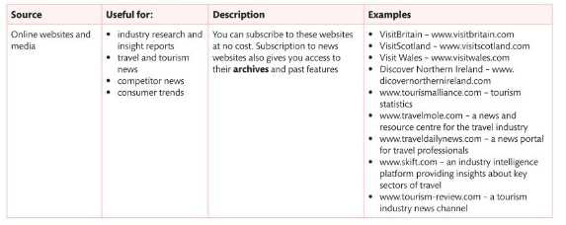
Internet
There is a vast amount of information concerning market research available on the internet.
It is important that the information and data being used is reliable and up to date.
It is a good idea to use other sources of market research as well as the internet.
However, using the internet effectively can cut down on the amount of time and money spent.
Notes:
Online sources of information you may find helpful include:
Department for Digital, Culture, Media and Sport – www.culture.gov.uk
Tourist board for Great Britain and Northern Ireland – www.visitbritain.com
English Tourist Board – www.visitEngland.com
Northern Irish tourist board – www.discovernorthernireland.com
Scottish tourist board – www.visitscotland.com
Welsh tourist board – www.visitWales.com
British Association of Leisure Parks, Piers and Attractions – www.balppa.org
FCO travel advice – www.gov.uk/government/organisations/foreign-commonwealth-office
Association of British Travel Agents – www.abta.com
Association of Independent Tour Operators – www.aito.com
Civil Aviation Authority – www.caa.co.uk

Slide 23
Government statistics
These are available on government websites and cover a whole range of topics that would be useful in market research such as population and demographics of regions across the country.
Notes:
Both central and local government carry out research and publish the results. The Office for National Statistics (ONS) publishes several very useful volumes of statistics, trends, demographic and census-related data. In all, the government publishes 400 sets of statistics, and many publications have specific sections on travel and tourism.

Slide 24
Competitors reports
These are often available on the internet, for example the accounts that registered businesses must submit to Companies House.
This information can be purchased through a variety of websites.

Slide 25
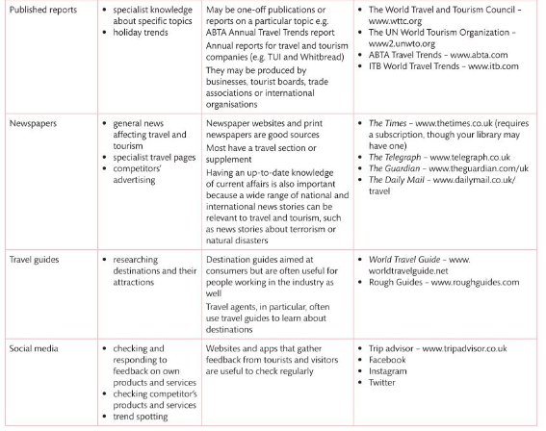
Other Sources ……

Slide 26
Issues with research methods…..?

Slide 27
Cost
Some methods of research are very expensive, while others can be undertaken with little cost attached.
Gathering primary data by stopping people in the street to ask specific questions, or by observing how many customers walk through a shop door is both time consuming and costly.
By contrast, undertaking secondary research on the internet using data that has already been gathered from another source, is much quicker to obtain and does not tie up a member of staff for days at a time.
However, if a business wanted to use a specialist market research agency, then there would be significant cost involved.
Businesses need to consider the scope of the research they wish to undertake to ensure that the best option is chosen, in relation to cost.
Most market research will have a budget that must be considered.

Slide 28
Accuracy
Secondary research must be verified to ensure that the data is accurate.
When using surveys and questionnaires, businesses must be aware of who is responding to their questions and be sure that the answers that are given by the respondents are an accurate reflection of what they are really thinking.
For example, an online survey might seem less reliable than a focus group, but you would need to consider who else is involved in the focus group.
People may be less inclined to speak their mind about sensitive topics in front of other people. In some instances, anonymity, e.g. via an online survey, might produce more honest replies. Ensure that any survey questions will not result in ambiguous (vague/ uncertain) answers.

Slide 29
Timelines
An adequate amount of time must be allowed to ensure that the data can be collected, collated and analysed for the research to be meaningful.
When undertaking primary research, is there enough time to distribute surveys and then wait for the responses to come in, to conduct consumer interviews, or to set up a focus group?
Timelines are also important when completing secondary research to ensure that there is sufficient time to browse the internet, newspapers or libraries.
Many businesses will conduct market research to a specific schedule to ensure they get the result they need prior to their next action, for example a product proposal or new marketing campaign.

Slide 30
Response rates
Certain factors must be taken into consideration that could affect the response rate to any questionnaire or survey.

Slide 31
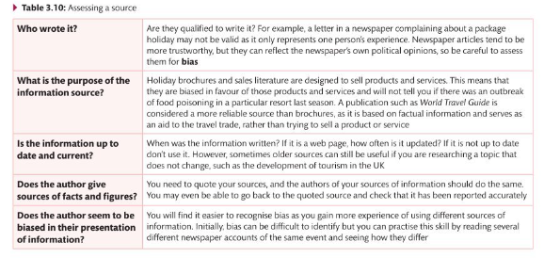

Slide 32
Qualitative research
This is used to gain an understanding of what customers are thinking and motivates them.
It can provide an insight into a problem or it can help to develop ideas.
Quite often Qualitative research is gathered through face-to-face interviews or focus groups where respondents are encouraged to elaborate on their answers.
Notes:
Qualitative research provides an understanding of how or why things are as they are. This involves the study of attitudes or motivation. It relates specifically to consumer preferences and opinions and generates data through the use of open-ended questions. Unlike quantitative research there is no fixed set of questions to use in qualitative research. Much of this type of research is carried out in the belief that a customer engaged in a tourism activity is best placed to comment on their own experience and that this experience is best communicated using the customer’s own words. Research of this sort is mostly done face-to-face, through interviews, or focus group discussions.

Slide 33
Advantages
This can capture changing attitudes within a target group such as consumers of a product or service, or attitudes in the workplace.
This type of research does not have the limitations that quantitative methods have. If responses don’t fit the researcher’s expectation that’s equally useful qualitative data to add context and perhaps explain something which numbers alone are unable to reveal.
This type of research provides a much more flexible approach, the questions, the groups of people and settings can be changed.
This type of research can be more targeted on specific sample groups.

Slide 34
Disadvantages
Sample size can be a big issue. For example if you have found out information/opinions that is for 200 employees but you have only asked 5 employees in your research this questions whether the opinions reflect the other 97.5% of employees?
Are the questions bias so the answers received are the ones that are required?
Are the right people being asked?

Slide 35
Quantitative
This is where customers or potential customers are asked structured questions so that hard facts can be obtained.
The questions are likely to be closed questions and do not allow the respondent to elaborate on their answers or give their opinions.
From these replies, statistical data can be drawn up and analysed.
Quantitative research is usually through surveys or questionnaires.
By asking a large group of people the same questions, a business can build up a picture.
Notes:
Quantitative research is numerically oriented, focuses on the measurement of market data and involves statistical analysis. For example, an airline might ask its customers to rate its overall service as either excellent, good, poor or very poor. This will provide quantitative information that can be analysed statistically. The main rule with quantitative that can be analysed statistically. The main rule with quantitative research is that every respondent is asked the same series of questions. The approach is very structured and normally involves large numbers of interviews/questionnaires. Surveys are the most common form of quantitative research carried out.

Slide 36
What businesses use Quantitative research for?
To rank employees and work units
To award raises or promotion
To measure and justify termination or disciplining of staff
To measure productivity
To measure group/ individuals targets

Slide 37
Advantages
Each answer is standardised to reduce bias when collecting and analysing data.
The results are valid and reliable.
This type of research is very good when the research involves numbers.

Slide 38
Disadvantages
As quantitative research involves numbers it is not useful for all types of research.

