Slide 1
Research Project Ideas….

Slide 2
Your Task
Organisations use market research to see whether a business idea is viable or to help identify a gap for a new product or service in a particular sector. The research can:
Identify or review the characteristics and behaviour of the target market
Establish customer needs
Identify a gap in the market
Identify competitors
You will be carrying out market research to identify a new product or service for a real travel and tourism organisation or destination.

Slide 3
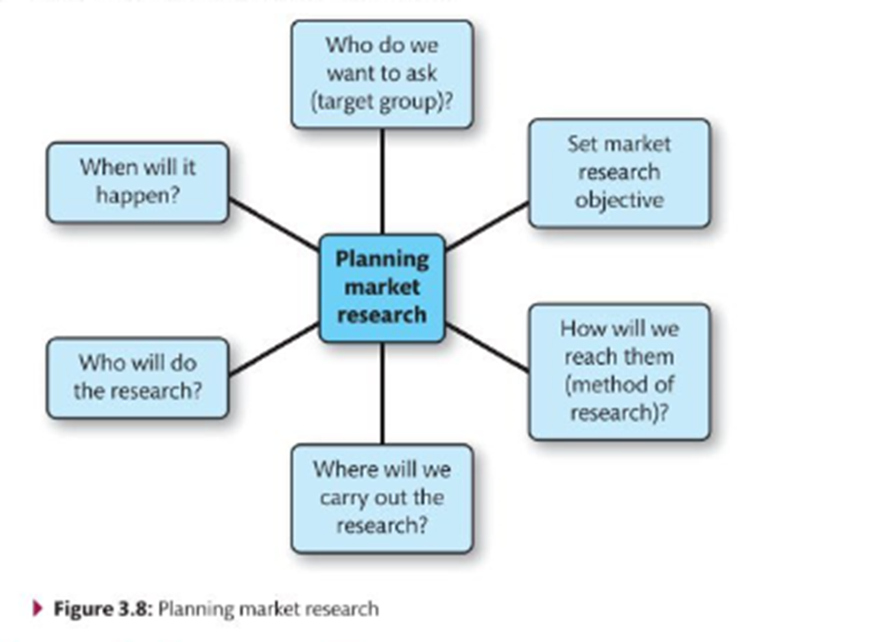
Alice Holt Forest park
Forest Lodges
Glamping Site
New Activities for families? Petting Zoo? Weekly Forest School?
Festival style weddings (Tepee's / hay bales / BBQ catering)
Who is the product aimed at?? Demographic??
Customer need?
Gap in market?
Competitors?

Slide 4
Butlin’s
Gym and Indoor activity centre
New type of accommodation
Family style wedding’s
Who is the product aimed at?? Demographic??
Customer need?
Gap in market?
Competitors?

Slide 5
Thorpe park
Themed hotel
Water park
Evening events
Rides for young family members
Who is the product aimed at?? Demographic??
Customer need?
Gap in market?
Competitors?

Slide 6
Centre parks
Family weddings – Festival style
Evening entertainment
Indoor activity centre
Go karts
Who is the product aimed at?? Demographic??
Customer need?
Gap in market?
Competitors?

Slide 7
Bognor Regis
Regeneration of Bognor Regis?
Mini Theme park like Harbour Park
New 4* seafront hotel
Redevelopment of the Pier
Splash area for young kids
Who is the product aimed at?? Demographic??
Customer need?
Gap in market?
Competitors?

Slide 8
