Slide 1
Mission Statements Aims Objectives
BTEC 2, Unit 3,(NEW)

Slide 2
LO: To understand an organisations mission statement, aims and objectives.

Slide 3
Mission Statement
Most organisations, including the places you work, study and spend your leisure time will have a mission statement.
The mission statement sets out the purpose and values of the organisation so that all members can pull in the same direction.

Slide 4
Can you guess which organisation wrote this mission statement?
… … is an International group of independent non-governmental organisations dedicated to fighting poverty and related injustice around the world.

Slide 5
Can you guess which organisation wrote this mission statement?
… … : The Earth’s favourite little food company. A company that makes delicious, healthy, natural, ethical food universally available for all.

Slide 6
Can you guess which organisation wrote this mission statement?
"We create happiness by providing the finest in entertainment for people of all ages, everywhere."

Slide 7
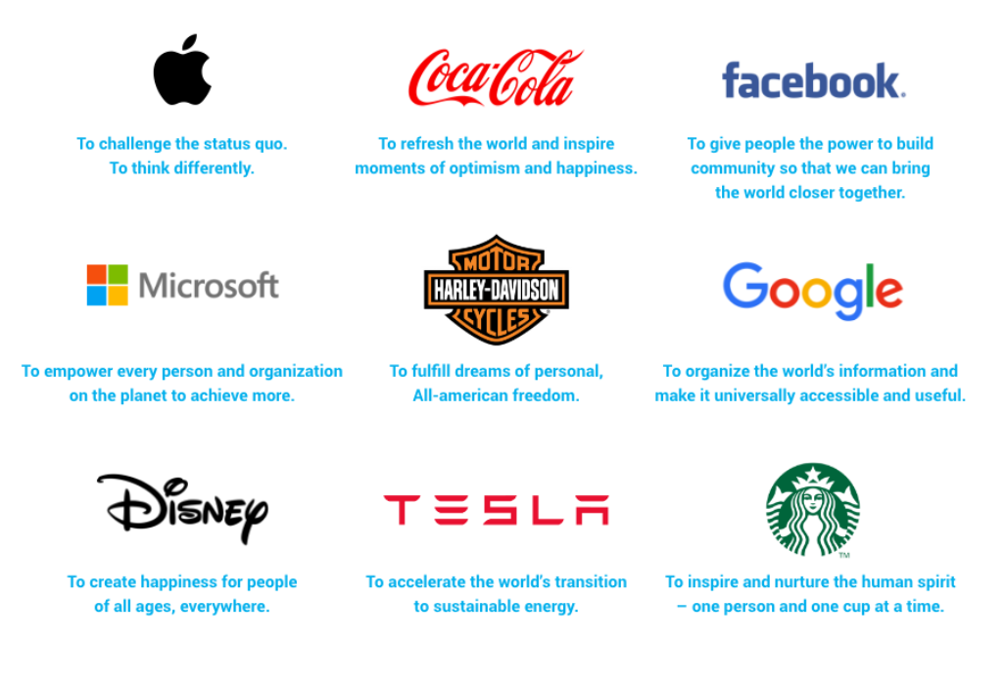

Slide 8
Your Turn
Write a mission statement for your business idea on the sheet provided.

Slide 9
Aims of the Organisation
The aims of an organisation set out in broad terms what the organisation seeks to achieve through its strategic plan.
The aims are clearly tied to the mission, and give a general sense of direction for planning.
Aims are long-term plans.

Slide 10
Can you think of some ‘aims’ for a business?
Survival
Profit maximisation
Innovation
Securing locations
Expansion

Slide 11
Your Turn
Identify 3 aims for your business idea on the sheet provided.

Slide 12
Objectives of the Organisation
The aims of the organisation can then be broken down into more specific objectives.
The objectives are goals that the organisation seeks to achieve during the period of strategic planning.

Slide 13
Whose objectives are these?
To undercut fairs the of rivals.
To take over similar airlines.
To increase the number of destinations flown to each year.
To increase sales.

Slide 15
Smart Objectives
In business a good set of objectives should be SMART.
What does SMART stand for?

Slide 16
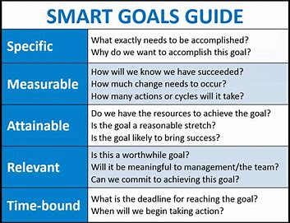

Slide 17
SMART and KPI (Key Performance Indicator)
SMART
Specific | The objective focuses on a particular key performance indicator.
Measurable | Focusing on a particular KPI means you can see if you have met your target. For example 5% growth.
Achievable | You can not increase your sales KPI if you don’t have enough room for the extra stock.
Realistic | You must have all the resources you need to achieve this objective. You can not sell more stock if suppliers can’t produce it.
Time-Related | Clear deadlines make it easier to see if you are on target or not.

Slide 18
Ryan Air’s SMART objectives:
To undercut the fairs of rivals.
To take over similar airlines.
To increase the number of destinations flown to each year.
To increase sales.
To undercut the fairs of rivals by 2% by the end of the financial year.
To own a 51% shareholding of AirBaltic by 2025.
To increase the number of destinations flown to in Europe by 10% by 2022.
To increase sales by 15% by investing 2 million dollars in advertising during 2020.

Slide 19
SMART Video
https://www.tutor2u.net/business/reference/business-objectives-introduction-1

Slide 20
Your Turn
Write 3 SMART objectives for your business idea on the sheet provided.

