Slide 1
STAKEHOLDERS
BTEC 2, Unit 3

Slide 2
Who are Stakeholders?
https://www.bbc.com/bitesize/guides/z4gcd2p/video

Slide 3
What are Stakeholders?
A stakeholder is anyone with an interest in a business. Stakeholders are individuals, groups or organisations that are affected by the activity of the business.

Slide 4
Types of Stakeholder
Owners who are interested in how much profit the business makes.
Managers who are concerned about their salary.
Workers who want to earn high wages and keep their jobs.
Customers who want the business to produce quality products at reasonable prices.
Suppliers who want the business to continue to buy their products.
Lenders who want to be repaid on time and in full.
The community which has a stake in the business as employers of local people. Business activity also affects the local environment. For example, noisy night-time deliveries or a smelly factory would be unpopular with local residents.

Slide 5
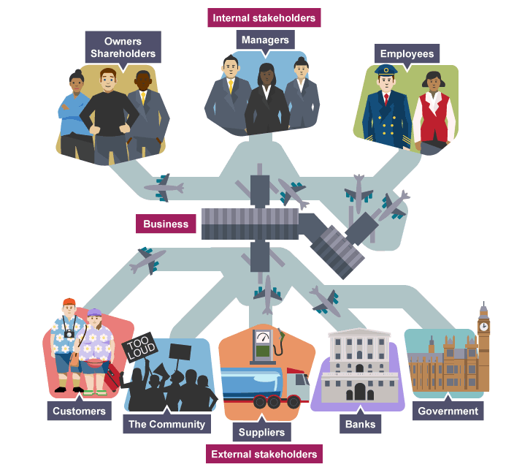
Internal and External Stakeholders
Internal stakeholders are groups within a business - eg owners and workers. External stakeholders are groups outside a business - eg the community.

Slide 6
Influence of Stakeholders
Owners have a big say in how the aims of the business are decided, but other groups also have an influence over decision making. For example, the directors who manage the day-to-day affairs of a company may decide to make higher sales a top priority rather than profits.

Slide 7
Influence of Customers
Customers are also key stakeholders. Businesses that ignore the concerns of customers find themselves losing sales to rivals.

Slide 8
Primary and Secondary Stakeholders
In a small business, the most important or primary stakeholders are the owners, staff and customers. In a large company, shareholders are the primary stakeholders as they can vote out directors if they believe they are running the business badly.
Less influential stakeholders are called secondary stakeholders.

Slide 9
Conflicting Stakeholder Objectives
Different stakeholders have different objectives. The interests of different stakeholder groups can conflict. For example:
Owners generally seek high profits and so may be reluctant to see the business pay high wages to staff.
A business decision to move production overseas may reduce staff costs. It will therefore benefit owners but work against the interests of existing staff who will lose their jobs. Customers also suffer if they receive a poorer service.

