Slide 1
Exam walk through
Comp 1 – section C – Whiplash

Slide 2
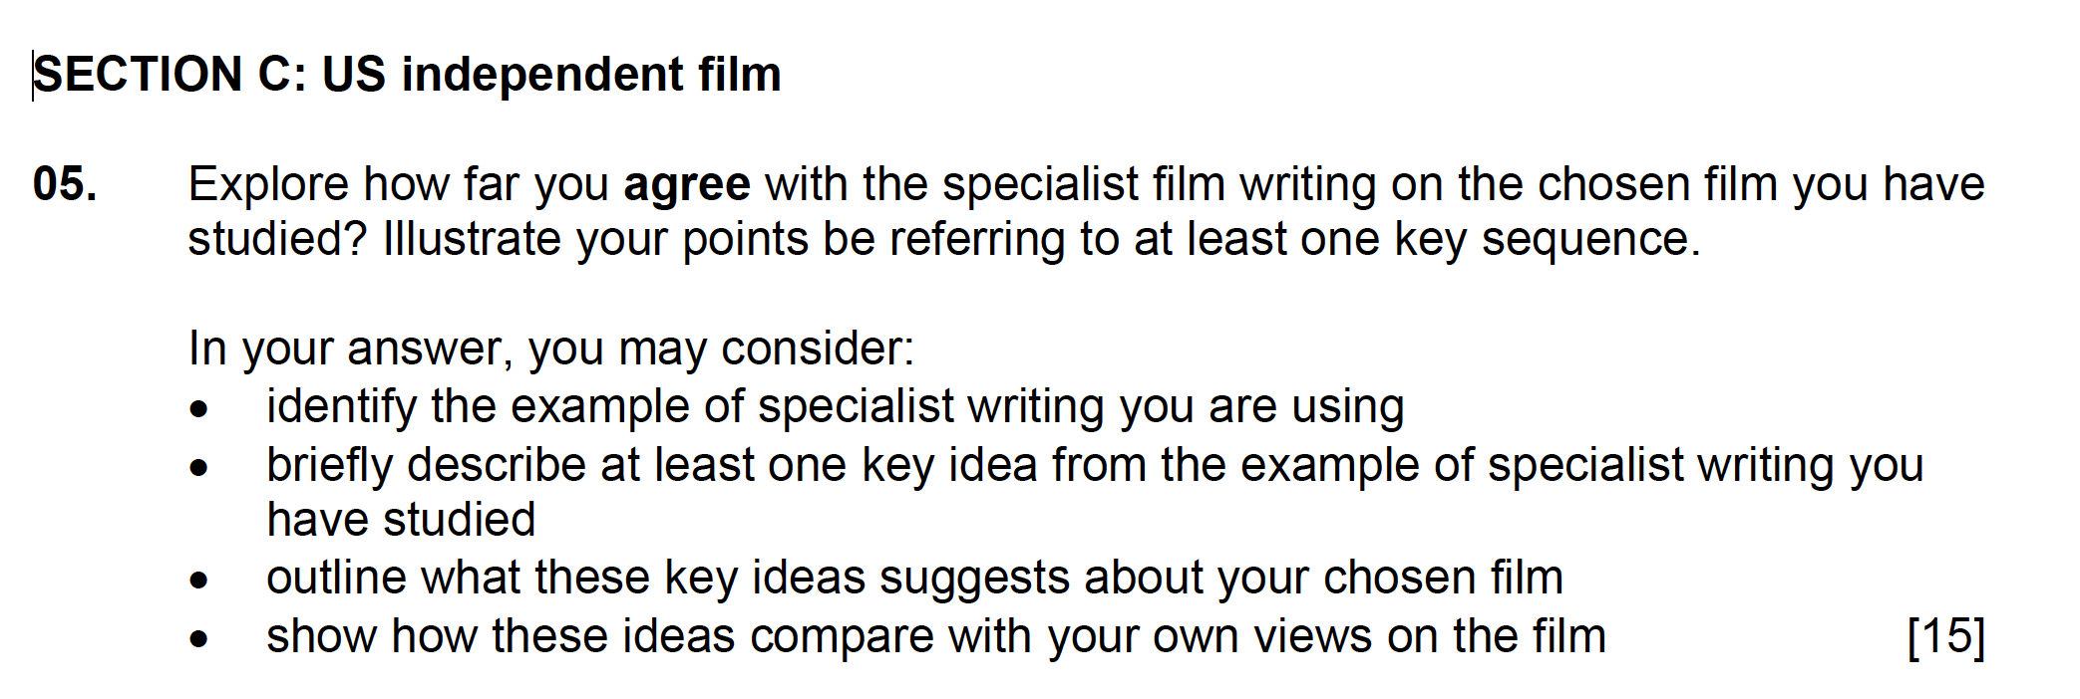

Slide 3
This question asks you HOW FAR YOU AGREE with the specialist film writing you have studied.
It requires you to have a stance – do you agree or not? You may agree with some points but not others.
Find 1-3 sequences to support your argument. These may illustrate your agreement with the specialist writing or an alternative way of looking at the film.

Slide 4
It might help you to plan your response to this question.
That will enable you to decide whether you have more points for agree or disagree.
The plan below shows more points for the ‘disagree’ argument
HURT LOCKER IS WAR PROPAGANDA - AGREE | HURT LOCKER IS WAR PROPAGANDA - DISAGREE
Use of heroic male character played by sexy male star Jeremy Renner | Sequence - bomb disposal where soldier dies – does not glamourize events of war
 | Sequence – closing – Main character is unhappy and cannot adjust to normal daily life

Slide 5
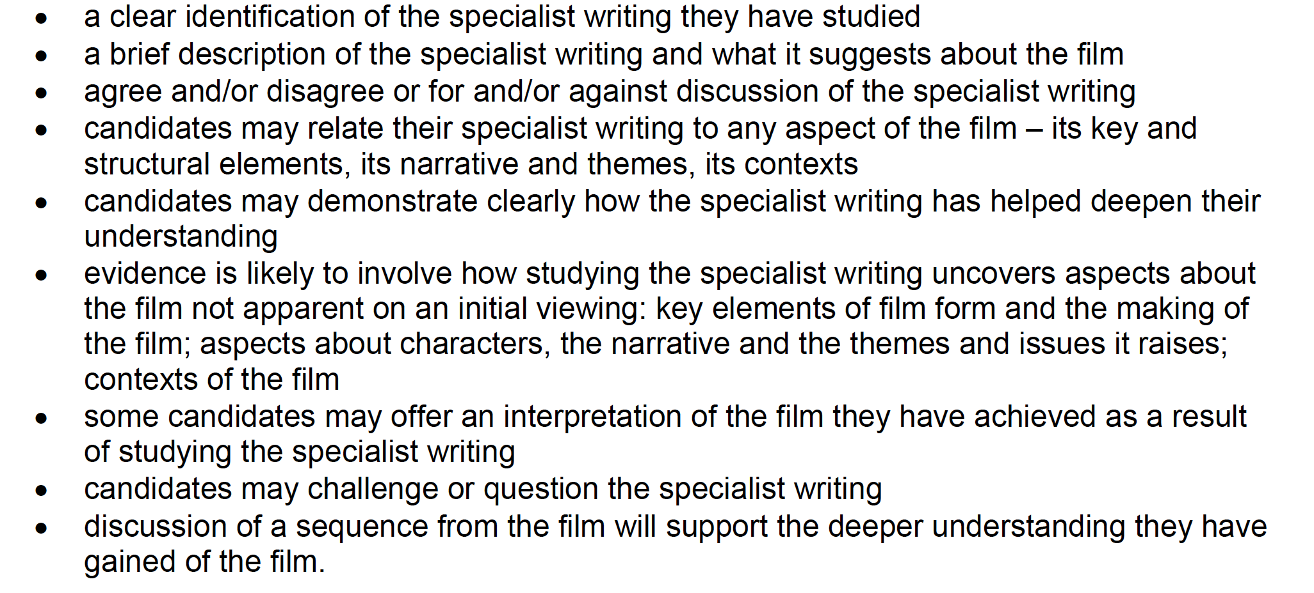
The mark scheme gives examples of what a response to this question might look like:

Slide 6
Example Opening
The opening to a question like this needs to set out your stall:
SET OUT YOUR STALL or where you stand in the debate using key phrases from the question.
INTRODUCE THE WRITING and THE FILM YOU HAVE STUDIED
Whilst I agree with some points in Tara McKelvey’s article ‘The American Prospect’ article, there is more evidence to suggest that The Hurt Locker does not glamourise war.

Slide 7
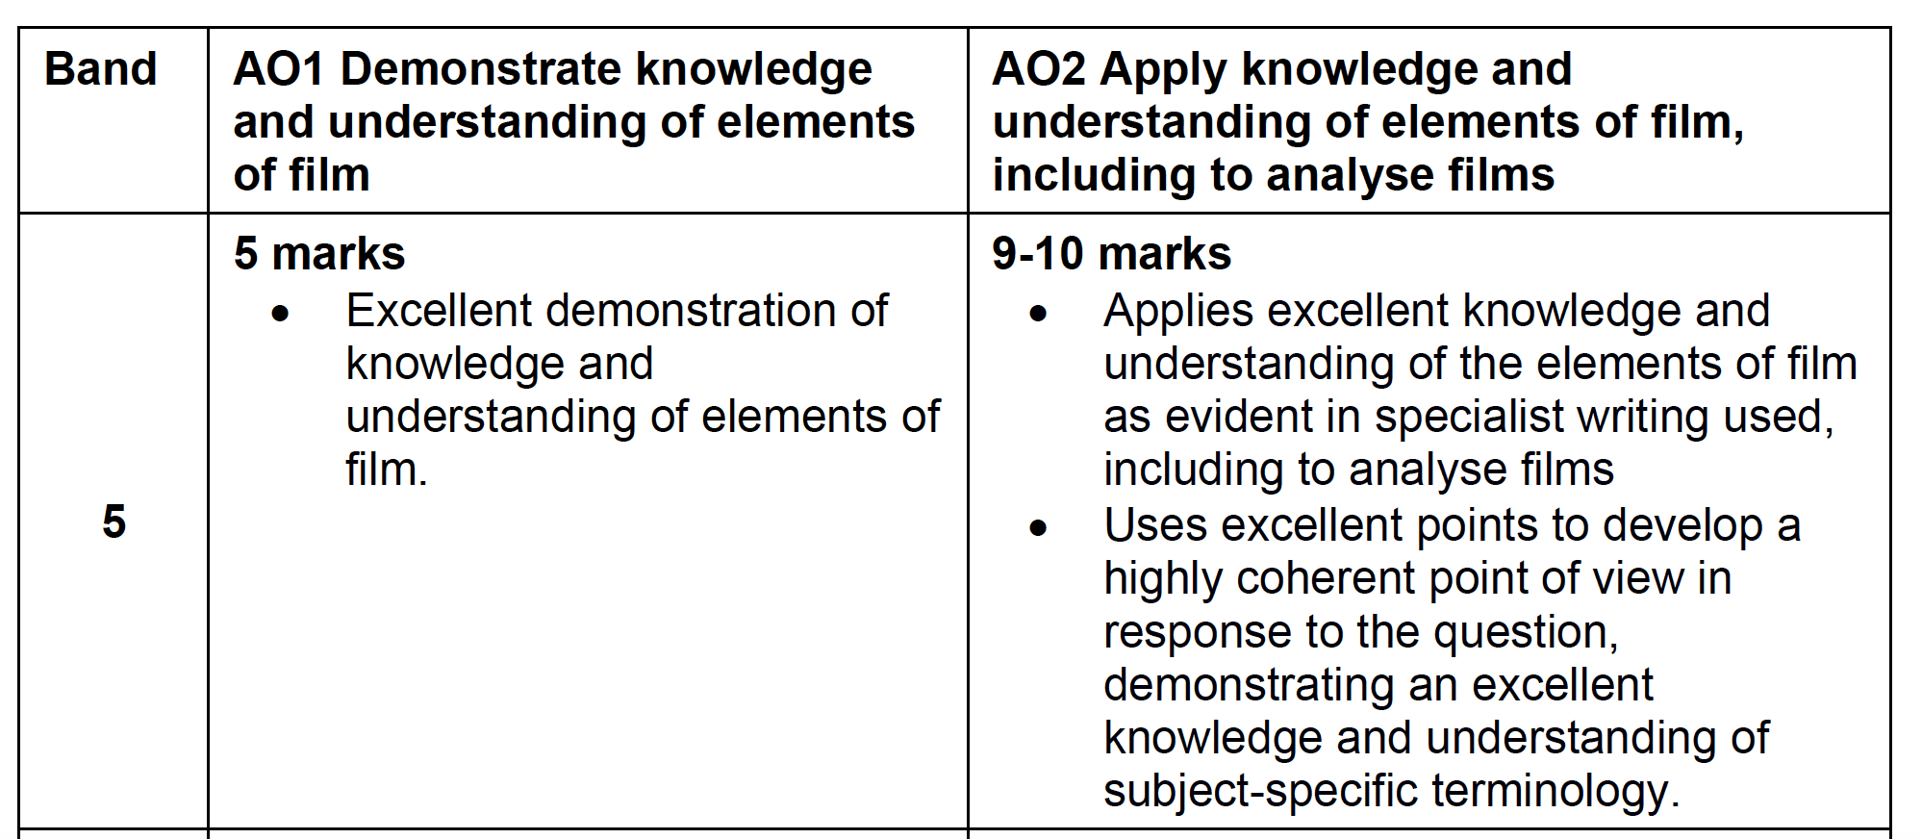

Slide 8
You may now wish to complete Section C Q5:
You have 15 minutes.

