Slide 1
3.1.1.4 Carbon Cycle
Learning Objectives
To have a clear understanding of the concept of ‘mitigation’.
To be able to identify a range of human interventions to reduce or prevent emissions
To be able to describe and explain a range of specific strategies including carbon capture and sequestration (CCS), changing rural land use and improved transport practices.
Concept Checker:
Can you define mitigation?
Can you describe, explain and evaluate how CCS, changing rural land use and improved transport practices can help mitigate climate change.
Key words:
Mitigation
CCS
Geo-sequestration
Silviculture

Slide 2
Definition of mitigation – any actions, strategies, measures or projects undertaken (by mankind) to offset the known detrimental impacts of a process.
https://www.youtube.com/watch?v=yhlg9txl7yM

Slide 3
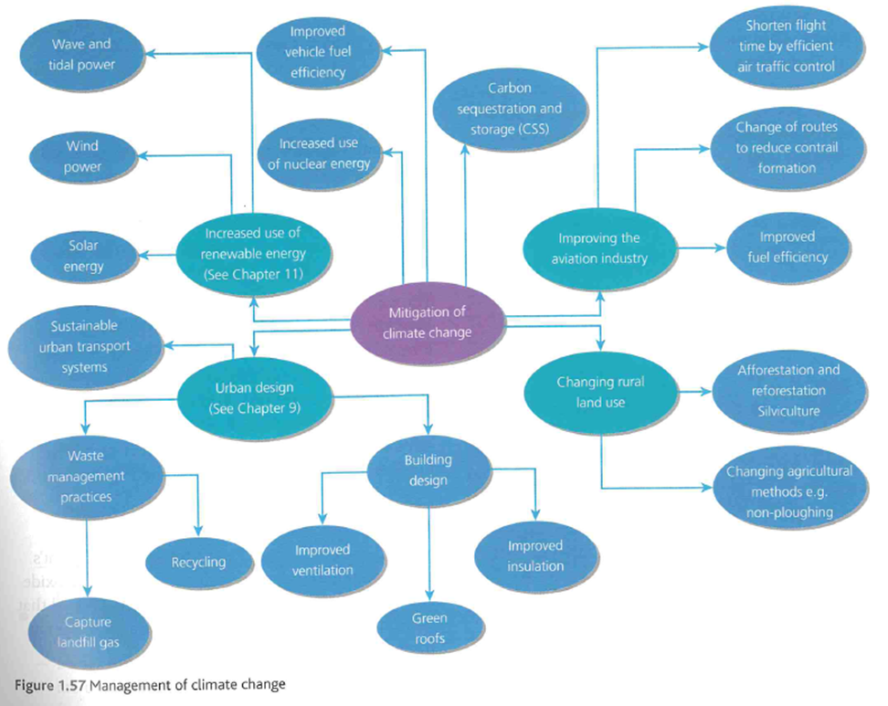

Slide 4
Read the Geography Review article – How can we manage global warming?
Answer the questions in the handout

Slide 5
Research three areas of mitigation:-
Carbon capture and sequestration (CCS)
Changing rural land use
Improved transport practices
You will need to describe and explain the methods of mitigation, give examples of where it has been used and evaluate how successful it has been. It may be helpful to create a list/table of advantages and disadvantages of each method.
Use the following pages on this PPT, the Oxford and Hodder textbook information but also research online as there is a wealth of information on the topic.

Slide 6
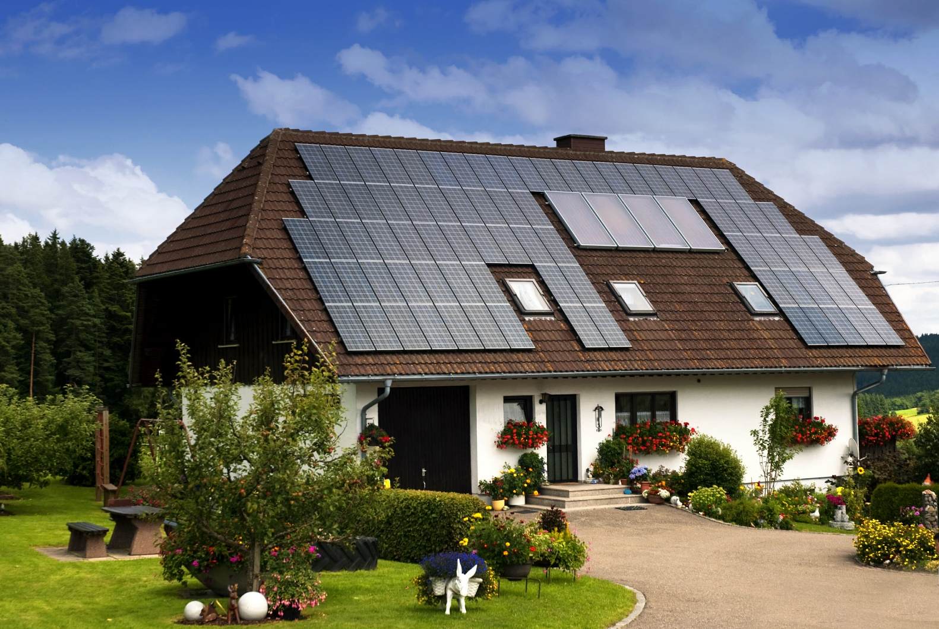
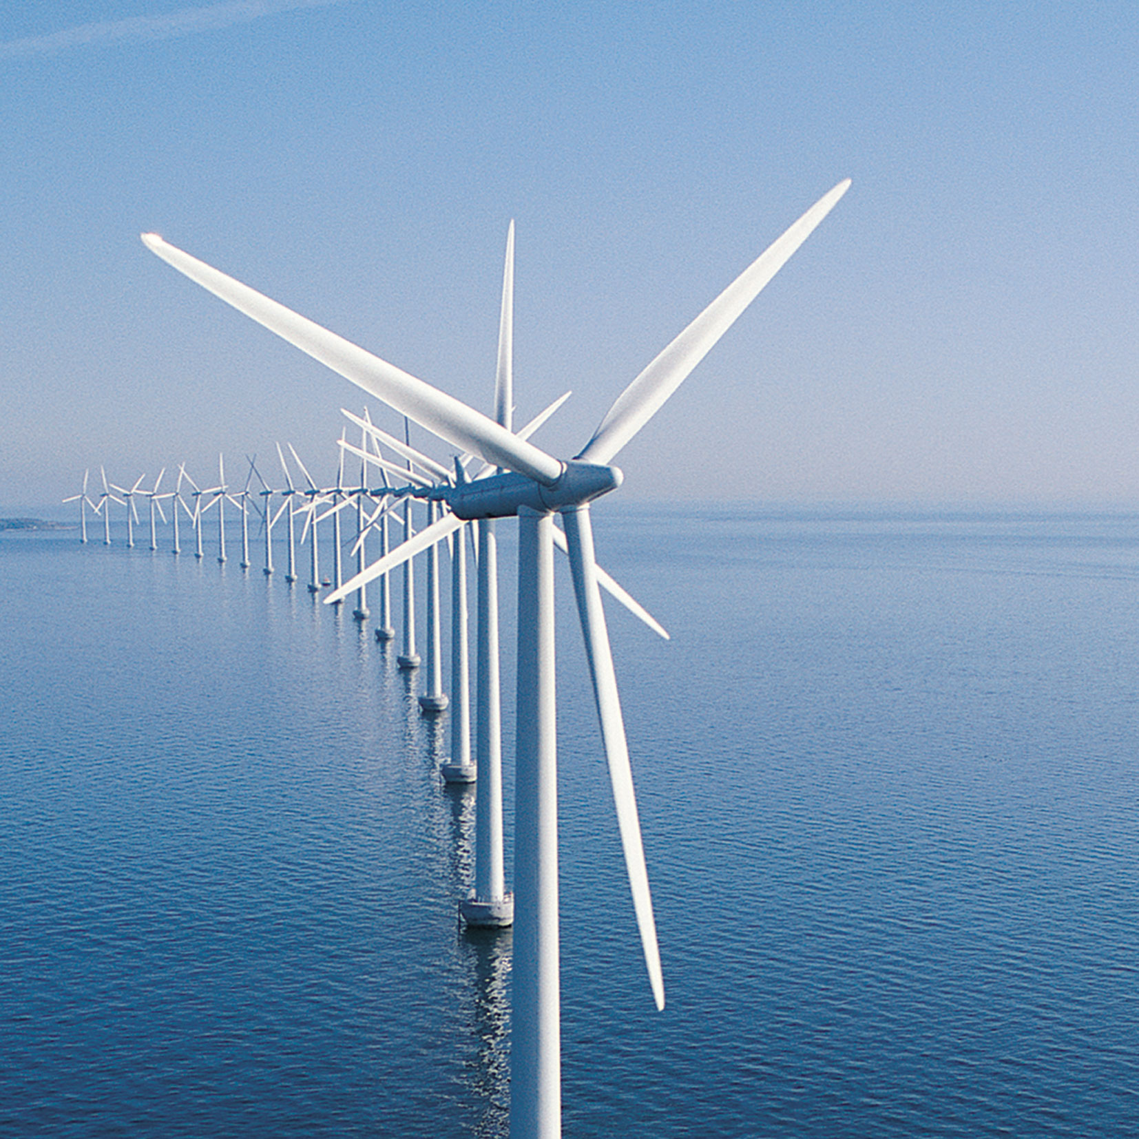
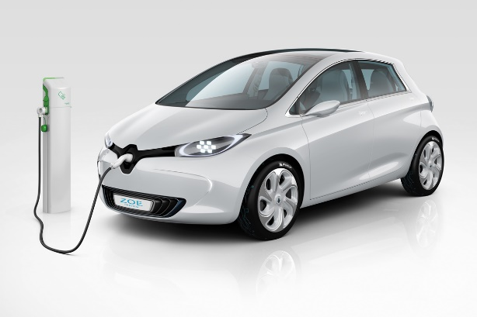
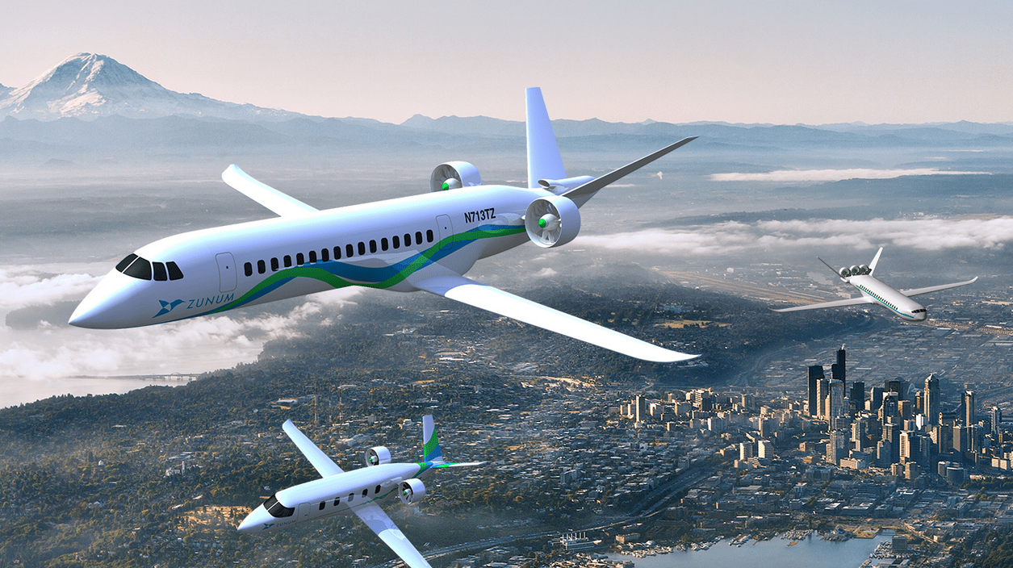
https://timeforgeography.co.uk/videos_list/resource-management/achieving-energy-sustainability/
https://www.youtube.com/watch?v=EzAB5IMPtMw

Slide 7
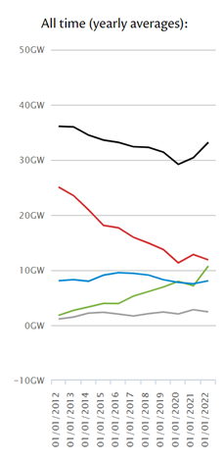
What progress has already been made in the UK? National grid data

Slide 8
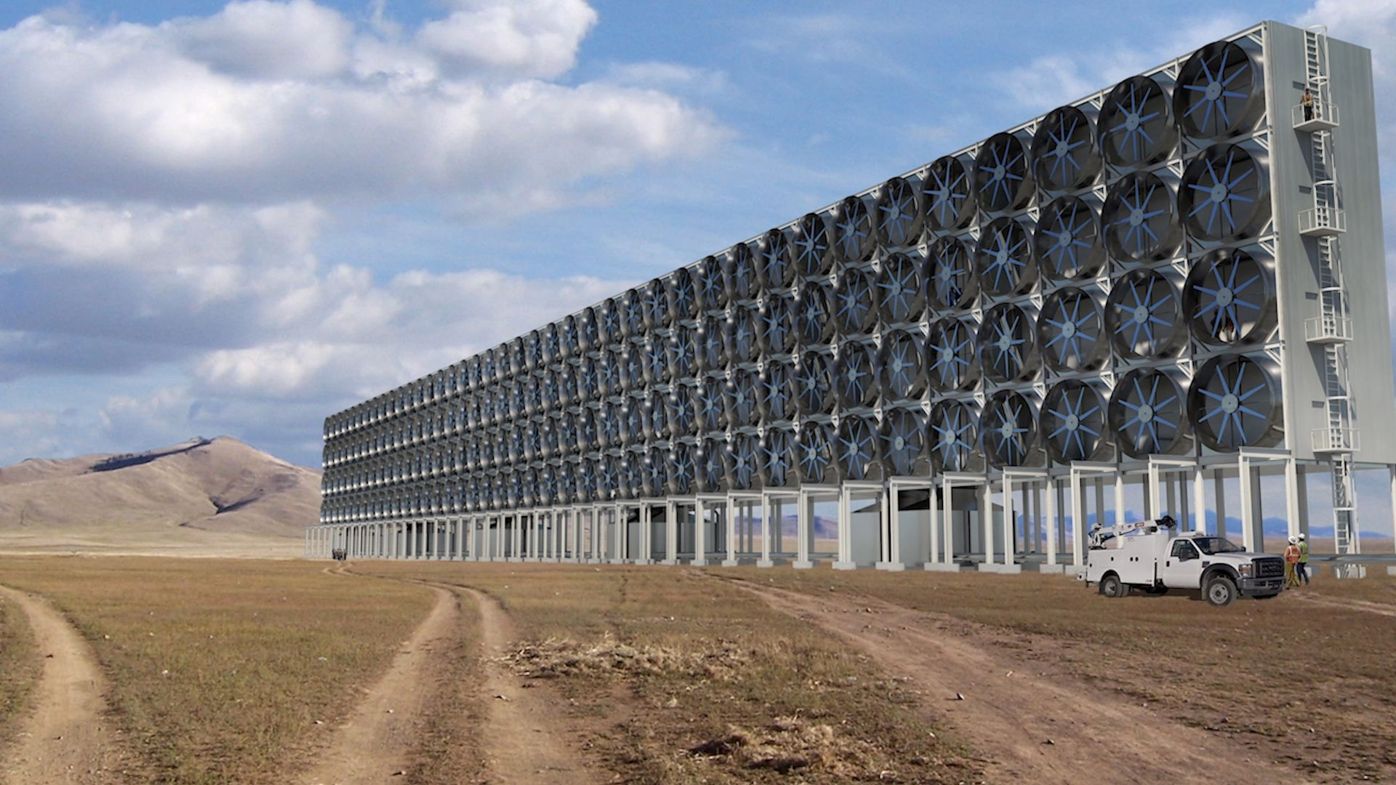
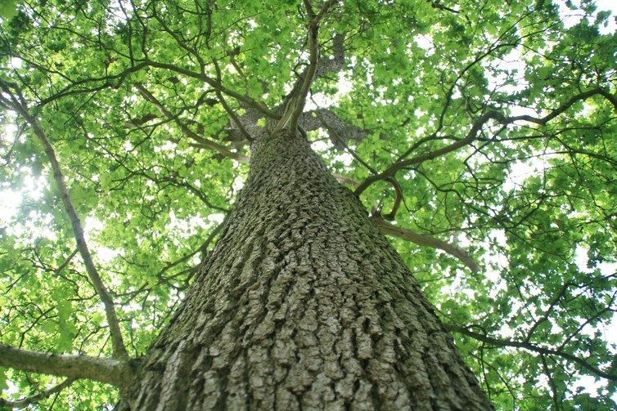
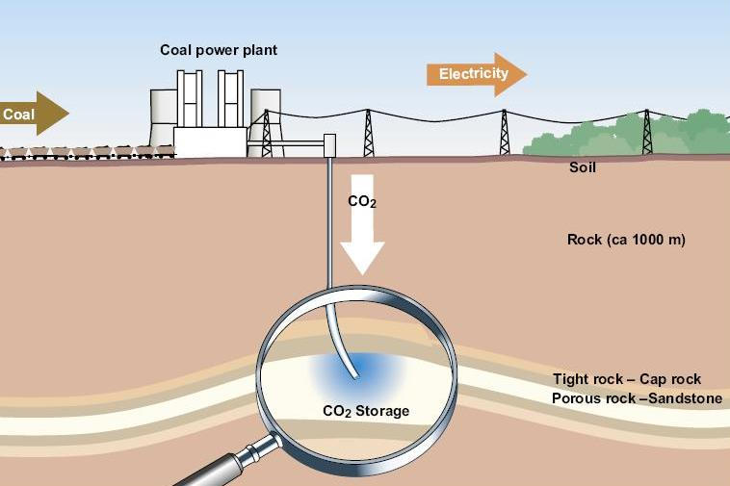
https://www.youtube.com/watch?v=XxjNhLZCae0

Slide 9
New plan to pay farmers who protect winter soil
https://www.bbc.co.uk/news/uk-politics-59499371
Coastal saltmarsh 'engineered' to fight climate change
https://www.bbc.co.uk/news/science-environment-59241053
Indonesia's biodiesel drive is leading to deforestation
https://www.bbc.co.uk/news/59387191

Slide 10
Additional useful clips on carbon capture and storage
https://www.youtube.com/watch?v=aHtbDmzjYgg
https://www.bbc.co.uk/news/av/science-environment-35029984/cop21-what-is-carbon-capture
https://www.bbc.co.uk/news/science-environment-47163840

Slide 11
Critically evaluate the different mitigating strategies for reducing global CO2 levels (20 marks)

