Slide 1
Income Elasticity of demand (YED)
Discuss with the person next to you….
Why do marketers try to understand a product’s Y.E.D?
What are the differences between coefficients for PED and coefficients for YED?
5 minutes

Slide 2
Learning Objectives
Analyse data to better understand the position of the business in the market and the requirements of customers at present and in the future
Calculate income elasticity of demand
Evaluate the impact of changes in income on business revenue

Slide 3
Income Elasticity of Demand
Businesses also want to know how rises or falls in consumers’ income affect the demand for their products.
Analyse the relationship between changing incomes and changing demand levels for different goods or services
Real incomes increase over time, leading to decreased wealth and rising demand for most but not all goods and services

Slide 4
Income Elasticity of Demand
Formula:
Y.E.D. =
% change in quantity demanded
% change in income

Slide 5
Income Elasticity of Demand
Here, you do not ignore the signs!
If the co-efficient is a negative number = INFERIOR GOOD
If it is a number between 0 and 1 = NORMAL GOOD
If it is a number over 1 = SUPERIOR/LUXURY GOOD

Slide 6
Income Elasticity of Demand
INFERIOR GOODS: Those that you will lose interest in buying if your income increases (i.e. demand falls).
(Negative co efficient)
NORMAL GOODS: Those that demand remains relatively unchanged if your income increases
(Positive and low co efficient)
SUPERIOR/LUXURY GOODS: Those that demand increases if your income increases.
(Positive and high co efficient)
GIVE EXAMPLES OF EACH TYPE OF PRODUCT

Slide 7
YED

Slide 8
The details you need to know
Normal goods have a positive income elasticity of demand so as consumers’ income rises, so more is demanded at each price level
Necessities have an income elasticity of demand of between 0 and +1
Luxuries have an income elasticity of demand > +1 i.e. the demand rises more than proportionate to a change in income
Inferior goods have a negative income elasticity of demand. Demand falls as income rises

Slide 9
The details you need to know

Slide 10
For example:
Yed = - 0.6:
Good is an inferior good but inelastic
a rise in income of 10% would lead to demand falling by 6%
Yed = + 0.4:
Good is a normal good but inelastic
a rise in incomes of 10% would lead to demand rising by 4%
Yed = + 1.6:
Good is a normal good and elastic
a rise in incomes of 10% would lead to demand rising by 16%
Yed = - 2.1:
Good is an inferior good and elastic
a rise in incomes of 10% would lead to a fall in demand of 21%

Slide 11
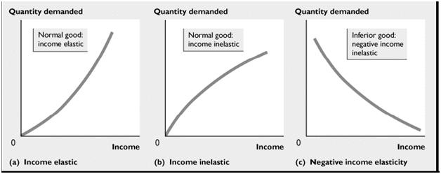
Income Elasticity on a Graph

Slide 12
Income Elasticity of Demand
What are the advantages and disadvantages of selling each type of product?

Slide 13
Why is understanding the concept of elasticity useful?
Helps the business to make decisions / plan ahead
Changes to marketing strategy (price, place, promotion, product, target market)
Levels of stock to hold / raw materials to order (to cope with potential increase/decrease in demand)
Purchase new equipment or machinery to cope with demand (or reduce to improve capacity if demand is going to fall)
Increasing or decreasing labour
Determining by how much should change price to clear surplus stock
Plan/forecast future sales and
Plan/forecast revenues and profits
Plan which TYPE of goods to stock more or less of (e.g. inferior vs normal vs luxury)
Increase market share

Slide 14
YED activities
Work your way through the YED booklet.
Show all your workings and be mindful of the – signs
30 minutes

Slide 15
plenary
What does it mean when a product is described as price inelastic? Give two examples
How can a business attempt to reduce the price elasticity of its product?
Explain how a business can use information on price elasticity of demand to help plan its business activities

Slide 16
50/50 work
Due in L1 next week:
Create a revision / summary sheet on Profit and Loss Accounts (Income Statements) and GPM / NPM (no more than two sides of A4) (1hour to 1 hour 30 minutes)
Due in L2 next week:
Finish YED activities from last lesson (approx. 1 hour)
Using the ‘Analysing Financial Performance”, create a table of definitions for the following Balance Sheet key terms (including formulas where applicable) (1 hour to 1 hour 30 minutes) and read about Balance Sheets.
Balance sheet
Asset
Fixed (or non-current) assets
Current assets
Current liabilities
Long term (or non-current) liabilities
Net assets
Net current assets
Shareholders’ funds
Working capital
Liquidity
Due in L3 next week:
Assessed HW1 Peter Sports

