Slide 1
Aims and Objectives
Getting started:
What do you remember about business aims and objectives from your first year…?
Thinking points….
What is the main aim of a business?
Can a business have more than one aim? If you believe so, come up with an example.
Are aims and objectives the same?
How might various stakeholders influence a business aims?
Notes:
5-10 mins

Slide 2
Learning Objectives
Today:
Explain the role of vision statements and their relationship to a business’ aims
Explain how objectives are used by a business in order to achieve its aims
Explain what is meant by SMART objectives
Thursday:
Explain the role and purpose of mission statements
Evaluate vision statements, objectives and mission statements and their impact on a business and its stakeholders
Notes:
Key terms are in bold

Slide 3
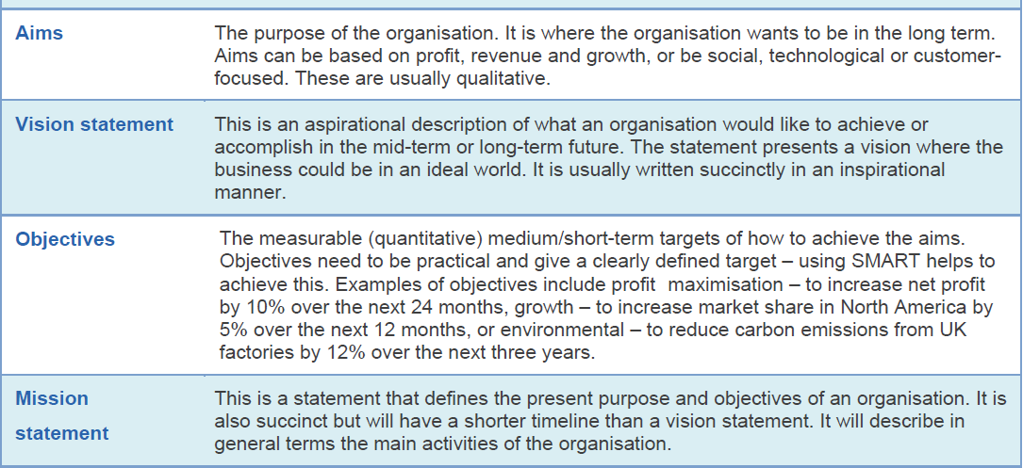
Key terms

Slide 4
Aims
What the business intends to achieve in the long term (i.e. its purpose). Aims are qualitative.
Maximise profit
Maximise shareholder value
Survival
Maximise sales revenue
Growth
Customer welfare
Employee benefits
Corporate social responsibility
Notes:
Briefly discuss with class,
Which stakeholders would be concerned with which objectives?
How might this cause conflict?

Slide 5
Objectives
Practical and measurable (quantitative) medium/short term targets of how to achieve the business aims
(e.g. to grow market share in North America by 5% over the next 12 months….which aim does this relate to?).
Objectives should be SMART
S – specific – they must set out clearly what a business is attempting to achieve
M – measurable – quantifiable, they must be capable of being measured to judge whether they have been achieved
A – agreed – everyone involved in achieving the objective must have agreed and understood it
R – realistic – achievable and not in conflict with other objectives
T – time bound – based on an explicit timescale

Slide 6
Why are SMART objectives important?
Everyone interprets the objective in the same way.
Common view of what is to be achieved.
Unrealistic targets can be demotivating and counter productive.
If they have not been agreed by all parties, they are less likely to be supported by all.

Slide 7
Objectives: corporate and functional
Corporate objectives
These are the goals or targets of the whole organisation, usually based on its mission or aims.
Set by the most senior management and directors.
Example: For carbon emissions from company operations to fall by 15 per cent over the next five years.
Functional objectives
Most medium to large business are organised into different departments based on the functions of those departments (e.g. Marketing, Finance, HR and Operations).
Each department will have their own goals or targets to achieve which are based on the wider corporate objectives.
Example: Marketing: increase the sales places with the sales representatives from £50,000 to £52,000 per quarter.
Notes:
In Uk Corporate objectives tend to be financial

Slide 8
Activity 1 – Aims and Objectives
Read the Business Aims and Objectives section of your notes – highlight / make a note of key information
Work with the person next to you to complete Question 1 of the handout
20 minutes

Slide 9
Prep work for Tuesday 6th November
Read and summarise pages 598 to 600 of HJR (Aims and Visions Chapter).
Bring your summary notes in to lesson on Tuesday 6th November

