Slide 1
Growth

Slide 2
Advantages and Disadvantages of Growth
Advantages
  Economies of scale
  Increase market share (Porter’s 5 forces?)
  Reduce risk
  Increased profitability
  Potential for globalisation
Disadvantages
  Diseconomies of scale
  Approaching capacity
  Increased short term costs (Advertising? Stock? Staffing?) therefore decreased short-term profits

Slide 3
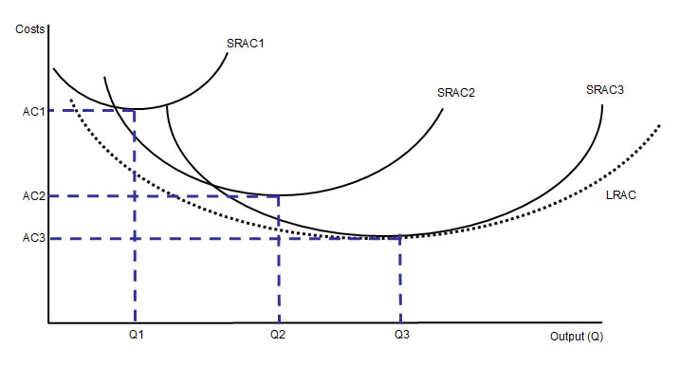
Economies and diseconomies of scale: A reminder

Slide 4
What limits growth?
Market size / market growth
Cash and other resources
Inertia
Relative power of 5 forces
Hostile external environment (SLEEPP + Economic & Technological)

Slide 5
Non-Organic Growth: Mergers and Takeovers
Horizontal integration example example
Backward vertical integration example
Forward vertical integration example example 2
Conglomeration example
Hostile or friendly? Which is best?

Slide 6
Reasons for Mergers and Takeovers
Synergy
Quick and ‘easy’ expansion
Often cheaper than growing internally (organically)
Uses spare cash
Defensive reasons – Porter’s 5 forces
Response to economic conditions
To access new markets
To access another firm’s competitive strengths e.g. technology
To globalise
Economies of scale
To asset strip

Slide 7
Activity in Recent Years
Lots
High profile, large companies
Economic Growth = high profits = firms appear more attractive and they can be afforded by cash-rich companies
Consolidation to increase critical mass e.g. car market and banking
Deregulation e.g. AT&T and BT and electric companies
Information exchange is quicker and easier
The urge to globalise
Bargain hunting during the recession
The rise of the PRIVATE EQUITY firm e.g. Boots, Pets at Home

Slide 8
De-mergers
6 out of 10 mergers / takeovers fail.
http://www.rasmussen.edu/degrees/business/blog/best-and-worst-corporate-mergers/

Slide 9
MBOs & MBIs
Management Buy-Outs: A management team buys out the owners of the organisation they work for.
silverstone
Management Buy-ins: A management team buy out the ownership of an organisation they don’t work for.
Which do you think is the most risky growth strategy?

Slide 10
Consider
Anthony Jenkins, in an interview in the Sunday Times, said it best by echoing/paraphrasing/plagiarising Howard Schultz after he closed almost 1000 Starbucks stores in the US - “Growth is not a strategy, it’s the by-product of good strategy”.

