Slide 1
Strategy and Tactics

Slide 2
Decision Making
Making the ‘right’ decision is important to a business as it will help achieve their aims and objectives.
All decisions involve some risk but by making the right decision they may be able to minimise this type of risk.

Slide 3
Types of decision
Strategic decisions – these concern the overall general direction and policy of a business.
They will be far reaching and can effect the performance of a business.
They will be long –term and affect the business for a period of time over one year, e.g a takeover such as the purchase of Bebo by AOL
Strategic decisions tend to be high risk

Slide 4
Tactical decisions
These tend to be medium term decisions.
They are tactical because they are calculated and their outcome is more predictable e.g when Safeway was taken over by Morrisons how many staff needed to be made redundant

Slide 5
Operational decisions
These are lower level decisions and are sometime known as administrative decisions.
They are relatively quick to make and effect the everyday running of the business e.g how many tills to open.

Slide 6
Decision making process
Set/identify objectives
Gather ideas and data
Analyse ideas and data
Make a decision
Implement decision
Monitor and evaluate

Slide 7
Constraints on decision making
Internal
These could include:
Availability of finance
Existing company policy
People’s behaviour

Slide 8
Constraints cont
External
These could include:
Government and EU legislation
Competitors behaviour
Lack of technology
Economic environment
To assess the effects of these a firm should carry out a SWOT analysis

Slide 9
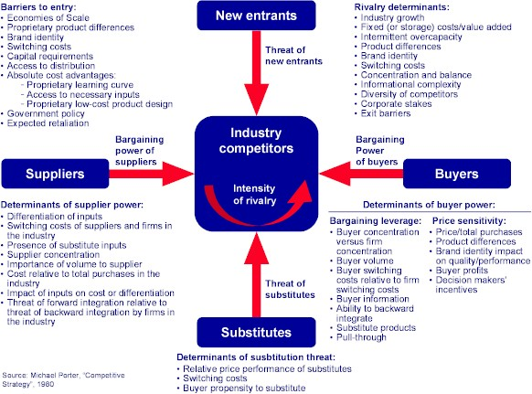
Porter’s Five Forces

