Slide 1
Political Influence on Business
Getting started: Read the Political Factors section of your PEST notes (pages 1 – 3) highlighting/annotating key points

Slide 2
Introduction to PEST
A PEST analysis examines the POLITICAL, ECONOMIC, SOCIAL AND TECHNOLOGICAL environments that affects markets and businesses.
The survival and success of a business are dependent upon adopting business objective and strategies appropriate to the external environment within which the business operates.

Slide 3
Learning Objectives
Explain how political factors affect business activity
Explain the role of the government in providing a stable framework in which businesses operate
Explain how businesses are affected by taxation and subsides

Slide 4
The Role of the Government in the economy
Provides a legal and regulatory framework e.g. the right to own property and the right to enter into contracts
Provides Public Goods and Merit Goods
Uses tax and public spending to influence the way businesses and individuals behave – e.g. tax on smoking or subsidies on training of workers
Uses tax and public spending to influence demand in the economy – i.e. to help prevent recessions or to control inflation
Has a role in the setting of interest rates that will do the same as the above

Slide 5
Government provides goods and services
The UK government accounts for approx. 40% of all goods and services produced.
It also redistributes income through the welfare benefit system
The main areas of government spending are:
  Social protection and welfare state
  Education
  Healthcare
  Transport, including road and rail subsidies
  Defence
The private sector uses these services e.g. a healthy, educated workforce
Often, the private sector is used to produce goods and service which are then consumed by the public sector to provide these services

Slide 6
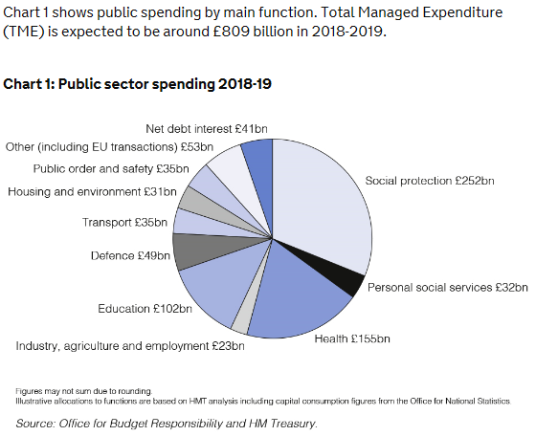
2018-19 Public Sector Spending
Notes:
Social protection encompasses the financial assistance and services provided to those in need or at risk of hardship. It provides a safety net to protect the
vulnerable in society: those who are unable to make provision for a minimum decent standard of
living. Social protection policies aim to reduce poverty and wealth gaps through the national
minimum wage, means-tested benefits, payments such as working tax credits to low earners and
assistance with child care. Assistance is provided through direct measures such as benefits
payments, tax credits or pensions, payments in kind such as free prescriptions, and the provision
of services such as local authority (LA) home-care help

Slide 7
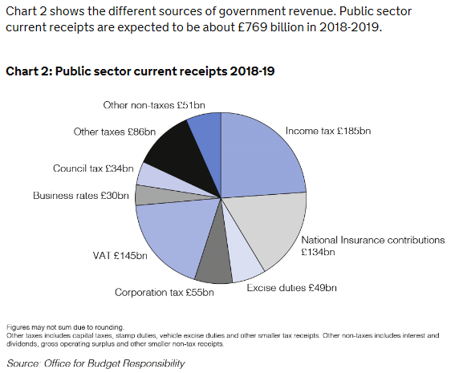
2018-19 Public Sector Receipts

Slide 8
Shortfall? National Borrowings
Public Debt in the United Kingdom is principally the debt of the central government.
In 2005 the UK National Debt was less than £0.5 trillion. But then came the worldwide financial crisis of 2008 and subsequent recession. The National Debt increased rapidly and went over £1 trillion in 2011. At the end of the 2015-16 fiscal year, the National Debt went over £1.5 trillion.

Slide 9
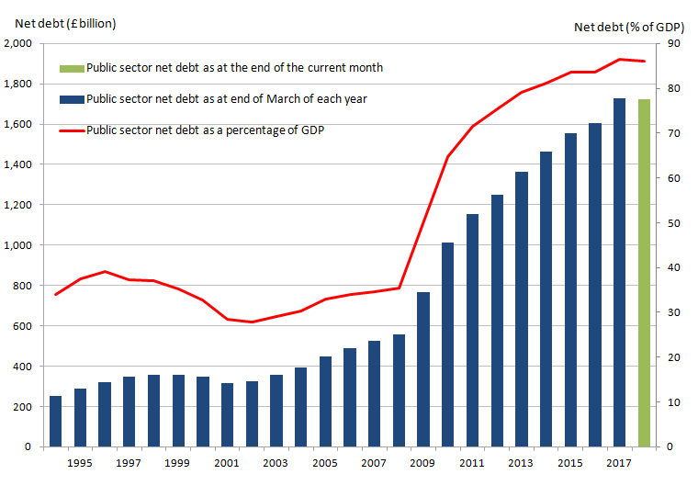
At the end of the financial year ending March 2017, UK government gross debt was £1,720.1 billion, equivalent to 88.0% of GDP, an increase in £68.1 billion compared with the financial year ending March 2016

Slide 10
National debt : GDP
In terms of Gross Domestic Product the UK National Debt in 2005 was about 38 percent of GDP.
But in the last ten years, in the wake of the Crash of 2008 and subsequent recession, the National debt has doubled to over 80 percent GDP, but shows signs of levelling out as a percent of GDP

Slide 11
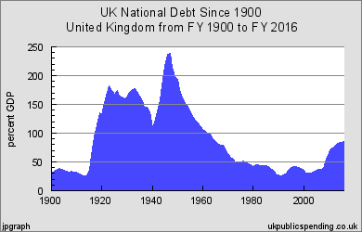
Bigger picture

Slide 12
Fiscal Policy
Tax, government spending and borrowings can also be used to govern the economy as a whole.
Fiscal policy can be used to target political, economic or social objectives so expenditure or increased taxation is sometimes targeted at specific industry sectors or alternatively subsidies can be paid to industries

Slide 13
Monetary Policy
Remember, the government has a role in the Monetary Policy Committee, who sets the interest rates. They can also control the economy in this way.

Slide 14
Tax
Tax creates revenues for the government to spend on the public sector. It is also used to govern how individuals and businesses behave.
Taxation can be broadly split into two types, direct taxation (taxation on income) and indirect taxation (taxation on spending)

Slide 15
Subsidies
The government can offer financial support to certain industries to alter behaviour.
It is a grant given by government to lower the price of a good.
Example: training subsidies might be given to encourage businesses to train their workers.
A business might be given a subsidy to encourage them to set up in a deprived area of the UK

Slide 16
Questions
Political factors
Describe the following political factors
  Instability
  National security
  Major trading partners
  Changes in government
  Pressure groups
How do these factors affect firms and the wider economy?

Slide 17
Questions
Fiscal policy (see page 696 of text book and PEST notes)
If there is a proportionately greater increase in government spending than tax, what will happen to the economy as a whole? Will it be restricted or will it expand?
If there is a proportionately greater increase in tax than government spending (direct tax like income tax, in particular) will the economy be restricted or will it expand?

Slide 18
Questions
Taxes (see page 670 onwards in text book)
  Explain the following taxes, whether they are direct or indirect and how changes in each will influence businesses and individuals
    Income tax
    VAT
    Corporation tax
    National Insurance
    Capital gains tax
    Customs Duties
    Business rates

Slide 19
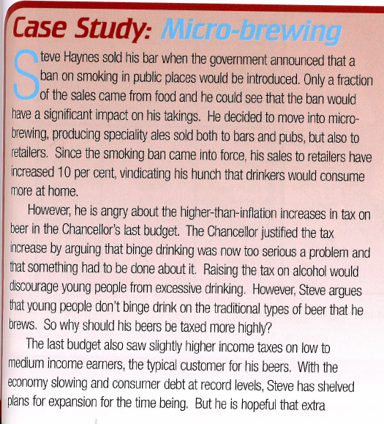
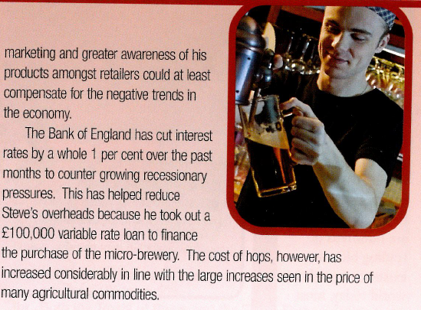
Case Study question
Evaluate the impact of changes in government policy described in the passage on Steve Hayne’s micro brewery [10 marks]
Explain whether Steve Hayne’s micro brewery would have higher sales and higher profits if the government cut every tax and every type of government spending by 20% [8 marks]

