Slide 1
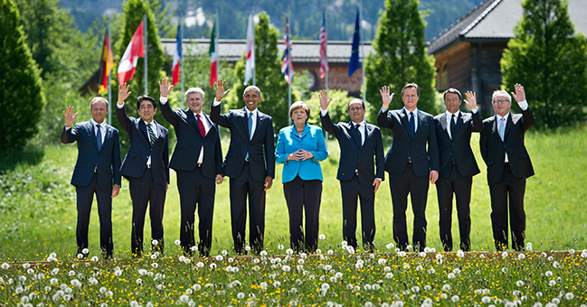
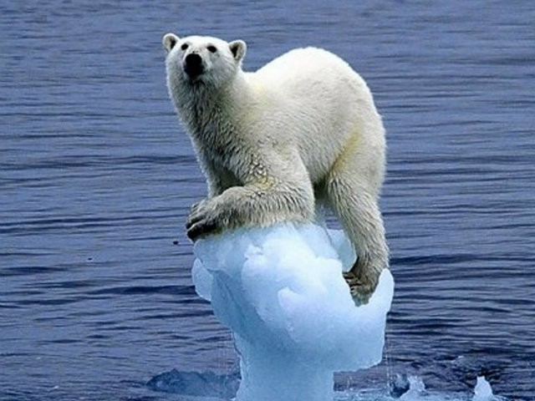
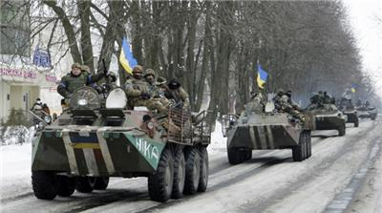
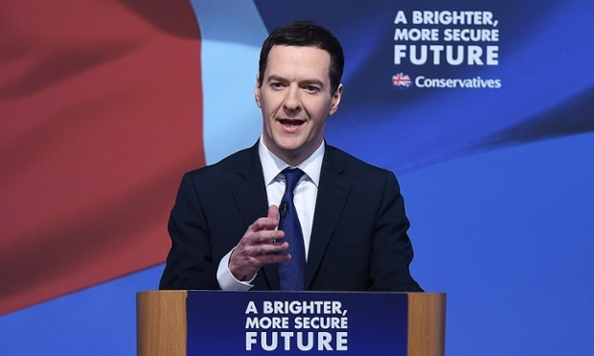
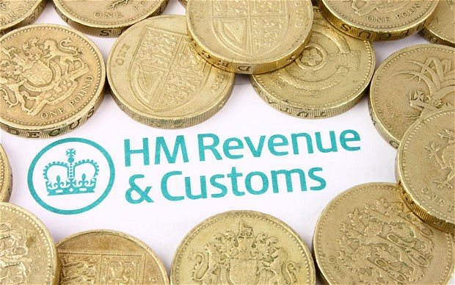

Slide 2
Political Factors – Learning Objectives
Identify and explain a range of domestic and international political issues.
Identify and explain relevant government policies that can affect businesses.
Evaluate the impact of political factors and government policies on businesses (negative and positive).

Slide 3
Political Factors
Political factors represent the way and extent to which government influences the economy and business.
This will include domestic and international issues.
Examples
Military conflict | Global warming | Labour laws
Effects of pressure groups (e.g. Greenpeace)
Government changes (e.g. to retirement age, taxes, funding of NHS, minimum wage)
Impact of government policies on business carbon rationing, privatisation vs nationalisation
http://www.cityam.com/213267/general-election-2015-how-will-ftse-be-affected

Slide 4
Political Factors
Domestic political issues (e.g. increased spending on education paid for by higher taxes)
International political issues, within the EU and worldwide and their effects (e.g. military conflicts around the world – that can affect the supply of petrol and other resources).
The effects of global warming and the attempts by governments to reduce it - there will be some businesses that gain and some that lose out.
Notes:
Discuss – Think Pair Share – examples.

Slide 5
Government policies
Changes to the law can restrict business behaviour and increase costs but they can also create business opportunities...
For example:
Carbon rationing: likely to increase costs and reduce competitiveness
Privatisation
24 hour drinking laws
Minimum wage
Notes:
Discuss

Slide 6
Government economic policies and their effects on businesses
Encouraging economic growth
Controlling and reducing inflation
Maintaining a satisfactory level of employment
Maintaining a stable exchange rate
The Government influences the economy through:
Government spending
Taxation (Fiscal Policy)
Regional Policy
Legislation

Slide 7
Learning Activities
Watch the excerpts from the Panorama Kyoto Summit video and take notes to answer the questions on the board.
In pairs, complete the Political Factors/Government Policy research task. You should create a useful and informative information resource based on your research (to be shared with the class).
In pairs, complete the ‘Queen’s Speech/Government Policy’ table (one completes the front, the other the back) You will then join up with another pair to compare your findings.
Notes:
- Why did the need for the treaty arise?
- Who was lobbying against the treaty and why?
- What methods were used to try and lobby the government and influence consumer’s views?
What was the potential impact for small businesses?
Pressure groups?

Slide 8
Plenary
Based on what you have learnt from the videos and your research....
List 3 political factors which can impact a business.
Give 2 examples of businesses which may be affected by those factors.
Give 1example of a positive impact and a negative impact of one factor for one business

